Slide 1
Supplementary Material
to
Network meta-analysis of transcriptome expression changes in different manifestations of dengue virus infection
Christine Winter¹, António A. R. Camarão², Imke Steffen², Klaus Jung^{1*}
1) Institute for Animal Breeding and Genetics, University of Veterinary Medicine Hannover, Hannover, Germany
2) Department of Biochemistry and Research Center for Emerging Infections and Zoonoses, University of Veterinary Medicine Hannover, Hannover, Germany
Supplementary Figures S3: Mutual information networks based on top genes from each comparison between the three groups of patients, as identified from the network meta-analysis. Considering a comparison A versus B, blue edges indicate an increased correlation in samples from A compared to the correlation observed in B, while red edges indicate a stronger correlation in B compared to that in A. The thicker an edge, the stronger the observed correlation.

Slide 2
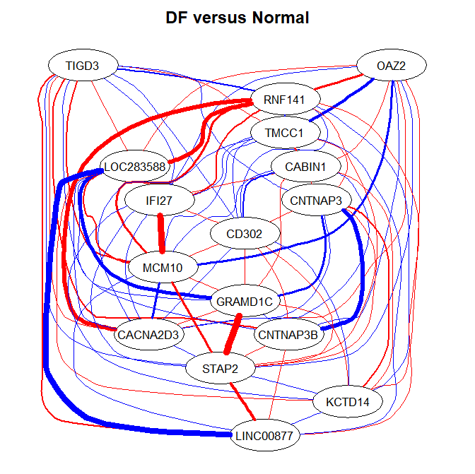
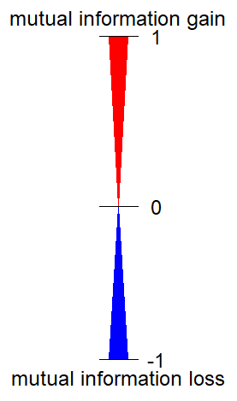

Slide 3
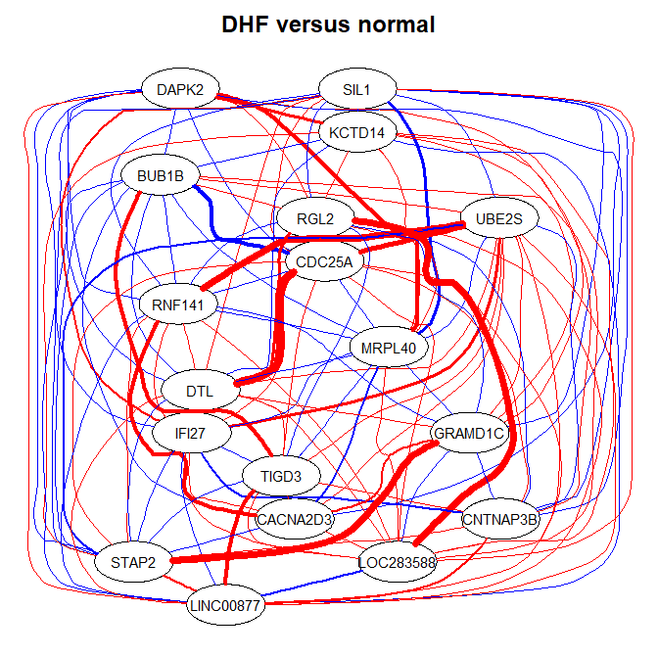
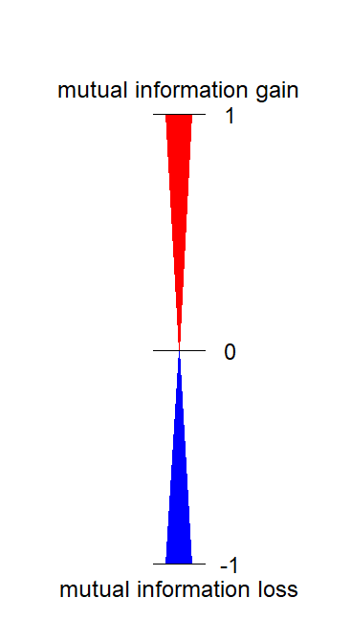

Slide 4
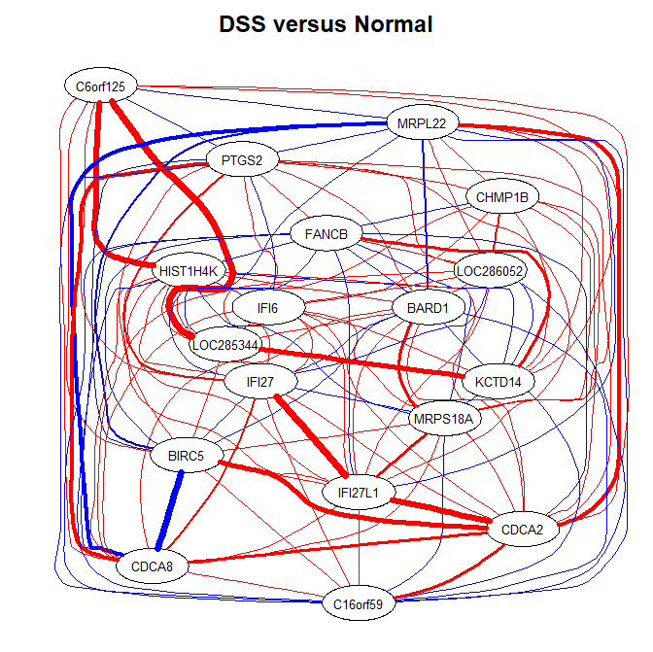

Slide 5
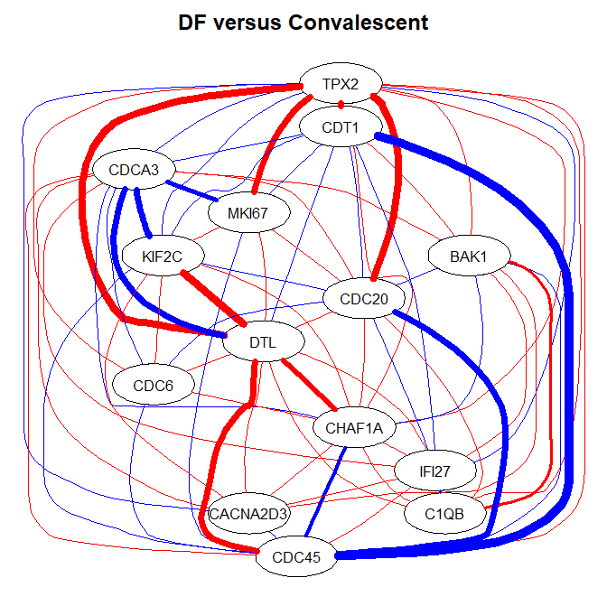

Slide 6
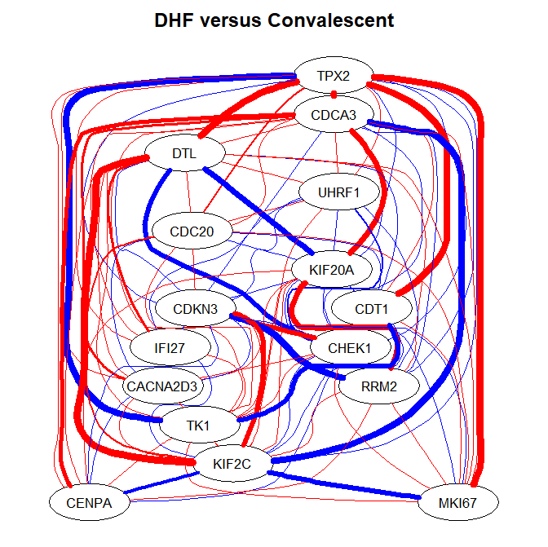

Slide 7
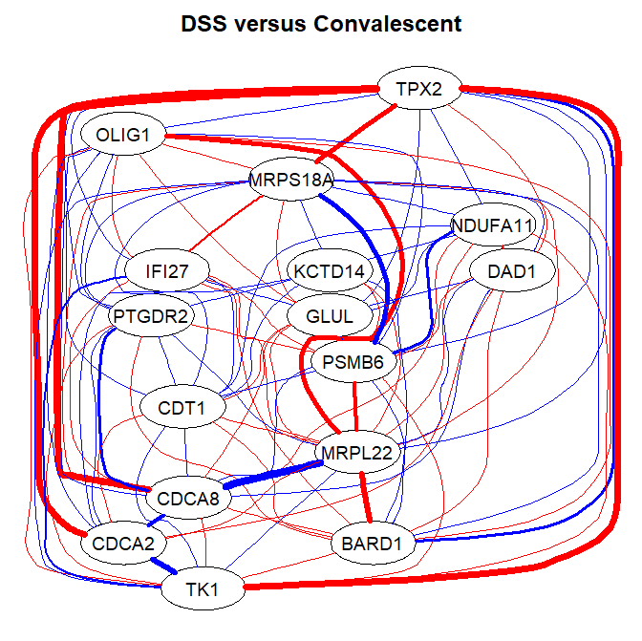

Slide 8
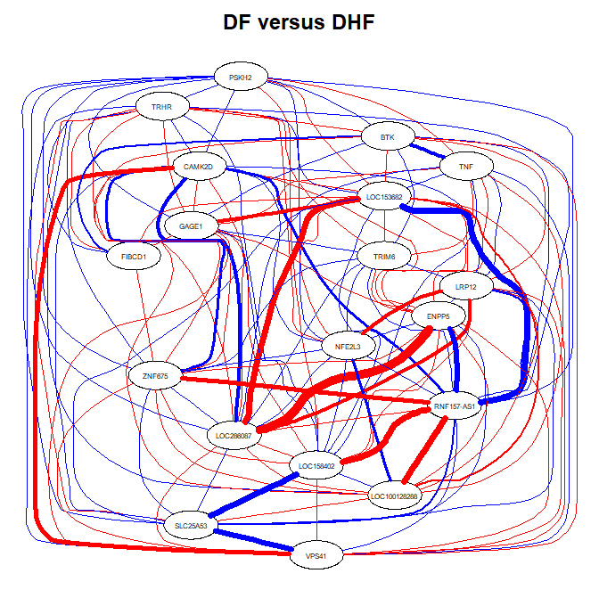

Slide 9
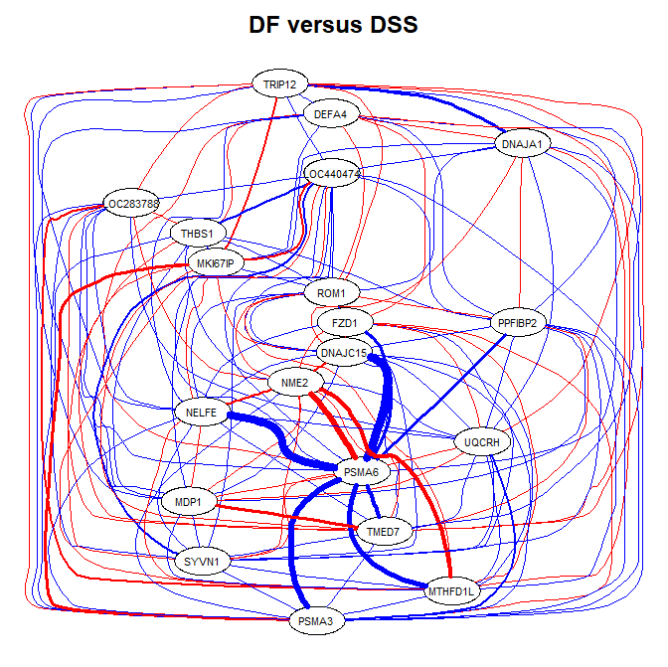

Slide 10
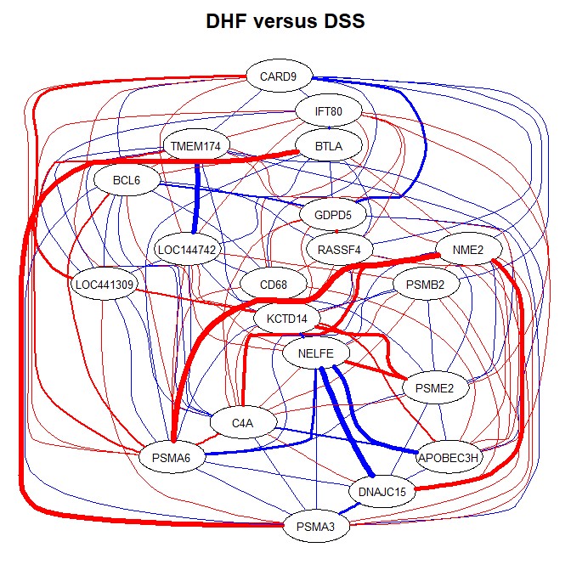

Slide 11
