Slide 1
Supplementary Material
to
Network meta-analysis of transcriptome expression changes in different manifestations of dengue virus infection
Christine Winter¹, António A. R. Camarão², Imke Steffen², Klaus Jung^{1*}
1) Institute for Animal Breeding and Genetics, University of Veterinary Medicine Hannover, Hannover, Germany
2) Department of Biochemistry and Research Center for Emerging Infections and Zoonoses, University of Veterinary Medicine Hannover, Hannover, Germany
Supplementary Figures S4: Sensitivity, Specificity, and positive (PPV) and negative (NPV) predictive values of SVM, LDA and NSC models with respect to the number of top ranked genes used as predictors. As the four measures are defined for two-group designs, we define them here in each scenario for one of the disease groups (DF, DHF and DSS) versus the two other groups.

Slide 2
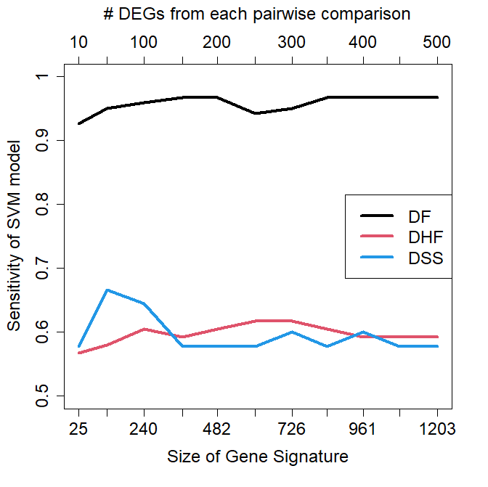
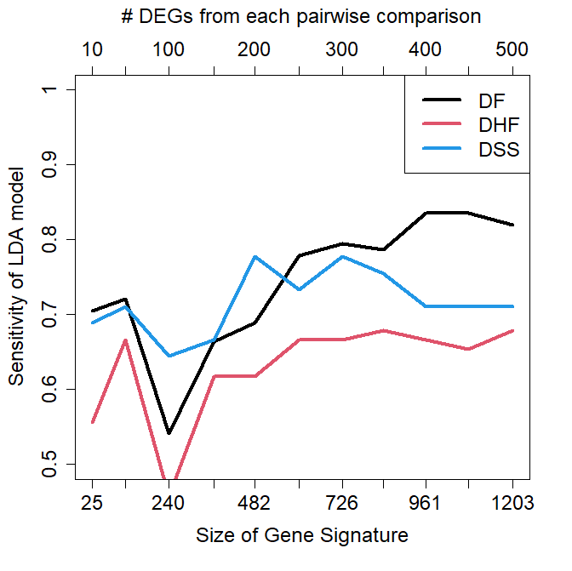
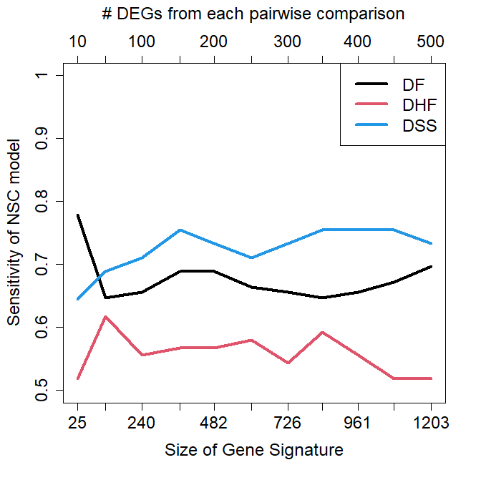

Slide 3
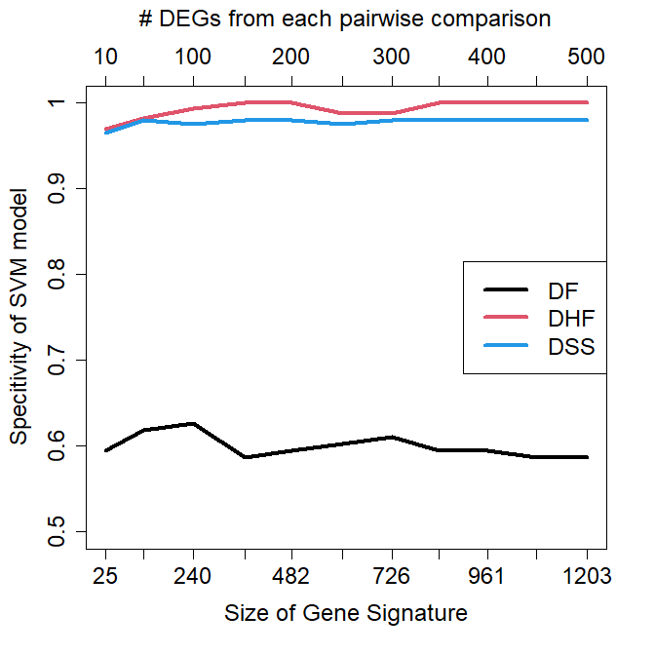
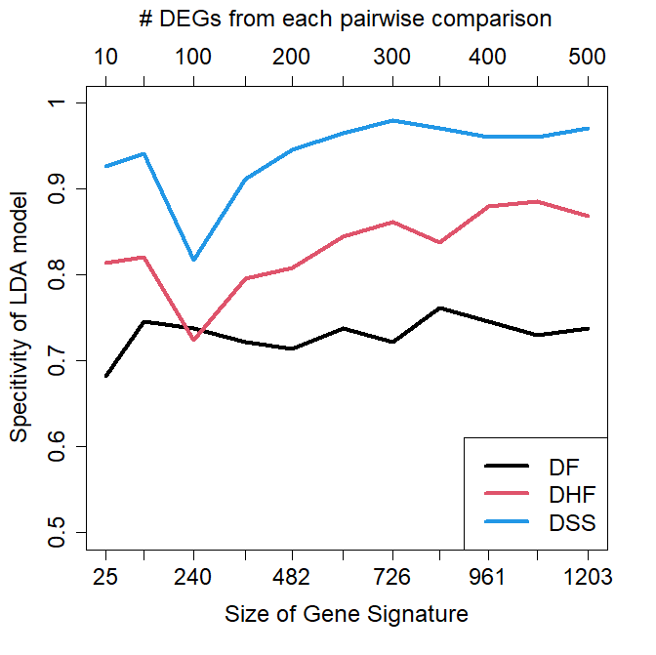
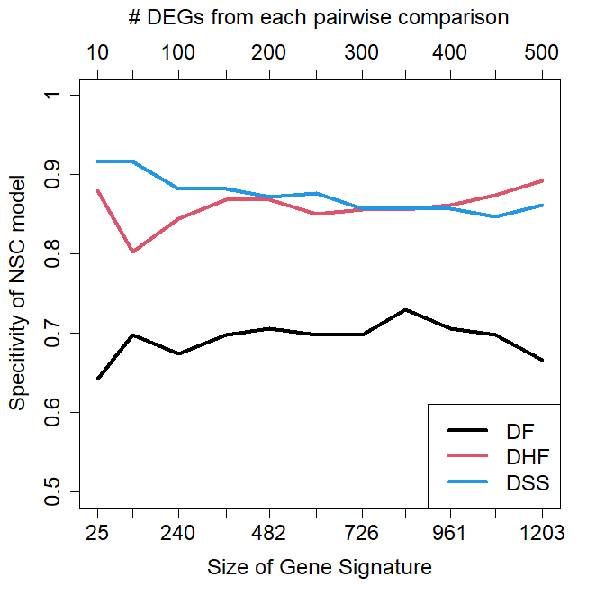

Slide 4
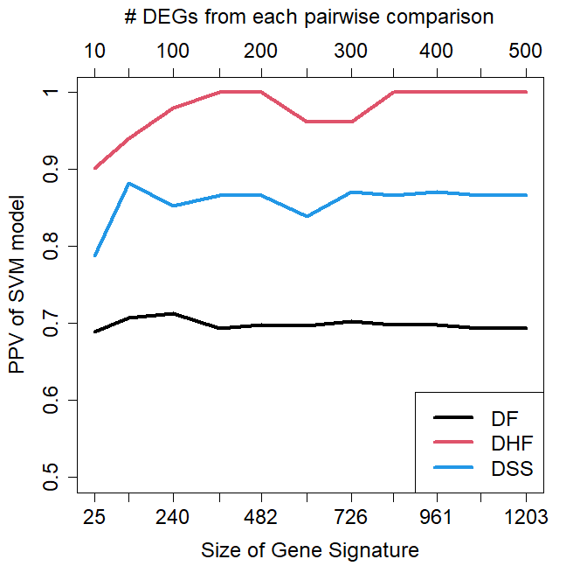
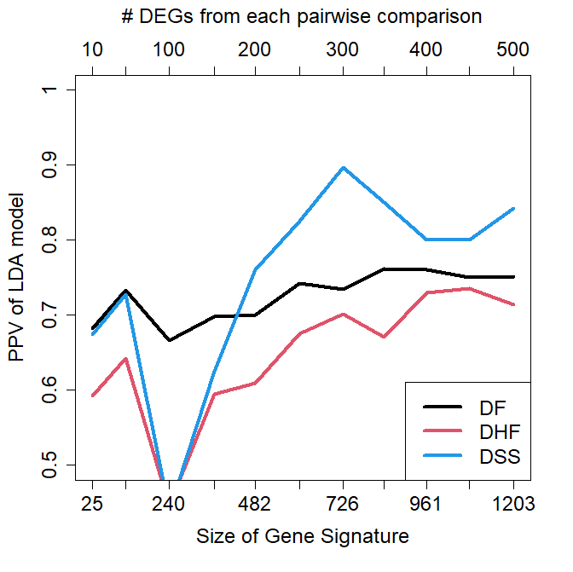
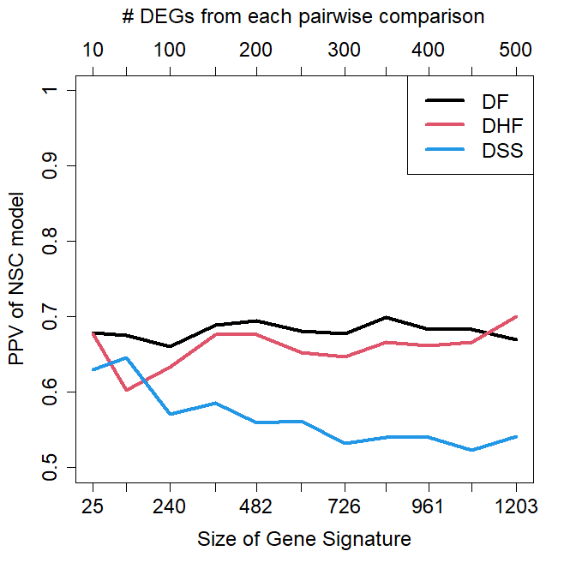

Slide 5
