Slide 1
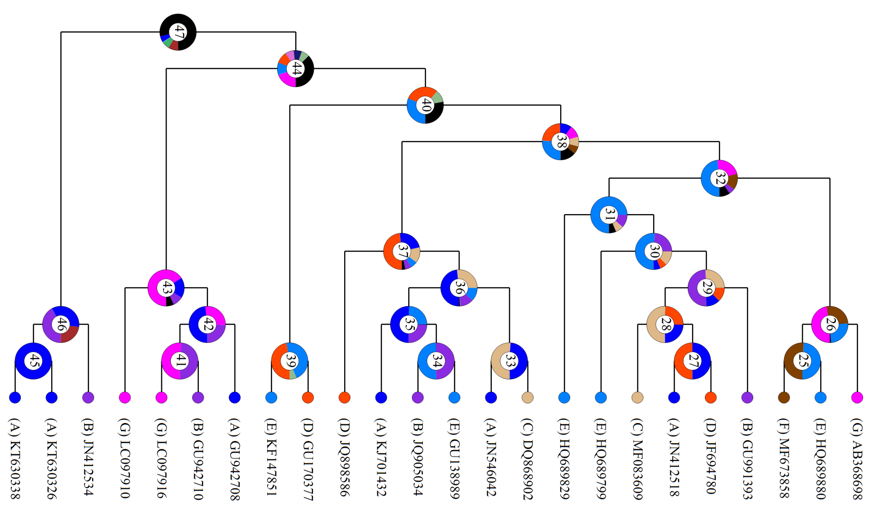

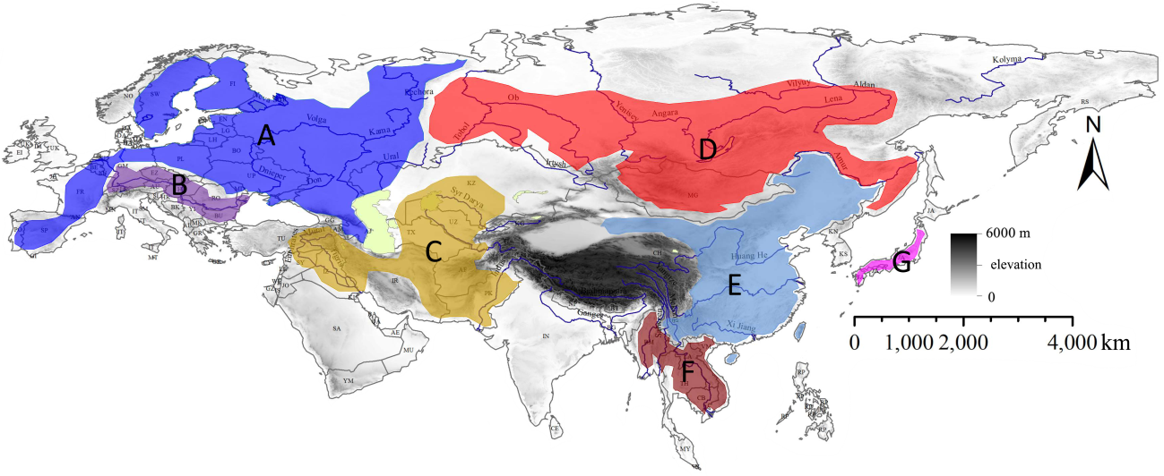
C. carassius
C. cuvieri
C. langsdorfii
C. auratus complex

