Slide 1
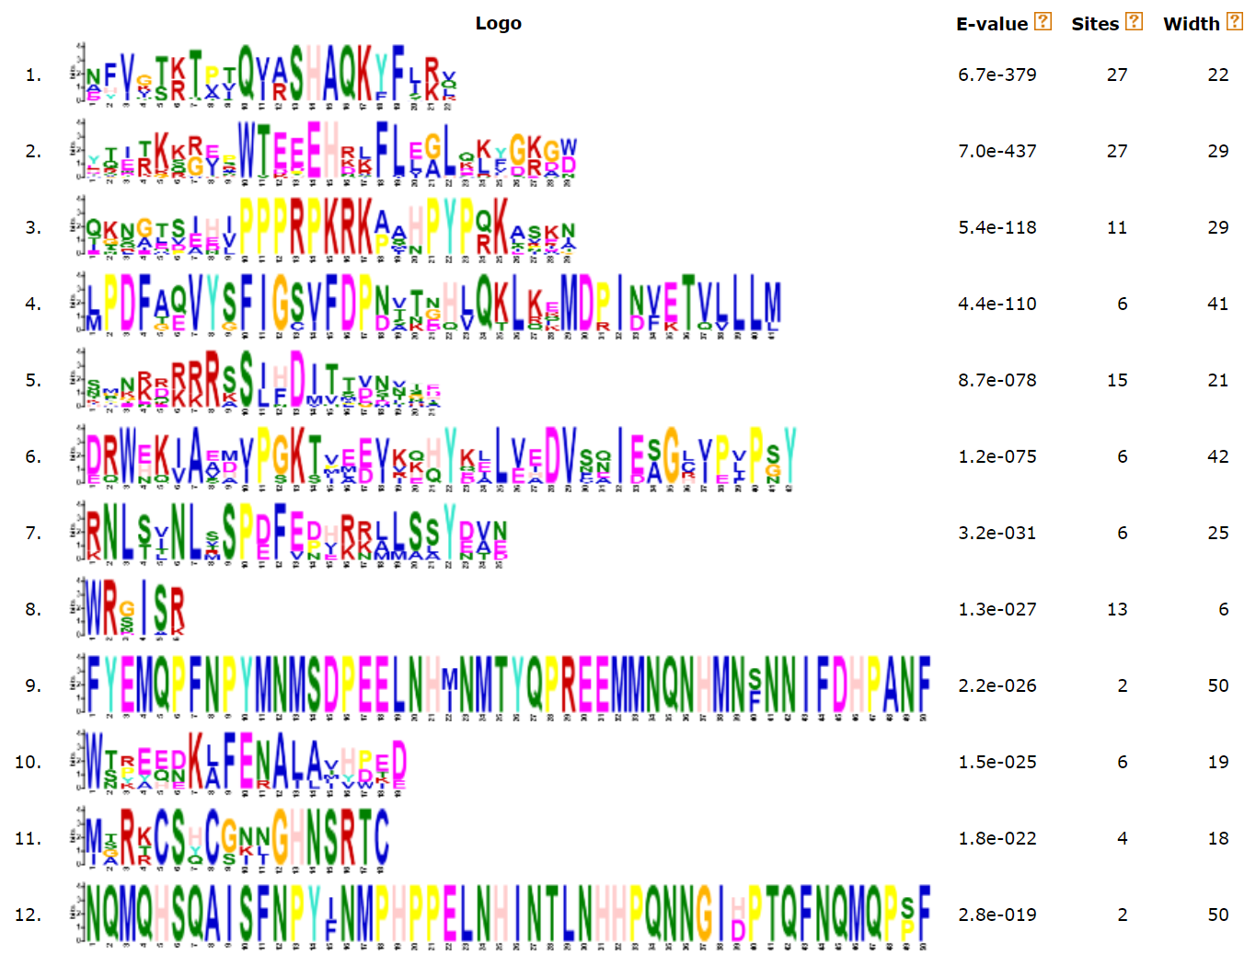
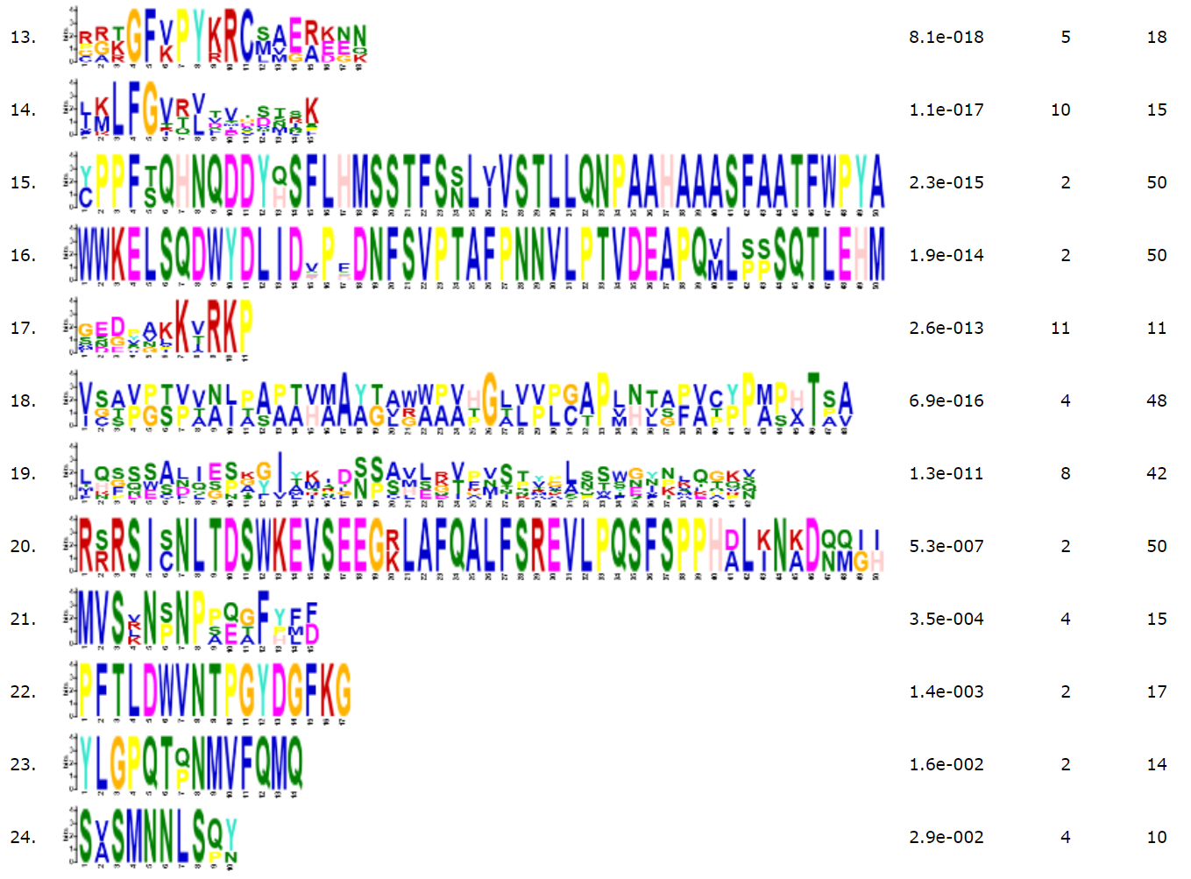
E-value
Sites
Width
Motif1
6.7e-379
27
22
Motif2
7.0e-437
27
29
Motif3
5.4e-118
11
29
Motif4
4.4e-110
6
41
Motif5
8.7e-078
15
21
Motif6
1.2e-075
6
42
Motif7
3.2e-031
6
25
Motif8
1.3e-027
13
6
Motif9
2.2e-026
2
50
Motif10
1.5e-025
6
19
Motif11
1.8e-022
4
18
Motif12
2.8e-019
2
50
Motif13
8.1e-018
5
18
Motif14
1.1e-017
10
15
Motif15
2.3e-015
2
50
Motif16
1.9e-014
2
50
Motif17
2.6e-013
11
11
Motif18
6.9e-016
4
48
Motif19
1.3e-011
8
42
Motif20
5.3e-007
2
50
Motif21
3.5e-004
4
15
Motif22
1.4e-003
2
17
Motif23
1.6e-002
2
14
Motif24
2.9e-002
4
10
Additional file 4: Sequence logos of 24 conserved motifs in VrCCA1L proteins. The “sites” indicates the number of VrCCA1L proteins containing each motif, and the “width” indicates the amino acid number of each motif.

