Slide 1
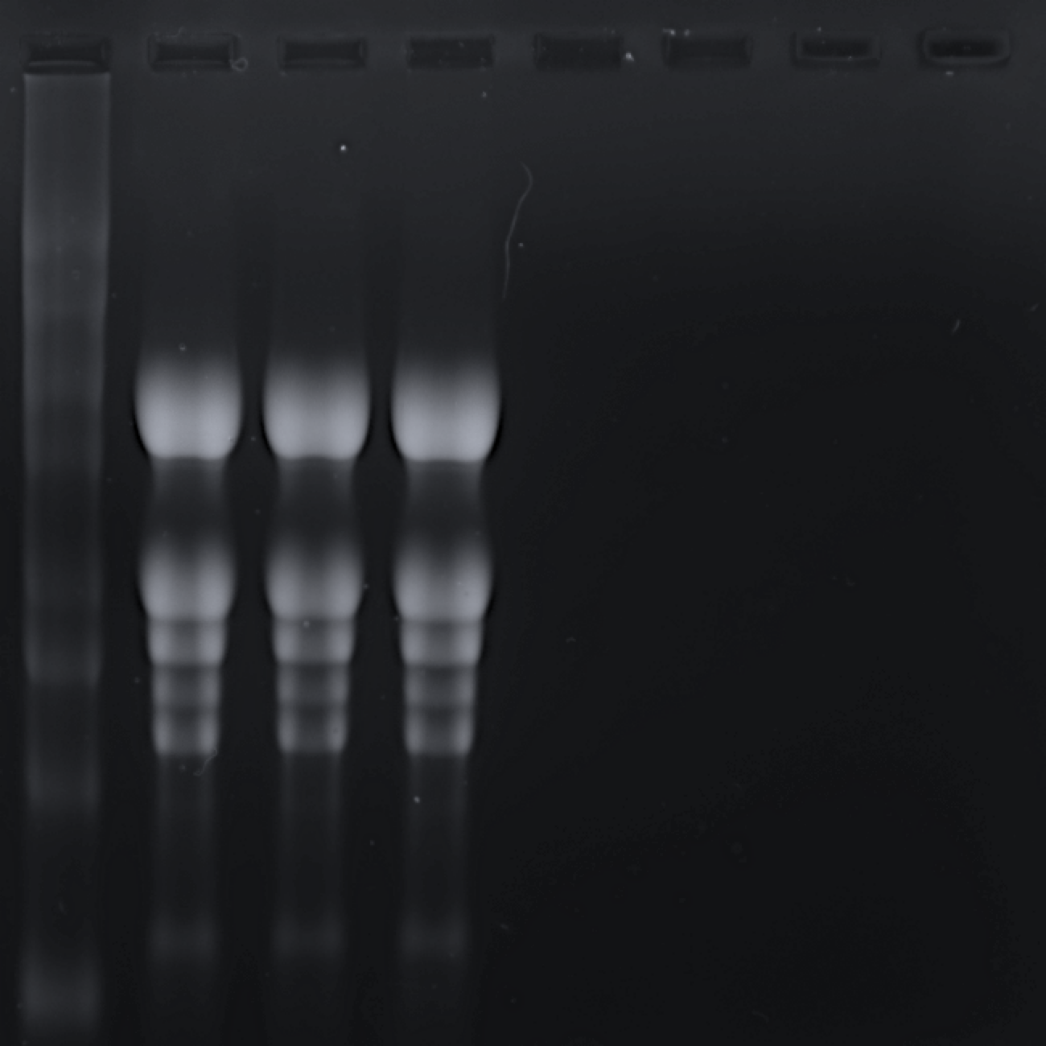
M
1
2
3
10000
6000
4000
28S rRNA
3000
Cytoplasmic
Size (nts)
18S rRNA
2000
1500
16S rRNA
Organellar
23S rRNA
500
5.8S rRNA
200
Fig. S1 A denaturing formaldehyde agarose gel electrophoresis was used to examine the integrity and size distribution of total RNA obtained from 10 days old seedlings of Arabidopsis thaliana (three biological replicates). 3.0 µg of RNA was loaded into each of the three lanes (1, 2, and 3) from three biological replicates. EtBr staining was used to visualize RNA. The cytoplasmic rRNAs are represented by the two higher bands (28S and 18S), whereas the organellar-type rRNAs are represented by the following smaller bands (16S and 23S). The 28S and 18S rRNAs have lengths of around 4,000 and 1,600 nucleotides (nts), respectively whereas organellar 16S rRNAs belong to 1,400 nts. The lower most RNA bands correspond to 5.8S rRNA. M represents the RNA ladder 0.2-10 Kb (loaded volume 3 µl).

