Slide 1
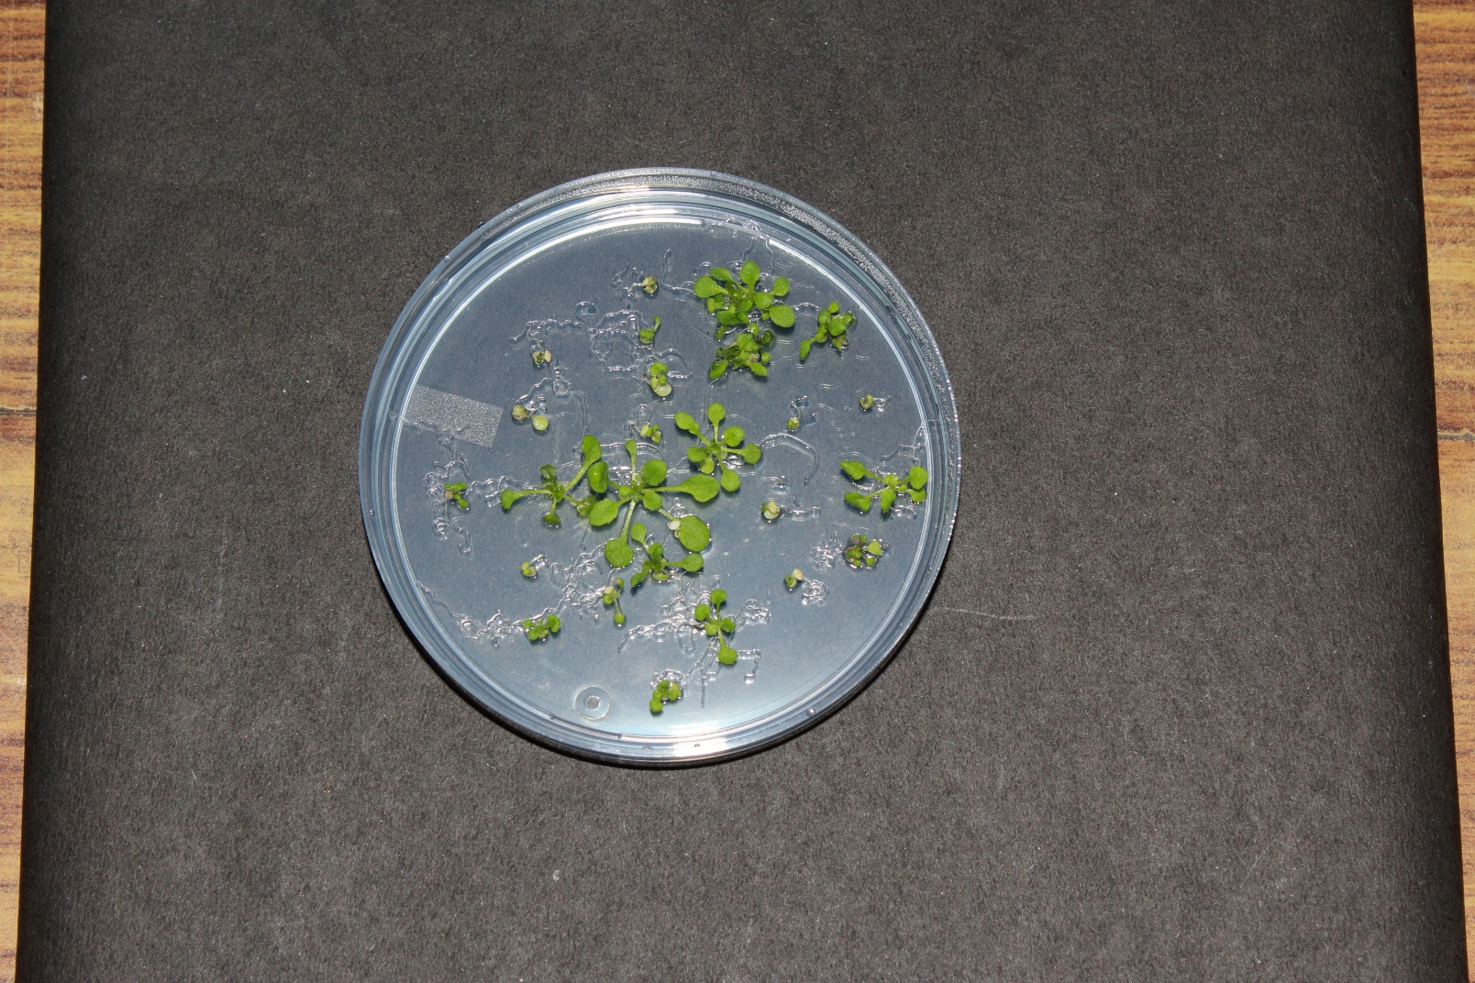
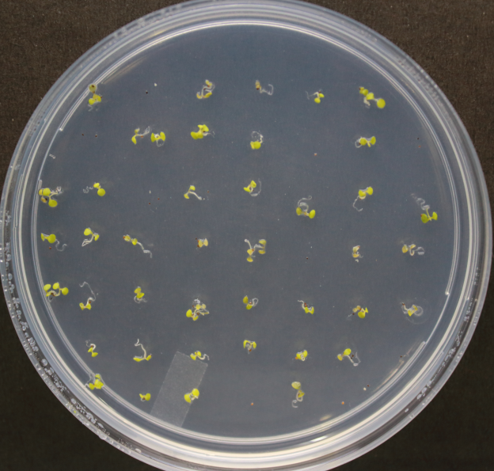
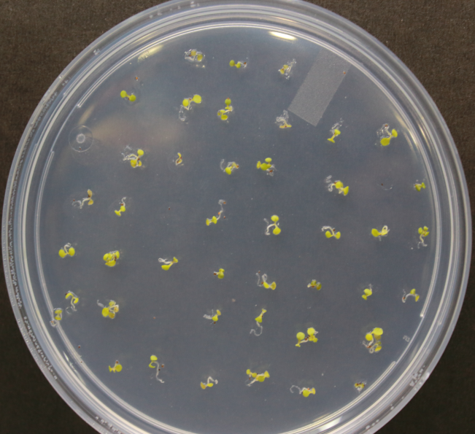
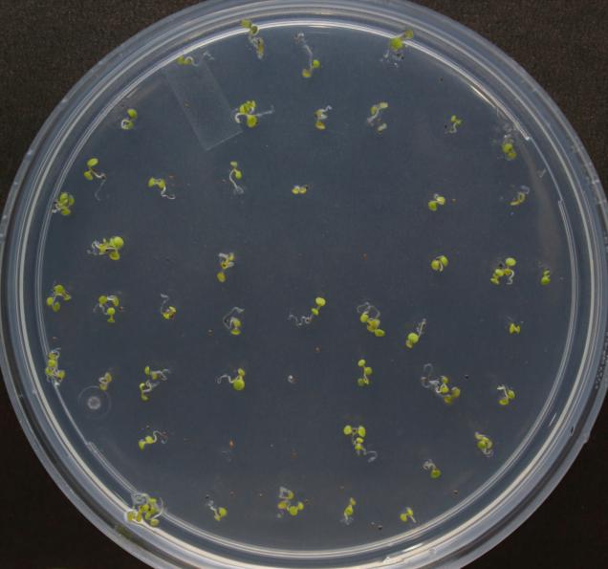
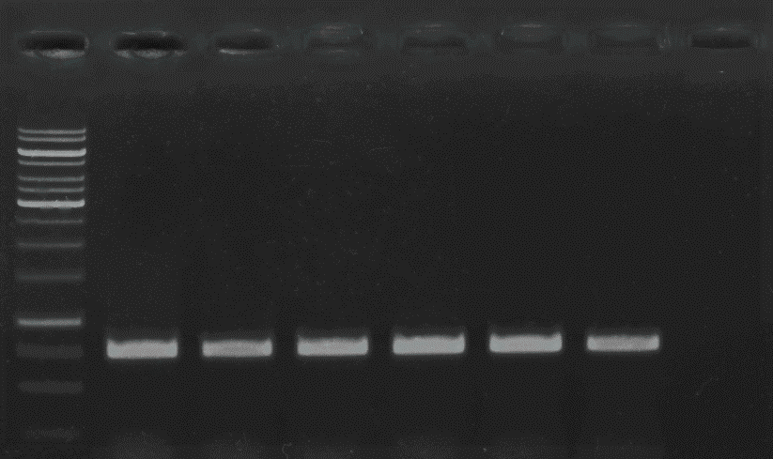
A
B
C
D
Plants were transferred on soil and PCR based genotyping were performed using hpt gene
Plants were transferred on soil and PCR based genotyping were performed using 4hppd and hpt gene
Plants were transferred on soil and PCR based genotyping were performed using 4hppd and hpt gene
Plants were transferred on soil and PCR based genotyping were performed using hpt and 4hppd gene
T₀
T₁
T₂
T₃
Plant 4 (L4)
Plant 6 (L6)
Plant 1(L1)
Plant 2(L2)
Plant3(L3)
Plant 4(L4)
Plant 5(L5)
Plant1(L1)
Plant 2 (L2)
Plant 3(L3)
Plant 4(L4)
Plant 6(L5)
Plant1(L1)
Plant 2(L2)
Plant 3(L3)
Plant 4(L4)
Plant 5(L5)
Plant 1(L1)
Plant 3 (L3)
Plant 5 (L5)
Plant 2(L2)
Wild type
hppd
hppd
hppd
hppd
hppd
hppd
hppd
hppd
hppd
hppd
hppd
hppd
hppd
hppd
hpt
hpt
hpt
hpt
hpt
hppd
hpt
hpt
hpt
hpt
hpt
hpt
hpt
hpt
hpt
M
M
M
hpt
M
10000
1500
1000
750
500
250
1:0.54
1:0.48
1:0.46
1:1.17
1:0.51
1:1.15
1:1.16
1:1.21
1:0.92
1:1.15
1:0.92
1:1.13
1:1.23
1:1.5
1:1.23
Fig. S3 Represents the steps for PCR based genotyping for At5g03350:: overexpression line (L) in Arabidopsis thaliana. (A) PCR amplification of hpt gene in T₀ transgenic plants, which were selected from hygromycin B plates. (B), (C), and (D) represents the subsequent generation (T₁, T₂ and T₃) for the selection of independent homozygous lines of At5g03350::overexpression from five independent lines of T₀. The hpt specific amplification along with endogenous 4hppd gene (represented on the gels as hppd) were used as reference gene during PCR based genotyping due to its single copy number in the genome of A. thaliana. Ratio of hppd and hpt band intensities in individual five plants is given bellow B, C, and D gel, which were used to determine the homozygosity. Band intensity was quantified using ImageJ software and ratio was calculated by using the formula, 4hppd/4hppd and hpt/4hppd for each plant

