Slide 1
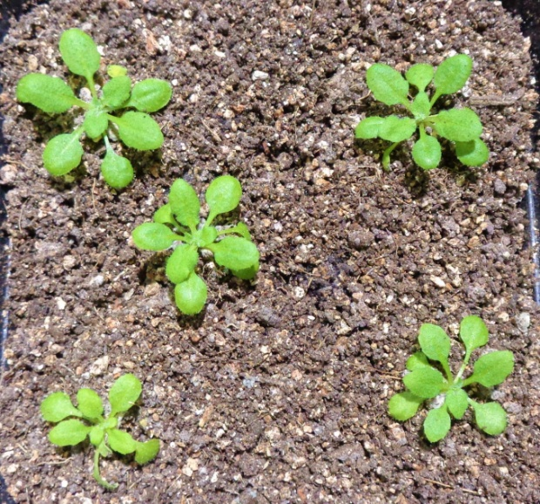
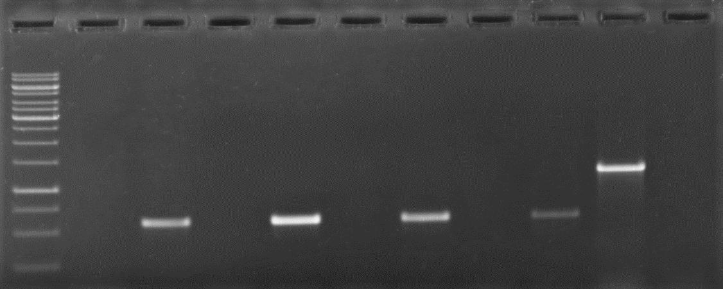
Seeds for mutant AT5g03350 were obtained from Nottingham Arabidopsis Stock Centre (NASC) (NASC ID: N536814;SALK ID- SALK_036814)
Stratifications of seeds followed by spreading on soil
1
2
3
4
PCR based genotyping were performed using gene specific and tDNA primers
Plant 1
Plant 2
Plant 3
Plant 4
WT
gene
gene
gene
gene
tDNA
tDNA
tDNA
gene
tDNA
M
tDNA
10000
1500
1000
750
500
250
Fig. S4 Steps of PCR-based genotyping of AT5g03350 gene-specific homozygous T-DNA insertion line 1, 2, 3, and 4, where wild type (WT) plant was used as negative control for T-DNA specific amplification and gene specific primers were used as positive control. WT corresponds to wild type Arabidopsis thaliana Col-0, while M corresponds to Marker.

