Slide 1
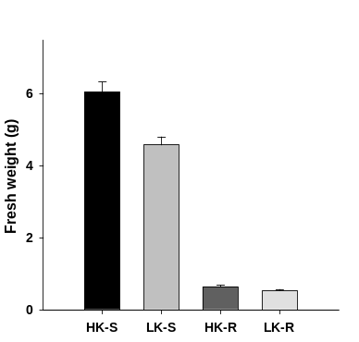
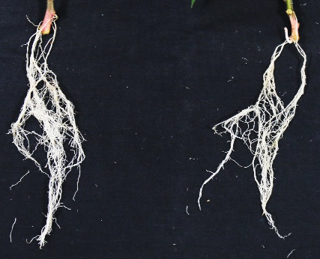
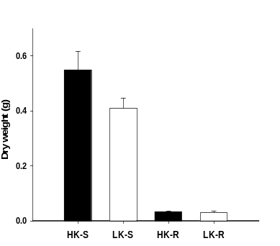
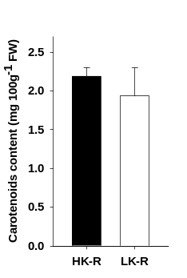
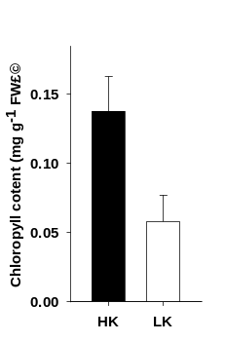
a
b
HK LK
*
c
d
e
Fig. S1 Phenotypic and quantitative data of sweet potato under normal and K⁺-deficient conditions.
a. Phenotype of the root. b. Fresh weight of the shoot and root. c. The dry weight of the shoot and root. d. The content of carotenoids in root under low-K⁺ stress. e. Chlorophyll content of shoot. Sweet potato stems were cut into 5 cm fragments and growth in plot full with vermiculite to two leaf stage. Seedlings were then treated with HK (1 mM K) and LK (0 mM K) Hoagland solution for 14 days, and then the weight, carotenoids and chlorophyll content were detected. Data are shown as means ± SE (n = 4). Student’s t test (*P < 0.05) was used to analyze statistical significance, HK-S: sufficient potassium shoot, HK-R: sufficient potassium root, LK-S: low potassium shoot, LK-R: low potassium root, bar=5 cm.
.

Slide 2
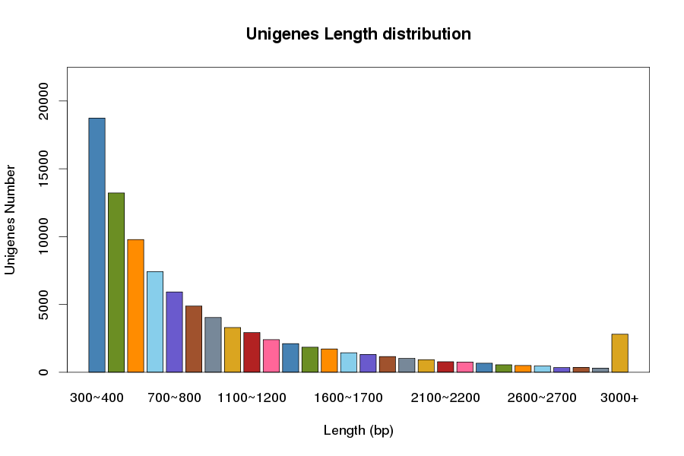
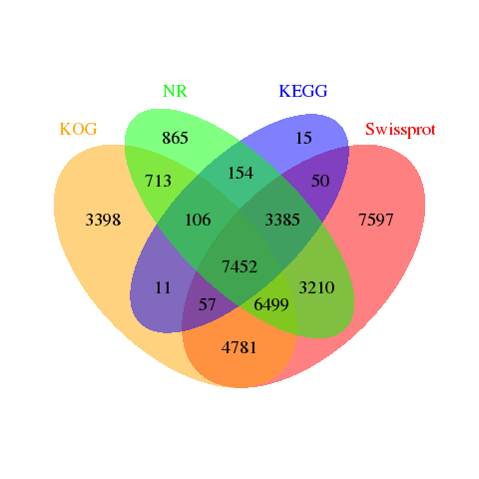
a
b
Fig. S2 The numbers of different unigenes length and venn diagrams of different annotation database.
a. Distribution of the numbers of different length unigenes. b. Venn diagrams of transcriptions in each annotation database.

Slide 3
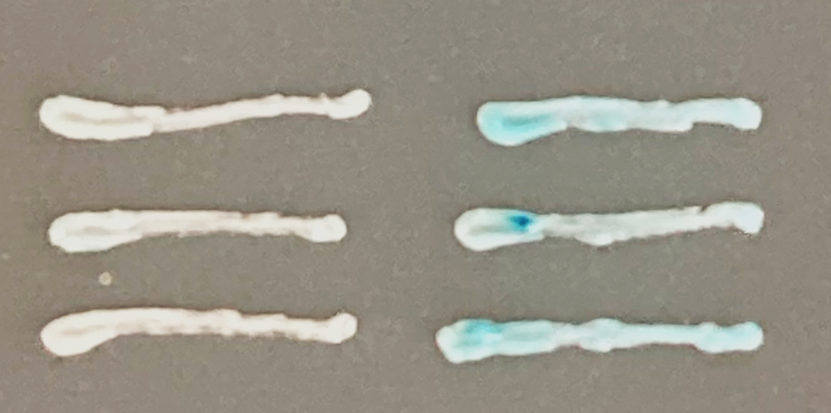
a
IbHAK5 promoter
-1
1760 bp
ATG
200 bp
ATTTTAAA-motif
ERE-BOX-Like
b
AD
ProIbHAK5:lacz
AD-IbERF
ProIbHAK5:lacz
Fig. S3 Transcription factor ERF binds to IbHAK5 promoter.
a. Diagram of the IbHAK5 promoter. The adenine residue of the translational start codon ATG was assigned position +1, and the two ERF binding motif were showed in different color. Relative positions of the two motif were indicated by red and green lines. The scale length is 200 bp. b. Transient expression of the ProIbHAK5:lacZ fusion together with IbERF in yeast. AD together with ProIbHAK5:lacZ was taken as negative control. Observe the color and then photoes were taken.

Slide 4
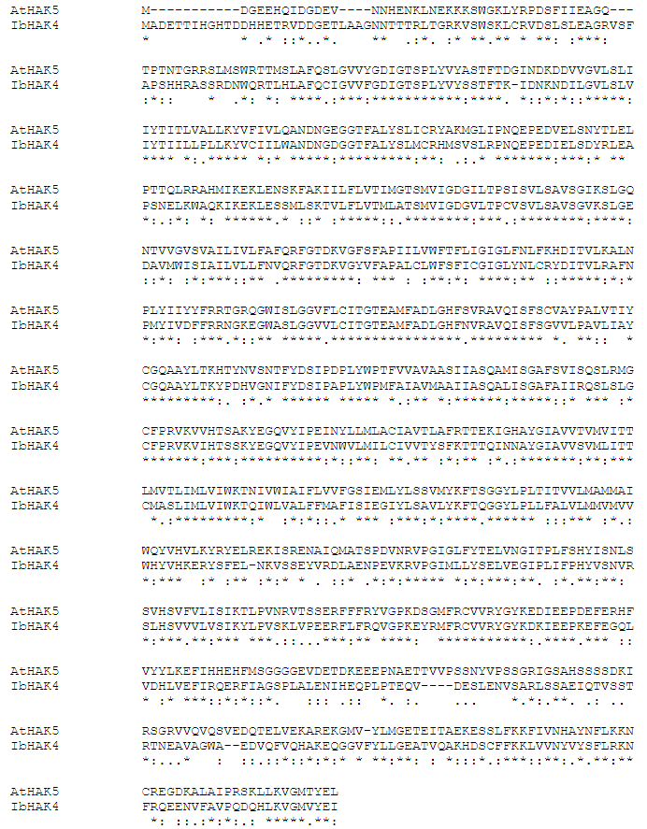
Fig. S4 Amino acid sequence alignment of AtHAK5 and IbHAK5.

Slide 5
Table S1 Summary of RNA-seq quality information
Sample Name | Clean Reads | Clean Bases | Clean GC | Clean Q20 | Clean Q30
HKR-1 | 25172692 | 7551807600 | 46.93;46.68 | 98.05;95.32 | 94.42;88.83
HKR-2 | 26211539 | 7863461700 | 46.59;46.31 | 97.97;96.09 | 94.27;90.48
HKR-3 | 27077557 | 8123267100 | 46.57;46.25 | 97.91;96.33 | 94.10;91.01
LKR-1 | 21080434 | 6324130200 | 46.47;46.19 | 97.75;95.30 | 93.65;88.97
LKR-2 | 23602694 | 7080808200 | 47.33;47.09 | 98.04;96.74 | 94.40;91.65
LKR-3 | 22369151 | 6710745300 | 46.60;46.17 | 98.05;94.63 | 94.37;87.80

Slide 6
Table S2 Unigenes statistical table
Type | Value
Total number | 91690
Total length | 86552863
N50 length | 1249
Mean length | 943.9727669
GC% | 42%

Slide 7
Table S3 Statistical table of unigenes annotation
Anno_database | Annotated_ Number | 0<=length<1000 | 1000<=length<2000 | 2000<=length<3000 | 3000<=length<6000 | length>=6000
GO_Annotation | 12093 | 6224 | 3567 | 1429 | 825 | 48
KEGG_Annotation | 11230 | 5662 | 3392 | 1330 | 796 | 50
KOG_Annotation | 23017 | 12157 | 6933 | 2498 | 1350 | 79
NR_Annotation | 22384 | 10387 | 7050 | 2998 | 1820 | 129
NT_Annotation | 2257 | 1316 | 573 | 212 | 133 | 23
Swissprot_Annotation | 33031 | 16978 | 10115 | 3766 | 2048 | 124
All_Annotated | 38516 | 20148 | 11745 | 4244 | 2245 | 134

Slide 8
Table S4 primers used in this study.
Gene | F (5’-3’) | R (5’-3’)
IbCIPK23 (g37215.t1) | TGGTGGCGAACTGTTTGAC | ATCTTCCCGAACTTGCTGC
IbHAK4 (g13675.t1) | GAGACAAGGGTTGATGACG | TGGTGTAGATGACGAGGGAC
g60212.t1 | CAAGGTCTTCAAAGTCGGAG | GAGCAGAAATAGAAATCGCC
g9485.t1 | TCTCCATCTCCATAACCGC | GTCTGTTTGGTGAAGTGCC
g1670.t1 | GATGTTGAATCCTGTAGGTGC | AGAGAAGAAATGGGCTGTTG
g29758.t1 | GCAGGCTTTGGTGTTTGAG | CGTTGGGTTCTGGATTCTC
g3926.t1 | CGGTGGTGACTTGAAATGAG | CAGGAAGAAGGGAGGAATAAG
g3636.t1 | CCTCACCTCCACTTTCTCAAG | CGTTATTGCTCCTTTCGCC
g1753.t1 | GGGCAAGAGACTAAGGTTTG | GATAGAGCATTTGAGAGGACG
g5301.t1 | CGGTTCAATGGCGATTTC | GCCTTCATCATCCTACCTGG
g61385.t1 | CCACGATGAAGACCAGGAGG | GGCATTTCCCCCACACCTAA
g21304.t1 | CCCACACTCCAAAGGTCACA | CAAGTCGGAGAGTGCCCTG
g51110.t1 | TGGCAAAAATGTCAGACCCAC | TGGATCACTTGGGCCAGGAA
IbACTIN | GTATTGTGCTGGATTCTGGTGAT | TCAGCAGTAGTGGTGAACATGT

Slide 9
Table S5 Differently expressed unigenes in KEGG
Term | ID | Input number | Background number | P-Value | Hyperlink
Retinol metabolism | ko00830 | 16 | 356 | 3.65E-9 | KEGG PATHWAY: Retinol metabolism (genome.jp)
Tyrosine metabolism | ko00350 | 6 | 116 | 0.000189988 | KEGG PATHWAY: Tyrosine metabolism (genome.jp)
Metabolism of xenobiotics by cytochrome P450 | ko00980 | 9 | 305 | 0.000296447 | KEGG PATHWAY: Metabolism of xenobiotics by cytochrome P450 (genome.jp)
Steroid hormone biosynthesis | ko00140 | 9 | 336 | 0.000588814 | KEGG PATHWAY: Steroid hormone biosynthesis (genome.jp)
Other glycan degradation | ko00511 | 4 | 65 | 0.001289471 | KEGG PATHWAY: Other glycan degradation (genome.jp)

