Slide 1
Sample Name | Condition | RIN: | Total Reads | Trimmed Reads | % Trimmed Reads | Too Short Reads | % Too Short | Exact Match Reads | % Exact Matches | Mismatch Reads | % Mismatched | Mapped Reads | % Mapped | miR Mapped Reads | % miR Mapped
F2_MIN_S65_R1_001 | A | 6.1 | 44923368 | 22068944 | 49.13 | 21481178 | 47.82 | 12464082 | 56.48 | 9604862 | 43.52 | 16215782 | 73.48 | 1946854 | 12.01
M2_MIN_1_S64_R1_001 | A | 7.9 | 47308371 | 21924986 | 46.34 | 22148058 | 46.82 | 11860956 | 54.1 | 10064030 | 45.9 | 15165328 | 69.17 | 2304575 | 15.2
Apc_Min_S35_R1_001 | A | 7.2 | 71735551 | 47923315 | 66.81 | 17895251 | 24.95 | 29090172 | 60.7 | 18833143 | 39.3 | 36917847 | 77.04 | 1179439 | 3.19
MinF2_merged | A | 6.9 | 95620530 | 62063755 | 64.91 | 24374134 | 25.49 | 26226361 | 42.26 | 35837394 | 57.74 | 39374992 | 63.44 | 1736433 | 4.41
Min_PlusKP_S58_R1_001 | AKP | 7.3 | 32143451 | 15200572 | 47.29 | 14188634 | 44.14 | 9957103 | 65.5 | 5243469 | 34.5 | 11844839 | 77.92 | 3348713 | 28.27
F2S333_S59_R1_001 | B | 5.2 | 36205749 | 24495551 | 67.66 | 10334673 | 28.54 | 17826831 | 72.78 | 6668720 | 27.22 | 20721430 | 84.59 | 2602451 | 12.56
S33_F1_S29_R1_001 | B | 8.1 | 45215165 | 28580129 | 63.21 | 7100221 | 15.7 | 21145834 | 73.99 | 7434295 | 26.01 | 22397730 | 78.37 | 5075581 | 22.66
S33_F2_S30_R1_001 | B | 9.7 | 38034820 | 21753615 | 57.19 | 11892611 | 31.27 | 11861590 | 54.53 | 9892025 | 45.47 | 14741669 | 67.77 | 1328772 | 9.01
S33_M1_S31_R1_001 | B | 9.2 | 50361930 | 26489605 | 52.6 | 6849153 | 13.6 | 17047920 | 64.36 | 9441685 | 35.64 | 19044646 | 71.89 | 6851189 | 35.97
S33_M2_S28_R1_001 | B | 7.7 | 45452754 | 28622165 | 62.97 | 8105128 | 17.83 | 21233309 | 74.18 | 7388856 | 25.82 | 22671210 | 79.21 | 3820033 | 16.85
S33KP_S66_R1_001 | BKP | 7 | 44352791 | 22134957 | 49.91 | 18687955 | 42.13 | 13971997 | 63.12 | 8162960 | 36.88 | 16999981 | 76.8 | 4471089 | 26.3
KRP_1_S51_R1_001 | KRP | 8.3 | 38755678 | 22293744 | 57.52 | 11856405 | 30.59 | 14859721 | 66.65 | 7434023 | 33.35 | 16546308 | 74.22 | 4364093 | 26.38
KRP_2_S67_R1_001 | KRP | 8.7 | 40542974 | 21831099 | 53.85 | 14188551 | 35 | 13457395 | 61.64 | 8373704 | 38.36 | 16248558 | 74.43 | 4123200 | 25.38
N1_S53_R1_001 | KRPS | 10 | 43046457 | 18926957 | 43.97 | 12584443 | 29.23 | 13541733 | 71.55 | 5385224 | 28.45 | 15857352 | 83.78 | 9096511 | 57.36
N3_S55_R1_001 | KRPS | 7.4 | 37317699 | 16851178 | 45.16 | 11730533 | 31.43 | 12876083 | 76.41 | 3975095 | 23.59 | 14683796 | 87.14 | 8880541 | 60.48
N4_1_S56_R1_001 | KRPS | 8.7 | 35125005 | 16498547 | 46.97 | 11807583 | 33.62 | 12545823 | 76.04 | 3952724 | 23.96 | 14467462 | 87.69 | 9122619 | 63.06
N4_2_S63_R1_001 | KRPS | 9.1 | 33954457 | 16912881 | 49.81 | 10495399 | 30.91 | 13594056 | 80.38 | 3318825 | 19.62 | 15259102 | 90.22 | 11045447 | 72.39
47_KRS19_S32_R1_001 | KRS | 9.8 | 39761968 | 23241658 | 58.45 | 9376930 | 23.58 | 12133896 | 52.21 | 11107762 | 47.79 | 14526170 | 62.5 | 4212670 | 29
72_KRS19_B_S33_R1_001 | KRS | 8.9 | 46892739 | 32446691 | 69.19 | 7077760 | 15.09 | 22125336 | 68.19 | 10321355 | 31.81 | 25014984 | 77.1 | 5698620 | 22.78
961_KRS19_B_S34_R1_001 | KRS | 9.1 | 46844697 | 30676612 | 65.49 | 8393236 | 17.92 | 20023113 | 65.27 | 10653499 | 34.73 | 23302566 | 75.96 | 4907643 | 21.06
PR3_1_S60_R1_001 | R | 6.9 | 36254935 | 24660337 | 68.02 | 9439348 | 26.04 | 18500782 | 75.02 | 6159555 | 24.98 | 20370018 | 82.6 | 4045727 | 19.86
PR3_2_S50_R1_001 | R | 5.7 | 43743363 | 33355876 | 76.25 | 8810426 | 20.14 | 24323398 | 72.92 | 9032478 | 27.08 | 28370319 | 85.05 | 4341517 | 15.3
F2_S49_R1_001 | WT | 6.7 | 33533470 | 24155037 | 72.03 | 7881358 | 23.5 | 17605855 | 72.89 | 6549182 | 27.11 | 20527102 | 84.98 | 3099381 | 15.1
M2_MIN_S57_R1_001 | WT | 5.9 | 47104949 | 37447192 | 79.5 | 8112938 | 17.22 | 28484162 | 76.06 | 8963030 | 23.94 | 33292471 | 88.91 | 4157754 | 12.49
WT2B_merged | WT | 4.8 | 85109562 | 65713023 | 77.21 | 10215109 | 12 | 42270940 | 64.33 | 23442083 | 35.67 | 50651056 | 77.08 | 5954851 | 11.76
Notes:
Table S1: Mapping statistics of small RNA-seq data produced from genetically modified mouse enteroids and WT controls.

Slide 2
Sample Name | Condition | RIN: | STAR Total reads | STAR % Uniquely mapped | STAR % reads mapped to multiple loci | STAR % reads mapped to too many loci | STAR % reads unmapped: too short | Salmon % mapped | Salmon Processed reads | Salmon Mapped reads
F2_MIN | A | 6.1 | 63,668,245 | 28.56% | 13.62% | 0.37% | 57.20% | 37.49% | 58,888,520 | 22,075,956
M2_Min | A | 7.9 | 66,337,613 | 53.22% | 8.68% | 0.44% | 37.49% | 54.89% | 56,022,916 | 30,753,239
Apc_Min | A | 7.2 | 123,416,310 | 57.36% | 4.90% | 0.10% | 37.35% | 48.30% | 90,085,330 | 43,508,114
MinF2E | A | 6.9 | 108,718,172 | 39.85% | 4.79% | 0.26% | 54.98% | 34.45% | 91,820,244 | 31,635,914
MinKP | AKP | 7.3 | 65,632,615 | 63.43% | 13.96% | 0.43% | 21.89% | 73.15% | 55,266,561 | 40,424,893
F2S333 | B | 5.2 | 64,848,459 | 57.66% | 19.28% | 0.43% | 22.40% | 74.71% | 59,101,383 | 44,151,912
JV2_S33F1 | B | 8.1 | 87,353,836 | 69.76% | 5.32% | 0.20% | 23.89% | 61.98% | 57,244,257 | 35,478,693
JV3_S33F2 | B | 9.7 | 72,360,604 | 63.51% | 5.27% | 0.18% | 30.42% | 57.48% | 53,139,819 | 30,545,368
JV4_S33M1 | B | 9.2 | 75,519,903 | 70.09% | 6.12% | 0.18% | 23.11% | 64.68% | 50,870,038 | 32,904,364
JV1_S33M2 | B | 7.7 | 74,669,762 | 64.49% | 5.30% | 0.22% | 28.98% | 54.48% | 49,550,121 | 26,995,458
S33KP | BKP | 7 | 59,670,631 | 55.17% | 11.70% | 0.44% | 32.49% | 61.20% | 50,961,120 | 31,190,748
KRP_1 | KRP | 8.3 | 75,188,321 | 63.54% | 13.26% | 0.59% | 22.27% | 72.16% | 62,632,893 | 45,195,429
KRP_2 | KRP | 8.7 | 63,721,951 | 64.66% | 12.18% | 0.68% | 22.26% | 72.37% | 53,414,713 | 38,656,871
N1 | KRPS | 10 | 77,430,429 | 82.47% | 13.63% | 0.79% | 2.67% | 95.23% | 63,370,306 | 60,345,749
N3 | KRPS | 7.4 | 123,265,857 | 79.48% | 12.25% | 0.72% | 7.22% | 89.63% | 98,372,895 | 88,171,732
N4_1 | KRPS | 8.7 | 111,201,999 | 79.62% | 15.32% | 0.76% | 4.04% | 93.86% | 91,580,292 | 85,953,305
N4_2 | KRPS | 9.1 | 106,898,989 | 67.41% | 12.67% | 0.50% | 19.23% | 73.24% | 79,548,826 | 58,264,540
JV6_47KRS19 | KRS | 9.8 | 64,298,278 | 69.60% | 6.60% | 0.11% | 23.41% | 67.79% | 47,508,936 | 32,207,918
JV7_72KRS19B | KRS | 8.9 | 78,578,337 | 68.58% | 4.84% | 0.16% | 25.98% | 58.57% | 50,410,053 | 29,525,801
JV8_961KRSB | KRS | 9.1 | 68,750,162 | 68.39% | 4.95% | 0.20% | 25.93% | 58.72% | 44,404,030 | 26,073,856
PR3_1 | R | 6.9 | 64,050,653 | 64.78% | 13.53% | 0.54% | 20.88% | 72.68% | 50,852,009 | 36,957,087
PR3_2 | R | 5.7 | 116,465,081 | 57.05% | 20.07% | 0.55% | 22.09% | 72.98% | 98,614,927 | 71,965,108
F2 | WT | 6.7 | 62,602,180 | 54.97% | 16.43% | 0.59% | 27.82% | 66.64% | 53,674,549 | 35,771,331
M2 | WT | 5.9 | 38,081,211 | 56.69% | 23.31% | 0.51% | 19.33% | 77.43% | 33,727,933 | 26,114,625
WT2B | WT | 4.8 | 94,109,943 | 44.08% | 8.49% | 0.35% | 46.93% | 42.38% | 77,469,304 | 32,832,197
Notes:
Table S2: Mapping statistics of RNA-seq data produced from genetically modified mouse enteroids and WT controls.

Slide 3
Comparison | TCGA | Mmu Enteroid
TCGA: A (n=33) vs NT (n=8) Mmu Enteroid: A (n=4) vs WT (n=3) | hsa-let-7a-1, hsa-let-7a-2, hsa-let-7a-3, hsa-let-7b, hsa-let-7c, hsa-let-7d, hsa-let-7e, hsa-let-7f-1, hsa-let-7f-2, hsa-let-7g, hsa-let-7i, hsa-mir-101-1, hsa-mir-101-2, hsa-mir-106b, hsa-mir-10a, hsa-mir-10b, hsa-mir-125a, hsa-mir-125b-1, hsa-mir-125b-2, hsa-mir-126, hsa-mir-127, hsa-mir-1307, hsa-mir-139, hsa-mir-140, hsa-mir-141, hsa-mir-142, hsa-mir-143, hsa-mir-145, hsa-mir-148a, hsa-mir-150, hsa-mir-151a, hsa-mir-15b, hsa-mir-17, hsa-mir-181a-1, hsa-mir-181a-2, hsa-mir-182, hsa-mir-183, hsa-mir-191, hsa-mir-192, hsa-mir-193a, hsa-mir 194-1, hsa-mir-196b, hsa-mir-197, hsa-mir-199a-1, hsa-mir-199a-2, hsa-mir-199b, hsa-mir-200c, hsa-mir-203a, hsa-mir-20a, hsa-mir-21, hsa-mir-215, hsa-mir-22, hsa-mir-23a, hsa-mir-23b, hsa-mir-24-1, hsa-mir-24-2, hsa-mir-25, hsa-mir-26a-1, hsa-mir-26a-2, hsa-mir-26b, hsa-mir-27a, hsa-mir-28, hsa-mir-29b-1, hsa-mir-29b-2, hsa-mir-29c, hsa-mir-30d, hsa-mir-30e, hsa-mir-320a, hsa-mir-328, hsa-mir-338, hsa-mir-361, hsa-mir-374a, hsa-mir-375, hsa-mir-378a, hsa-mir-379, hsa-mir-423, hsa-mir-455, hsa-mir-486-1, hsa-mir-486-2, hsa-mir-500a, hsa-mir-574, hsa-mir-625, hsa-mir-92a-1, hsa-mir-92a-2, hsa-mir-92b, hsa-mir-99b | mmu-let-7a-1-3p, mmu-let-7c-1-5p_+_1, mmu-let-7c-2-3p, mmu-let-7c-2-5p_+_1, mmu-let-7e-5p, mmu-mir-101b-3p, mmu-mir-103-1-3p, mmu-mir-103-2-3p, mmu-mir-106b-3p, mmu-mir-107-3p, mmu-mir-10a-5p, mmu-mir-10a-5p_+_1, mmu-mir-125a-5p, mmu-mir-140-3p, mmu-mir-140-3p_+_1, mmu-mir-140-5p, mmu-mir-141-3p, mmu-mir-141-5p, mmu-mir-146a-5p, mmu-mir-146b-5p, mmu-mir-148a-3p, mmu-mir-155-5p, mmu-mir-15a-5p, mmu-mir-181d-5p, mmu-mir-182-5p, mmu-mir-183-5p, mmu-mir-183-5p_+_1, mmu-mir-185-5p, mmu-mir-192-5p, mmu-mir-192-5p_+_1, mmu-mir-194-1-3p, mmu-mir-194-1-5p, mmu-mir-194-2-3p, mmu-mir-194-2-5p, mmu-mir-1981-5p, mmu-mir-19b-1-3p, mmu-mir-19b-2-3p, mmu-mir-200a-3p, mmu-mir-200a-3p_+_1, mmu-mir-200c-3p, mmu-mir-203-3p, mmu-mir-203-3p_+_1, mmu-mir-215-3p, mmu-mir-215-5p, mmu-mir-215-5p_+_1, mmu-mir-21-5p_-_1, mmu-mir-218-1-5p, mmu-mir-218-2-5p, mmu-mir-222-3p, mmu-mir-22-3p, mmu-mir-24-1-3p, mmu-mir-24-2-3p, mmu-mir-24-2-5p, mmu-mir-27a-3p, mmu-mir-27b-5p, mmu-mir-29a-3p_-_1, mmu-mir-301a-3p, mmu-mir-30b-5p, mmu-mir-30e-5p, mmu-mir-30e-5p_+_1, mmu-mir-320-3p, mmu-mir-339-5p, mmu-mir-375-3p, mmu-mir-378-3p, mmu-mir-378-3p_+_1, mmu-mir-378-5p, mmu-mir-421-3p, mmu-mir-532-5p, mmu-mir-672-5p, mmu-mir-744-5p, mmu-mir-7b-5p, mmu-mir-802-3p, mmu-mir-802-5p, mmu-mir-872-5p, mmu-mir-92a-2-3p, mmu-mir-99b-3p, mmu-mir-99b-5p
TCGA: B (n=3) vs NT (n=8) Mmu Enteroid: B (n=5) vs WT (n=3) | hsa-let-7b, hsa-let-7c, hsa-let-7d, hsa-mir-101-1, hsa-mir-101-2, hsa-mir-10a, hsa-mir-125a, hsa-mir-125b-1, hsa-mir-125b-2, hsa-mir-139, hsa-mir-140, hsa-mir-141, hsa-mir-145, hsa-mir-150, hsa-mir-17, hsa-mir-181a-1, hsa-mir-181a-2, hsa-mir-191, hsa-mir-193a, hsa-mir-197, hsa-mir-203a, hsa-mir-21, hsa-mir-30d, hsa-mir-374a, hsa-mir-423, hsa-mir-486-1, hsa-mir-486-2, hsa-mir-582, hsa-mir-92b | mmu-let-7b-5p, mmu-let-7e-5p, mmu-let-7g-5p, mmu-mir-103-1-3p, mmu-mir-103-2-3p, mmu-mir-106b-3p, mmu-mir-125a-5p, mmu-mir-140-3p_+_1, mmu-mir-141-3p, mmu-mir-146b-5p, mmu-mir-155-5p, mmu-mir-181d-5p, mmu-mir-183-5p, mmu-mir-183-5p_+_1, mmu-mir-185-5p, mmu-mir-192-5p, mmu-mir-192-5p_+_1, mmu-mir-194-1-3p, mmu-mir-194-1-5p, mmu-mir-194-2-5p, mmu-mir-1981-5p, mmu-mir-200a-3p, mmu-mir-200c-3p, mmu-mir-203-3p, mmu-mir-203-3p_+_1, mmu-mir-21-3p, mmu-mir-215-3p, mmu-mir-215-5p, mmu-mir-215-5p_+_1, mmu-mir-21-5p_-_1, mmu-mir-218-1-5p, mmu-mir-218-2-5p, mmu-mir-222-3p, mmu-mir-22-3p, mmu-mir-24-2-5p, mmu-mir-25-3p, mmu-mir-26a-1-5p, mmu-mir-26a-2-5p, mmu-mir-30a-3p, mmu-mir-30e-5p, mmu-mir-30e-5p_+_1, mmu-mir-320-3p, mmu-mir-340-5p, mmu-mir-345-3p_-_1, mmu-mir-374-5p, mmu-mir-378-3p, mmu-mir-378-3p_+_1, mmu-mir-378-5p, mmu-mir-421-3p, mmu-mir-425-5p, mmu-mir-672-5p, mmu-mir-7b-5p, mmu-mir-802-3p, mmu-mir-802-5p, mmu-mir-872-5p, mmu-mir-99b-3p, mmu-mir-99b-5p
TCGA: KP (n=9) vs NT (n=8) Mmu Enteroid: KRP (n=2) vs WT (n=3) | hsa-let-7a-1, hsa-let-7a-2, hsa-let-7a-3, hsa-let-7b, hsa-let-7c, hsa-let-7d, hsa-let-7f-1, hsa-let-7f-2, hsa-let-7i, hsa-mir-101-1, hsa-mir-101-2, hsa-mir-10a, hsa-mir-10b, hsa-mir-125a, hsa-mir-125b-1, hsa-mir-125b-2, hsa-mir-126, hsa-mir-127, hsa-mir-1307, hsa-mir-139, hsa-mir-140, hsa-mir-141, hsa-mir-142, hsa-mir-143, hsa-mir-145, hsa-mir-146b, hsa-mir-148a, hsa-mir-150, hsa-mir-151a, hsa-mir-15b, hsa-mir-17, hsa-mir-181a-1, hsa-mir-181a-2, hsa-mir-182, hsa-mir-183, hsa-mir-191, hsa-mir-192, hsa-mir-193a, hsa-mir-197, hsa-mir-199a-1, hsa-mir-199a-2, hsa-mir-199b, hsa-mir-200c, hsa-mir-203a, hsa-mir-21, hsa-mir-215, hsa-mir-22, hsa-mir-24-1, hsa-mir-24-2, hsa-mir-26a-1, hsa-mir-26a-2, hsa-mir-26b, hsa-mir-27a, hsa-mir-28, hsa-mir-29c, hsa-mir-30d, hsa-mir-30e, hsa-mir-320a, hsa-mir-328, hsa-mir-361, hsa-mir-374a, hsa-mir-375, hsa-mir-378a, hsa-mir-379, hsa-mir-423, hsa-mir-486-1, hsa-mir-486-2, hsa-mir-500a, hsa-mir-574, hsa-mir-582, hsa-mir-625, hsa-mir-92a-1, hsa-mir-92a-2, hsa-mir-92b, hsa-mir-99b | mmu-let-7b-5p, mmu-let-7d-3p, mmu-mir-103-1-3p, mmu-mir-103-2-3p, mmu-mir-130a-3p, mmu-mir-141-3p, mmu-mir-146a-5p, mmu-mir-148a-3p, mmu-mir-155-5p, mmu-mir-181a-1-5p, mmu-mir-181a-2-5p, mmu-mir-194-1-5p, mmu-mir-1981-5p, mmu-mir-200c-3p, mmu-mir-205-5p, mmu-mir-21-3p, mmu-mir-21-5p, mmu-mir-21-5p_-_1, mmu-mir-21-5p_+_1, mmu-mir-21-5p_+_2, mmu-mir-24-2-5p, mmu-mir-26a-1-5p, mmu-mir-26a-2-5p, mmu-mir-26b-5p, mmu-mir-27a-3p, mmu-mir-28-3p, mmu-mir-3096b-5p, mmu-mir-3096b-5p_-_1, mmu-mir-30a-3p, mmu-mir-30a-3p_+_1, mmu-mir-30a-5p, mmu-mir-30b-5p, mmu-mir-30d-5p, mmu-mir-30e-3p, mmu-mir-30e-5p, mmu-mir-320-3p, mmu-mir-339-5p, mmu-mir-340-5p, mmu-mir-34a-5p, mmu-mir-378-3p, mmu-mir-378-3p_+_1, mmu-mir-378-5p, mmu-mir-674-5p, mmu-mir-7a-1-5p, mmu-mir-7a-2-5p, mmu-mir-7b-5p, mmu-mir-99b-3p, mmu-mir-99b-5p
TCGA: KS (n=2) vs NT (n=8) Mmu Enteroid: KRS (n=3) vs WT (n=3) | hsa-mir-181a-1, hsa-let-7a-2, hsa-let-7a-1, hsa-let-7a-3, hsa-let-7f-1, hsa-let-7f-2, hsa-mir-24-1, hsa-mir-24-2, hsa-mir-223, hsa-mir-143, hsa-mir-30b, hsa-mir-379 | mmu-let-7a-1-3p, mmu-let-7c-2-3p, mmu-let-7e-5p, mmu-mir-103-1-3p, mmu-mir-103-2-3p, mmu-mir-106b-3p, mmu-mir-107-3p, mmu-mir-125a-5p, mmu-mir-128-1-3p, mmu-mir-128-2-3p, mmu-mir-140-3p_+_1, mmu-mir-146b-5p, mmu-mir-148a-3p, mmu-mir-155-5p, mmu-mir-15b-5p, mmu-mir-16-1-5p, mmu-mir-16-2-5p, mmu-mir-17-5p, mmu-mir-181a-1-5p, mmu-mir-181a-2-5p, mmu-mir-181b-1-5p, mmu-mir-181b-2-5p, mmu-mir-182-5p, mmu-mir-183-5p, mmu-mir-183-5p_+_1, mmu-mir-190-5p, mmu-mir-192-5p, mmu-mir-192-5p_+_1, mmu-mir-194-1-3p, mmu-mir-194-1-5p, mmu-mir-194-2-3p, mmu-mir-194-2-5p, mmu-mir-1981-5p, mmu-mir-19a-3p, mmu-mir-203-3p, mmu-mir-203-3p_+_1, mmu-mir-205-5p, mmu-mir-20a-5p, mmu-mir-21-3p, mmu-mir-215-3p, mmu-mir-215-5p, mmu-mir-215-5p_+_1, mmu-mir-21-5p, mmu-mir-21-5p_-_1, mmu-mir-21-5p_+_1, mmu-mir-21-5p_+_2, mmu-mir-218-1-5p, mmu-mir-218-2-5p, mmu-mir-221-3p, mmu-mir-222-3p, mmu-mir-24-2-5p, mmu-mir-27a-3p, mmu-mir-29a-3p_-_1, mmu-mir-30a-3p, mmu-mir-30a-3p_+_1, mmu-mir-30a-5p, mmu-mir-30a-5p_+_1, mmu-mir-375-3p, mmu-mir-375-3p_-_1, mmu-mir-378-3p, mmu-mir-378-3p_+_1, mmu-mir-378-5p, mmu-mir-421-3p, mmu-mir-672-5p, mmu-mir-7b-5p, mmu-mir-802-3p, mmu-mir-802-5p, mmu-mir-872-5p, mmu-mir-92a-2-3p, mmu-mir-99b-3p, mmu-mir-99b-5p
TCGA: KPS (n=2) vs NT (n=8) Mmu Enteroid: KRPS (n=4) vs WT (n=3) | hsa-let-7c, hsa-let-7d, hsa-let-7f-1, hsa-let-7f-2, hsa-mir-106b, hsa-mir-10a, hsa-mir-143, hsa-mir-151a, hsa-mir-15b, hsa-mir-197, hsa-mir-200c, hsa-mir-30e, hsa-mir-328, hsa-mir-374a, hsa-mir-486-1, hsa-mir-486-2, hsa-mir-99b | mmu-let-7b-5p, mmu-let-7c-1-5p, mmu-let-7c-2-5p, mmu-let-7d-3p, mmu-let-7e-5p, mmu-let-7g-5p, mmu-let-7i-5p, mmu-mir-101b-3p_-_1, mmu-mir-103-1-3p, mmu-mir-103-2-3p, mmu-mir-106b-5p, mmu-mir-10a-5p, mmu-mir-125a-5p, mmu-mir-140-3p, mmu-mir-140-3p_+_1, mmu-mir-141-3p, mmu-mir-141-5p, mmu-mir-146a-5p, mmu-mir-146b-5p, mmu-mir-148a-3p, mmu-mir-151-3p, mmu-mir-155-5p, mmu-mir-15a-5p, mmu-mir-183-5p, mmu-mir-183-5p_+_1, mmu-mir-1839-5p, mmu-mir-185-5p, mmu-mir-186-5p, mmu-mir-18a-5p, mmu-mir-190-5p, mmu-mir-191-5p, mmu-mir-192-5p, mmu-mir-192-5p_+_1, mmu-mir-194-1-3p, mmu-mir-194-1-5p, mmu-mir-194-2-3p, mmu-mir-194-2-5p, mmu-mir-1981-5p, mmu-mir-200a-3p_+_2, mmu-mir-200b-5p, mmu-mir-200c-3p, mmu-mir-203-3p, mmu-mir-203-3p_+_1, mmu-mir-205-5p, mmu-mir-21-3p, mmu-mir-215-3p, mmu-mir-215-5p, mmu-mir-215-5p_+_1, mmu-mir-21-5p, mmu-mir-21-5p_-_1, mmu-mir-21-5p_+_1, mmu-mir-21-5p_+_2, mmu-mir-21-5p_+_4, mmu-mir-218-1-5p, mmu-mir-218-2-5p, mmu-mir-221-3p, mmu-mir-222-3p, mmu-mir-23a-3p, mmu-mir-24-1-3p, mmu-mir-24-2-3p, mmu-mir-24-2-5p, mmu-mir-25-3p, mmu-mir-26a-1-5p, mmu-mir-26a-2-5p, mmu-mir-26b-5p_-_1, mmu-mir-27a-3p, mmu-mir-27b-5p, mmu-mir-28-3p, mmu-mir-29a-3p_-_1, mmu-mir-301a-3p, mmu-mir-301b-3p, mmu-mir-3096-5p, mmu-mir-3096-5p_+_1, mmu-mir-3096b-5p, mmu-mir-3096b-5p_-_1, mmu-mir-30a-5p_+_1, mmu-mir-30b-5p, mmu-mir-30d-5p, mmu-mir-30e-3p, mmu-mir-31-5p, mmu-mir-320-3p, mmu-mir-328-3p, mmu-mir-339-5p, mmu-mir-340-5p, mmu-mir-34a-5p, mmu-mir-374-5p,mmu-mir-375-3p, mmu-mir-375-3p_-_1, mmu-mir-378-3p, mmu-mir-378-3p_+_1, mmu-mir-378-5p, mmu-mir-421-3p, mmu-mir-423-3p, mmu-mir-423-3p_-_1, mmu-mir-423-5p, mmu-mir-425-5p, mmu-mir-672-5p,mmu-mir-674-5p, mmu-mir-744-5p,mmu-mir-7a-1-5p, mmu-mir-7a-2-5p, mmu-mir-7b-5p, mmu-mir-802-3p, mmu-mir-802-5p, mmu-mir-872-5p, mmu-mir-92a-1-3p, mmu-mir-92a-1-3p_+_1, mmu-mir-92a-2-3p, mmu-mir-99b-3p, mmu-mir-99b-5p
Notes:
Table S3: Differentially expressed miRNAs when comparing TCGA tumors with specific genotypes to non-tumor (NT) controls (>500 RPMMM in either condition, p-value<0.05, hochberg p-adj<0.2, and fold change >1.5x) and mutant mouse enteroids with WT control (baseMean>500 DESeq normalized counts, p-value<0.05, DESeq2 p-adj<0.2, and fold change >1.5x). MiRNAs in red are upregulated. MiRNAs in blue are downregulated.

Slide 4
Sample Name | Condition | RIN | STAR Total reads | STAR % Uniquely mapped | STAR % reads mapped to multiple loci | STAR % reads mapped to too many loci | STAR % reads unmapped: too short | Salmon % mapped | Salmon Processed reads | Salmon Mapped reads
JV4 | Scramble | 9.6 | 59,224,241 | 92.75% | 3.09% | 0.04% | 4.03% | 94.74% | 46,708,369 | 44,249,548
JV5_merged | Scramble | 9.8 | 52,565,396 | 93.51% | 2.28% | 0.03% | 4.14% | 94.70% | 41,797,547 | 39,582,730
JV6 | Scramble | 9.7 | 59,383,576 | 93.59% | 2.11% | 0.02% | 4.26% | 94.65% | 47,782,704 | 45,228,006
JV7_merged | miR-24 Inhibitor | 9.5 | 50,692,803 | 92.99% | 2.48% | 0.02% | 4.47% | 94.24% | 39,866,034 | 37,568,866
JV8 | miR-24 Inhibitor | 9.4 | 53,911,150 | 92.71% | 2.90% | 0.02% | 4.34% | 94.42% | 42,416,623 | 40,048,915
JV9_merged | miR-24 Inhibitor | 9.9 | 52,064,840 | 93.08% | 2.57% | 0.02% | 4.30% | 94.53% | 41,375,709 | 39,112,128
Notes:
Table S4: Mapping statistics of RNA-seq data produced from HCT116 cells transfected with scramble control or miR-24 inhibitor.

Slide 5
Predicted miR-24-3p target genes that are upregulated in response to miR-24-3p inhibition (n=70)
DCAF16, WTAP, MAGT1, UTP15, FBXW2, FZD3, YKT6, RPL7L1, GDI1, PRSS8, TTPAL, MEN1, STRADB, RAB2B, PLEKHG6, COX18, TMEM51, GBA2, TP53, TDP1, RBM15B, C6orf47, CHID1, ZNF12, PMM2, SLC5A6, ZNF770, C12orf43, LPCAT3, SLC25A22, HS2ST1, C6orf120, RPS6KA3, TWSG1, TMEM184C, NCSTN, GIT1, COL18A1, BCL2L11, LYRM2, CENPB, CNDP2, CDKN2AIPNL, TLCD1, PIP4K2A, AGPAT5, GMFB, XIAP, LRPPRC, INSIG1, HMOX1, M6PR, TSPAN33, FGFR1OP2, AAMP, ZNF639, SLC30A6, HLA-E, ORMDL3, DDN, HYOU1, KCNAB2, STAT2, EREG, ATG13, MPI, CAV2, SIKE1, PURB, SEC61A1
Notes:
Table S5: 70 predicted miR-24-3p target genes (expression >500 normalized counts in either condition, p-adj<0.05, Fold change > 0, predicted target by TargetScan) in response to miR-24-3p inhibition, relative to scamble, in HCT116 cells.

Slide 6
Sample Name | Treatment | Number of original input reads: | Number of reads after adapter removal and QC: | Number of reads after PCR duplicates removal and QC: | Number of mappable reads: | Number of mappable reads (excluding rRNA):
JV4-Scr | Scramblei | 72433464 | 70653714 | 27152858 | 20150897 | 20150300
JV5-Scr | Scramblei | 61934266 | 60597730 | 14405838 | 10911896 | 10911605
JV6-Scr | Scramblei | 83756586 | 81286494 | 27161709 | 17409377 | 17408895
JV7-24i | miR-24 Inhibitor | 71257740 | 48718940 | 7406122 | 3842797 | 3840756
JV8-24i | miR-24 Inhibitor | 75166951 | 72457843 | 20922668 | 14981081 | 14980733
JV9-24i | miR-24 Inhibitor | 41698145 | 30352273 | 6557726 | 4062884 | 4062658
Notes:
Table S6: Mapping statistics of ChRO-seq data produced from HCT116 cells transfected with scramble control or miR-24 inhibitor.

Slide 7
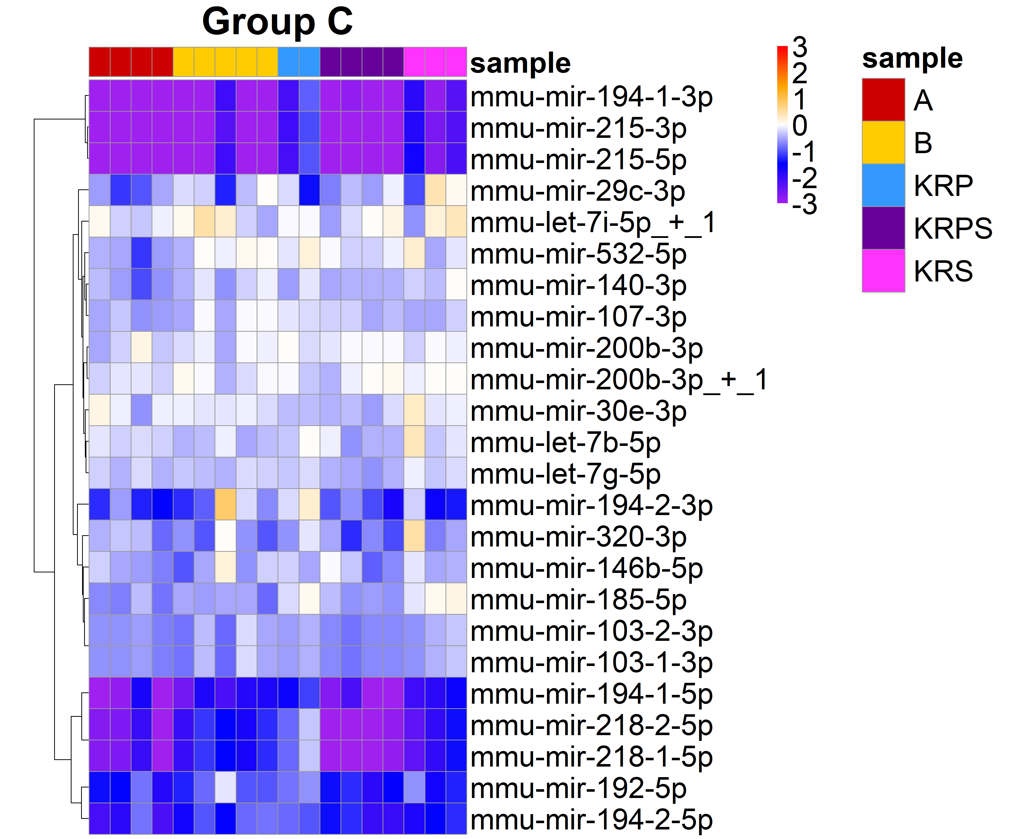
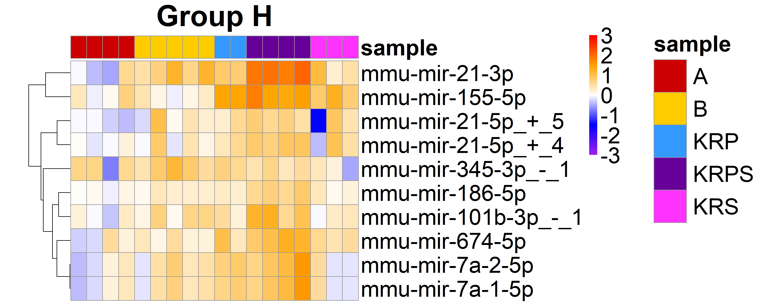
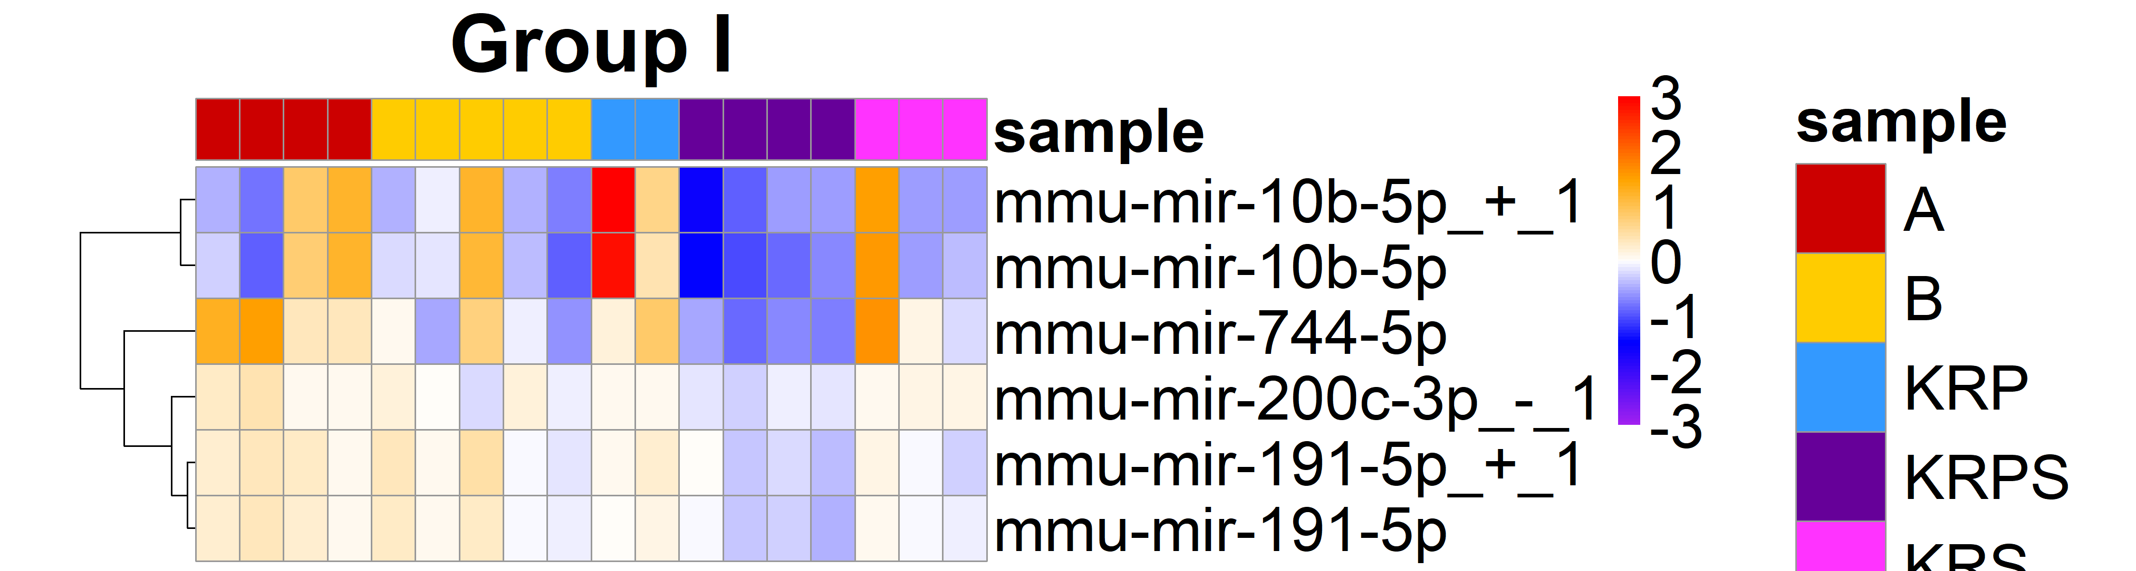
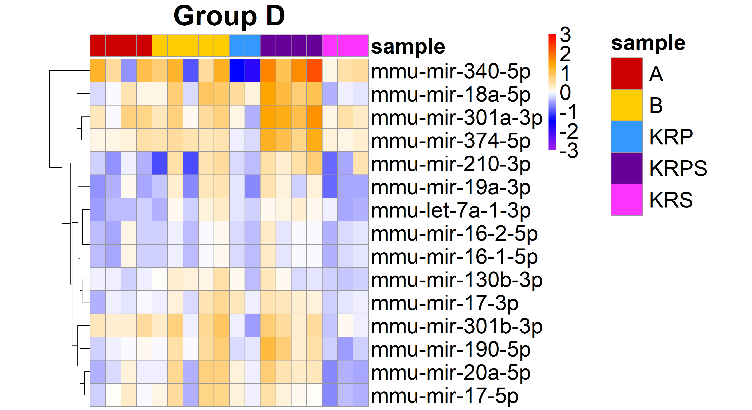
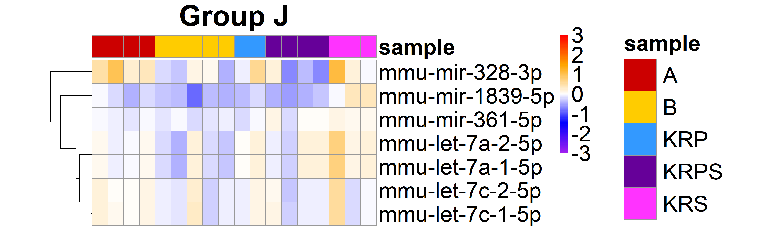
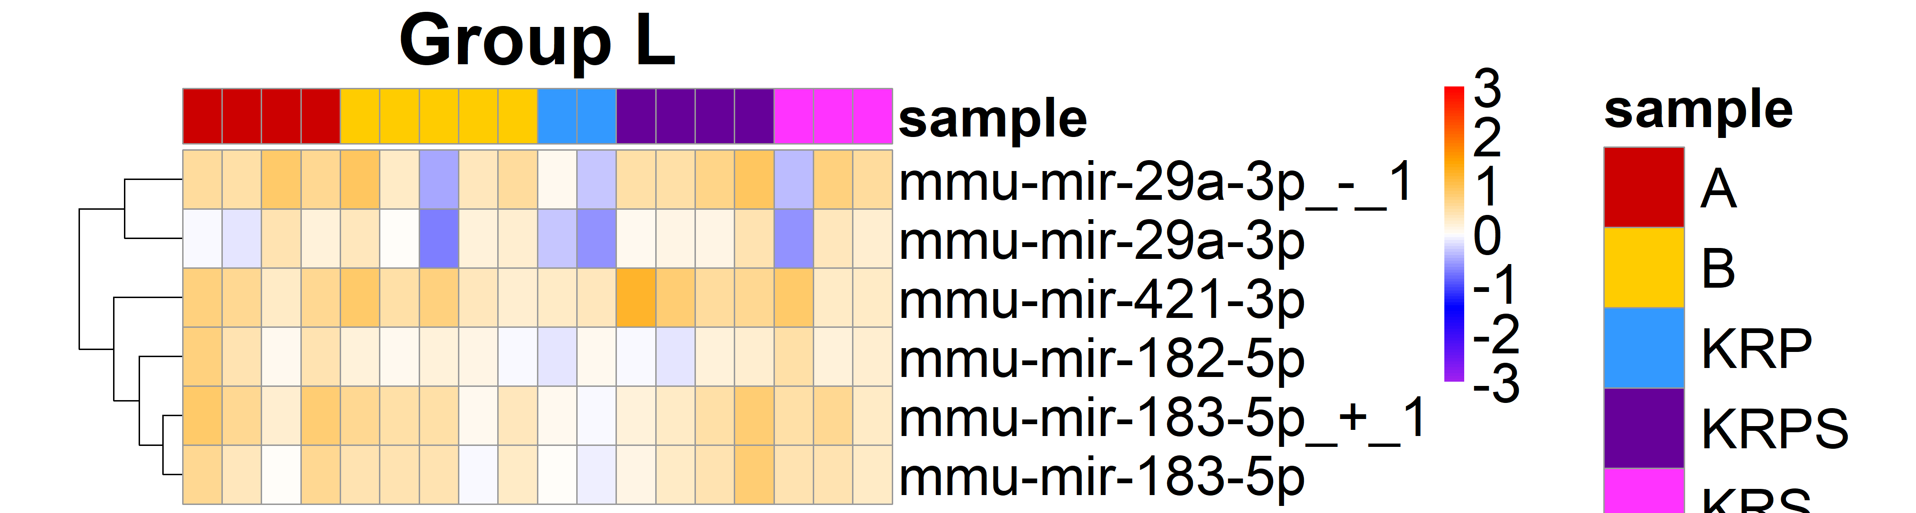
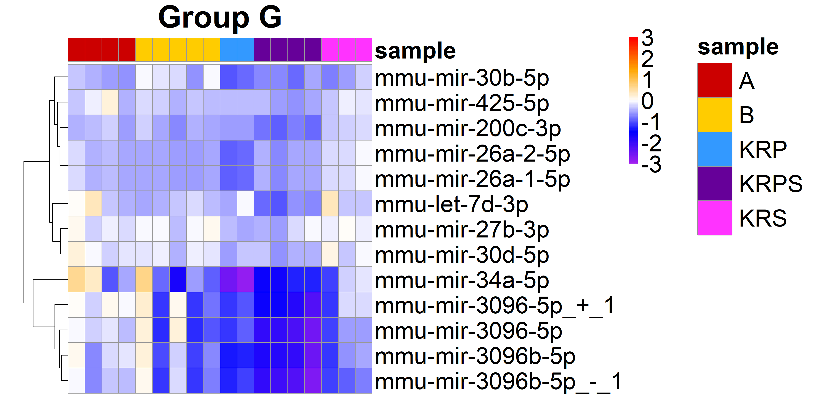
Rlog(sample) - Rlog(WT)
Rlog(sample) - Rlog(WT)
Rlog(sample) - Rlog(WT)
Rlog(sample) - Rlog(WT)
Rlog(sample) - Rlog(WT)
Rlog(sample) - Rlog(WT)
Rlog(sample) - Rlog(WT)
Notes:
Supplemental Figure 1: Heatmaps show the magnitude of change in miRNA expression relative to WT by subtracting rlog normalized miRNA expression for each enteroid sample by the rlog average WT expression. Groups not shown in the main text shown here. Color intensity rlog normalized miRNA expression in each genetically modified enteroid sample subtracted from average WT. Color scale minimum saturates at -3 and maximum saturates at 3.

Slide 8
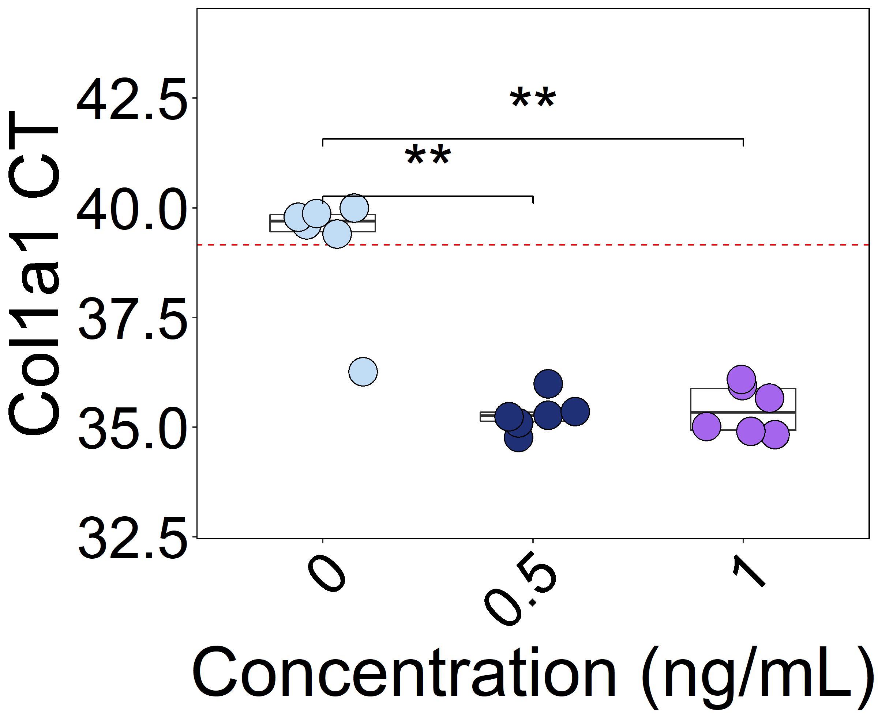
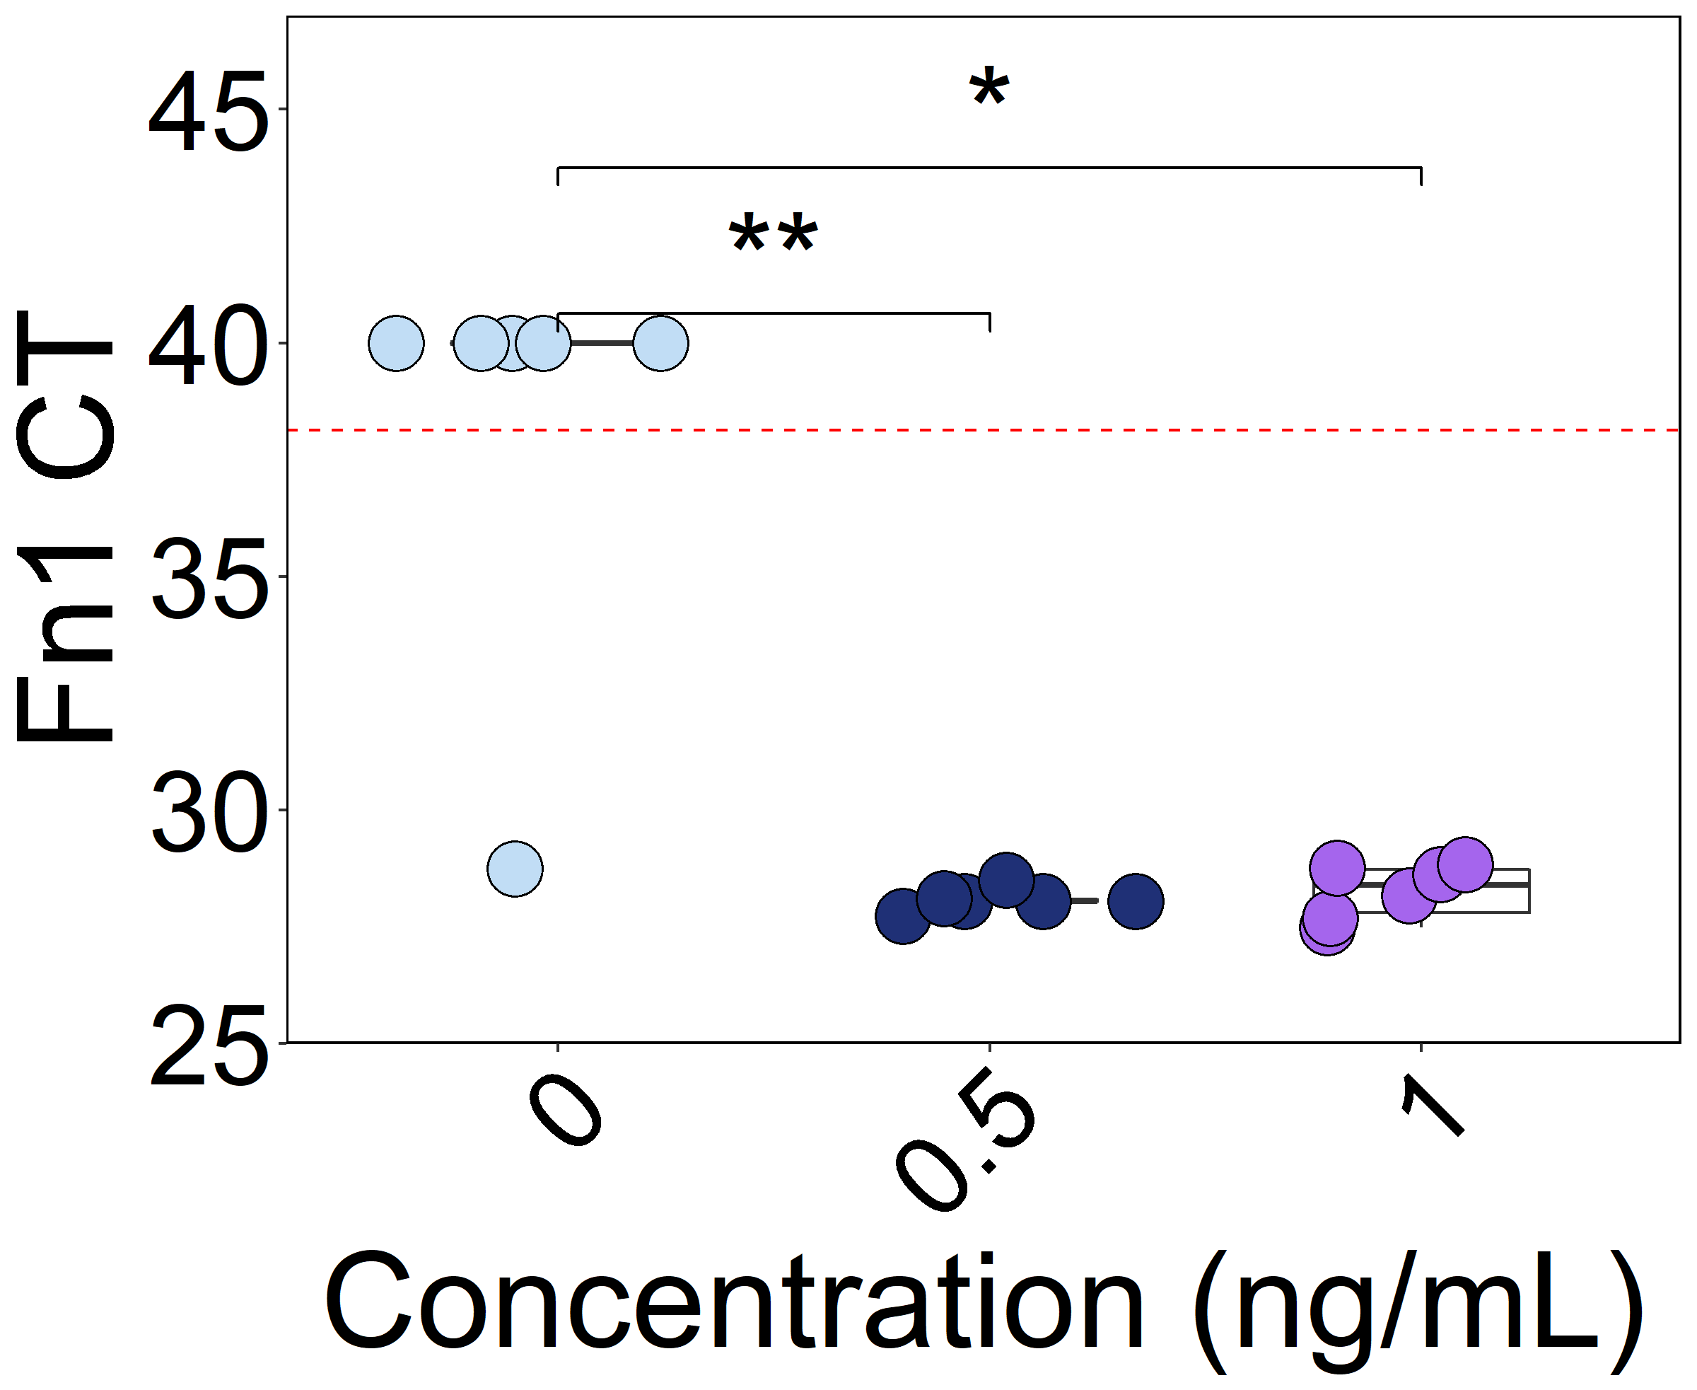
A
0 ng/mL
0.5 ng/mL
1 ng/mL
B
C
Notes:
Supplemental Figure 2: (A) Brightfield images of mouse enteroids treated with 0, 0.5, or 1 ng/mL recombinant human TGF-B1. (B) Col1a1 and (C) Fn1 CTs from RT-qPCR. In cases for which gene expression was not detected at 40 cycles, CT was set to 40 for analysis. Significance determined by two-sided Wilcoxon test. *p<0.05, **p<0.01, ***p<0.001.

Slide 9
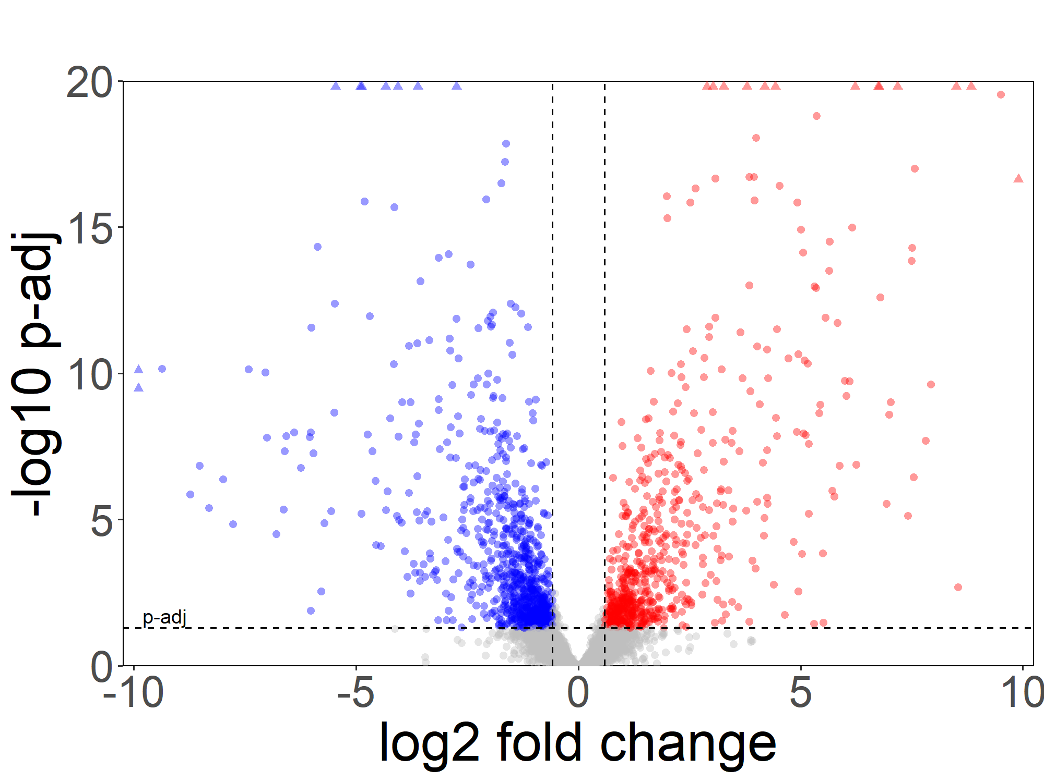
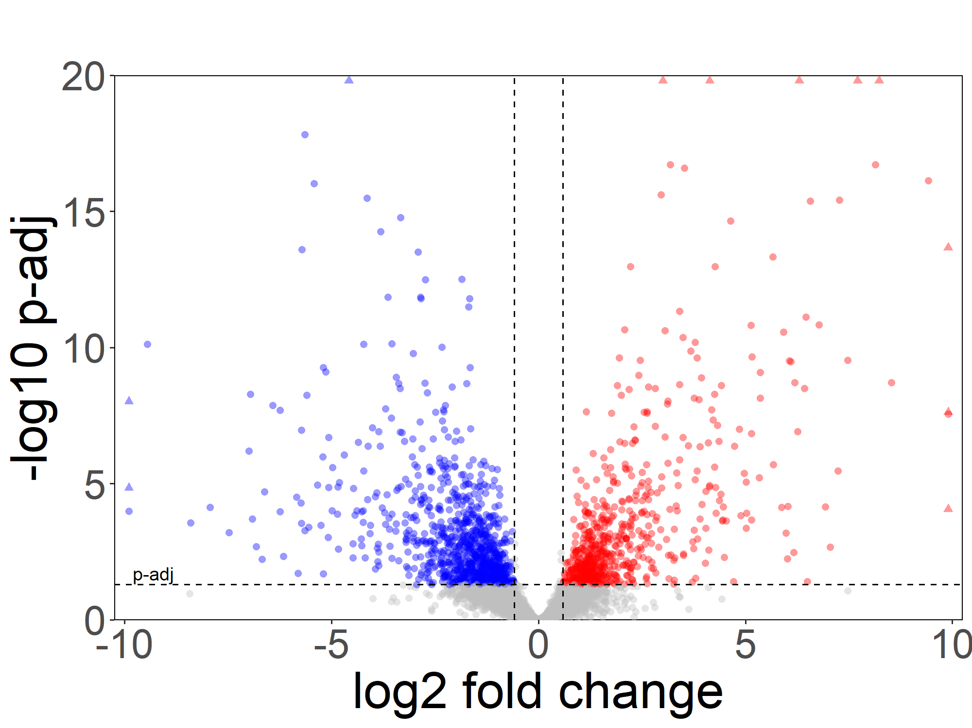
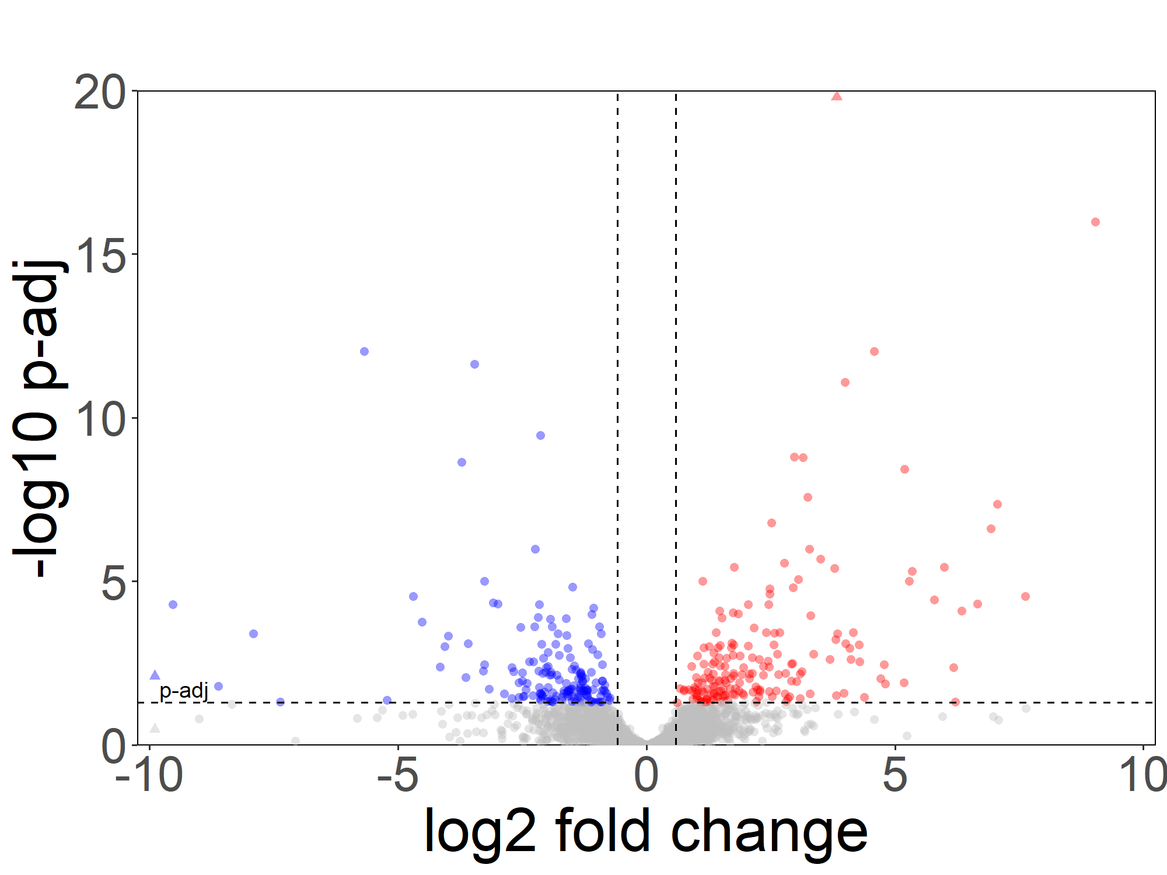
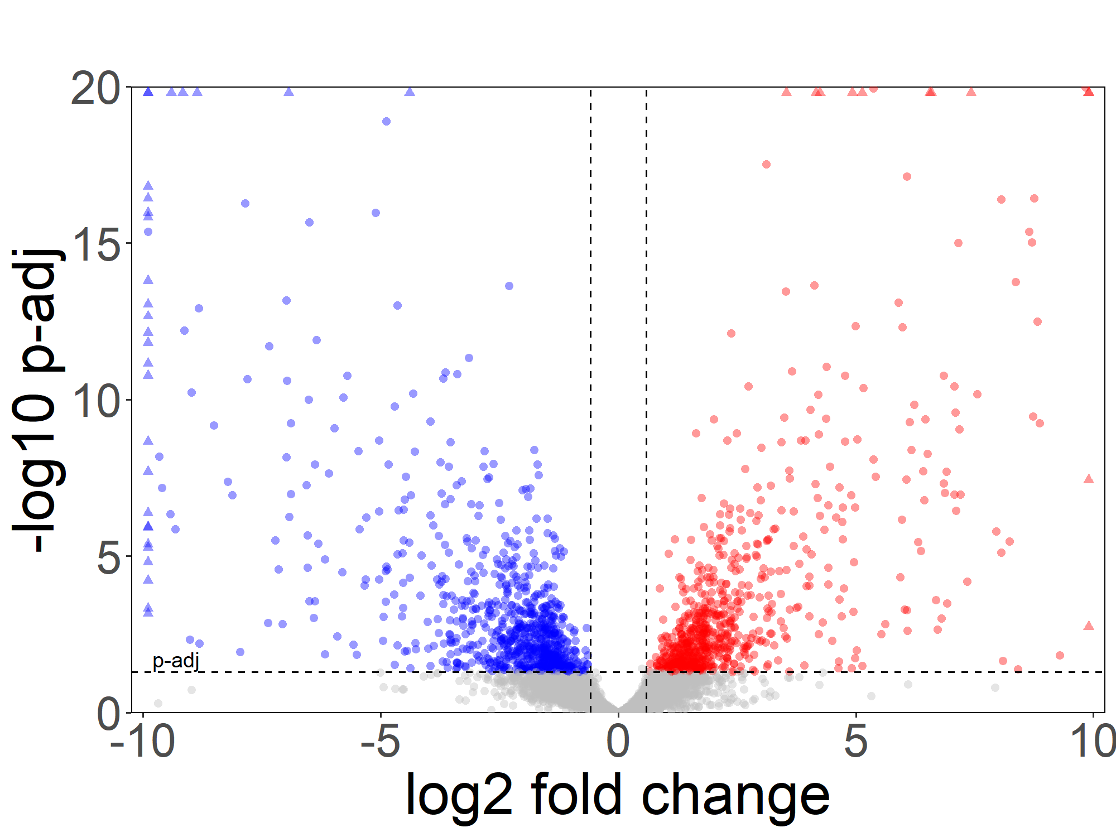
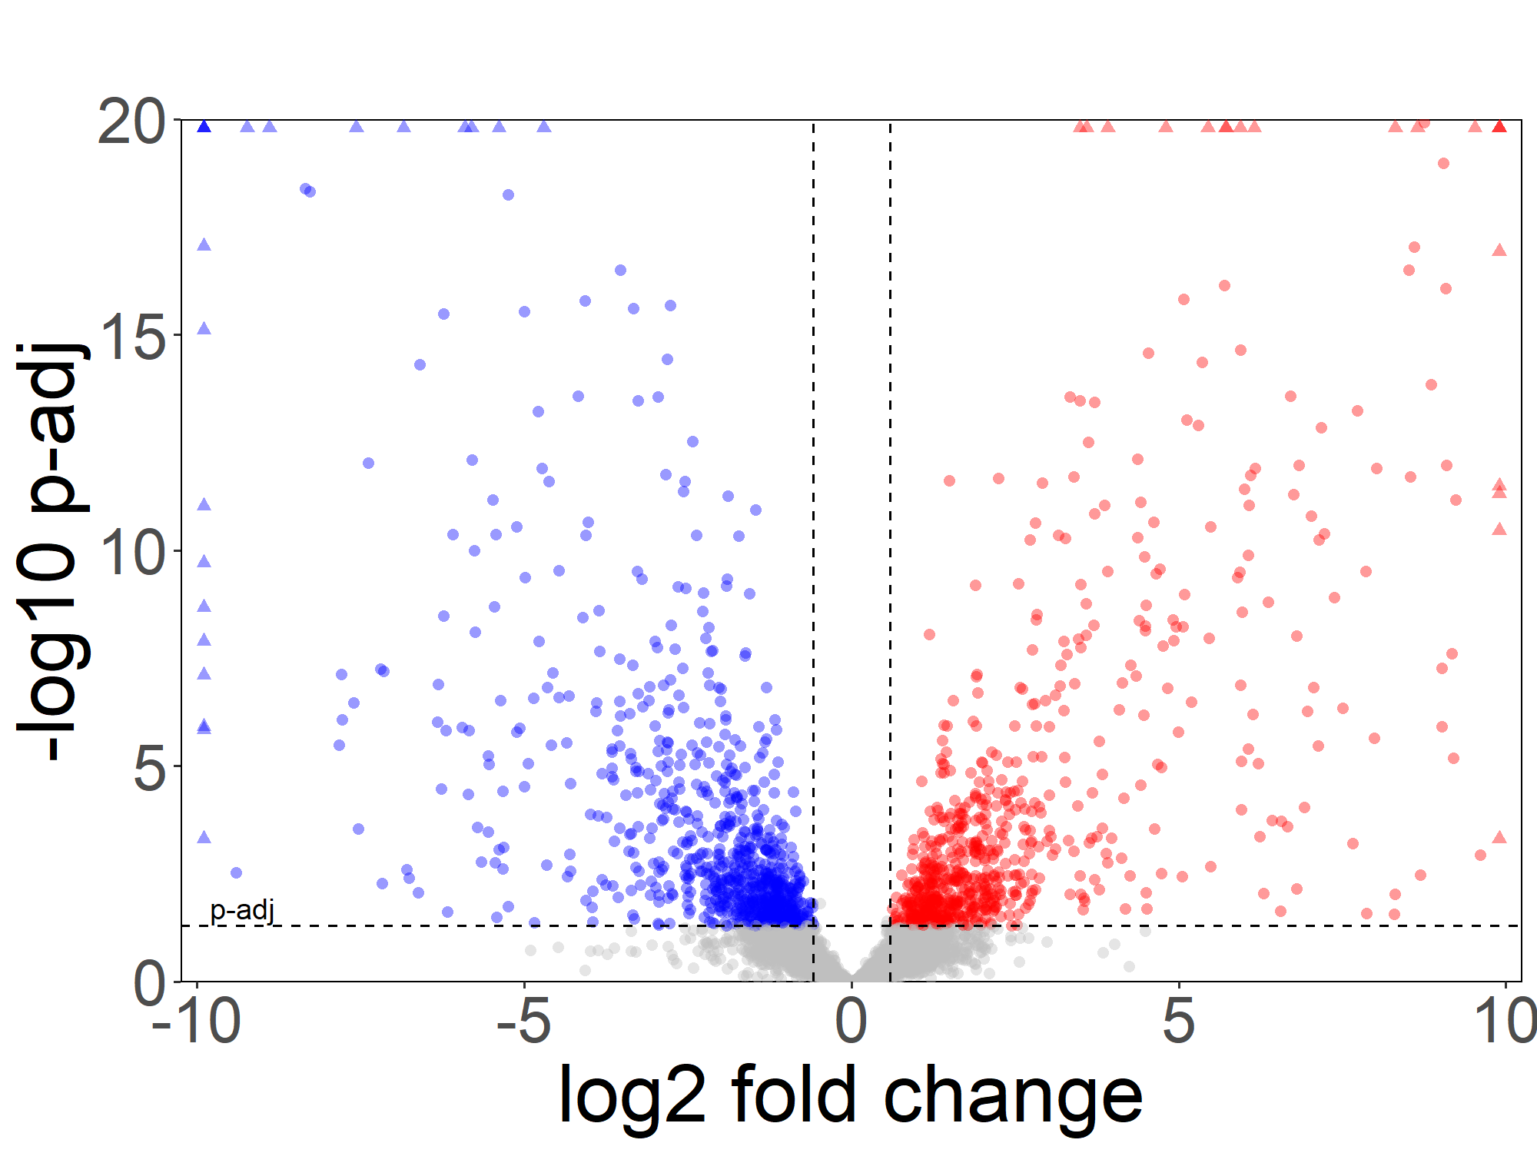
A
B
A vs WT
867
639
C
B vs WT
D
KRP vs WT
940
689
162
183
E
KRS vs WT
F
KRPS vs WT
818
713
840
710
Notes:
Supplemental Figure 3: (A) PCA plot generated using gene expression profiles generated from mutant mouse enteroids with wild-type controls. (B-F) Volcano plots highlighting differentially expressed genes in mutant mouse enteroids relative to WT control. Genes filtered for expression above 500 normalized counts in either condition. Horizontal dashed line represents p-adj cutoff of 0.05 (DESeq2). Vertical dashed lines represent 1.5x fold change.

Slide 10
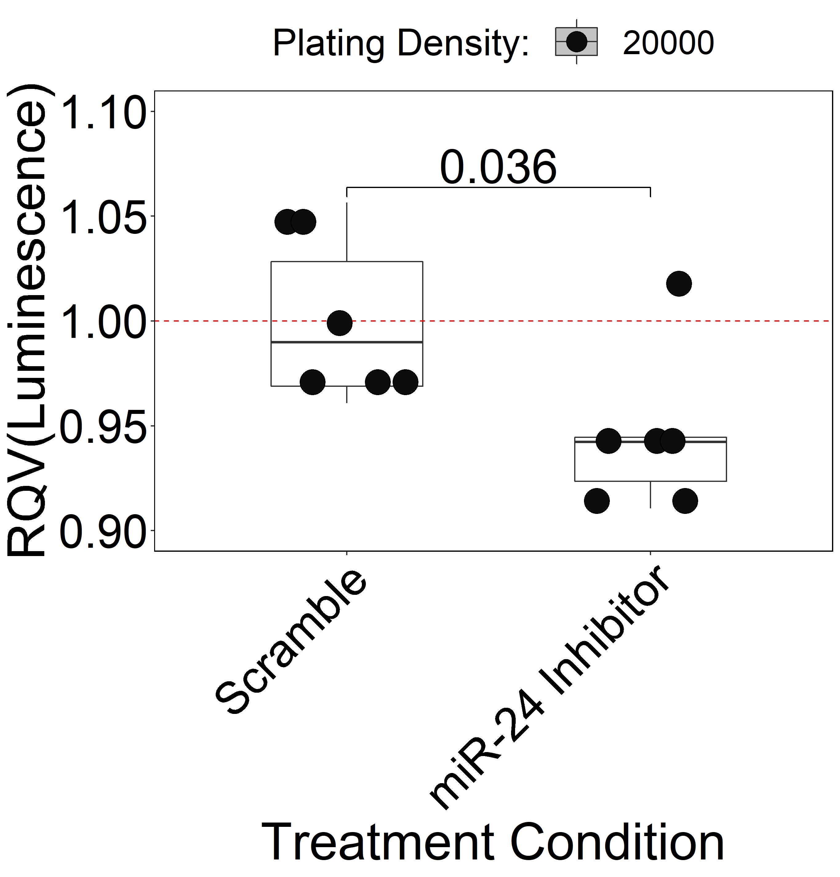
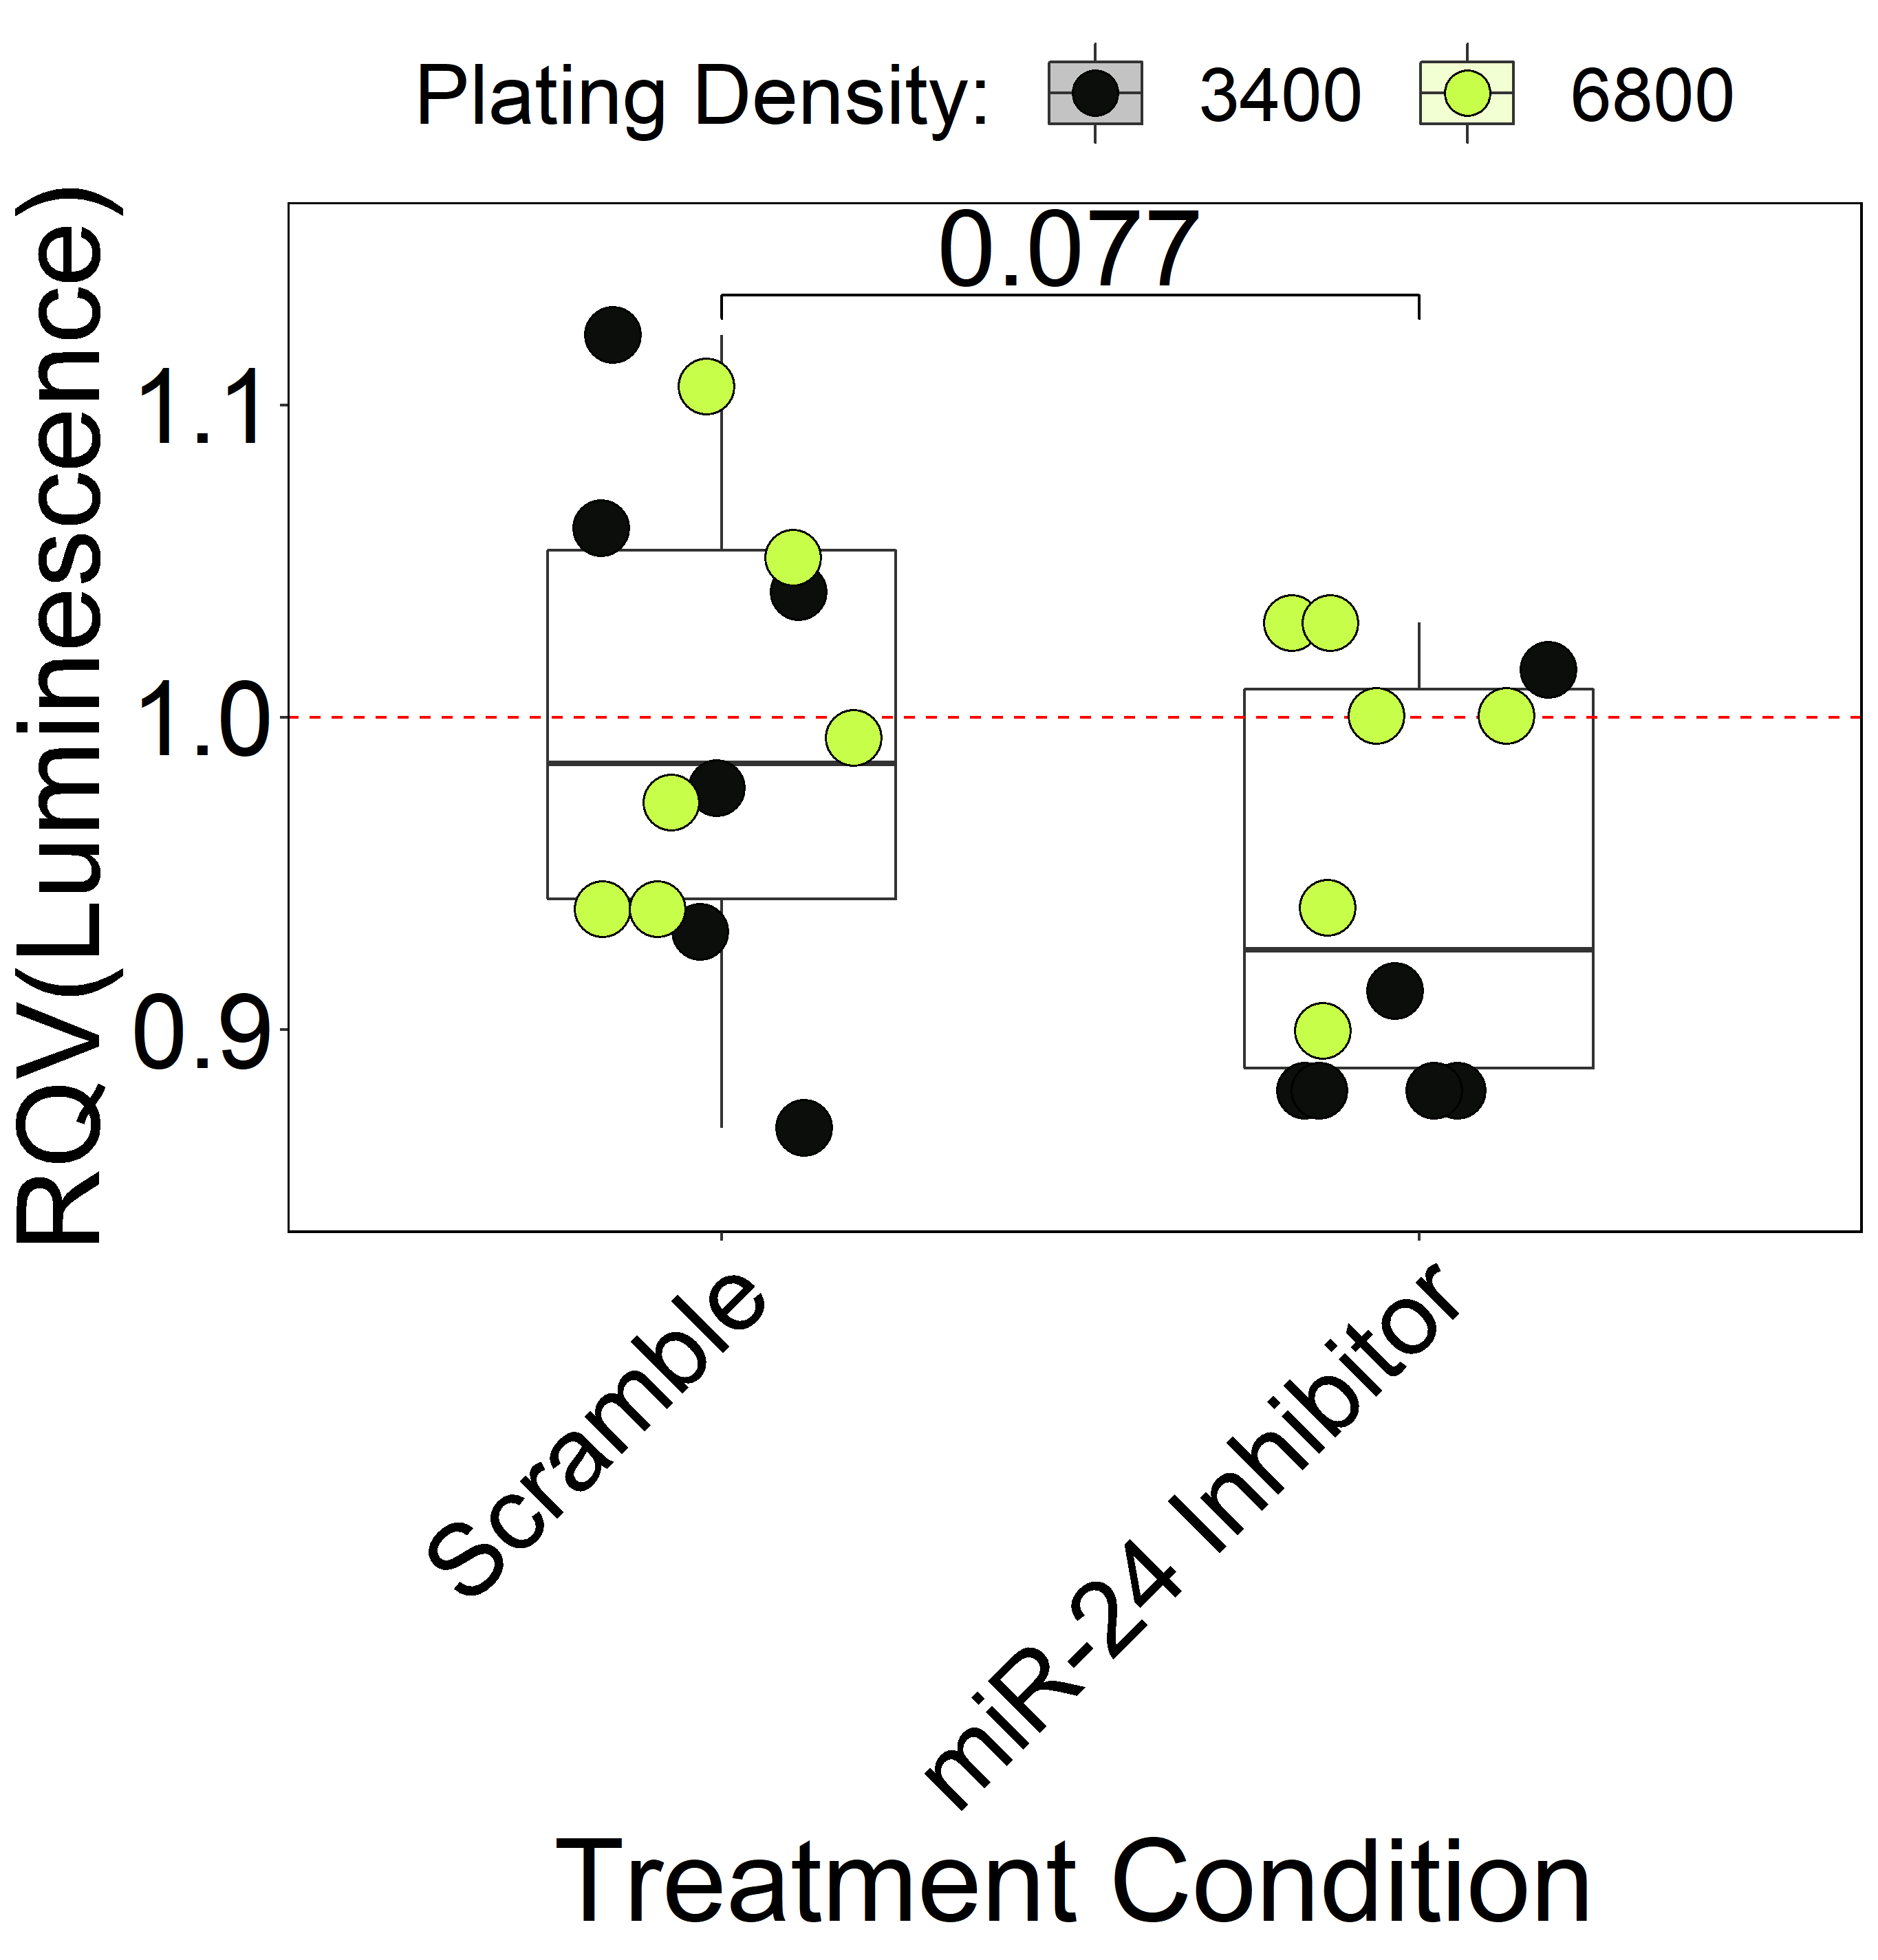
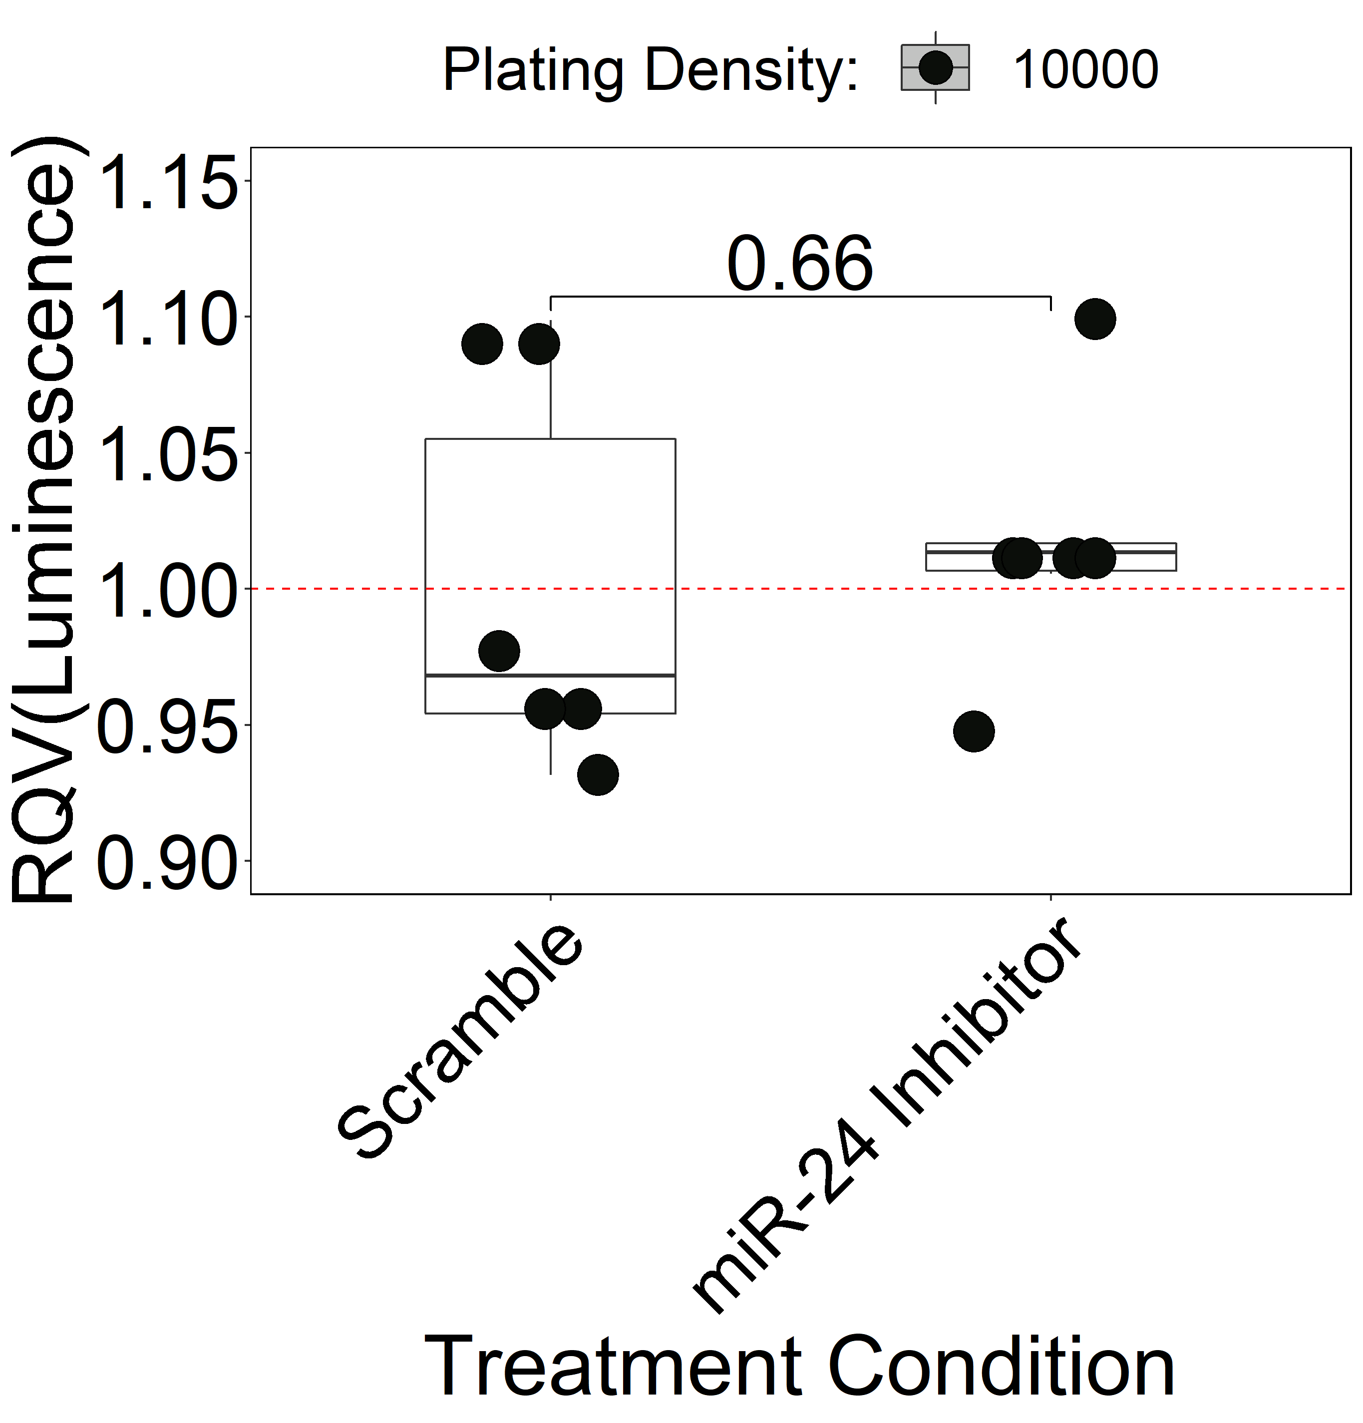
Supplement Figure 4
A
Caco-2
B
HT-29
C
SW48
Notes:
Supplemental Figure 4: Relative luminescent signal performed by the CellTiter-Glo assay after miR-24-3p inhibition in (A) Caco-2, (B) HT-29, and (C) SW48 colorectal cancer cell lines. Coloration represents the cell plating density in 96-well plates. Significance determined by two-tailed Welch t-test.

Slide 11
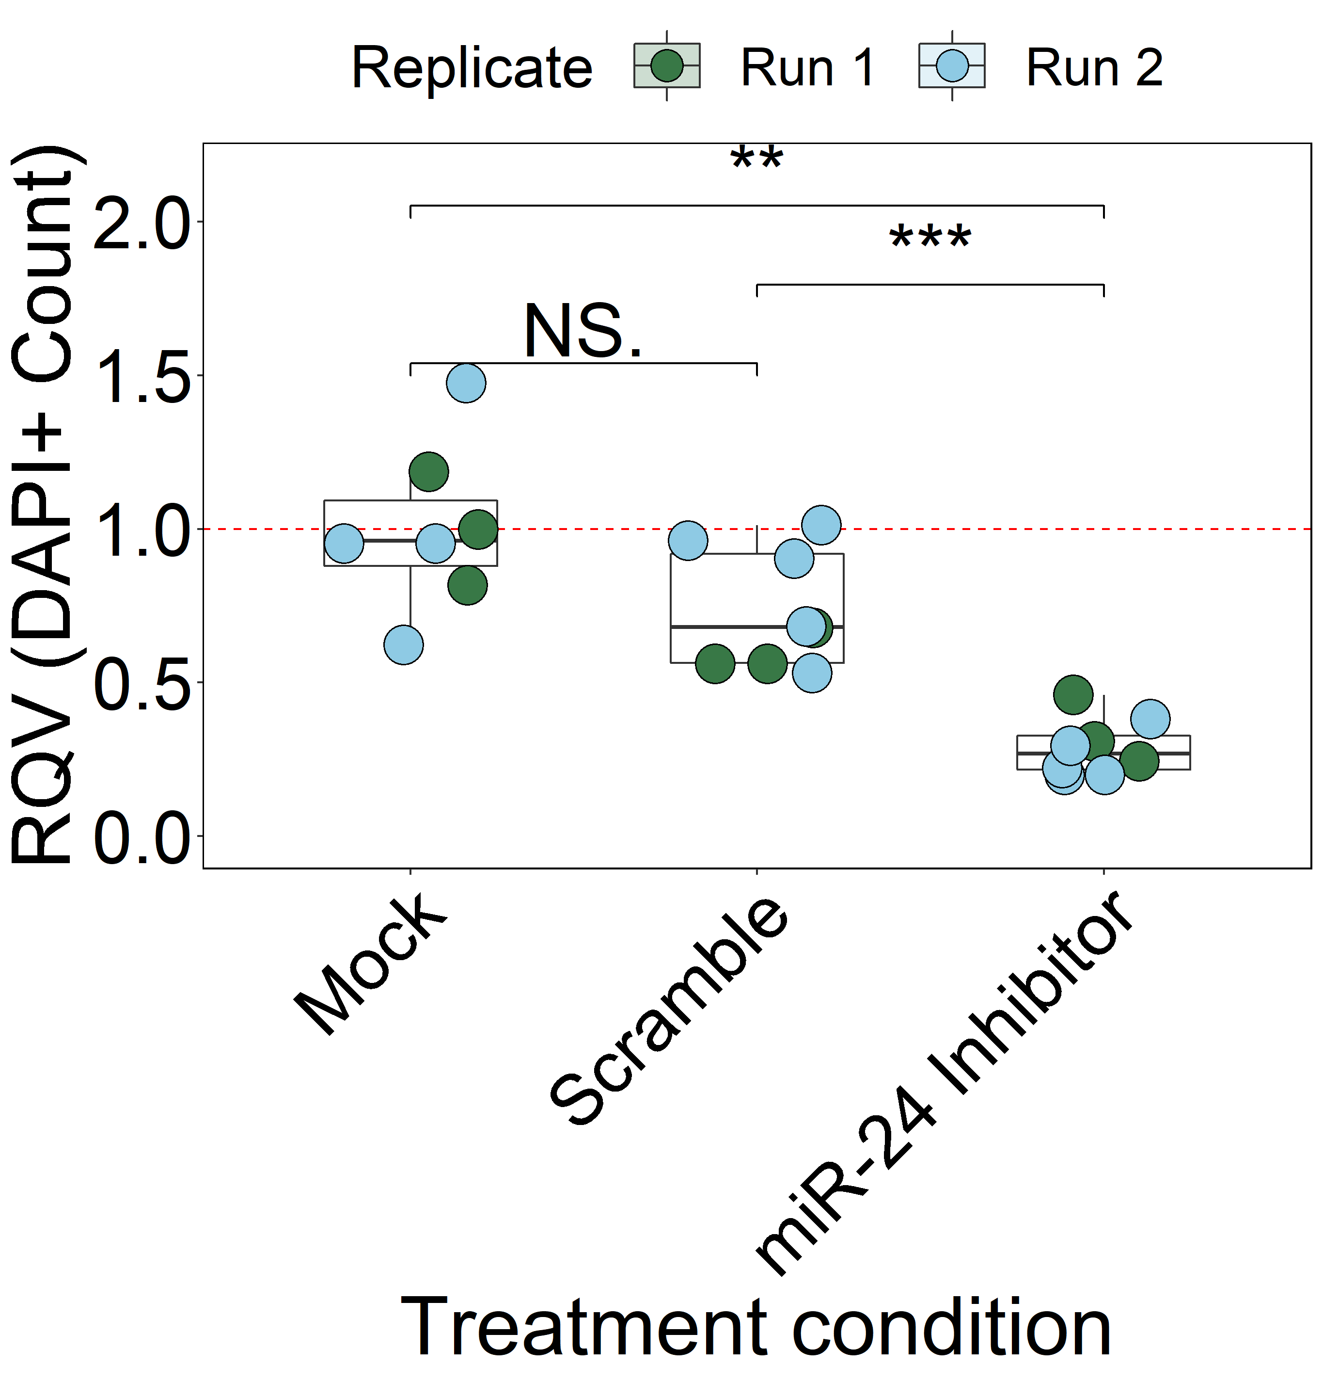
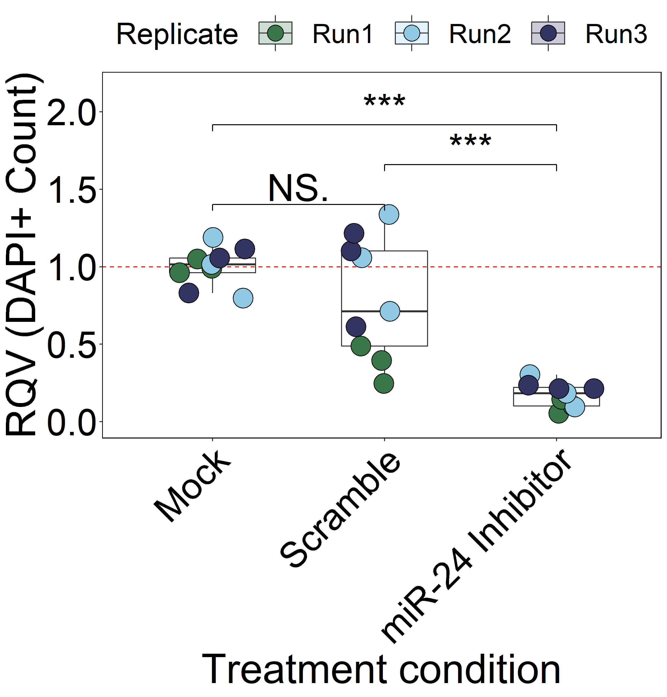
A
B
Notes:
Supplemental Figure 5: Relative number of DAPI+ HCT116 cells following mock, scramble or miR-24 inhibitor treatment from (A) EdU and (B) TUNEL experiments in Figure 5. Significance determined by two-sided Wilcoxon test. Color of data points represents experimental replicate. *p<0.05, **p<0.01, ***p<0.001.

Slide 12
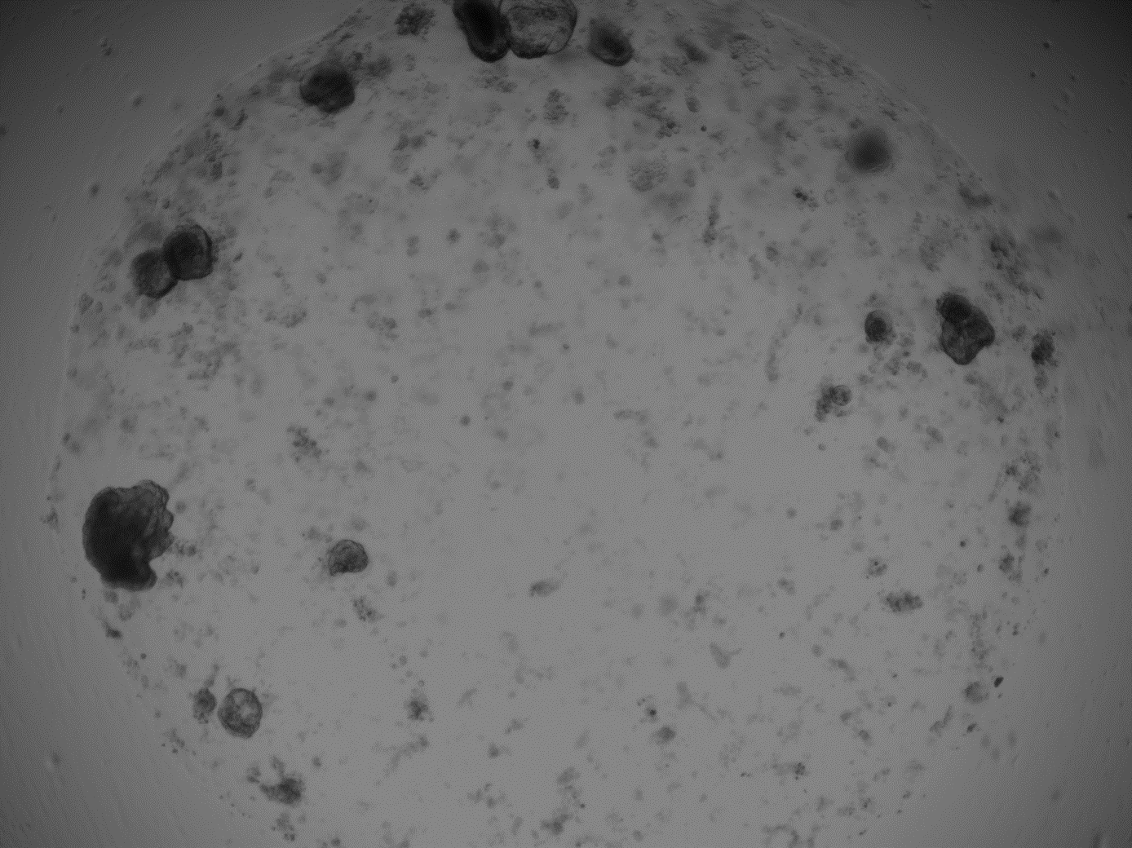
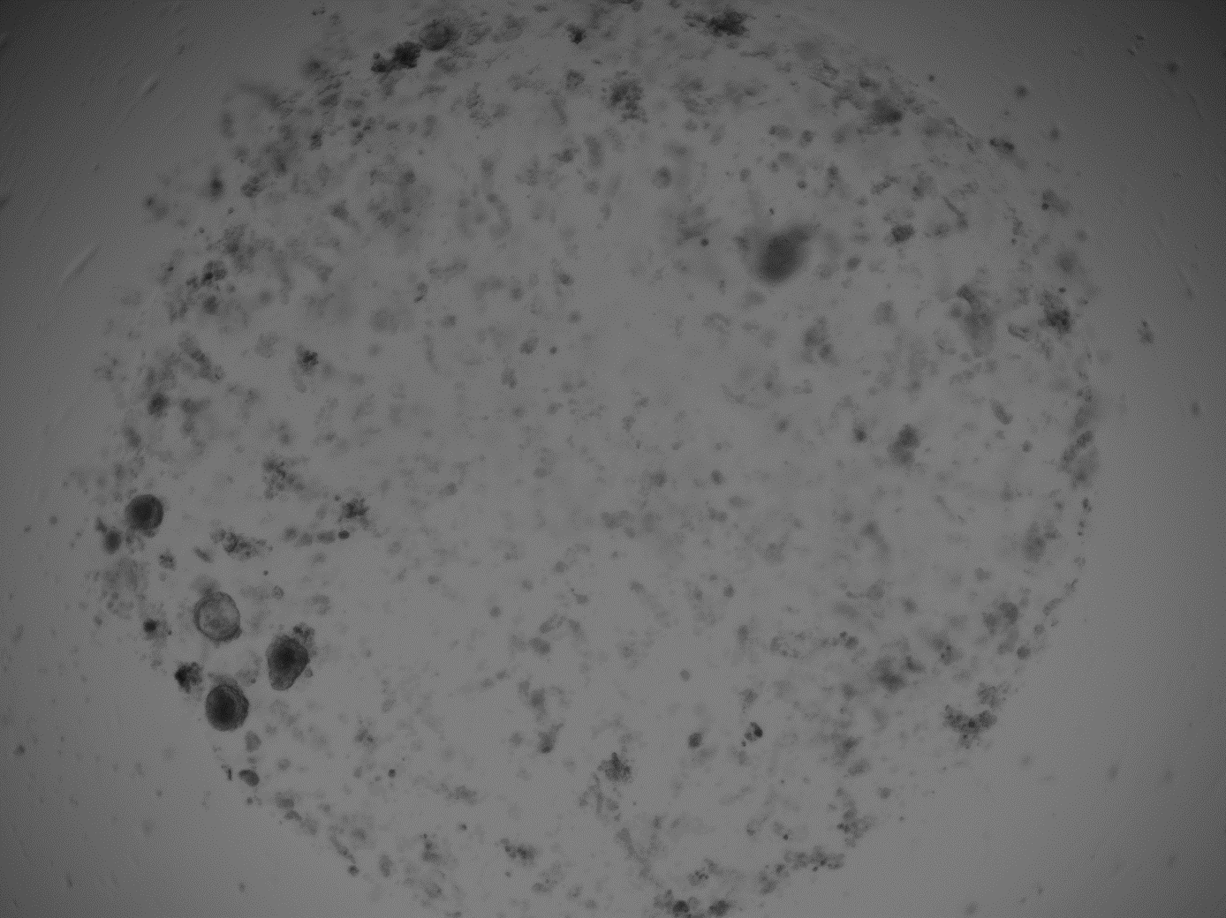
A
Scramblei
miR-24 Inhibitor
500 μm
500 μm
B
Scramblei
miR-24 Inhibitor
Notes:
Supplemental Figure 6: (A) Representative image of WT enteroid wells treated with scramble or miR-24 inhibitor and (B) representative image of a single enteroid treated with scramble or miR-24 inhibitor from a second experimental replicate.

Slide 13
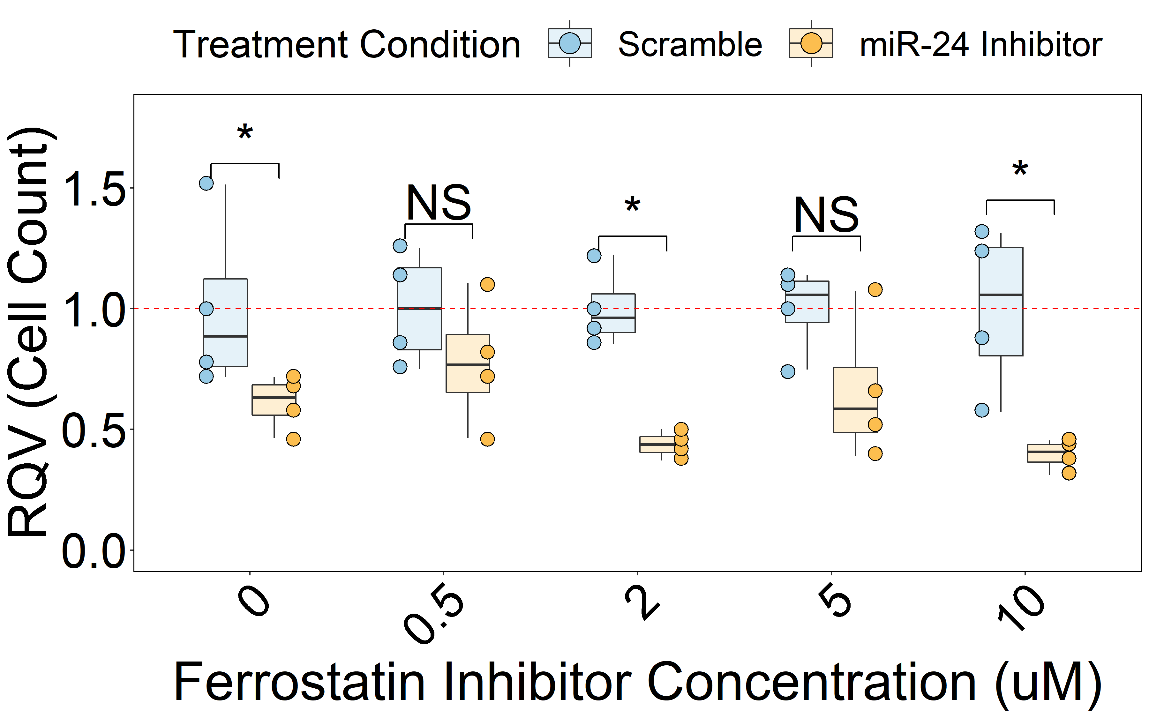
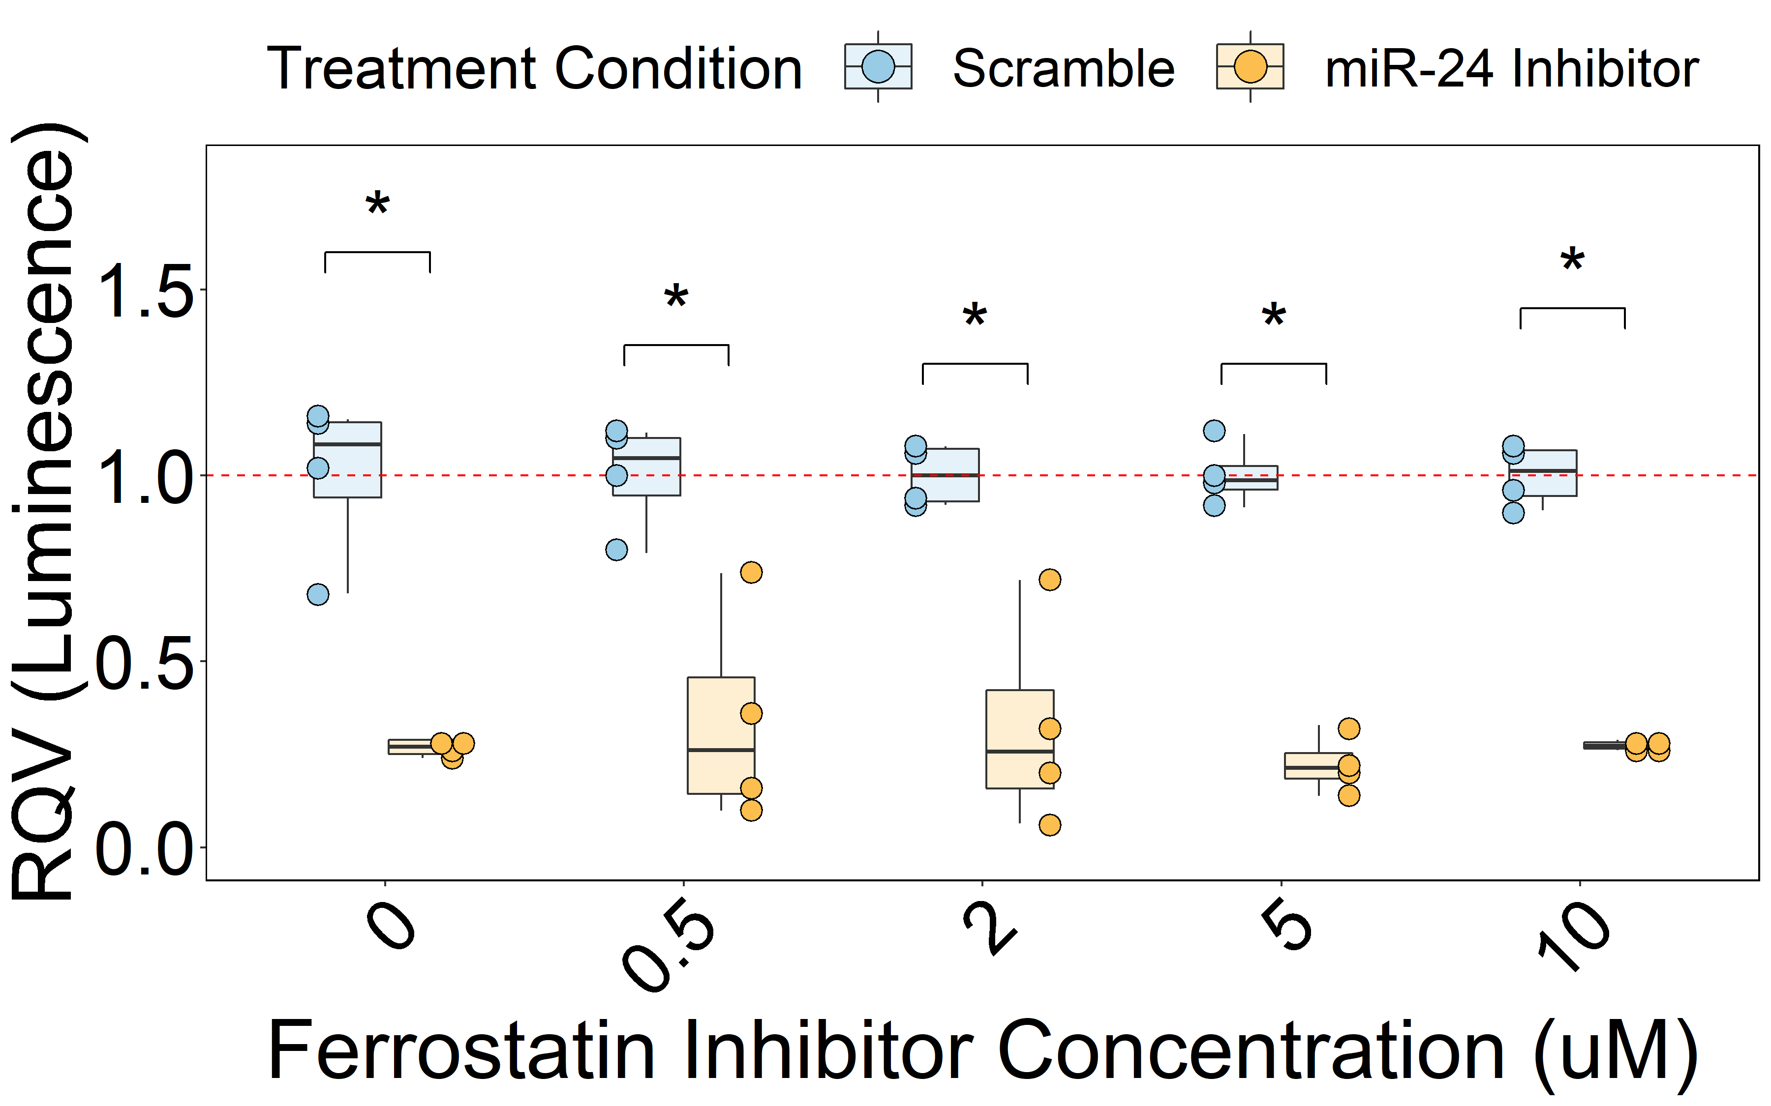
A
B
Notes:
Supplemental Figure 7: (A) Cell count and (B) CellTiter-glo assays following transfection of HCT116 cells with miR-24 inhibitor or scramble along with 0, 0.5, 2, 5, or 10 µM ferrostatin-1. Significance determined by two-sided Wilcoxon test. *p<0.05, **p<0.01, ***p<0.001.

