Slide 1
Table of contents
Page 2 | Fig. S1. Analysis workflow of RNA-seq (a) and WES data sets (b).
Page 3−5 | Fig. S2. Illustration of filtering novel transcript isoform in 2nd and 3rd filtering steps.
Page 6 | Fig. S3. Alternative splicing events considered in this study.
Page 7 | Fig. S4. Example page of a selected sample (CMT-013) showing transcriptome (left) and SNP data (right) for ERBB2 gene.
Page 8 | Fig. S5. Comparison results of gene- and transcript-level expression (left), and transcript isoform structures (right) between dog and human.
Page 9 | Fig. S6. Inference results of three pure breeds (Maltese (MALT; a), Shih Tzu (SHIH; b), and Yorkshire Terrier (YORK; c)) with 150,131 SNPs.
Page 10 | Fig. S7. Count of alternative splicing events in tumor condition (orange) compared to normal (blue).
Page 11 | Fig. S8. Comparison results of alternative splicing events between normal and tumor conditions for a selected gene (TGFB1).
Page 12 | Fig. S9. Nucleotide sequence comparison of transcript isoforms between dog and human
Page 13 | Fig. S10. Gene expression similarities between dog and human in tumor (A; TCGA project) and normal conditions (B; GTEx project)

Slide 2
a
RNA-seq data analysis pipeline
b
WES data analysis pipeline
Read alignment
FASTQ
BAM
TOPHAT2
RNA-seq
(FASTQ)
Reference
(FASTA)
Annotation
(GTF)
REF
(FASTA)
GTF
Junctions
BED
WES
(FASTQ)
Reference
(FASTA)
StringTie
merged.gtf
Core processing unit
Transcriptome reconstruction
transcrpt.gtf
StringTie
--merge
BWA-mem
VCF
1st filtering step
1st filtering
strand-based filtering
1st filtered.gtf
Output GTF
WES
BAM
VEP
REF
(FASTA)
RSEM
-prepare-ref
transcript reference
No
Reached
a threshold?
Expression quantification
Yes
FASTQ
RSEM
-calculate-exp
Expression level
Samtools mpileup
VCF
annotated
Varscan2
Modification of output GTF
(tumor condition only)
2nd filtering
Expression-based filtering
Gene mapping-based filtering
VCFtools
2nd & 3rd filtering steps
Final expression quantification
3rd filtering
Exon/junction-based filtering
Output GTF
Fig. S1. Analysis workflow of RNA-seq (a) and WES data sets (b).

Slide 3
a
Expression-based filtering of the novel transcript isoform in the 2nd filtering step
Condition | Transcript | No. of samples in which the transcript was identified
Normal | A | 60 of 64 samples | Passed
 | B | 31 of 64 samples | Passed
 | C | 10 of 64 samples | Passed
 | D | 9 of 64 samples | Not passed
 | E | 3 of 64 samples | Not passed
Tumor | A | 150 of 158 samples | Passed
 | B | 41 of 158 samples | Passed
 | C | 10 of 158 samples | Passed
 | D | 9 of 158 samples | Not passed
 | E | 3 of 158 samples | Not passed
Novel transcript isoforms expressed in < 10 samples
Filter out
b
Gene-mapping-based filtering of the novel transcript isoform in the 2nd filtering step
Gene A
Gene B
Known transcript 1
Gene mapping confidence
Known transcript 2
Novel transcript 1
*
*
→ High
Novel transcript 2
*
*
→ High
Novel transcript 3
*
→ Medium
Gene mapped
Novel transcript 4
→ Low
Novel transcript 5
> 30% overlap
→ Low
Novel transcript 5
≤ 30% overlap
→ Less mapped
Novel transcript 7
Intergenic region
→ Unmapped
Filter out
Novel transcript 6
*
*
*
*
→ Fused
Fig. S2. Illustration of filtering novel transcript isoform in 2nd and 3rd filtering steps.

Slide 4
c
Exon-based filtering of the novel transcript isoform in the 3rd filtering step
(1) Examine per-base depth in each exon
(2) Determine confidence of all exons in a novel transcript isoform
(3) Filtering of novel transcript isoforms
Exon of a novel transcript | Length (A) | No. of positions satisfying thresholds for depth |  |  | Breadth (B/A) | Exon confidence
 |  | 1X (B) | 5X | 10X
A | 100 | 100 | 100 | 100 | 100% | High
B | 100 | 100 | 100 | 0 | 100% | Medium
C | 100 | 100 | 0 | 0 | 100% | Low
D | 100 | 90 | 0 | 0 | 90% | Very_low
E | 100 | 80 | 0 | 0 | 80% | Not passed
Minimum exon confidence | No. of supporting samples
High | ≥10
Medium | ≥10
Low | ≥10
Very_low | ≥10
Not passed
BAM
Exon 1
Intron 1
Exon 2
Per-base depth
Per-base depth
Per-base depth in each exon was calculated by using the “Mosdepth” program.
Filter out
Fig. S2. Illustration of filtering novel transcript isoform in 2nd and 3rd filtering steps. (continued)

Slide 5
d
Junction-based filtering of the novel transcript isoform in the 3rd filtering step
(1) Identification of the novel junctions for each transcript isoform
Known transcript 1
Known transcript 2
Novel transcript 1
Novel transcript 2
Examine per-base depth in each exon and spliced reads at each junction
Novel transcript 3
Novel transcript 4
Novel transcript 5
No novel junction
Filter out
Novel exons
Novel junctions
(2-1) Examine spliced reads at each junction
(2-2) Determination of confidence at all junctions in a novel transcript isoform
(2-3) Filtering of novel transcript isoforms
TOPHAT2
BED (Junctions)
No. of supporting samples | SR5 counts | Junction confidence
≥ 10 | ≥ 10 | High
 | ≥ 5 & < 10 | Medium
 | < 5 | Low
< 10 |  | Not passed
Minimum junction confidence
High
Medium
Low
Not passed
Exon 1
Intron 1
Exon 2
Sample 1:
Spliced read
SR5 count means the number of supporting samples with ≥ 5 spliced reads at a junction.
Filter out
107/146(73.3%)
107/135(79.3%)
⋅⋅⋅
⋅⋅⋅
Number of spliced reads / Total depth
Fig. S2. Illustration of filtering novel transcript isoform in 2nd and 3rd filtering steps. (continued)

Slide 6
Alternative promoters
(APR)
Alternative polyadenylation
(APA)
pA
pA
Alternative 5’ splice site
(A5SS)
Alternative 3’ splice site
(A3SS)
Cassette exon
(CE)
Cryptic exon
(CRE)
Retained intron
(RI)
Cryptic intron
(CRI)
Mutually exclusive exons
(ME)
Upper: splicing of reference transcript
Lower: splicing of test transcript
Fig. S3. Alternative splicing events considered in this study.

Slide 7
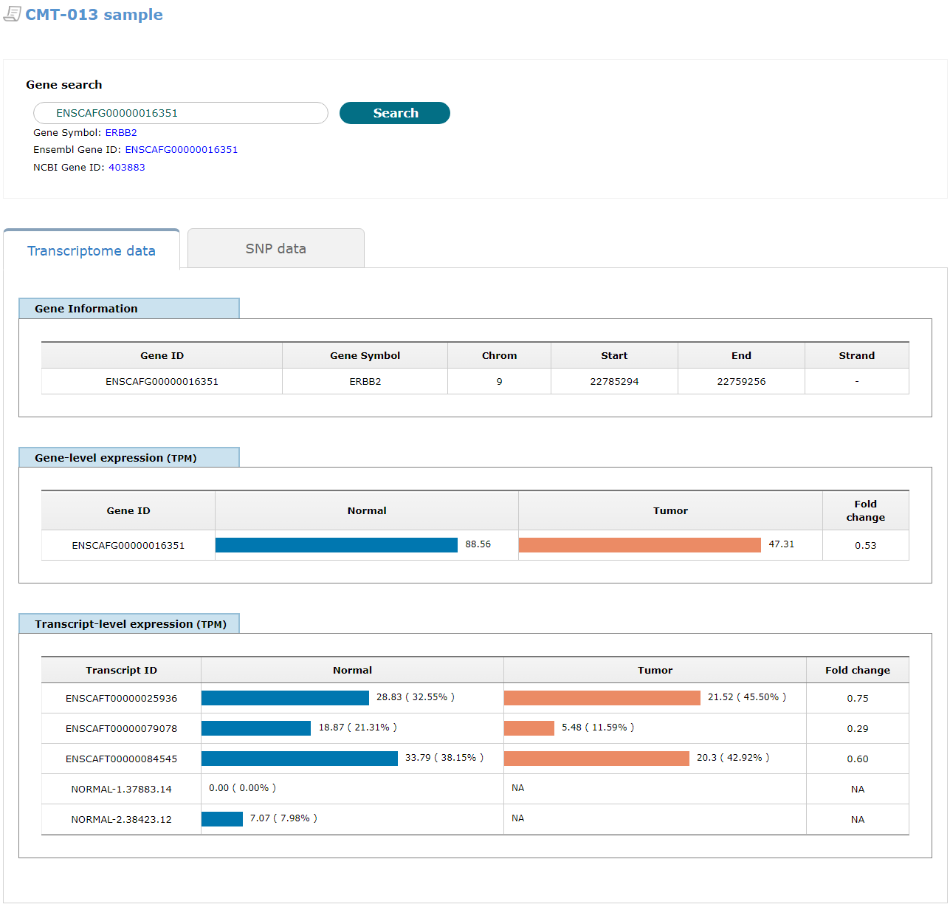
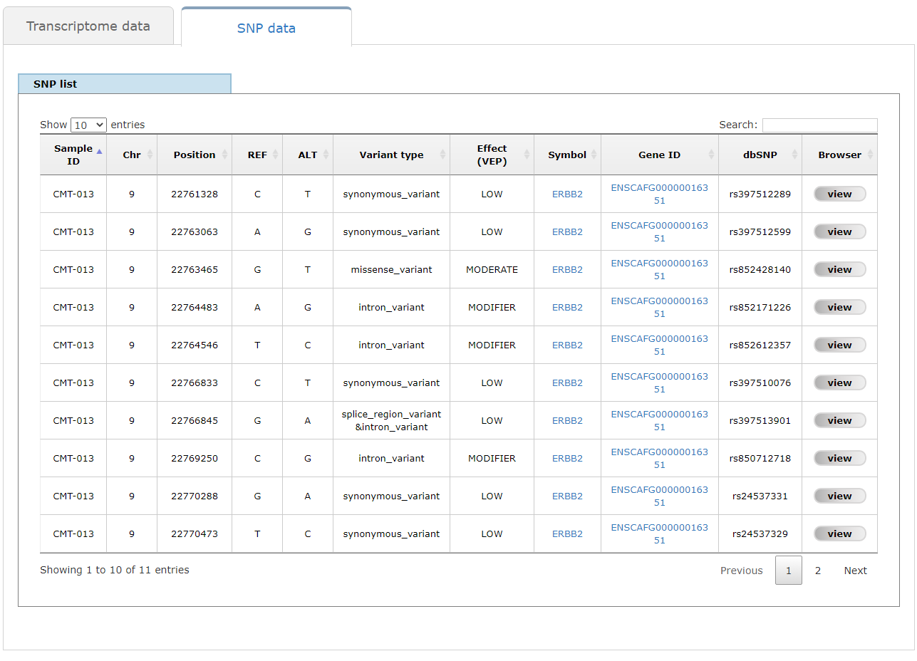
Fig. S4. Example page of a selected sample (CMT-013) showing transcriptome (left) and SNP data (right) for ERBB2 gene.

Slide 8
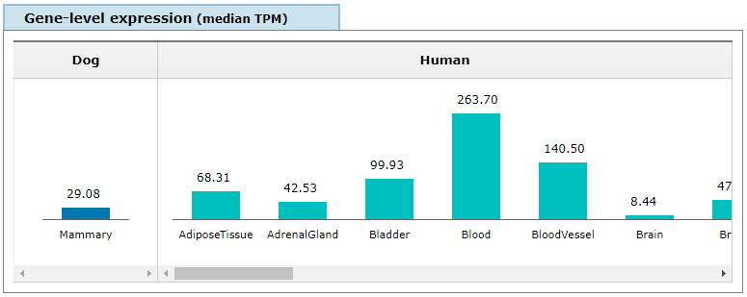
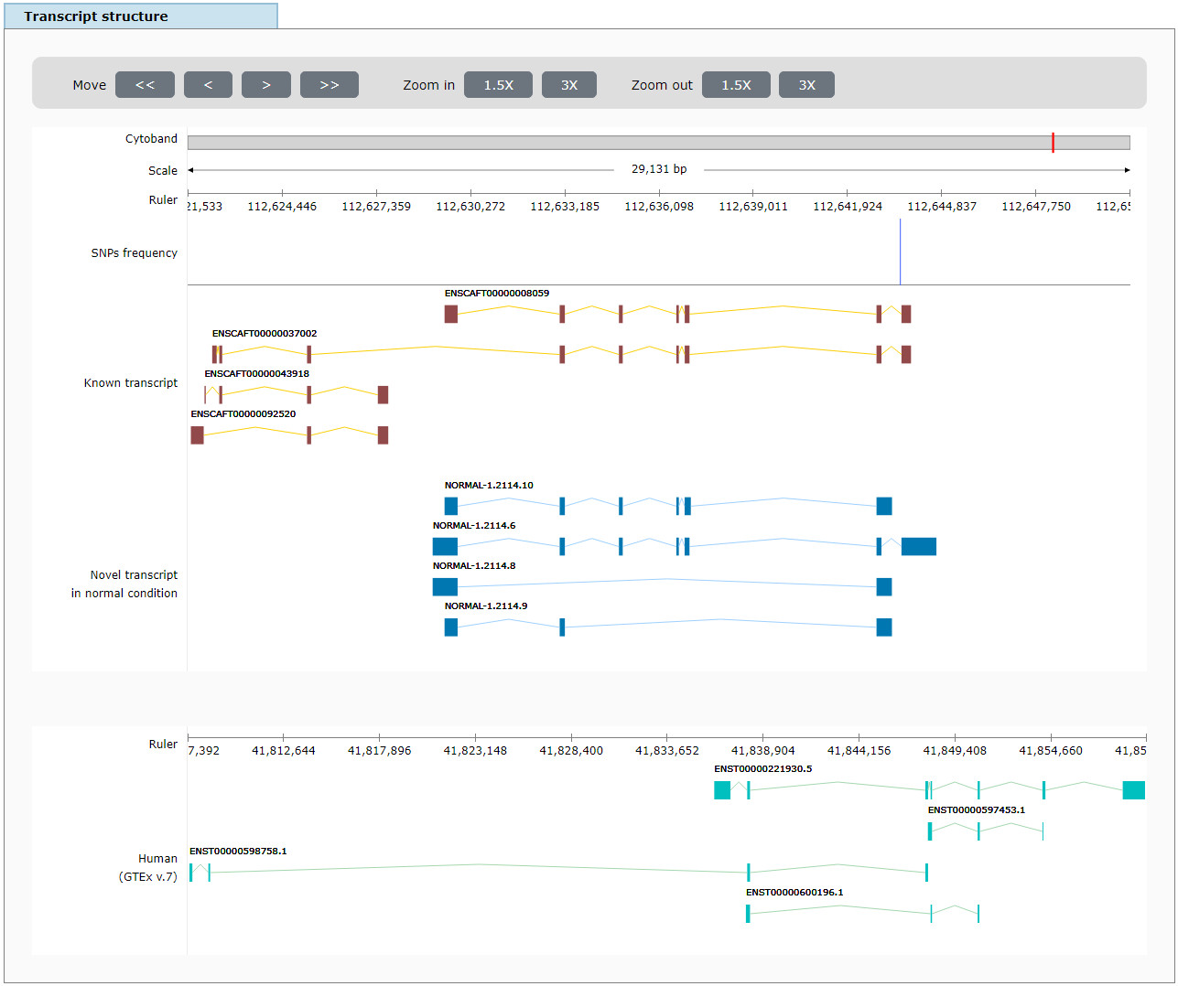
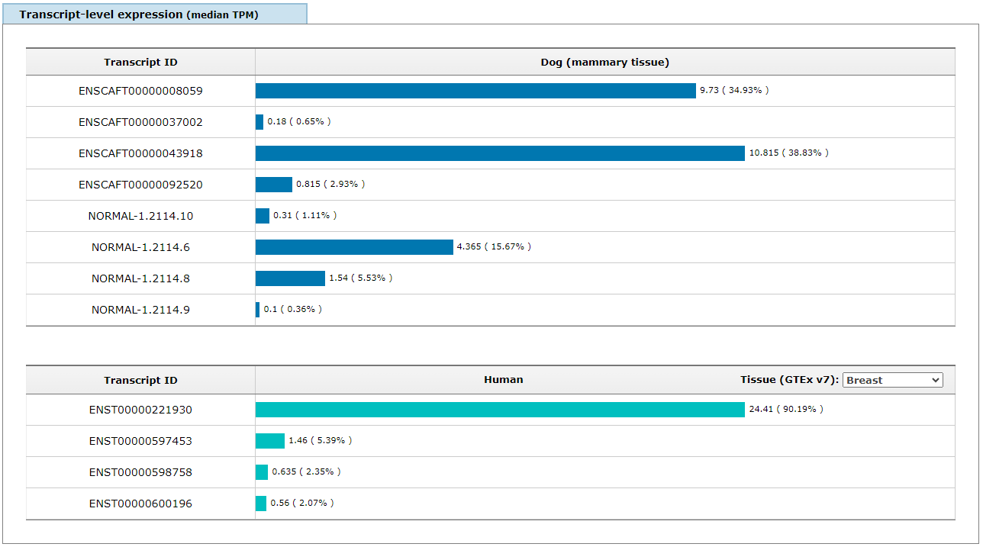
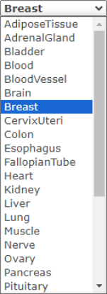
a. Gene-level expression of the TGFB1 gene between dogs and humans
c. Transcript isoforms of the TGFB1 gene between dogs and humans
b. Transcript-level expression of the TGFB1 gene between dogs and humans
Known transcripts
(dog)
Known transcripts (dog)
Novel transcripts in normal condition
(dog)
Novel transcripts (dog)
Known transcripts (human)
Known transcripts (human)
Fig. S5. Comparison results of gene- and transcript-level expression (left), and transcript isoform structures (right) between dog and human.

Slide 9
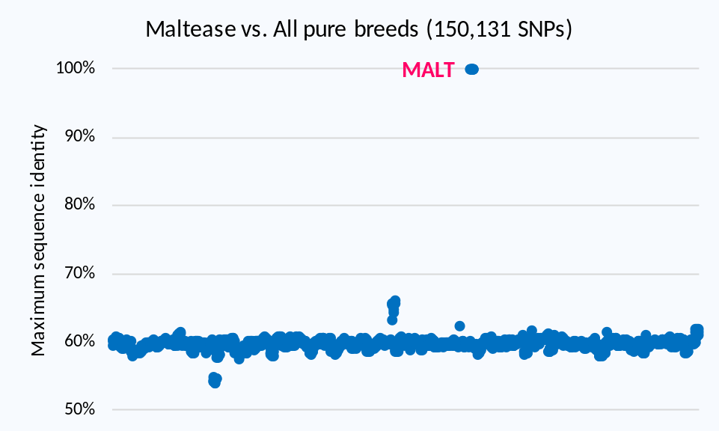
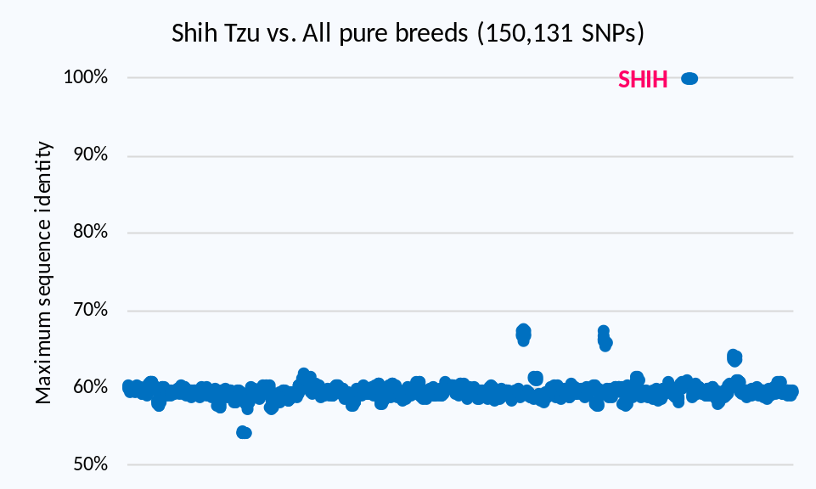
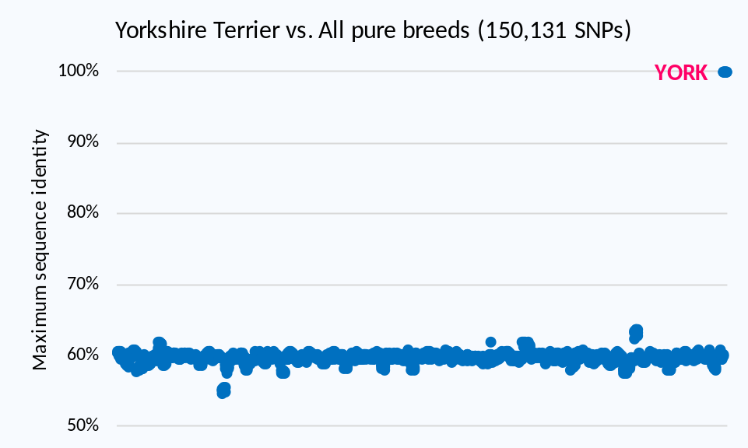
a
b
c
Fig. S6. Inference results of three pure breeds (Maltese (MALT; a), Shih Tzu (SHIH; b), and Yorkshire Terrier (YORK; c)) with 150,131 SNPs.

Slide 10
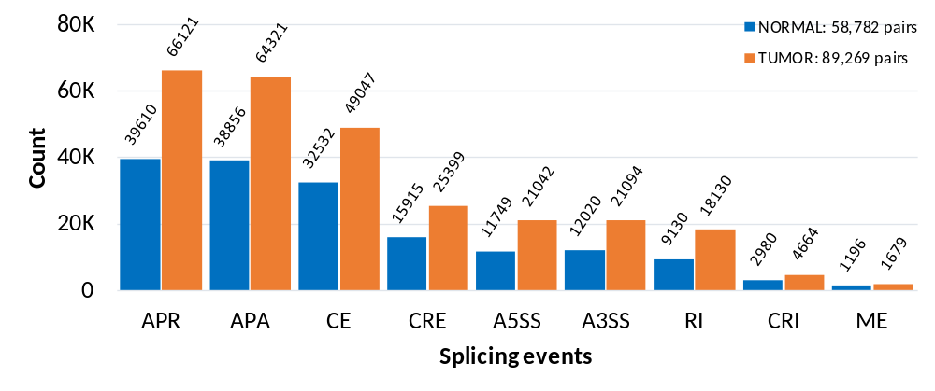
Fig. S7. Count of alternative splicing events in tumor condition (orange) compared to normal (blue).

Slide 11
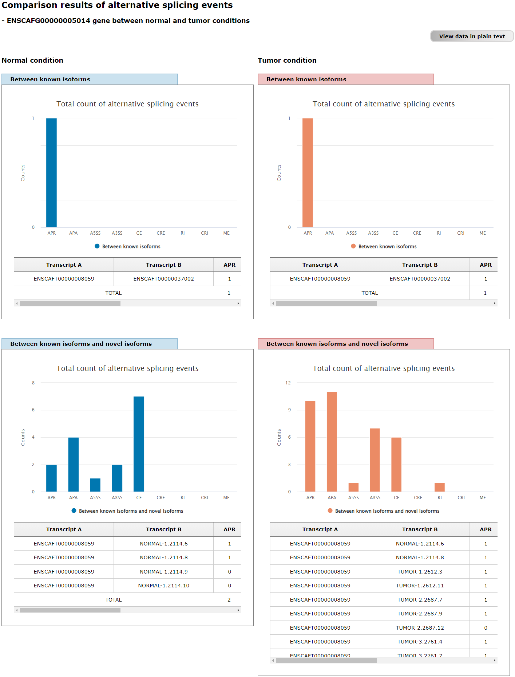
Fig. S8. Comparison results of alternative splicing events between normal (left) and tumor conditions (right) for a selected gene (TGFB1).

Slide 12
Gene symbol matching
Dog genes
(N=30,951)
Human genes
(N=57,820)
16,375 genes matched
Known vs. Novel
N=3,370
Putative
(N=17,064)
Known
(N=38,394)
Novel
(N=9,329)
Known vs. Known
N=13,018
Novel
(N=76,103)
Known
(N=92,459)
Known vs. Novel
N=4,616
Novel vs. Known
N=30,186
Dog transcript isoforms
(N=114,497)
No. of transcript isoforms with high similarity (≤ 0.1 distance) between dog and human
Human transcript isoforms
(N=118,852)
Fig. S9. Nucleotide sequence comparison of transcript isoforms between dog and human

Slide 13
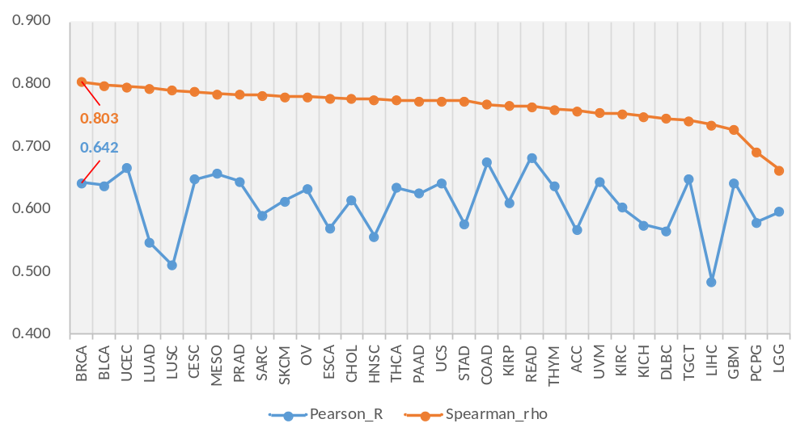
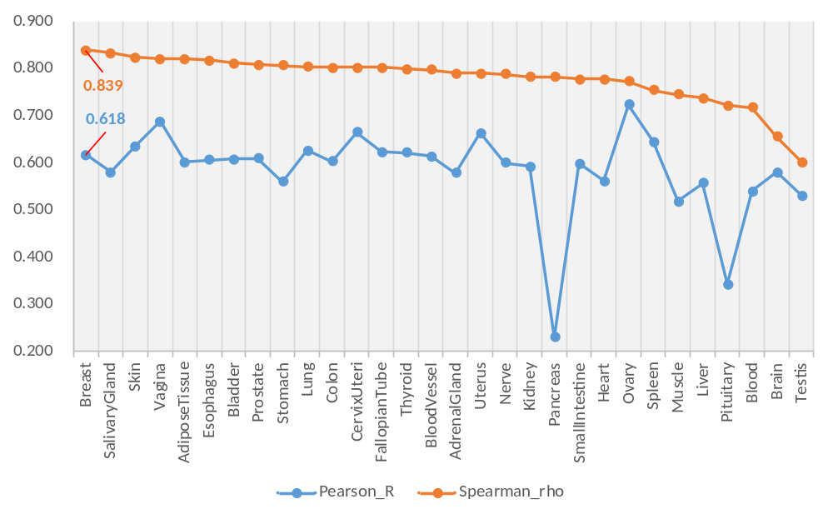
a
TCGA
b
GTEx v7
Fig. S10. Gene expression similarities between dog and human in tumor (A; TCGA project) and even normal conditions (B; GTEx project)

