Slide 1
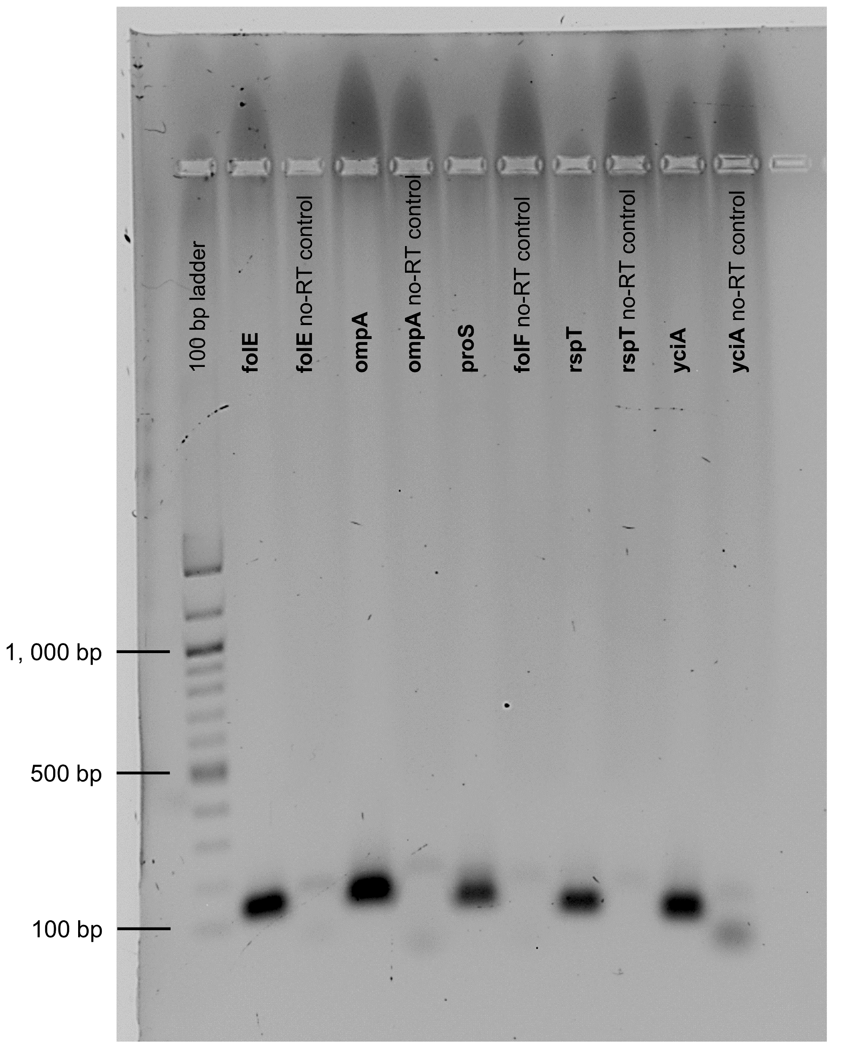
Supplementary Figure S6. A 2% agarose gel loaded with the PCR amplification products of Buchnera transcripts that were amplified from Diuraphis noxia cDNA generated with oligo dT(₁₈) primers.

