Slide 1
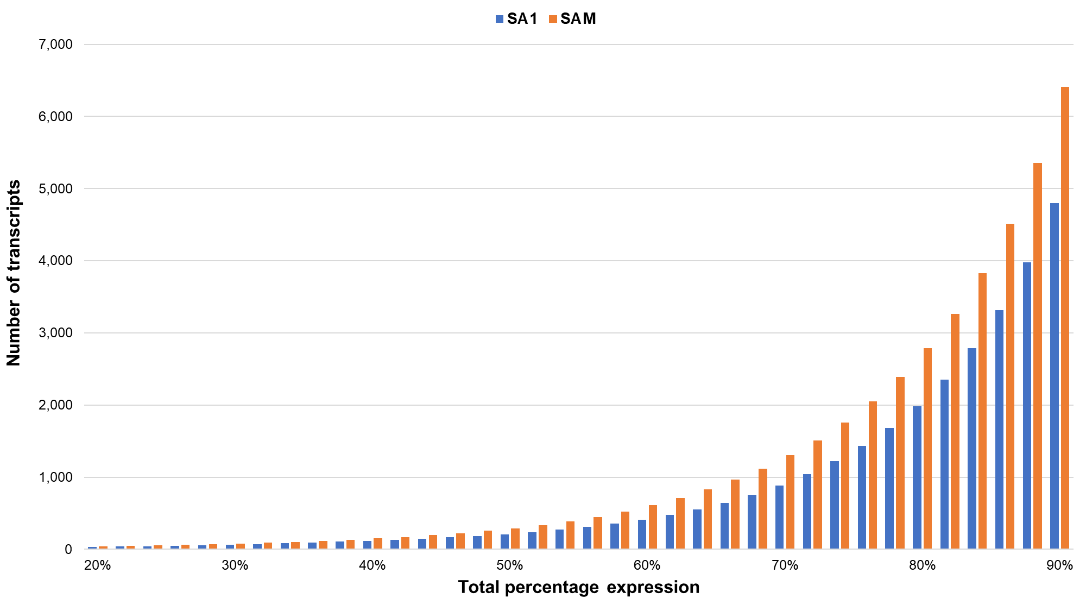
Supplementary Figure S8. A histogram with the number of Diuraphis noxia transcripts plotted over their total relative combined expression for D. noxia biotypes RWA-SA1 and RWA-SAM.

