Slide 1
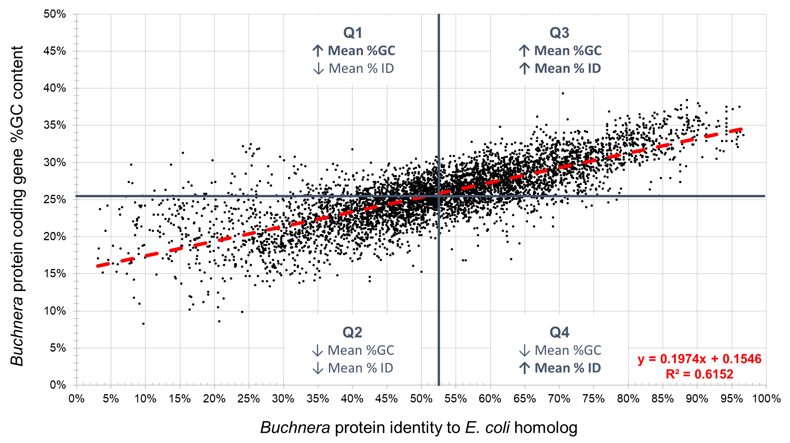
Supplementary Figure S2. Scatter plot produced by plotting Buchnera protein coding gene %GC content over Buchnera protein identity towards their Escherichia coli protein homologs.

