Slide 1
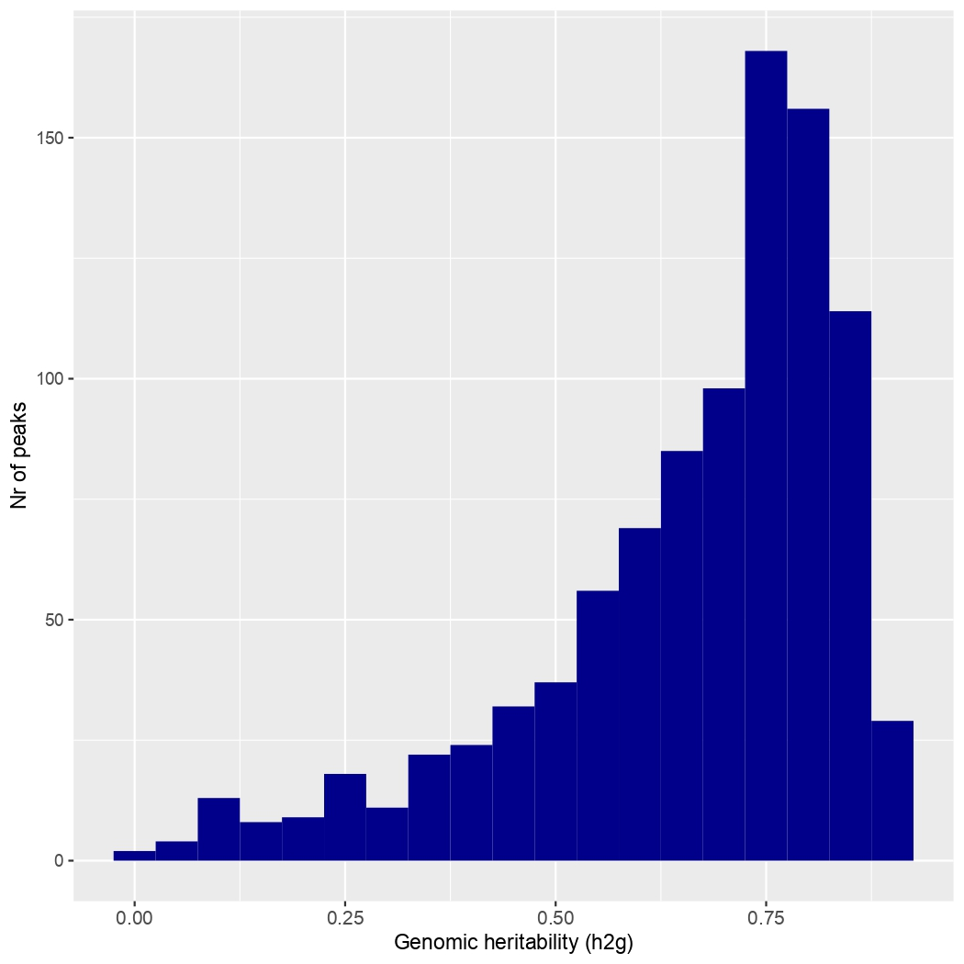
Nr of LC-MS features
Supplementary figure S01. Histogram of the genomic heritability (h²g) values of the 955 LC-MS features significantly associated to at least one reference SNP.

