Slide 1
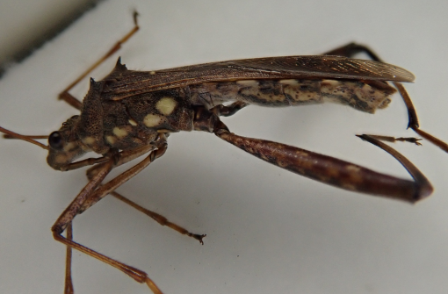
Supplementary Figure 1. Photograph of male R. pedestris

Slide 2
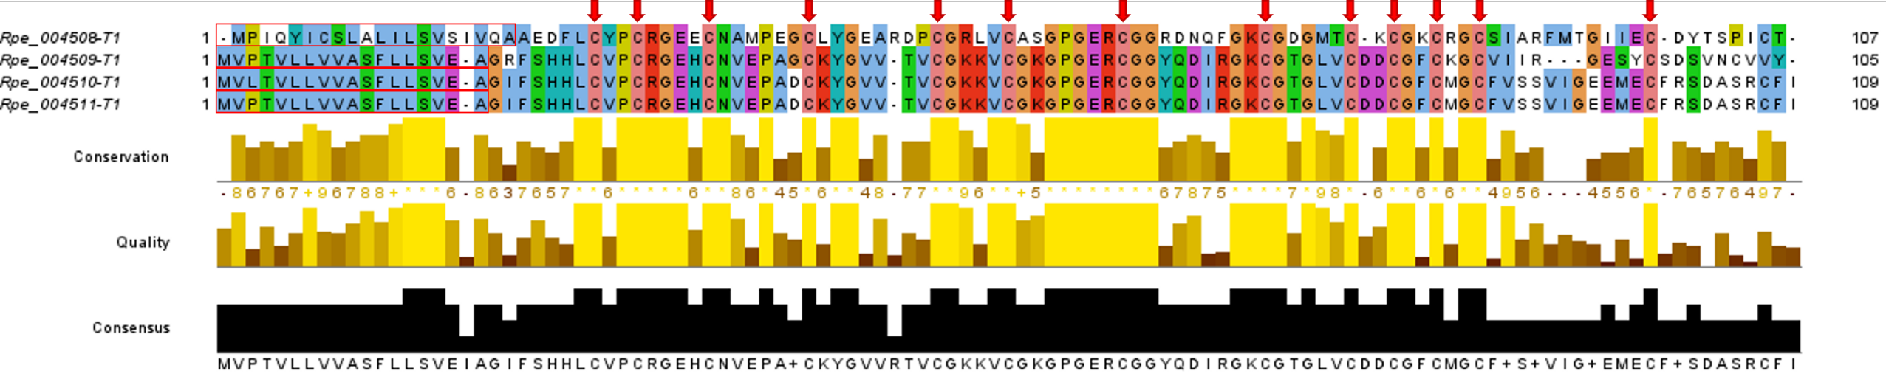
Supplementary Figure 2. Multiple sequence alignment of neuroparsin

Slide 3
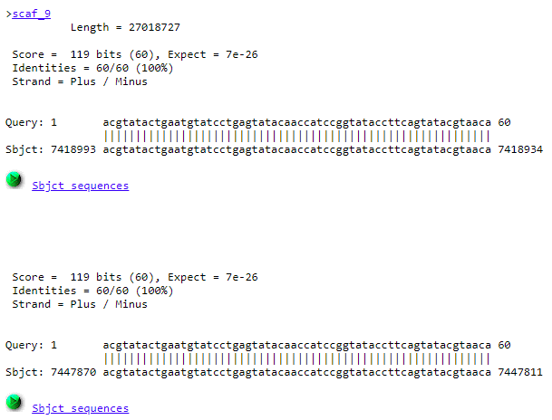
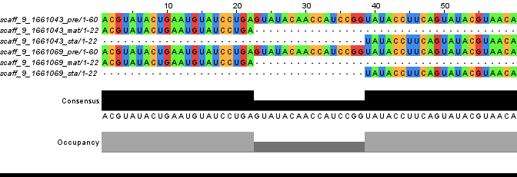
Supplementary Figure 3. Multiple sequence alignment of iab-4 and their location on the genome (scaffold 9)

Slide 4
Supplementary Figure 4. Summary count of non-coding RNAs in R. pedestris

Slide 5
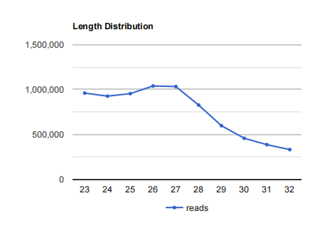
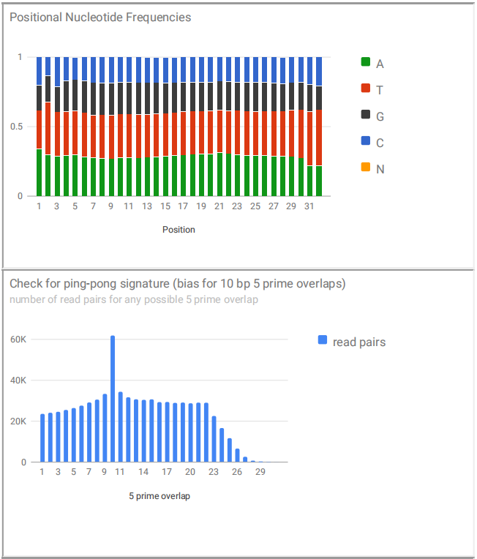
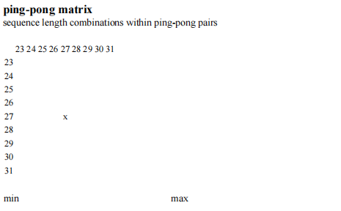
Supplementary Figure 5. all input reads. Absolute reads matching this class: 7520454 (values with fractionated multimappers are given in the table at the top).

Slide 6
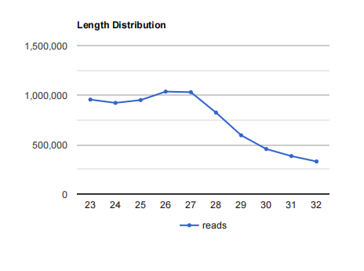

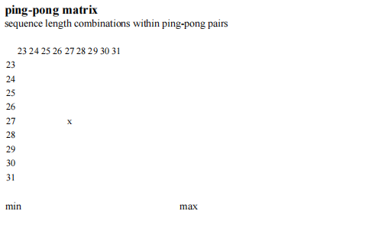
Supplementary Figure 6. no-annotation. Absolute reads matching this class: 7494671 (values with fractionated multimappers are given in the table at the top)

Slide 7
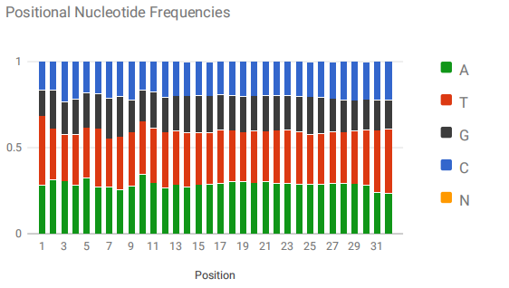
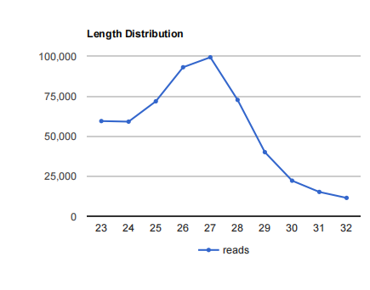
Supplementary Figure 7. ping-pong. Absolute reads matching this class: 545118 (values with fractionated multimappers are given in the table at the top)

Slide 8
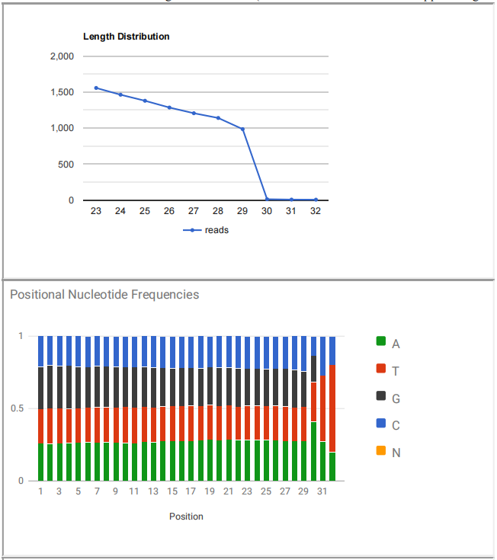
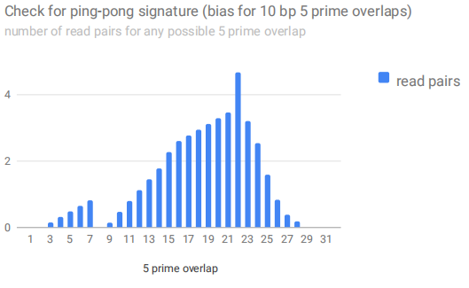

Supplementary Figure 8. rRNA. Absolute reads matching this class: 9037 (values with fractionated multimappers are given in the table at the top)

Slide 9
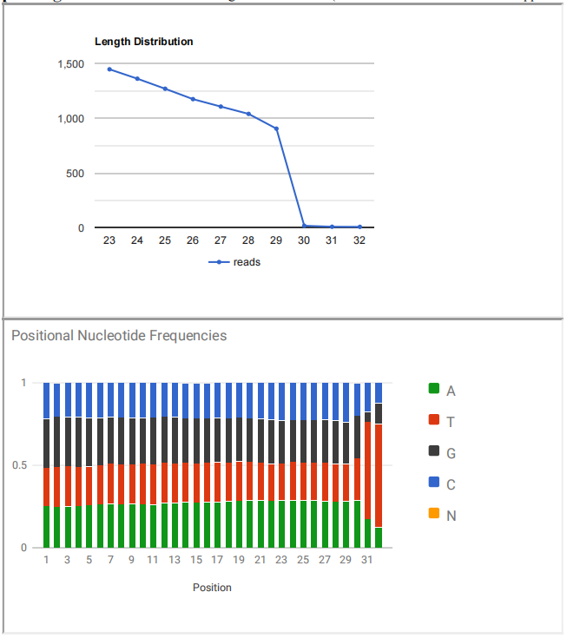
Supplementary Figure 9. pseudogene. Absolute reads matching this class: 8349 (values with fractionated multimappers are given in the table at the top)

Slide 10
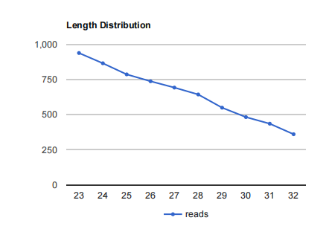
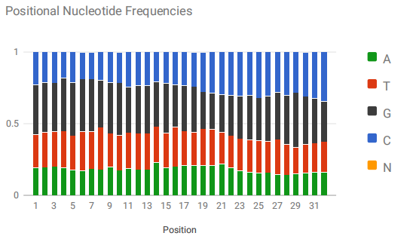
Supplementary Figure 10. tRNA. Absolute reads matching this class: 6487 (values with fractionated multimappers are given in the table at the top)

Slide 11
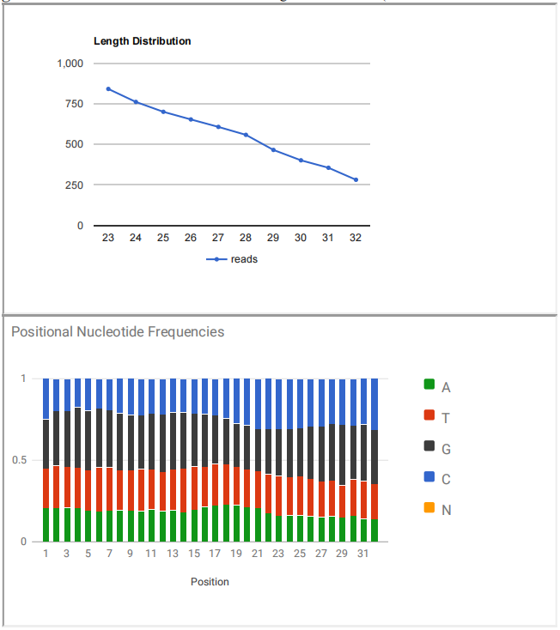
Supplementary Figure 11. genomic misc-tRFs. Absolute reads matching this class: 5622 (values with fractionated multimappers are given in the table at the top)

Slide 12
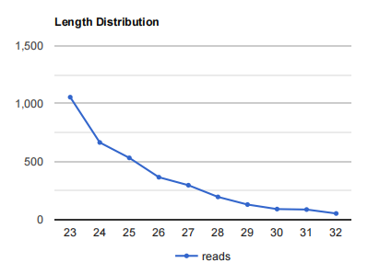
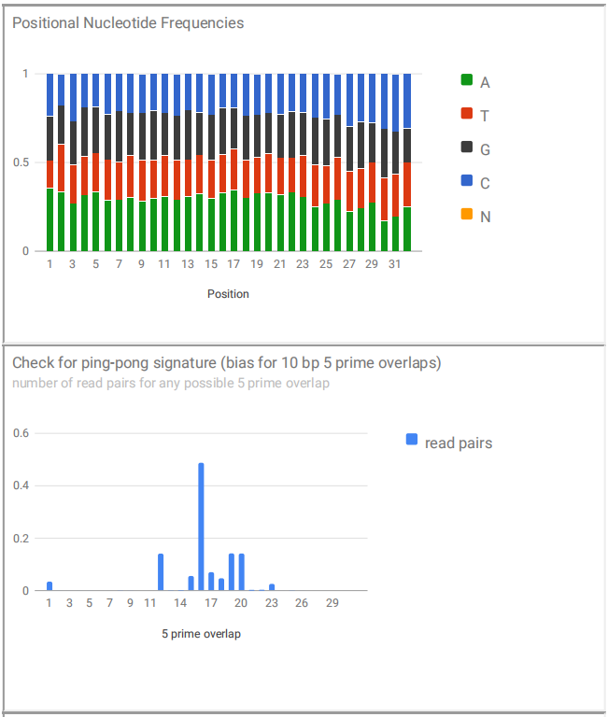
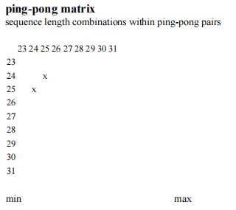
Supplementary Figure 12. protein coding. Absolute reads matching this class: 3466 (values with fractionated multimappers are given in the table at the top)

Slide 13

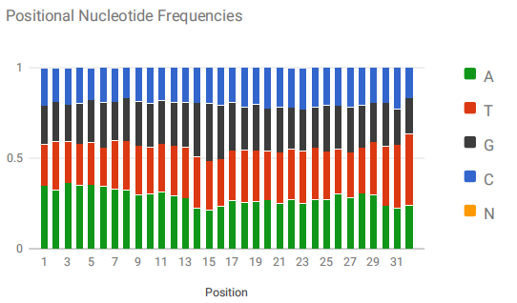
Supplementary Figure 13. snRNA. Absolute reads matching this class: 1320 (values with fractionated multimappers are given in the table at the top)

Slide 14
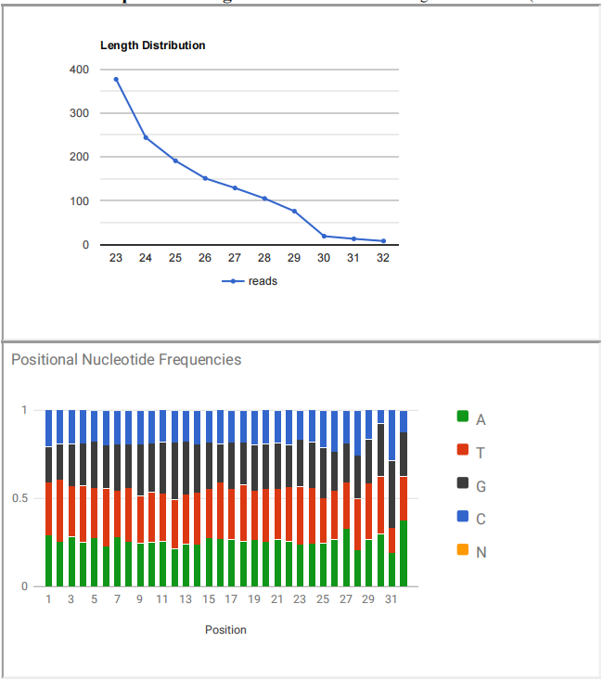
Supplementary Figure 14. miR.non-Drosophila melanogaster. Absolute reads matching this class: 1313 (values with fractionated multimappers are given in the table at the top)

Slide 15
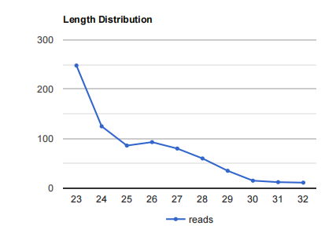
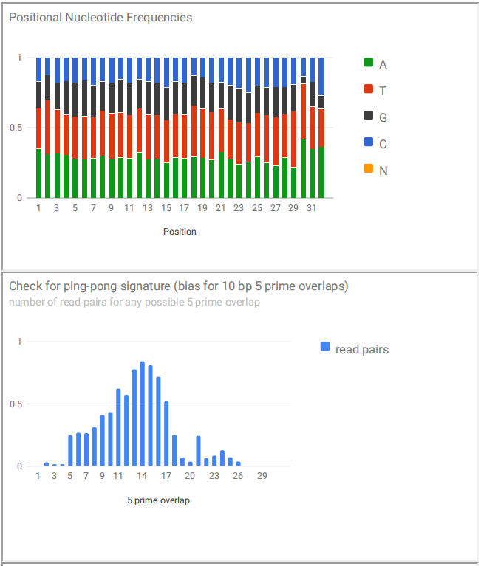

Supplementary Figure 15. piRcandidates. Absolute reads matching this class: 765 (values with fractionated multimappers are given in the table at the top)

Slide 16
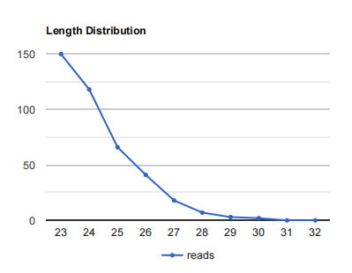
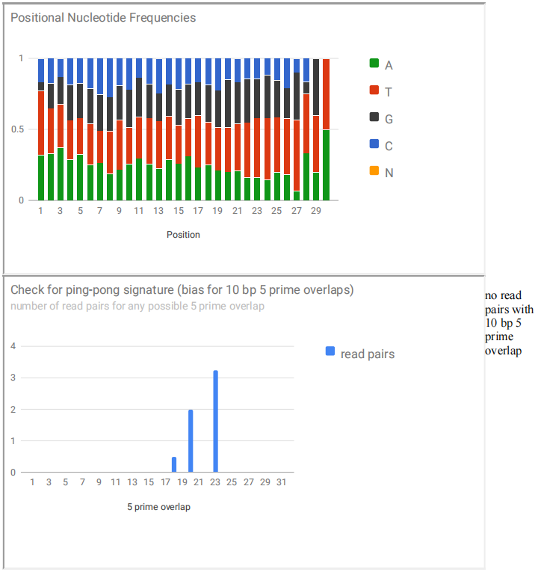
Supplementary Figure 16. miR.Drosophila melanogaster. Absolute reads matching this class: 405 (values with fractionated multimappers are given in the table at the top)
no read pairs with 10 bp 5 prime overlap

Slide 17
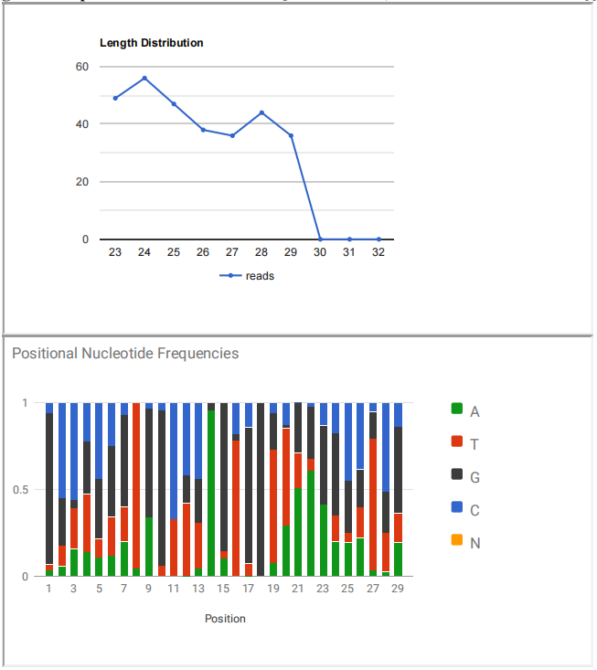
Supplementary Figure 17. genomic 5p-tRFs. Absolute reads matching this class: 306 (values with fractionated multimappers are given in the table at the top)

Slide 18
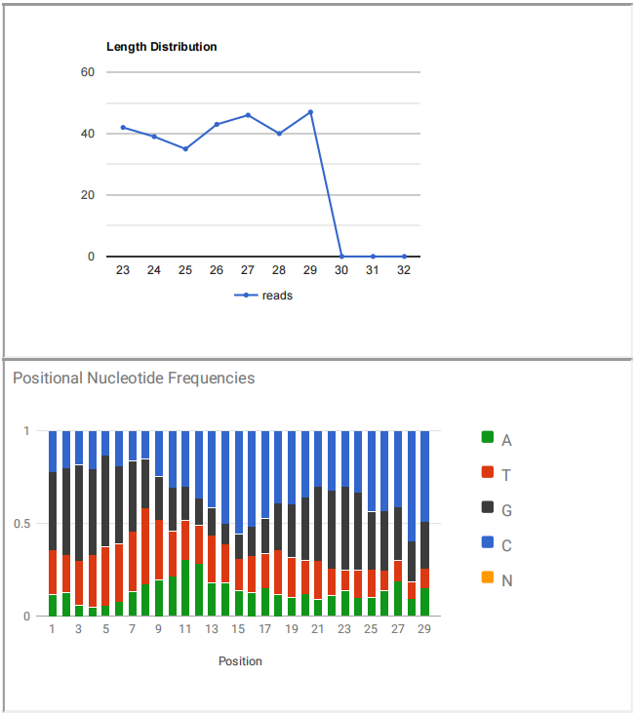
Supplementary Figure 18. genomic 3p-tRFs. Absolute reads matching this class: 292 (values with fractionated multimappers are given in the table at the top)

Slide 19
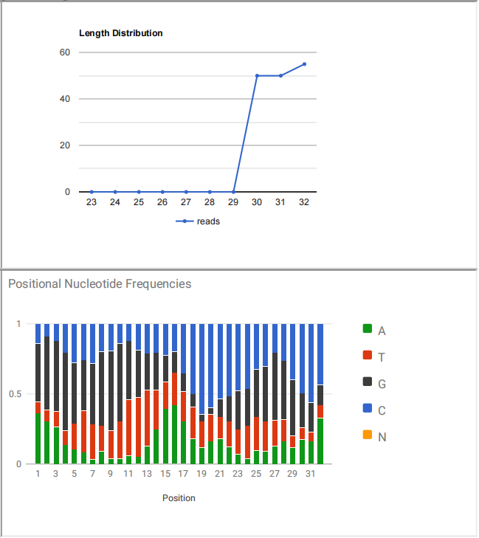
Supplementary Figure 19. genomic 3p-tR-halves. Absolute reads matching this class: 155 (values with fractionated multimappers are given in the table at the top)

Slide 20
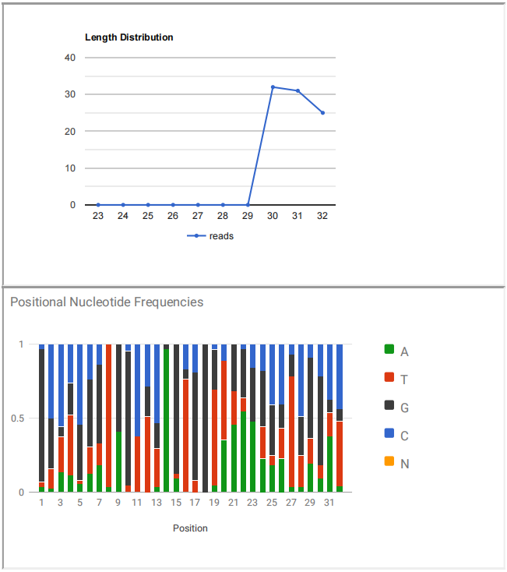
Supplementary Figure 20. genomic 5p-tR-halves. Absolute reads matching this class: 88 (values with fractionated multimappers are given in the table at the top)

Slide 21
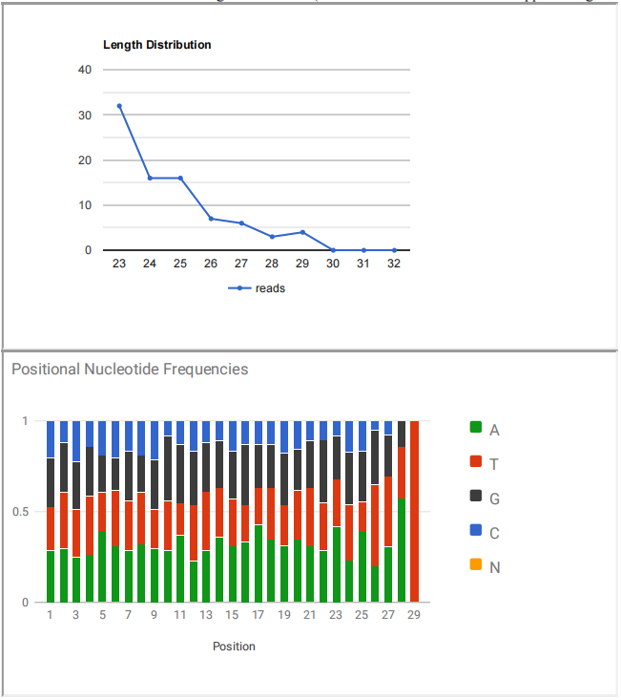
Supplementary Figure 21. ncRNA. Absolute reads matching this class: 84 (values with fractionated multimappers are given in the table at the top)

Slide 22
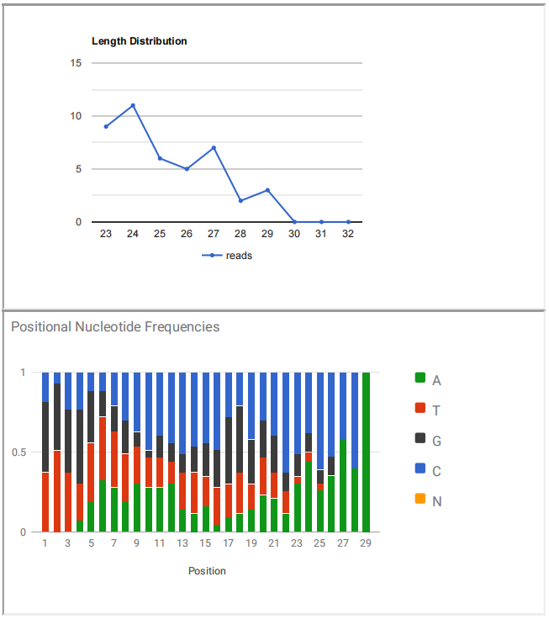
Supplementary Figure 22. genomic 3p-CCA-tRFs. Absolute reads matching this class: 43 (values with fractionated multimappers are given in the table at the top)

Slide 23
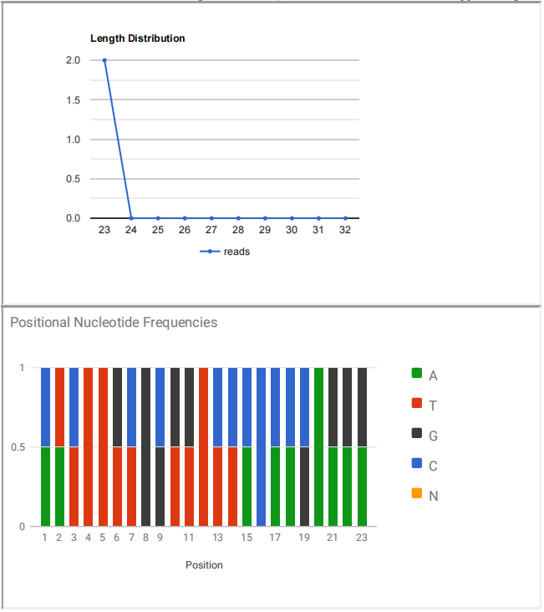
Supplementary Figure 23. snoRNA. Absolute reads matching this class: 2 (values with fractionated multimappers are given in the table at the top)

Slide 24
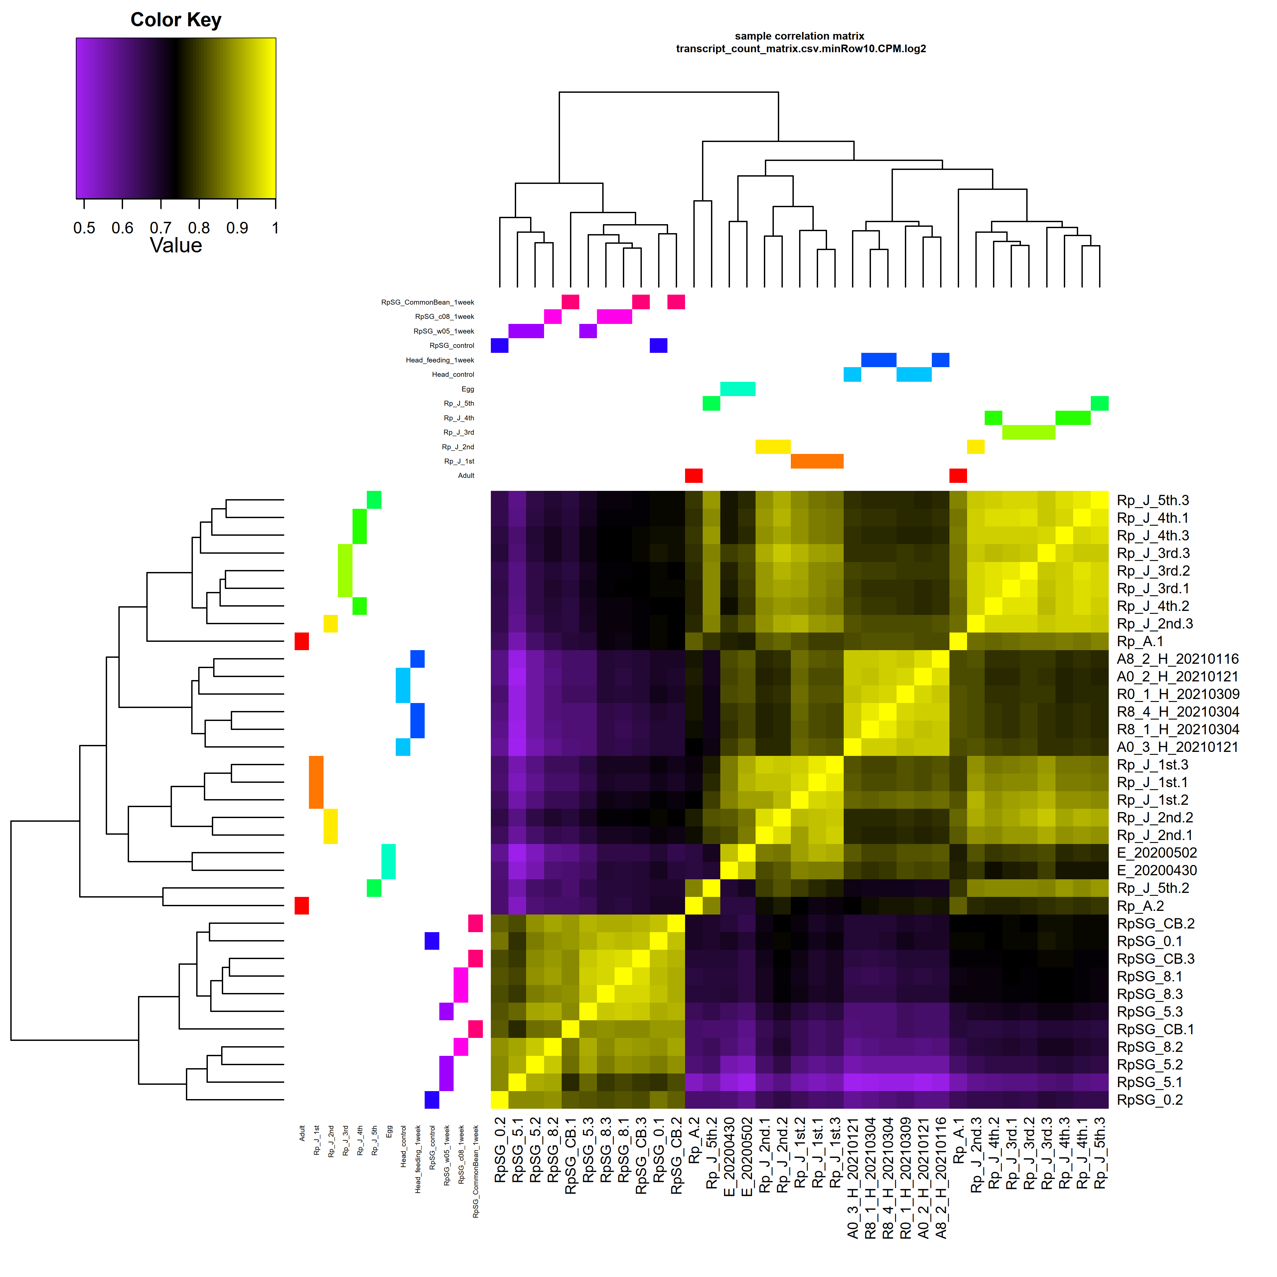
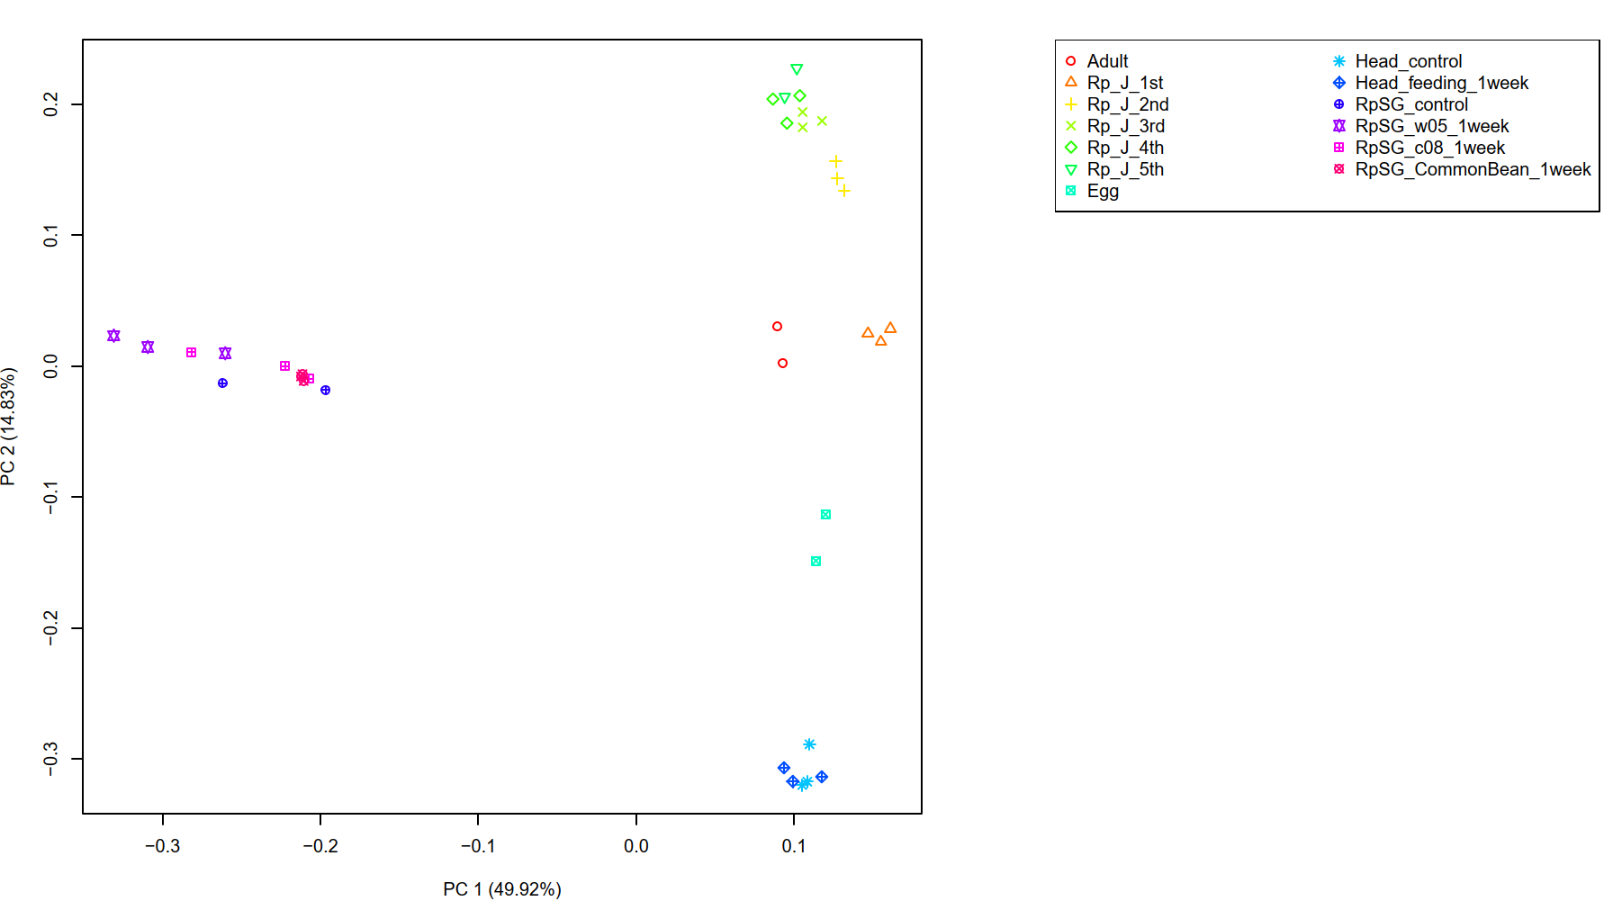
Supplementary Figure 24. PCA and hierarchical clustering of R. pedestris mRNA transcriptome data samples/replicates

Slide 25
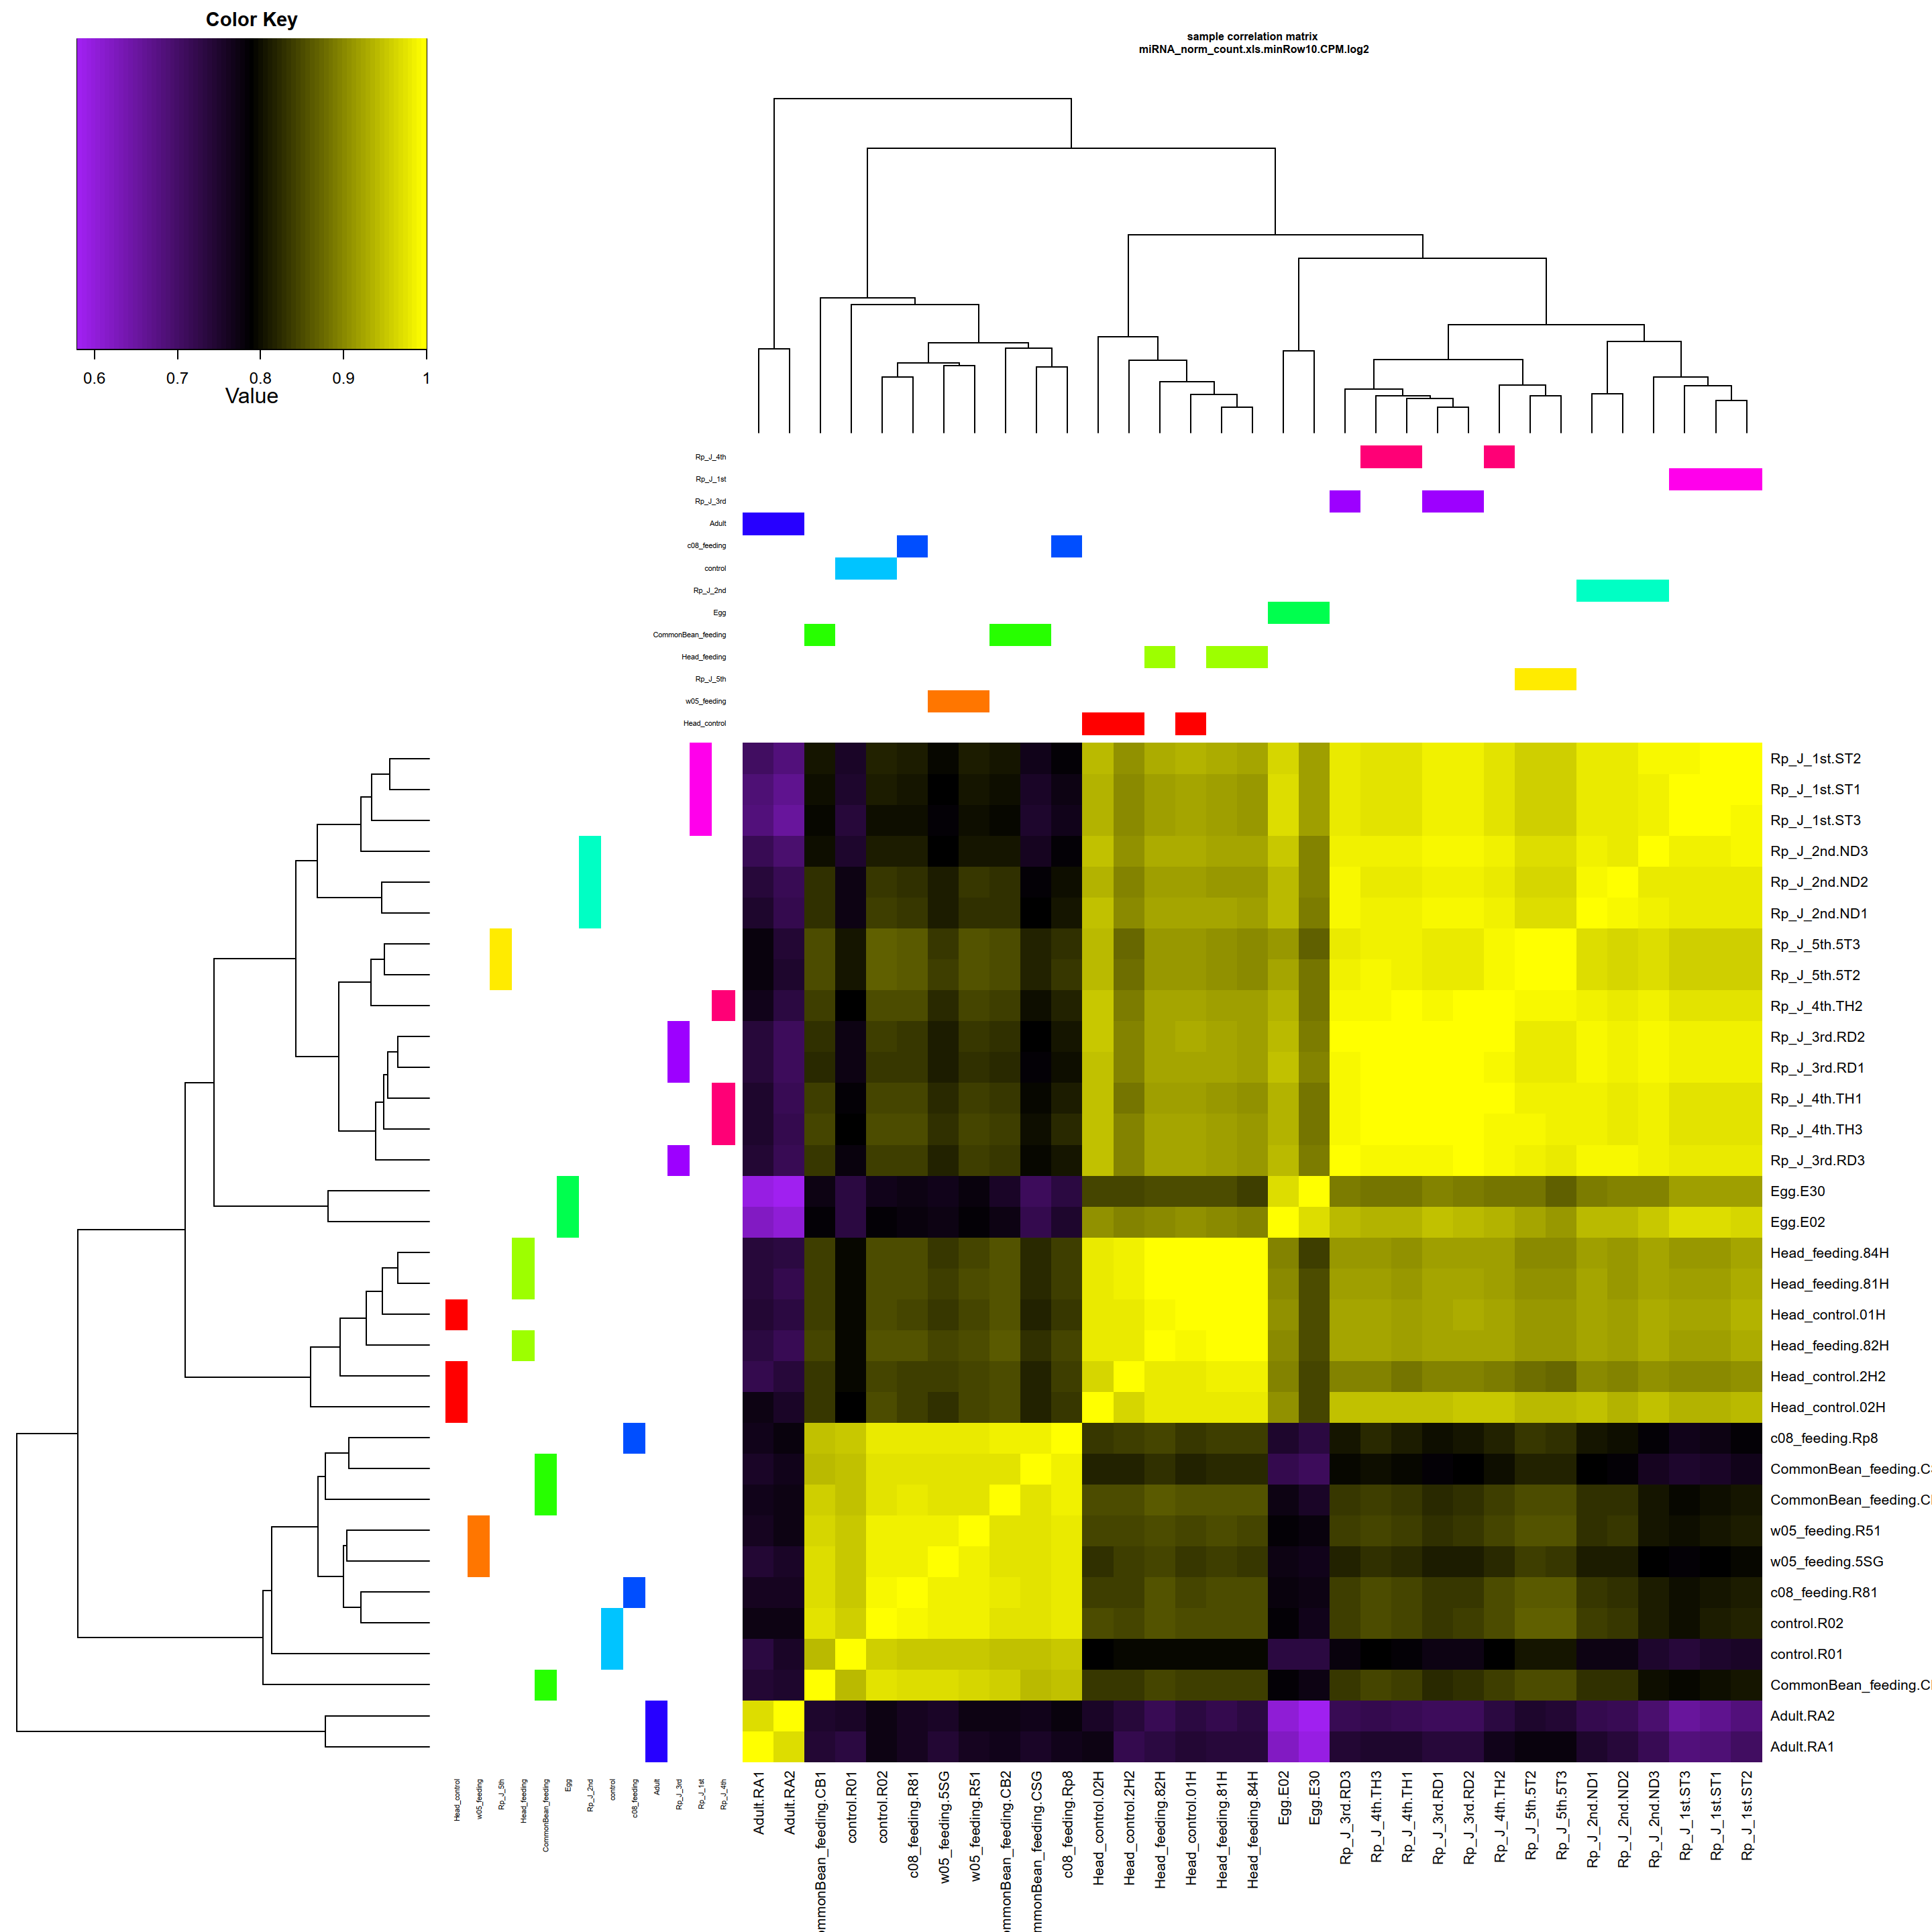
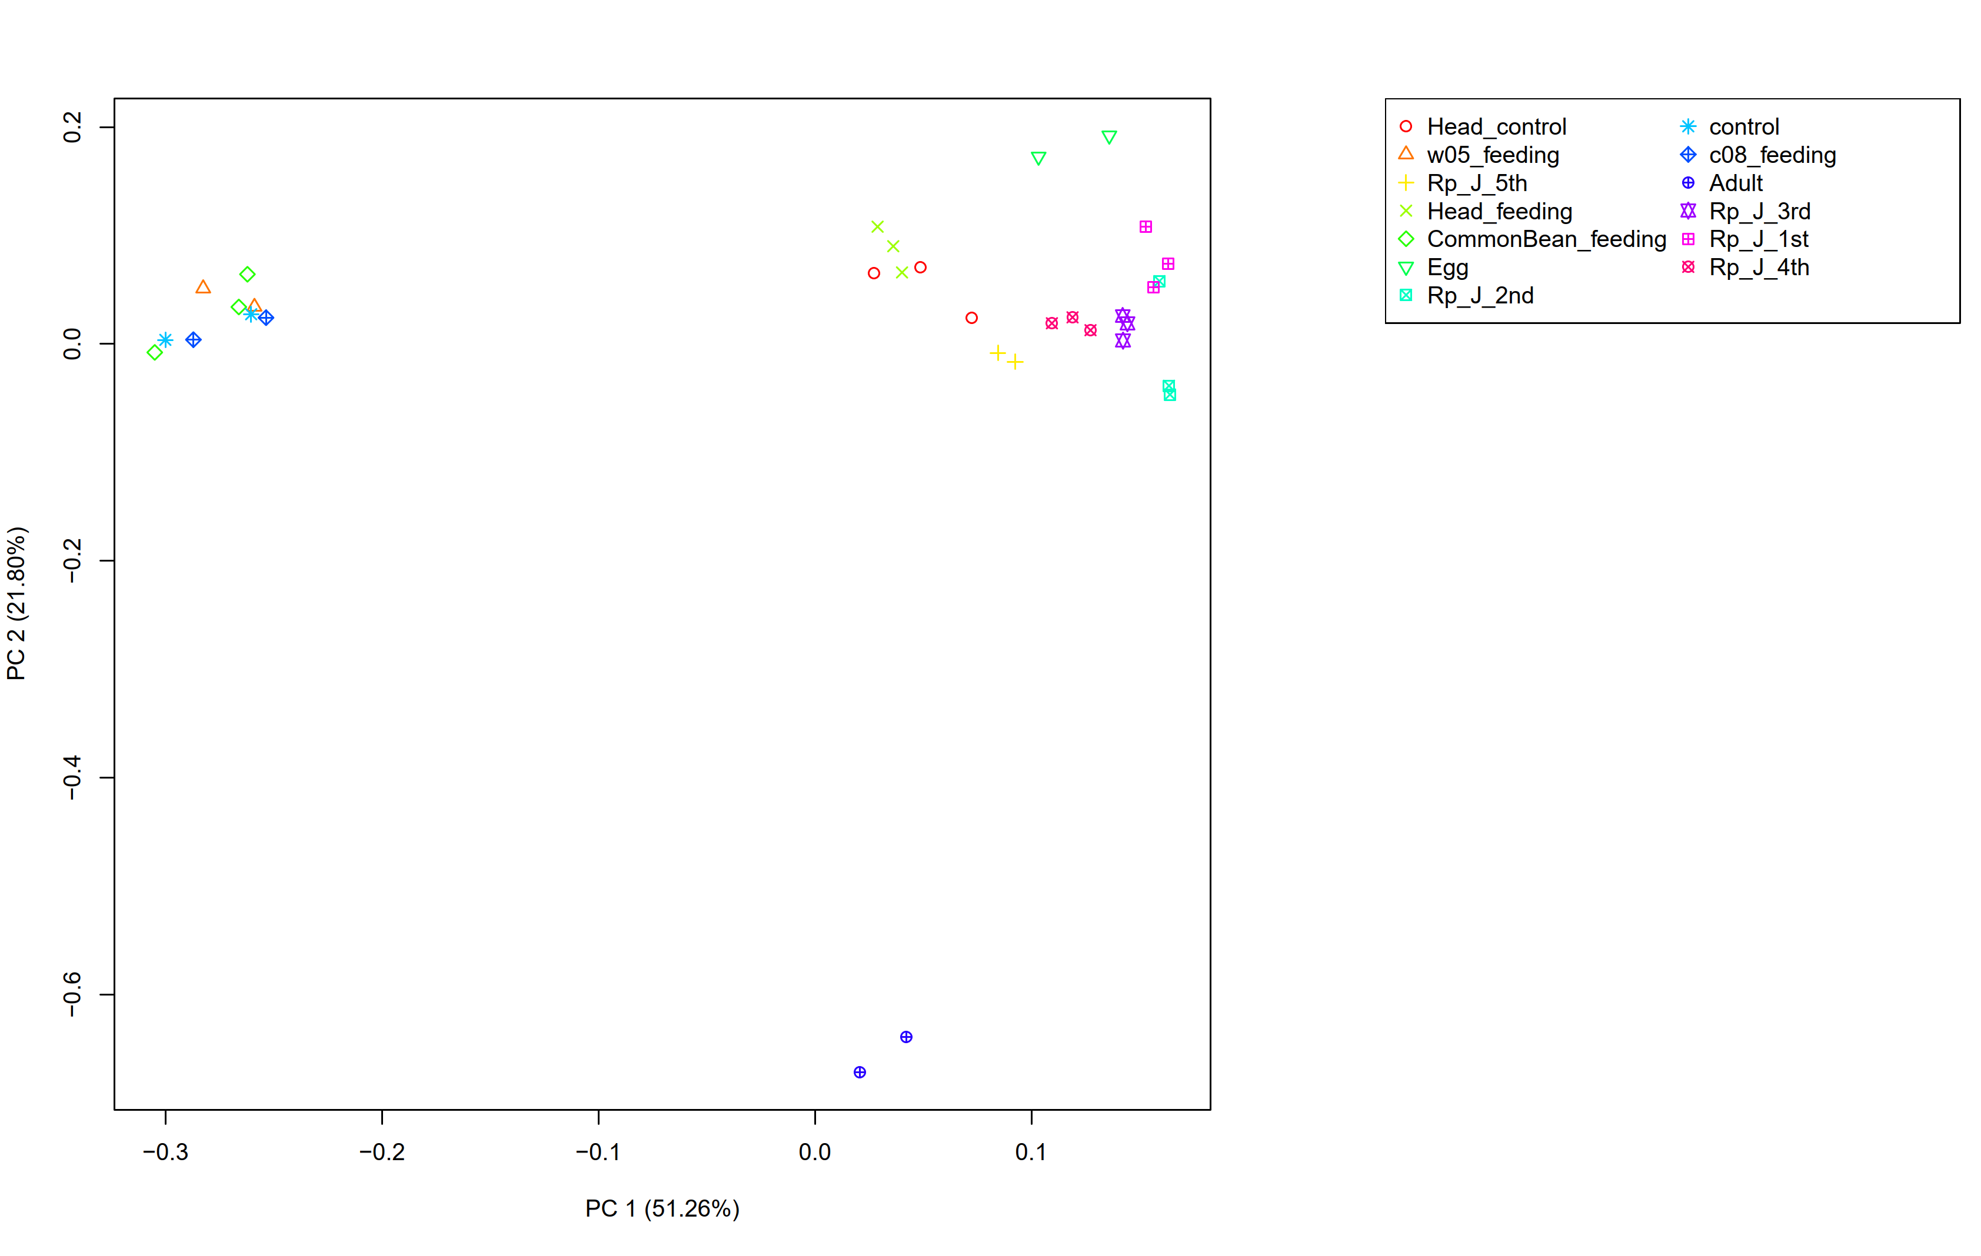
Supplementary Figure 25. PCA and hierarchical clustering of R. pedestris miRNA transcriptome data samples/replicates

Slide 26
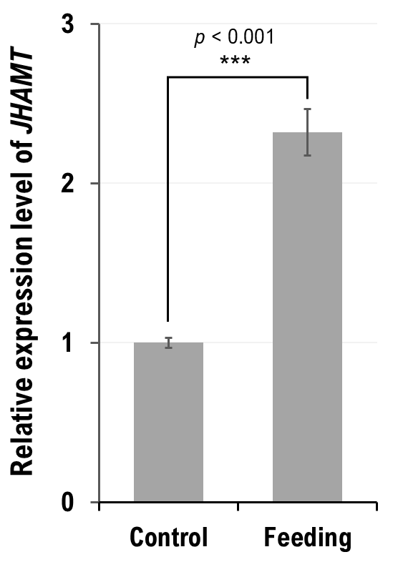
Supplementary Figure 26. Expression level of JHAMT determined by RT-qPCR between control and feeding groups. The graph was plotted by mean ± s.e.m. and the significance was evaluated by t-test. ***p < 0.001

Slide 27
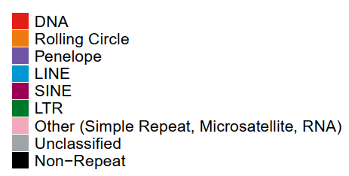
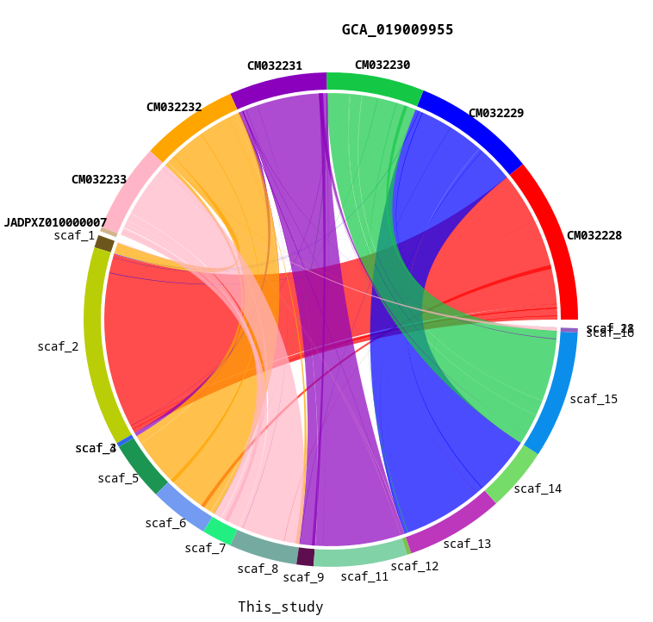
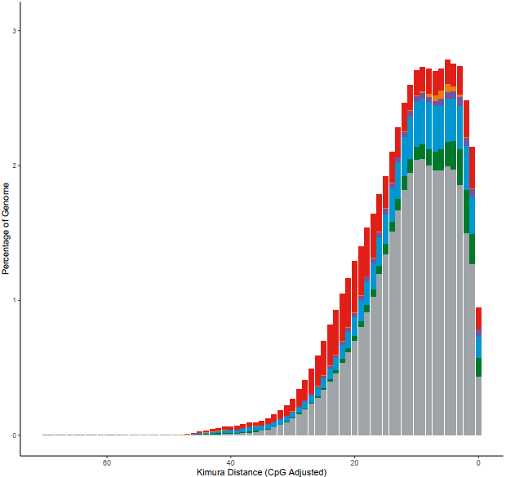
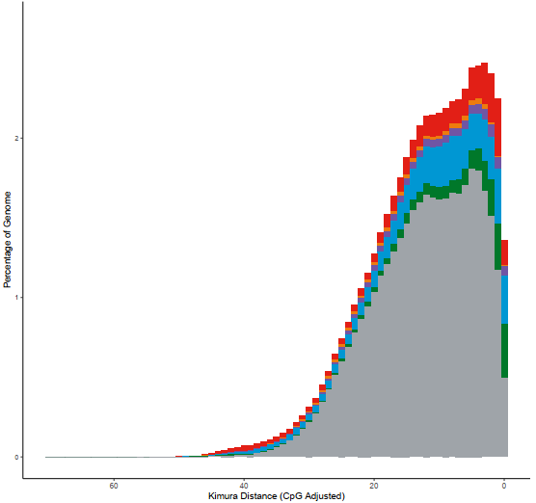
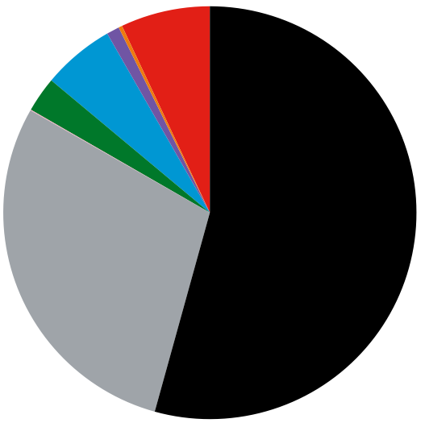
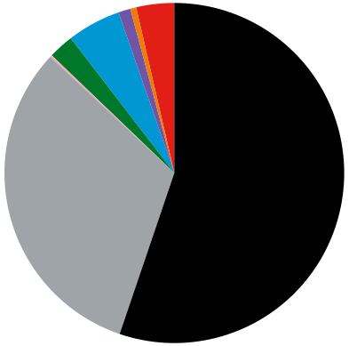
A
B
C
Supplementary Figure 27. Comparative analysis between the two representative genomes of Riptortus pedestris (Rped). (A) Synteny/circos plot between the Rped genomes of Huang et al. (2021) GCA_019009955 and in this study. (B-C) Repetitive elements in the Rped genomes of Huang et al. (2021) GCA_019009955 (B) and in this study (C).

