Slide 1
Identifying Homoplasy in the SNP Matrix of vSNP with CoV-2
February, 2024

Slide 2
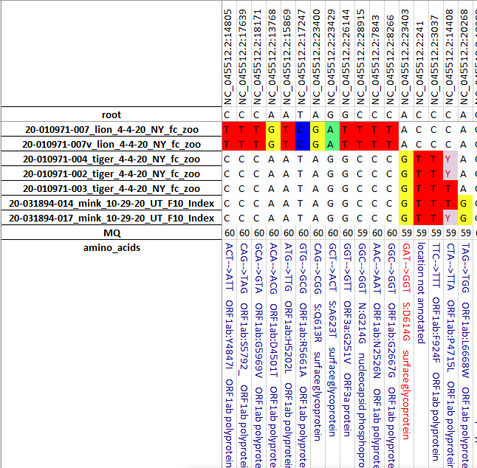
vSNP – SARS-CoV-2
SNP matrix only shows SNP differences
from the reference

Slide 3
vSNP – SARS-CoV-2
Genome location
Sample

Slide 4
vSNP – SARS-CoV-2
Genome location
Sample
Sorted by evolutionary order

Slide 5
vSNP – SARS-CoV-2
Genome location
Sample
Annotation and amino acid change if there is one

Slide 6
Reading the annotation bottom of SNP table
GAT-->GGT S:D614G surface glycoprotein

Slide 7
Reading the annotation bottom of SNP table
GAT-->GGT S:D614G surface glycoprotein
Nucleotide sequence ancestral → Nucleotide sequence new (mutation)

Slide 8
Reading the annotation bottom of SNP table
GAT-->GGT S:D614G surface glycoprotein
Nucleotide sequence ancestral → Nucleotide sequence new (mutation)
Spike protein: Amino acid ancestral; # of the amino acid in the protein sequence;
Amino acid new (D=Aspartic Acid; G=Glycine). Total of 1273 amino acids in spike.

Slide 9
Reading the annotation bottom of SNP table
GAT-->GGT S:D614G surface glycoprotein
Nucleotide sequence ancestral → Nucleotide sequence new (mutation)
Spike protein: Amino acid ancestral; # of the amino acid in the protein sequence;
Amino acid new (D=Aspartic Acid; G=Glycine)
Formal name for the spike protein

Slide 10
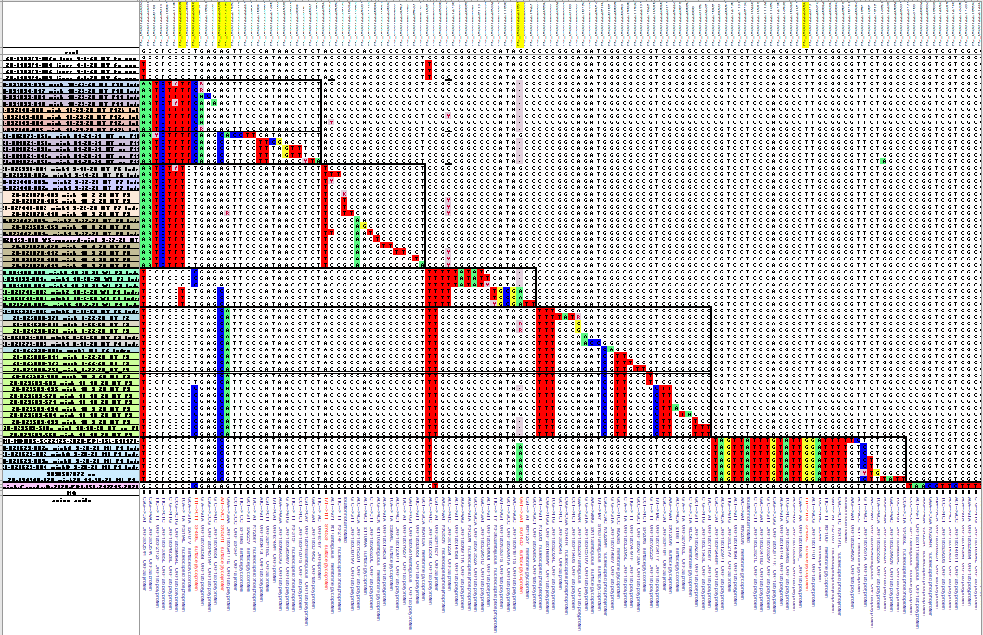
The SNP table allows homoplasy to be easily seen
Homoplasy = the same mutation evolving independently multiple times

Slide 11
The SNP table allows homoplasy to be easily seen
UT Cluster 1
UT Cluster 2
WI Cluster 1
WI Cluster 2
UT Cluster 3
MI Cluster
Canada

Slide 12
The SNP table allows homoplasy to be easily seen
UT Cluster 1
UT Cluster 2
WI Cluster 1
WI Cluster 2
UT Cluster 3
MI Cluster
Canada

Slide 13
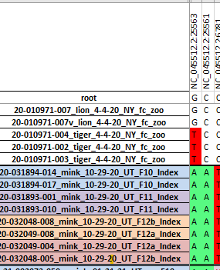
The SNP table allows homoplasy to be easily seen
UT Cluster 1
UT Cluster 2
= Not Homoplasy
WI Cluster 1
WI Cluster 2
UT Cluster 3
MI Cluster
Canada

Slide 14
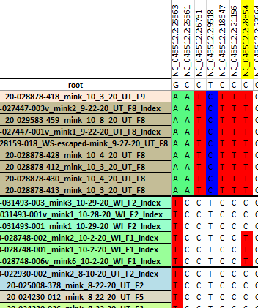
The SNP table allows homoplasy to be easily seen
UT Cluster 1
UT Cluster 2
Homoplasy
WI Cluster 1
WI Cluster 2
UT Cluster 3
MI Cluster
Canada

Slide 15
The SNP table allows homoplasy to be easily seen
UT Cluster 1
UT Cluster 2
WI Cluster 1
WI Cluster 2
UT Cluster 3
S:F486L
MI Cluster
Canada

Slide 16
The SNP table allows homoplasy to be easily seen
UT Cluster 1
UT Cluster 2
WI Cluster 1
WI Cluster 2
UT Cluster 3
S:F486L
S:F486L
MI Cluster
Canada

Slide 17
F486L – Strongly selected in mink
NC_045512.2:23018 TTT-->CTT S:F486L surface glycoprotein
NC_045512.2:23020 TTT-->TTG S:F486L surface glycoprotein
Phenylalanine to a Leucine
Amino Acid | SLC | DNA codons
Leucine | L | CTT, CTC, CTA, CTG, TTA, TTG
Genetic and Phenotypic homoplasy. Both have occurred in mink with this amino acid mutation – indicating very strong selection advantage.

