Slide 1
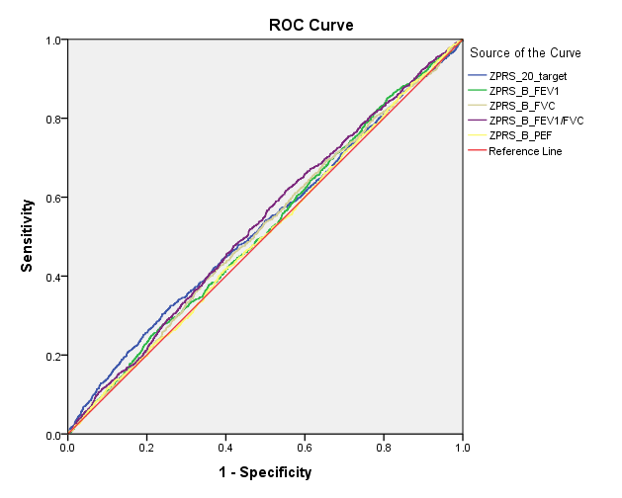
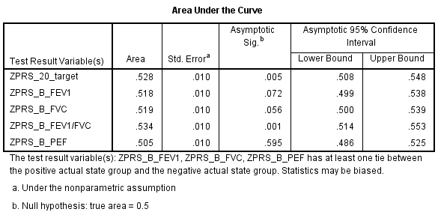
(Supplementary Figure S3)
(A)
Supplementary Figure S3 Receiver operating characteristic curves of the regression models with polygenic risk scores calculated with different references based on four lung function traits. (A) Best SNPs + Beta, (B) Best SNPs + OR, 20_target: PRS established in this study. AUC, area under curve.

Slide 2
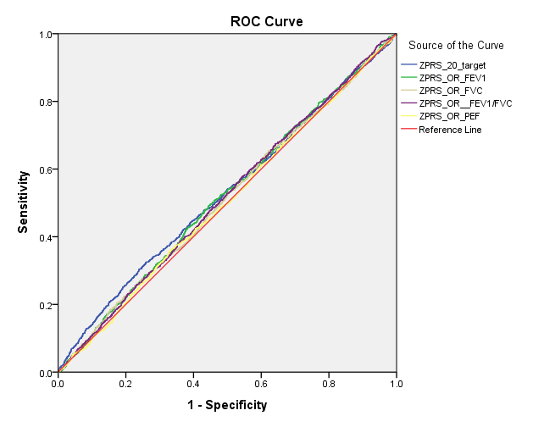
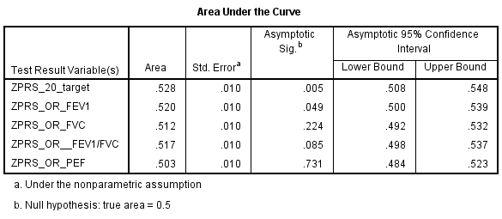
(Supplementary Figure S3, continued)
(B)

