Slide 1
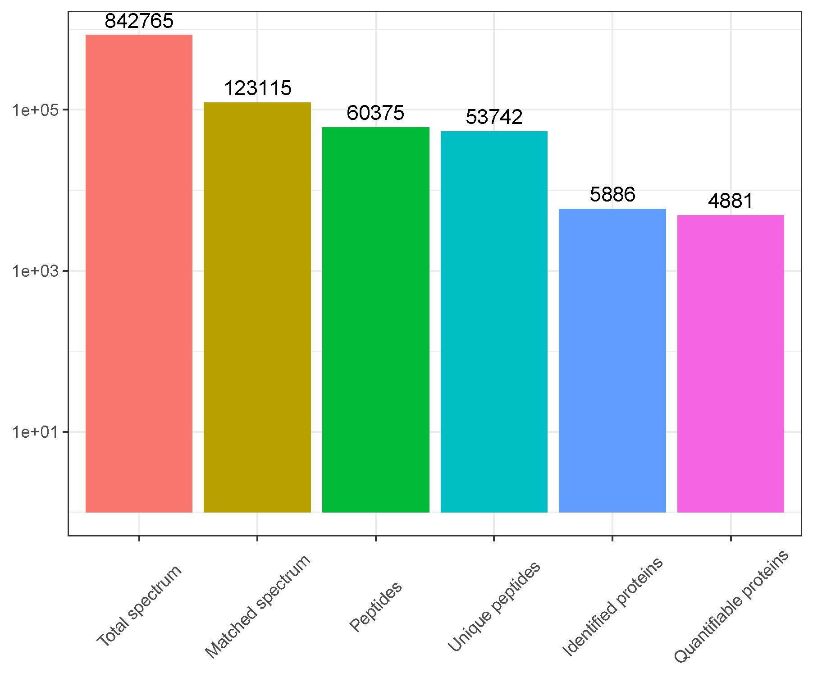
a
Fig. S1 Basic statistical results of MS data (a) and peptide length distribution (b).
b

Slide 2
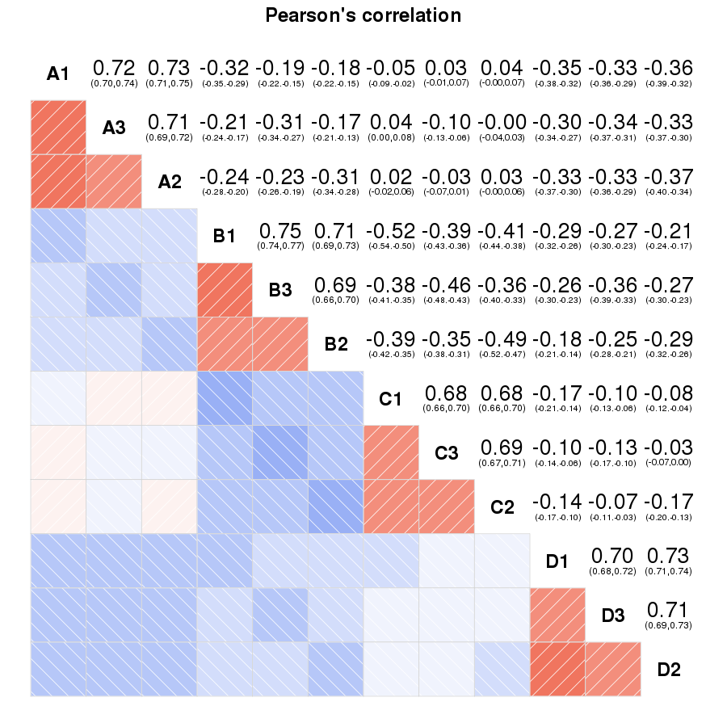
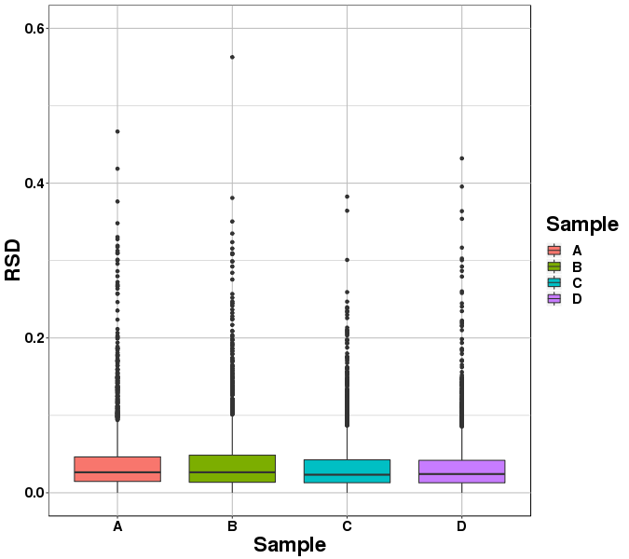
Fig. S2 Sample repeatability test. a: Box plot of RSD distribution of repeated samples; b: Heatmap of Person correlation coefficients from all quantified proteins between each pair of samples. Three biological replicates were contained in each genotype/treatment combination. A: Longdong_Control; B: Algonquin_Control; C: Longdong_Drought; D: Algonquin_Drought.
a
b

Slide 3
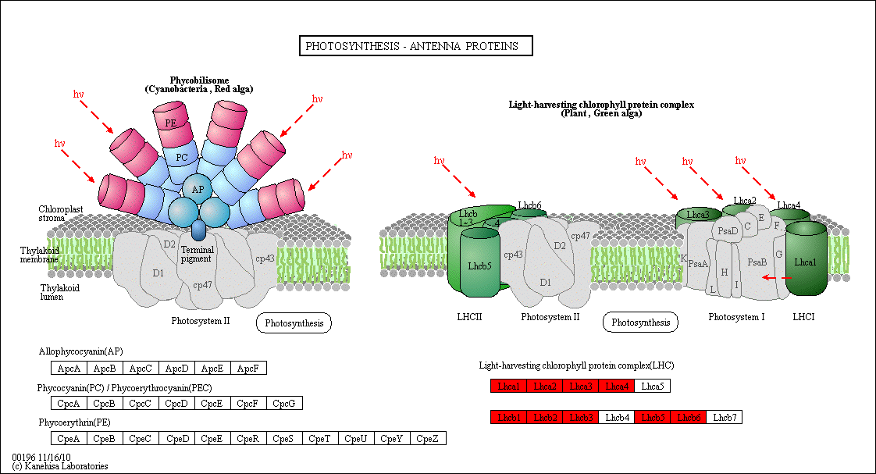
Fig. S3 Photosynthesis-antenna proteins modulated by genotypes. Red represents up-regulated DAPs. A: Longdong_Control; B: Algonquin_Control; C: Longdong_Drought; D: Algonquin_Drought.
A vs. B
C vs. D

Slide 4
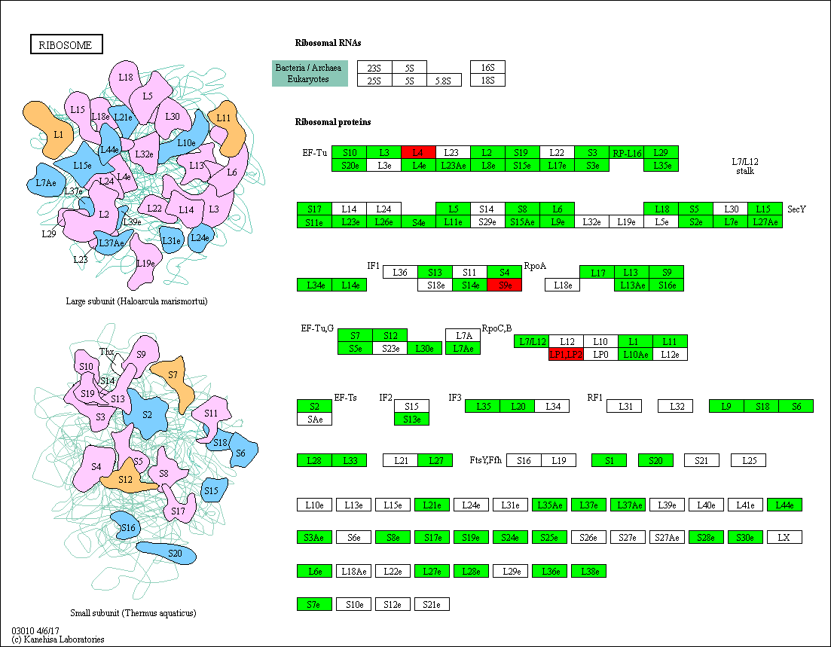
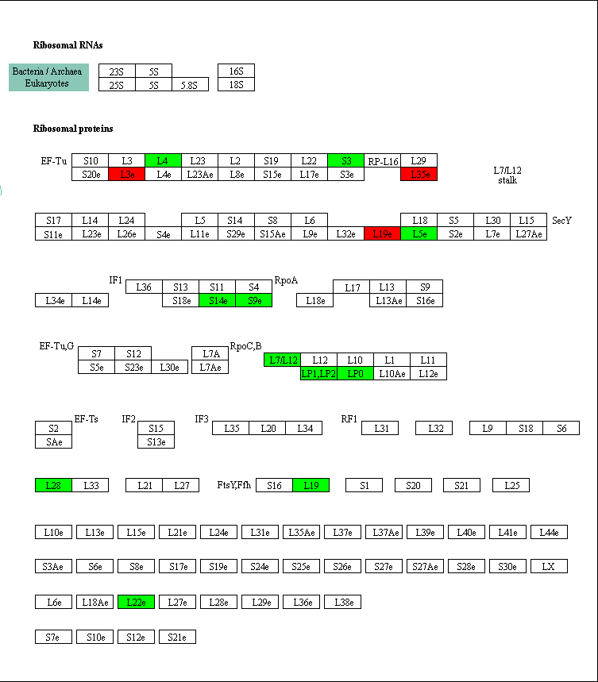
Fig. S4 Ribosome related proteins modulated by drought stress. Red represents up-regulated DAPs and green represents down-regulated DAPs. A: Longdong_Control; B: Algonquin_Control; C: Longdong_Drought; D: Algonquin_Drought.
D vs. B
C vs. A

