Slide 1
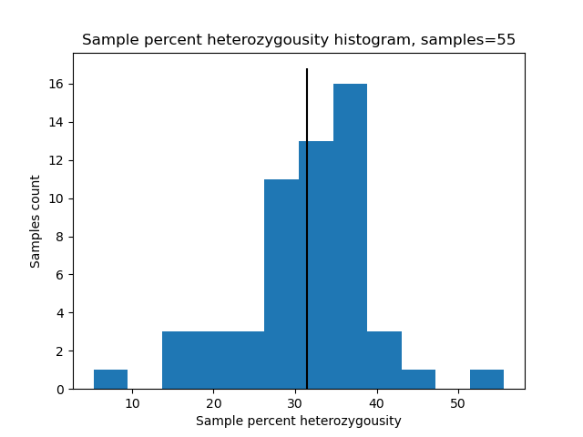
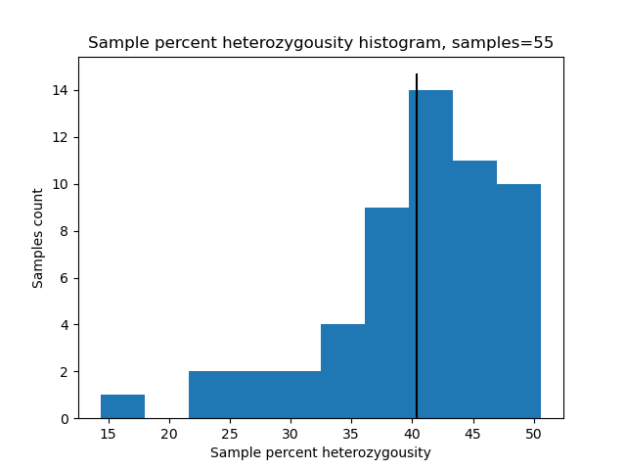
a.
HASCH
avg. 31.5
b.
GBS
avg. 40.1
Supplementary Figure 1: Sample heterozygosity of GBS and HASCH genotypes
Using the same HASCH and GBS datasets to generate Figure 5, the sample heterozygosity were calculated for each set using bcftools stats. The Per-sample Counts PSC rows give the number of homozygous reference, homozygous alternate and heterozygous. The percent heterozygosity was then calculated for each sample, and their distribution plotted using python matplotlib.

Slide 2
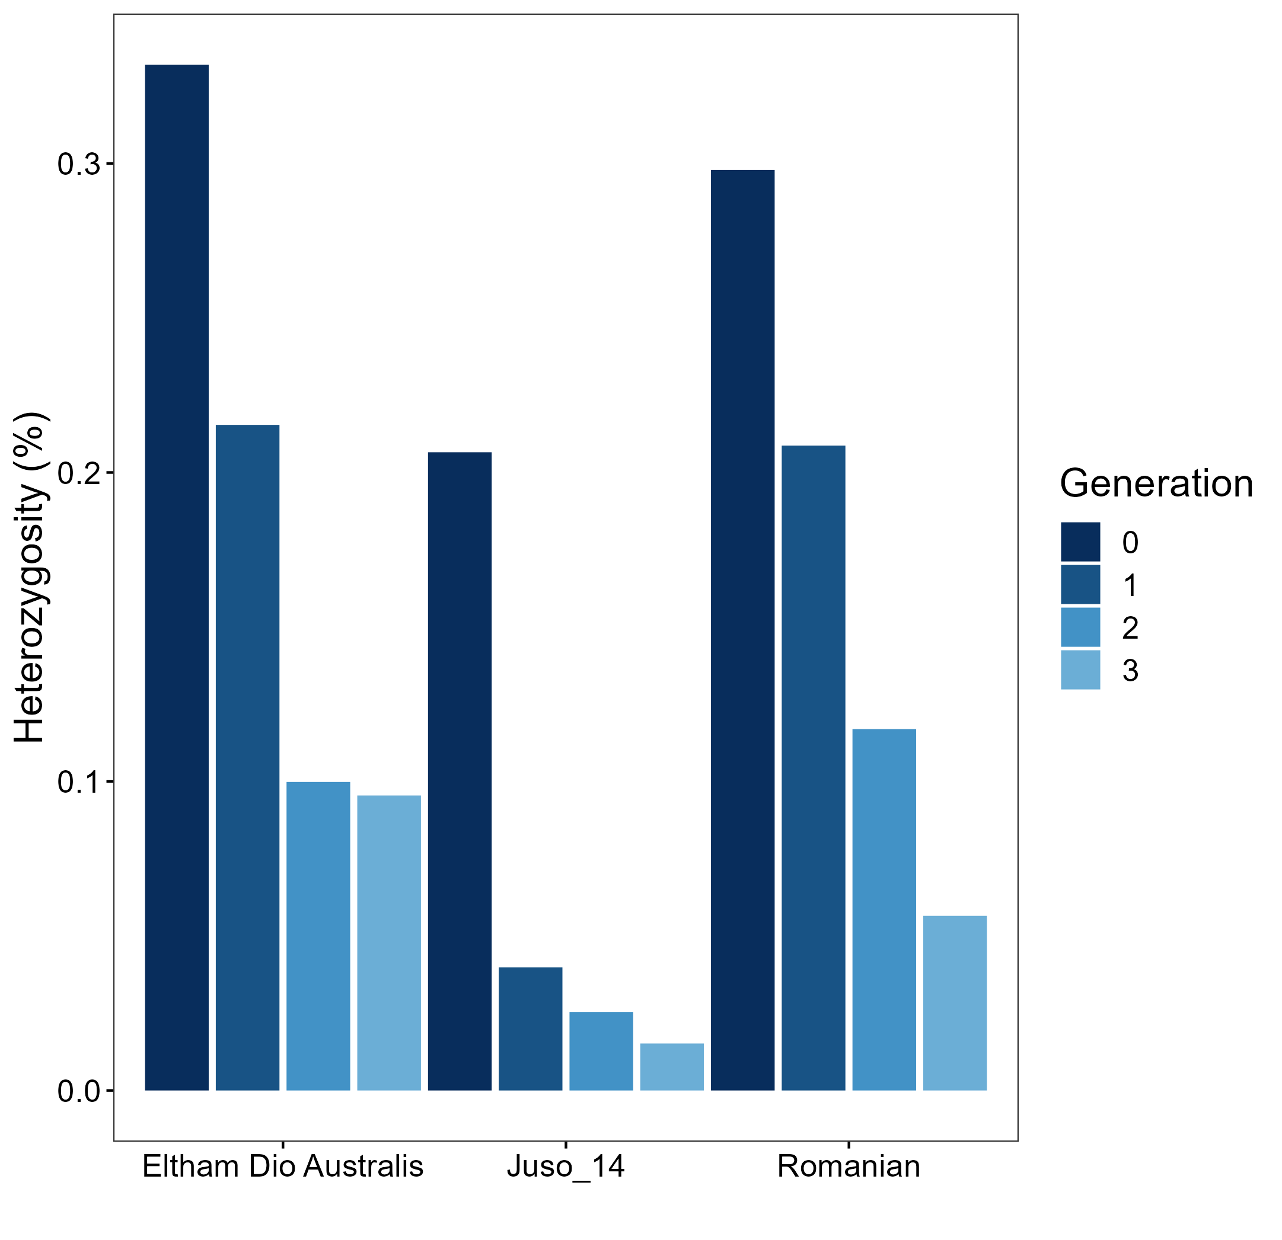
Supplementary Figure 2: Heterozygosity of successive inbreeds
Heterozygosity rates (%) of three rounds of inbreeding (Generation 1-3, lighter blue) from an original female individual (Generation 0; dark blue) for three cultivars, as determined by HASCH genotyping.

