Slide 1
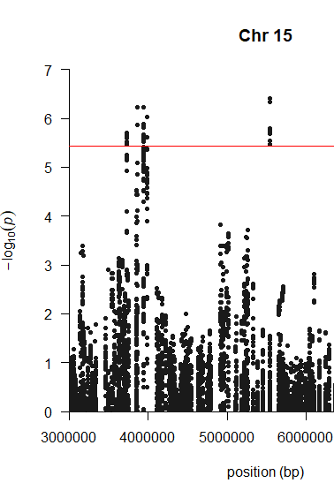
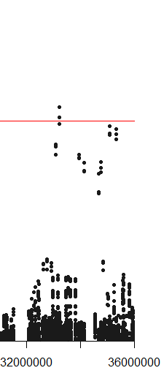
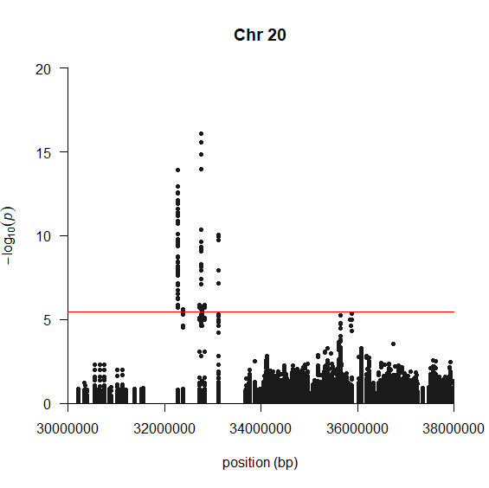
a
b
//
Fig. S1 Genome-wide association analysis of the 621 soybean accessions for amino acids using multi-locus mixed models. The trait associations (Approach II) on chromosomes 15 (a) and 20 (b) were plotted by all environments combined (ALL). Red horizontal line in the Manhattan plots indicate the genome-wide (5%) significance threshold. Traits above the threshold were colored by the same biochemical family and listed in the table according to significance in order if a SNP was linked with multiple traits. Positions are based on G. max genome assembly version Glyma.Wm82.a2.v1 (Gmax2.0) (http://soybase.org).

Slide 2
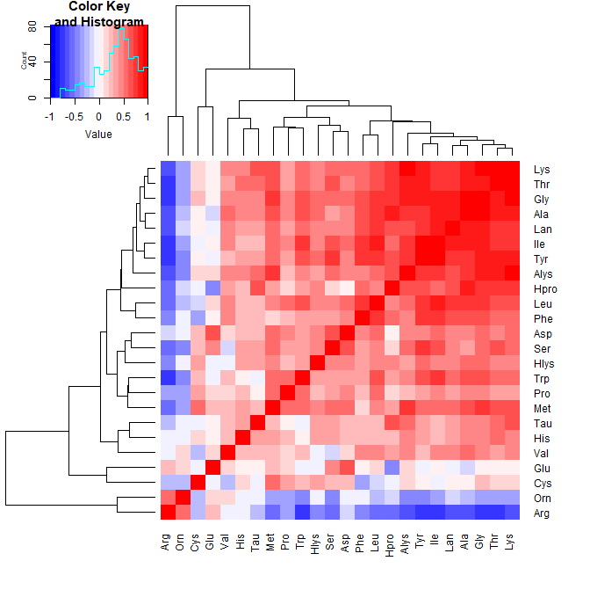
Fig. S2 Trait correlation heatmap across environments (ALL) using 621 soybean accessions. Pearson’s correlation matrix was calculated from the BLUP values.

Slide 3
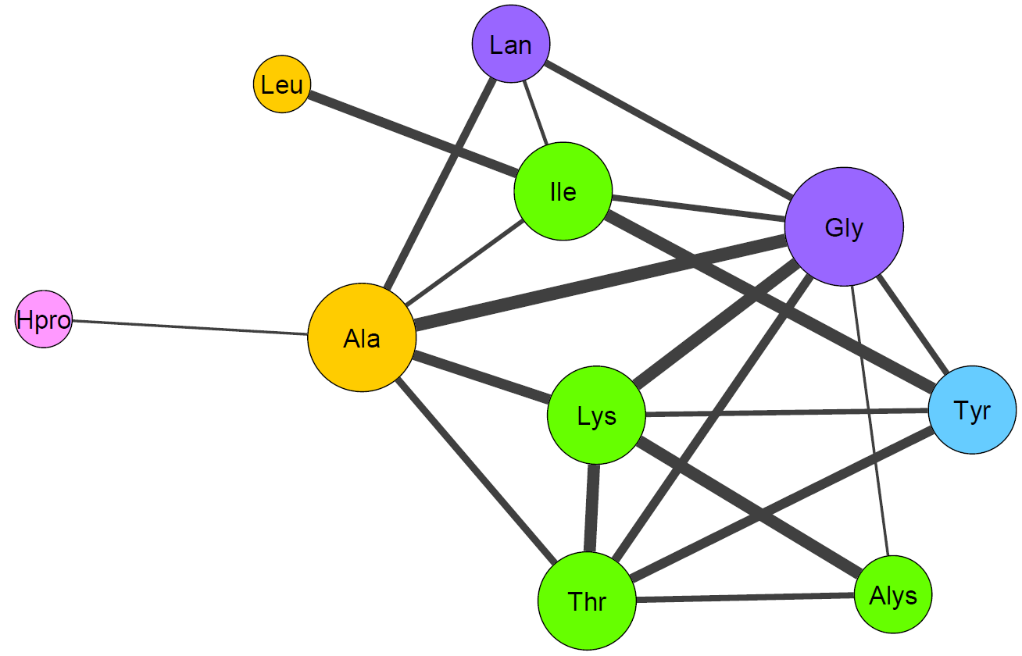
Fig. S3 Correlation-based network of soybean seed amino acid relationships across environments (ALL) using 621 soybean accessions. Pearson’s correlation matrix was calculated from the BLUP values. Each node and each edge represent an amino acid and correlations between pairs of amino acids (r ≥ ±0.8 and P ≤ 0.001), respectively. Node size and colors reflect nodal degree and the amino acid family. The strength of the correlation is presented by edge width.

Slide 4
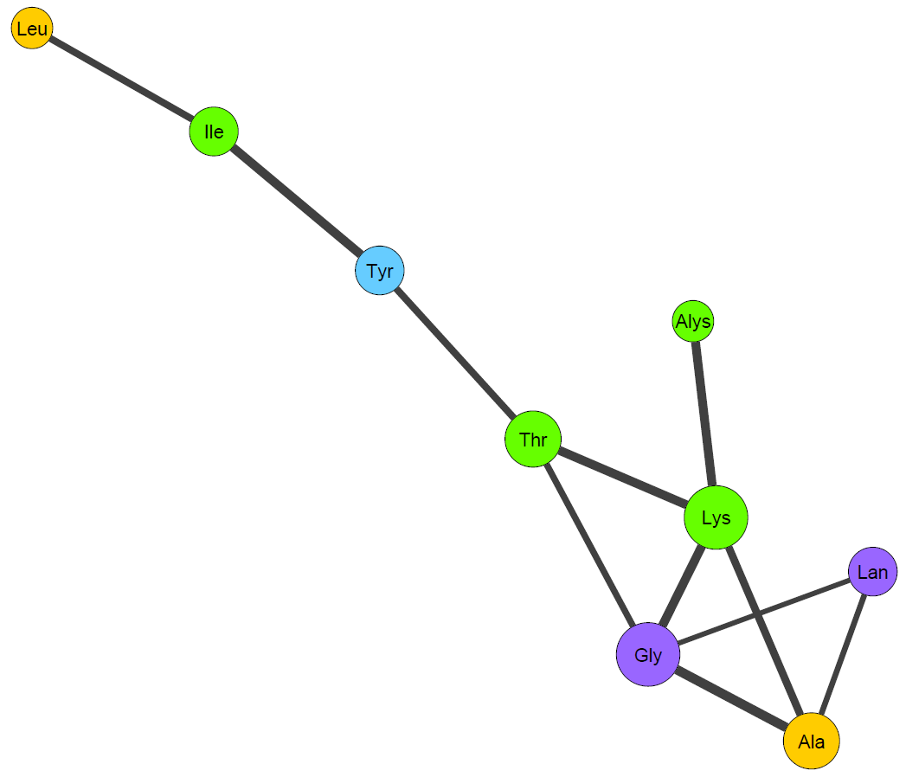
0.87
0.91
0.88
0.91
0.91
0.86
0.89
0.90
0.86
Fig. S4 Correlation-based network of soybean seed amino acid relationships across environments (ALL) using 621 soybean accessions. Correlations between pairs of amino acids (r ≥ ±0.85 and P ≤ 0.001) was used and other descriptions were the same as Fig. S3.
0.86
0.92

