Slide 1
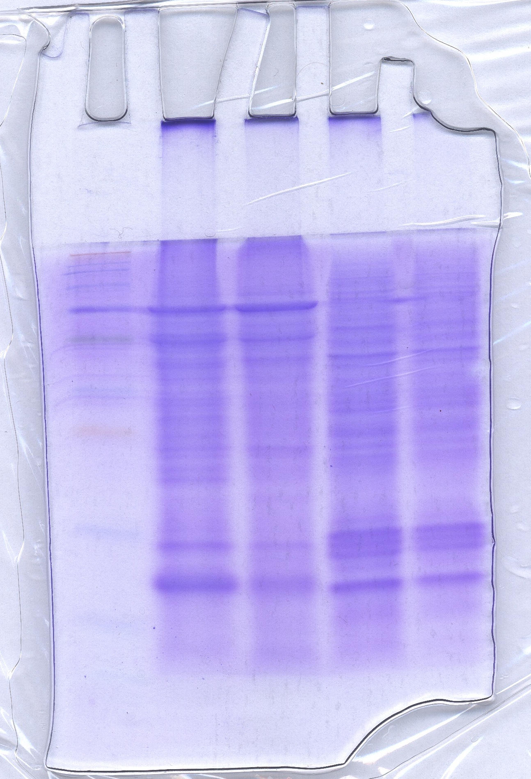
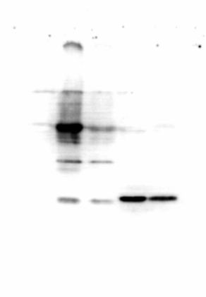
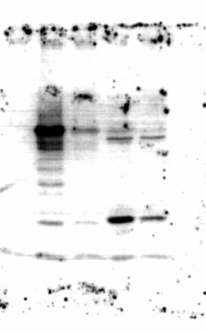
A
kDa
P
A
NB4
NB4
270
95
62
56
37
30
Human H3
L. infantum H3
16
6.5
B
kDa
P
A
NB4
NB4
kDa
P
A
NB4
NB4
16
H3K4me3
16
Total H3
Fig. 2. Evaluation of the ability of the anti-H3K4me3 antibody used in the study to recognize its target in L. infantum. (A) Total lysates from L. infantum promastigotes (P), amastigotes (A) and human acute promyelocytic leukemia NB4 cell line were separated by SDS-PAGE and stained with Coomassie Brilliant Blue to observe histones separation pattern. Putative Leishmania histone H3 (~15 kDa) and human histone H3 (~16 kDa) are indicated by arrows. (B) Western blot analysis of whole-cell lysates of L. infantum promastigotes (P), amastigotes (A) and NB4 cell line performed with the anti-H3K4me3 antibody used in the study (left panel) and an anti-histone H3 antibody (right panel).

