Slide 1
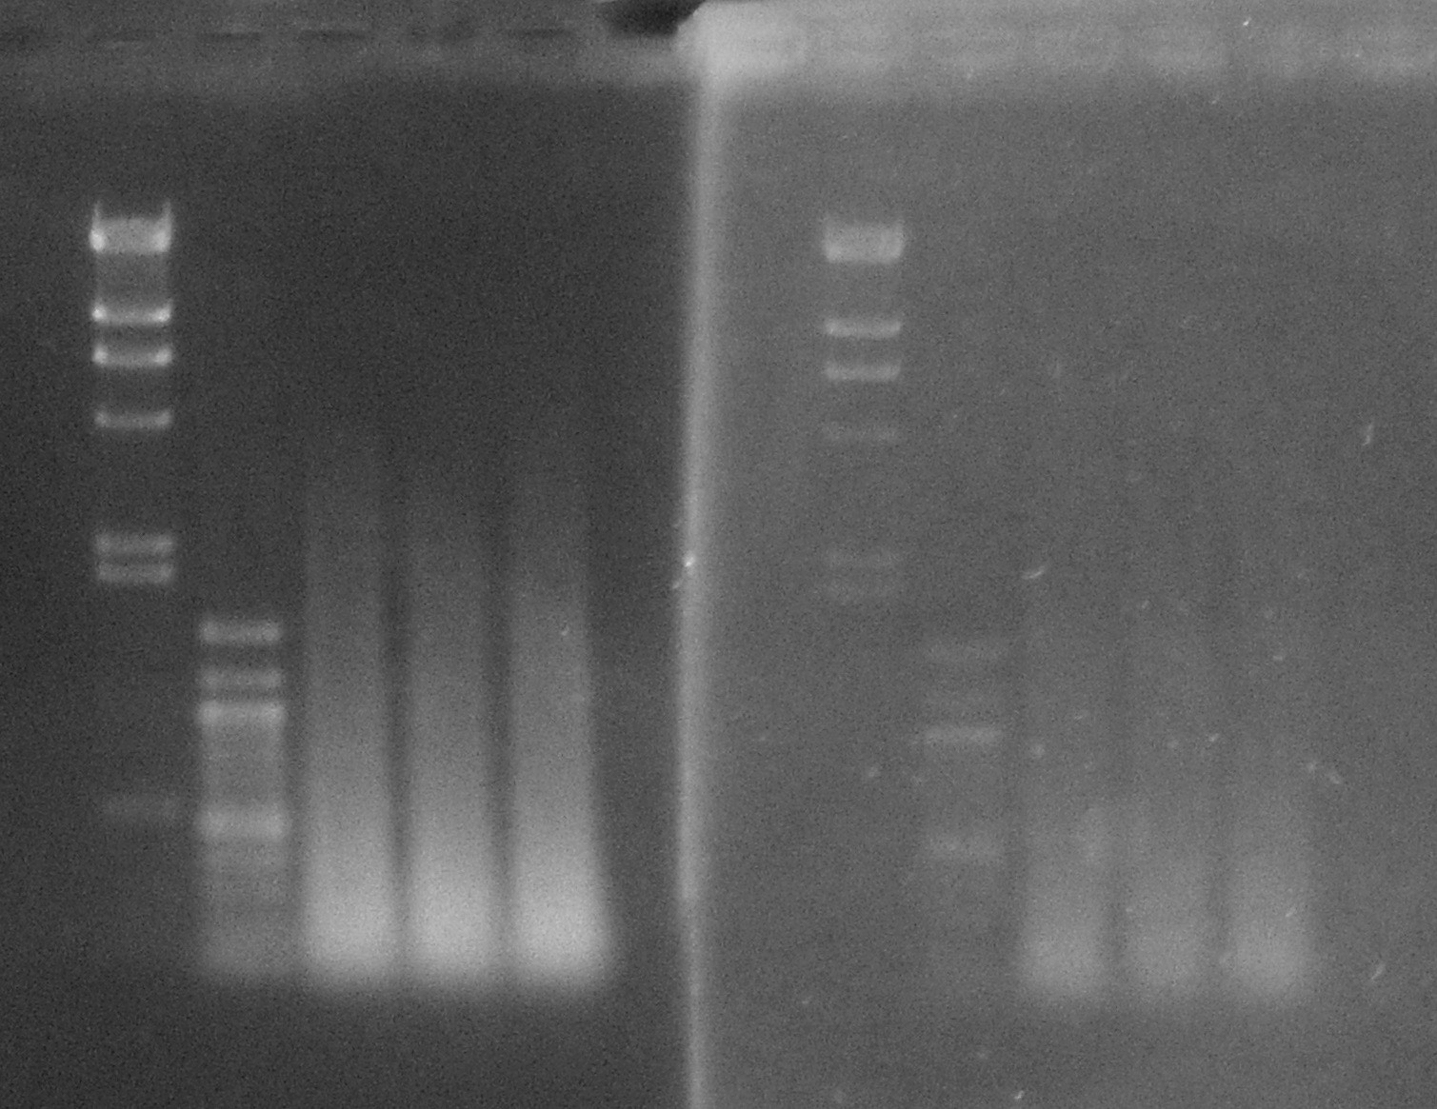
A
Not inf.
Infected
Spiked
Not inf.
Infected
Spiked
bp
23,100
4,350
2,300
1,500
1,000
500
100
Gelred batch 1
Gelred batch 2
B
C

