Slide 1
A
B
Amplicon region 1
Amplicon region 2
Amplicon region 1
Amplicon region 2
Duplicate
Duplicate
Different
Duplicate
Amplicon regions both contain identical sequences
Amplicon region 1 contains differences and Amplicon region 2 is a duplicate
C
D
Amplicon region 1
Amplicon region 2
Amplicon region 1
Amplicon region 2
Duplicate
Different
Different
Different
Amplicon region 1 is a duplicate and Amplicon region 2 contains differences
Amplicon regions both contain differences
Figure S1: Possible amplicon splits: (A) both amplicon regions contain identical sequences, (B) amplicon region 1 contains differences but amplicon region 2 is a duplicate, (C) amplicon region 1 is a duplicate but amplicon region 2 contains differences, (D) both regions contain differences

Slide 2
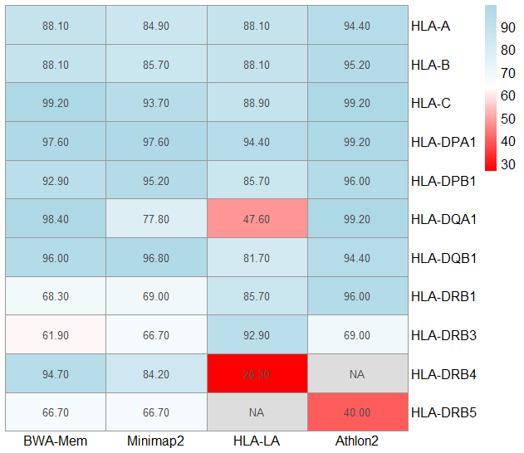
Percent Concordance
Figure S2: Percent concordance for third field resolution using different methods. Heatmap showing third field resolution concordances with BWA Mem, Minimap2, HLA-LA, and Athlon2.

