Slide 1
Supplementary material

Slide 2
Supplementary Table 1
Quality statistics of Onygenales reference genomes downloaded from NCBI database
Family | Strain |  | GenBank assambly accession | Size (Mb) | GC (%) | Contigs | L50 | # N's per 100 kbp | Complete BUSCOs (%) | Complete and single-copy BUSCOs (S) | Complete and duplicated BUSCOs (D) | Fragmented BUSCOs (F) | Missing BUSCOs
Onygenaceae | Amauroascus niger | UAMH 3544 | GCA_001430945.1 | 36,71 | 50.09 | 3,481 | 86 | 5,647.86 | 96 | 95.7 | 0.3 | 0.8 | 3.2
Onygenaceae | Amauroascus verrucosus | UAMH 3576 | GCA_001430935.1 | 30,37 | 49.26 | 3,075 | 40 | 8,888.54 | 96.7 | 96.4 | 0.3 | 0.7 | 2.6
Onygenaceae | Aphanoascus verrucosus | IHEM 4434 | GCA_014839905.1 | 23,05 | 49.59 | 211 | 17 | 10.51 | 96.3 | 95.3 | 1 | 0.7 | 0.7
Onygenaceae | Brunneospora queenslandica | CBS 280.77 | GCA_001430955.1 | 32,33 | 53.15 | 2,724 | 47 | 6,001.89 | 96.3 | 96 | 0.3 | 0.9 | 2.8
Onygenaceae | Byssoonygena ceratinophila | UAMH 5669 | GCA_001430925.1 | 27,45 | 48.44 | 4,851 | 67 | 6,870.54 | 94.1 | 93.9 | 0.2 | 1.9 | 4
Onygenaceae | Chrysosoporium keratinophilum | CBS 104.62 | GCA_029850275.1 | 25,43 | 49.09 | 25 | 4 | 10.06 | 96 | 94.1 | 1.9 | 0.6 | 3.4
Onygenaceae | Coccidioides immitis | RS | GCA_000149335.2 | 29,01 | 45.96 | 7 | 3 | 1.38 | 96.8 | 96.6 | 0.2 | 1 | 2.2
Onygenaceae | Coccidioides posadasii | C735 delta SOWgp | GCA_000151335.1 | 27,01 | 46.59 | 55 | 4 | 0.12 | 96.8 | 96.6 | 0.2 | 1 | 2.2
Onygenaceae | Nannizziopsis barbatae | USC001 | GCA_014964245.1 | 31,54 | 40.36 | 11 | 3 | 0.00 | 94.5 | 94.3 | 0.2 | 1 | 4.5
Onygenaceae | Ophidiomyces ophidiicola | MYCO-ARIZ | GCA_002167195.1 | 21,97 | 47.64 | 116 | 12 | 1.81 | 94.8 | 94.6 | 0.2 | 1 | 4.2
Onygenaceae | Uncinocarpus reesii | UAMH 1704 | GCA_000003515.2 | 22,34 | 48.66 | 45 | 2 | 812.87 | 93 | 92.8 | 0.2 | 3.5 | 3.5
Ajellomycetaceae | Blastomyces dermatitidis | ER-3 | GCA_000003525.2 | 66,6 | 37.07 | 27 | 5 | 507.46 | 97.7 | 97.6 | 0.1 | 0.6 | 1.7
Ajellomycetaceae | Blastomyces emzantsi | MRL_BACNE1992 | GCA_003206725.1 | 34,04 | 51.45 | 3,364 | 349 | 71.60 | 95.8 | 95.6 | 0.2 | 2.1 | 2.1
Ajellomycetaceae | Blastomyces gilchristii | SLH14081 | GCA_000003855.2 | 75,4 | 35.75 | 103 | 8 | 1,340.71 | 97.6 | 97.5 | 0.00 | 0.7 | 1.7
Ajellomycetaceae | Blastomyces percursus | IHEM 26956 | GCA_018296065.1 | 32,69 | 47.39 | 4,782 | 746 | 87.64 | 96.4 | 96.2 | 0.2 | 1.8 | 1.8
Ajellomycetaceae | Blastomyces silverae | UAMH 139 | GCA_001014755.1 | 30,96 | 44.45 | 3,706 | 281 | 741.04 | 88.5 | 88.5 | 0.1 | 5.2 | 6.2
Ajellomycetaceae | Emergomyces africanus | CBS 136260 | GCA_001660665.1 | 29,7 | 43.45 | 4,444 | 591 | 4.71 | 89.4 | 88.8 | 0.6 | 6.6 | 4
Ajellomycetaceae | Emergomyces orientalis | 5z489 | GCA_002110485.1 | 35,49 | 45.60 | 108 | 9 | 0.00 | 98.3 | 98 | 0.3 | 0.3 | 1.4
Ajellomycetaceae | Emergomyces pasteurensis | UAMH 9510 | GCA_001883825.1 | 32,41 | 44.48 | 1,643 | 200 | 89.88 | 97.8 | 97.6 | 0.2 | 0.7 | 1.5
Ajellomycetaceae | Emmonsia crescens | UAMH 4076 | GCA_002572855.1 | 33,75 | 42.90 | 1,288 | 104 | 44.17 | 98.3 | 98.1 | 0.2 | 0.5 | 1.2
Ajellomycetaceae | Emmonsia parva | UAMH 130 | GCA_002572885.1 | 27,83 | 47.48 | 383 | 52 | 15.30 | 98.3 | 98.2 | 0.1 | 0.4 | 1.3
Ajellomycetaceae | Helicocarpus griseus | UAMH 5409 | GCA_002573585.1 | 32,03 | 47.97 | 546 | 78 | 44.83 | 98.4 | 98.1 | 0.3 | 0.5 | 1.1
Ajellomycetaceae | Histoplasma capsulatum | G186AR | GCA_000150115.1 | 30,48 | 44.54 | 88 | 6 | 660.58 | 96.6 | 96.5 | 0.1 | 1.4 | 2
Ajellomycetaceae | Histoplasma mississippiense | NAm1 | GCA_000149585.1 | 33,03 | 46.13 | 280 | 4 | 7,208.57 | 88.9 | 88.9 | 0 | 5.5 | 5.6
Ajellomycetaceae | Histoplasma ohiense | G217B | GCA_017607445.1 | 39,44 | 42.63 | 12 | 3 | 0.00 | 97 | 96.8 | 0.2 | 0.8 | 2.2
Ajellomycetaceae | Paracoccidioides brasiliensis | Pb18 | GCA_000150735.2 | 29,95 | 44.35 | 57 | 5 | 1,615.27 | 96.1 | 96 | 0.1 | 1 | 2.9
Ajellomycetaceae | Paracoccidioides lutzii | Pb01 | GCA_000150705.2 | 32,92 | 42.82 | 110 | 12 | 911.20 | 96.6 | 96.5 | 0.1 | 1.2 | 2.2
Arthrodermataceae | Arthroderma crocatum | CBS 281.48 | GCA_000812245.1 | 21,7 | 48.16 | 521 | 31 | 0.00 | 96.1 | 96.1 | 0 | 1 | 2.9
Arthrodermataceae | Arthroderma uncinatum | CBS 119779 | GCA_011692745.1 | 23,56 | 48.65 | 5 | 2 | 0.00 | 97.6 | 97.5 | 0.1 | 0.5 | 1.9
Arthrodermataceae | Microsporum audouinii | IHEM 2214 | GCA_022344085.1 | 23,41 | 47.35 | 7 | 2 | 214.21 | 97.6 | 97.5 | 0.1 | 0.9 | 1.5
Arthrodermataceae | Microsporum canis | CBS 113480 | GCA_000151145.1 | 23,26 | 47.50 | 17 | 4 | 539.94 | 97 | 96.9 | 0.1 | 1.1 | 1.9
Arthrodermataceae | Nannizzia gypsea | CBS 118893 | GCA_000150975.2 | 23,27 | 48.46 | 19 | 3 | 676.42 | 97.1 | 97 | 0.1 | 1.3 | 1.6
Arthrodermataceae | Trichophyton benhamiae | CBS 112371 | GCA_000151125.2 | 22,22 | 48.75 | 68 | 10 | 0.02 | 97.7 | 97.7 | 0 | 0.9 | 1.4
Arthrodermataceae | Trichophyton equinum | CBS 127.97 | GCA_000151175.1 | 24,15 | 47.37 | 125 | 22 | 2,820.12 | 92.1 | 92 | 0.1 | 2.9 | 5
Arthrodermataceae | Trichophyton interdigitale | UCMS-IGIB-CI11 | GCA_019359935.1 | 22,04 | 48.75 | 815 | 101 | 49.60 | 97.5 | 97.5 | 0 | 1.1 | 1.4
Arthrodermataceae | Trichophyton kuryangei | IHEM 4712 | GCA_910591595.1 | 22,21 | 48.23 | 18 | 4 | 55.73 | 97.8 | 97.8 | 0 | 0.6 | 1.6
Arthrodermataceae | Trichophyton mentagrophytes | D15P127 | GCA_003664465.1 | 23,71 | 47.88 | 1,842 | 85 | 1.49 | 97.6 | 97.6 | 0 | 1 | 1.4
Arthrodermataceae | Trichophyton rubrum | CBS 118892 | GCA_000151425.1 | 22,53 | 48.28 | 36 | 4 | 1,784.51 | 96.9 | 96.9 | 0 | 1.2 | 1.9
Arthrodermataceae | Trichophyton schoenleinii | CMCC(F)T2s | GCA_018357685.1 | 23,77 | 47.21 | 15 | 2 | 0.00 | 97.9 | 97.9 | 0 | 0.7 | 1.4
Arthrodermataceae | Trichophyton simii | IHEM 4420 | GCA_014839955.1 | 23,42 | 47.58 | 290 | 15 | 1.40 | 98 | 98 | 0 | 0.8 | 1.2
Arthrodermataceae | Trichophyton soudanense | IHEM 19744 | GCA_910592025.1 | 22,34 | 48.15 | 19 | 4 | 38.91 | 98 | 98 | 0 | 0.7 | 1.3
Arthrodermataceae | Trichophyton tonsurans | CBS 112818 | GCA_000151455.1 | 22,98 | 48.12 | 111 | 20 | 2,101.90 | 94.9 | 94.9 | 0 | 2.6 | 2.5
Arthrodermataceae | Trichophyton verrucosum | HKI 0517 | GCA_000151505.1 | 22,54 | 48.24 | 523 | 94 | 7.95 | 97.3 | 97.3 | 0 | 1 | 1.7
Arthrodermataceae | Trichophyton violaceum | IHEM 13775 | GCA_910591785.1 | 22,19 | 48.30 | 19 | 4 | 55.25 | 97.3 | 97.3 | 0 | 0.9 | 1.8
Arthrodermataceae | Trichophyton yaoundei | IHEM 13375 | GCA_910592095.1 | 22,36 | 48.11 | 17 | 4 | 40.91 | 97.4 | 97.4 | 0 | 1 | 1.6
Ascosphaeraceae | Ascosphaera apis | ARSEF 7405 | GCA_001636715.1 | 20,31 | 47.66 | 82 | 13 | 1,369.07 | 81.5 | 81.3 | 0.2 | 5.1 | 13.4
Spiromastigoidaceae | Spiromastix sp. | SCSIO F190 | GCA_014805645.1 | 38,12 | 44.75 | 22 | 3 | 0.00 | 95.9 | 95.3 | 0.6 | 0.8 | 3.3
Incertae sedis | Polytolypa hystricis | UAMH 7299 | GCA_002573605.1 | 34,69 | 45.63 | 641 | 79 | 11.26 | 97.3 | 97.2 | 0.1 | 0.9 | 1.8

Slide 3
Supplementary Table 2
Statistics of select genomes that were part of the custom database
Species (Strain) |  | Aphanoascus verrucosus (IHEM 4434) | Arthroderma uncinatum (CBS 119779) | Chrysosoporium keratinophilum (CBS 104.62) | Nannizzia gypsea (CBS 118893) | Trichophyton benhamiae (CBS 112371)
GenBank assambly accession |  | GCA_014839905.1 | GCA_011692745.1 | GCA_029850275.1 | GCA_000150975.2 | GCA_000151125.2
# Contigs |  | 211 | 5 | 25 | 19 | 68
Total length (bp) |  | 23,059,040 | 23,563,256 | 25,439,844 | 23,272,942 | 22,224,160
Largest contig (bp) |  | 894,230 | 6,630,942 | 5,001,415 | 5,365,613 | 2,108,575
G+C content (%) |  | 49.59 | 48.65 | 49.09 | 48.46 | 48.75
N50 (bp) |  | 431,853 | 6,243,631 | 2,037,736 | 3,227,799 | 644,461
N90 (bp) |  | 132,993 | 3,340,665 | 460,884 | 1,025,350 | 288,963
L50 |  | 17 | 2 | 4 | 3 | 10
L90 |  | 52 | 4 | 14 | 8 | 30
# N's per 100 kbp |  | 10.51 | 0.00 | 10.06 | 676.42 | 0.02
Onygenales_odb10 | C* (%) | 96.3 | 97.6 | 96.0 | 97.1 | 97.7
 | F* (%) | 0.7 | 0.5 | 0.6 | 1.3 | 0.9
 | M* (%) | 3.0 | 1.9 | 3.4 | 1.6 | 1.4
 | n* | 4,862 | 4,862 | 4,862 | 4,862 | 4,862
Archaea_odb10 |  | C:18.0%,n:194 | C:18.5%,n:194 | C:19.6%,n:194 | C:18.0%,n:194 | C:16.5%,n:194
Bacteria_odb10 |  | C:12.9%,n:124 | C:12.1%,n:124 | C:10.5%,n:124 | C:10.5%,n:124 | C:10.5%,n:124
Eukaryota_odb10 |  | C:99.2%,n:255 | C:98.0%,n:255 | C:98.4%,n:255 | C:98.4%,n:255 | C:97.7%,n:255
Viruses |  | 0.01 | 0.02 | 0.01 | 0.01 | 0.02
Archaea |  | 0.04 | 0.06 | 0.05 | 0.07 | 0.04
Bacteria |  | 1.20 | 1.10 | 1.44 | 1.11 | 4.98
Eukaryota |  | 0.28 | 1.12 | 0.39 | 0.41 | 0.58
Total |  | 1.53 | 2.3 | 1.89 | 1.6 | 5.61
C*,Complete BUSCOs; F*, Fragmented BUSCOs; M*, Missing BUSCOs; n, Total BUSCO groups searched

Slide 4
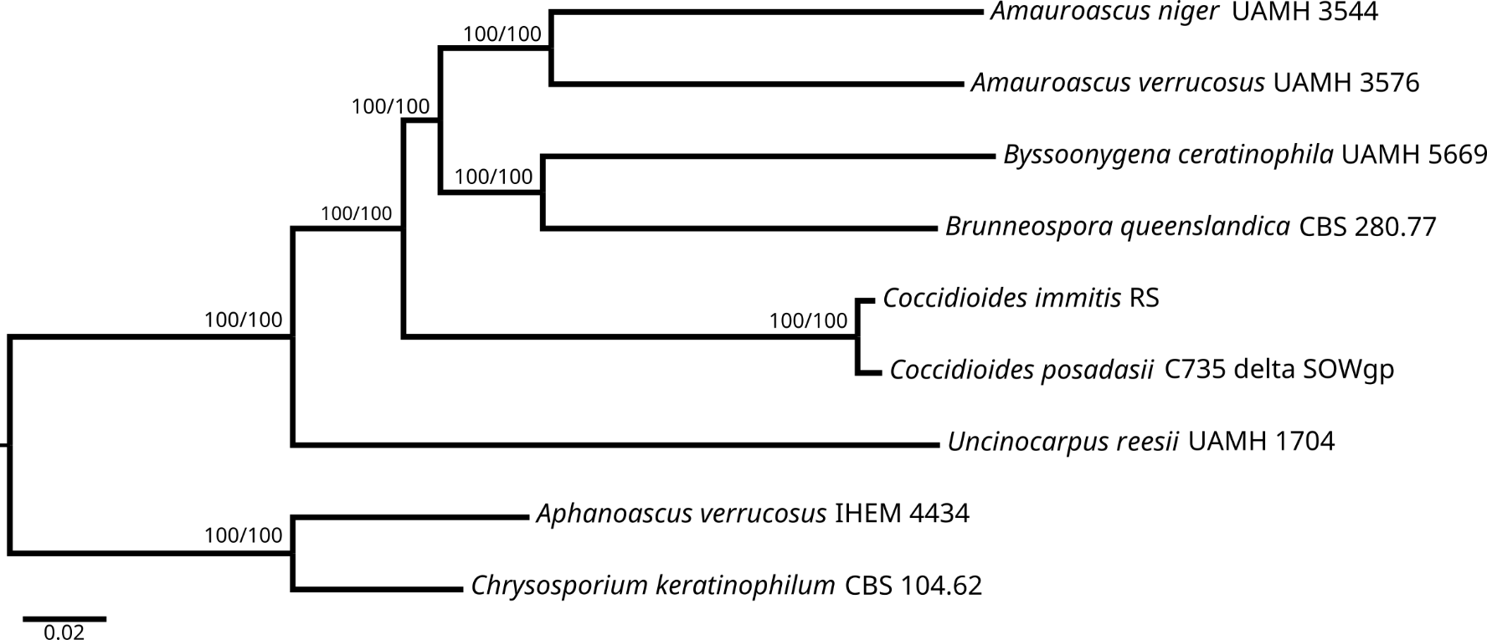
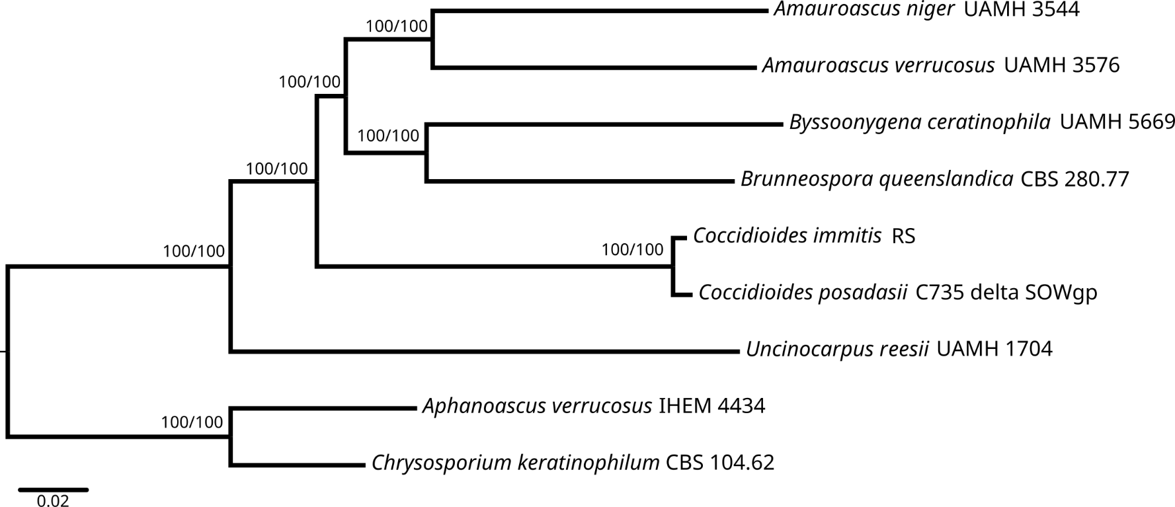
Fig 6
A
Supplementary figure 1
Maximum likelihood (IQ-TREE) tree of concatenated single copy orthologous using JTT+I+G4+F model and 1000 ultrafast bootstrap replicates.
A) Analysis performed with the original genomes. B) Analysis performed with the filtered genomes.
B

Slide 5
Supplementary Table 3
NCBI FCS genome report from analyzed genomes
Family | Strain |  | GenBank assambly accession | NCBI FCS Genome Report
Onygenaceae | Amauroascus niger | UAMH 3544 | GCA_001430945.1 | https://ftp.ncbi.nlm.nih.gov/genomes/all/GCA/001/430/945/GCA_001430945.1_ASM143094v1/GCA_001430945.1_ASM143094v1_fcs_report.txt
Onygenaceae | Amauroascus verrucosus | UAMH 3576 | GCA_001430935.1 | https://ftp.ncbi.nlm.nih.gov/genomes/all/GCA/001/430/935/GCA_001430935.1_ASM143093v1/GCA_001430935.1_ASM143093v1_fcs_report.txt
Onygenaceae | Aphanoascus verrucosus | IHEM 4434 | GCA_014839905.1 | https://ftp.ncbi.nlm.nih.gov/genomes/all/GCA/001/430/925/GCA_001430925.1_ASM143092v1/GCA_001430925.1_ASM143092v1_fcs_report.txt
Onygenaceae | Brunneospora queenslandica | CBS 280.77 | GCA_001430955.1 | https://ftp.ncbi.nlm.nih.gov/genomes/all/GCA/001/430/955/GCA_001430955.1_ASM143095v1/GCA_001430955.1_ASM143095v1_fcs_report.txt

