Slide 1
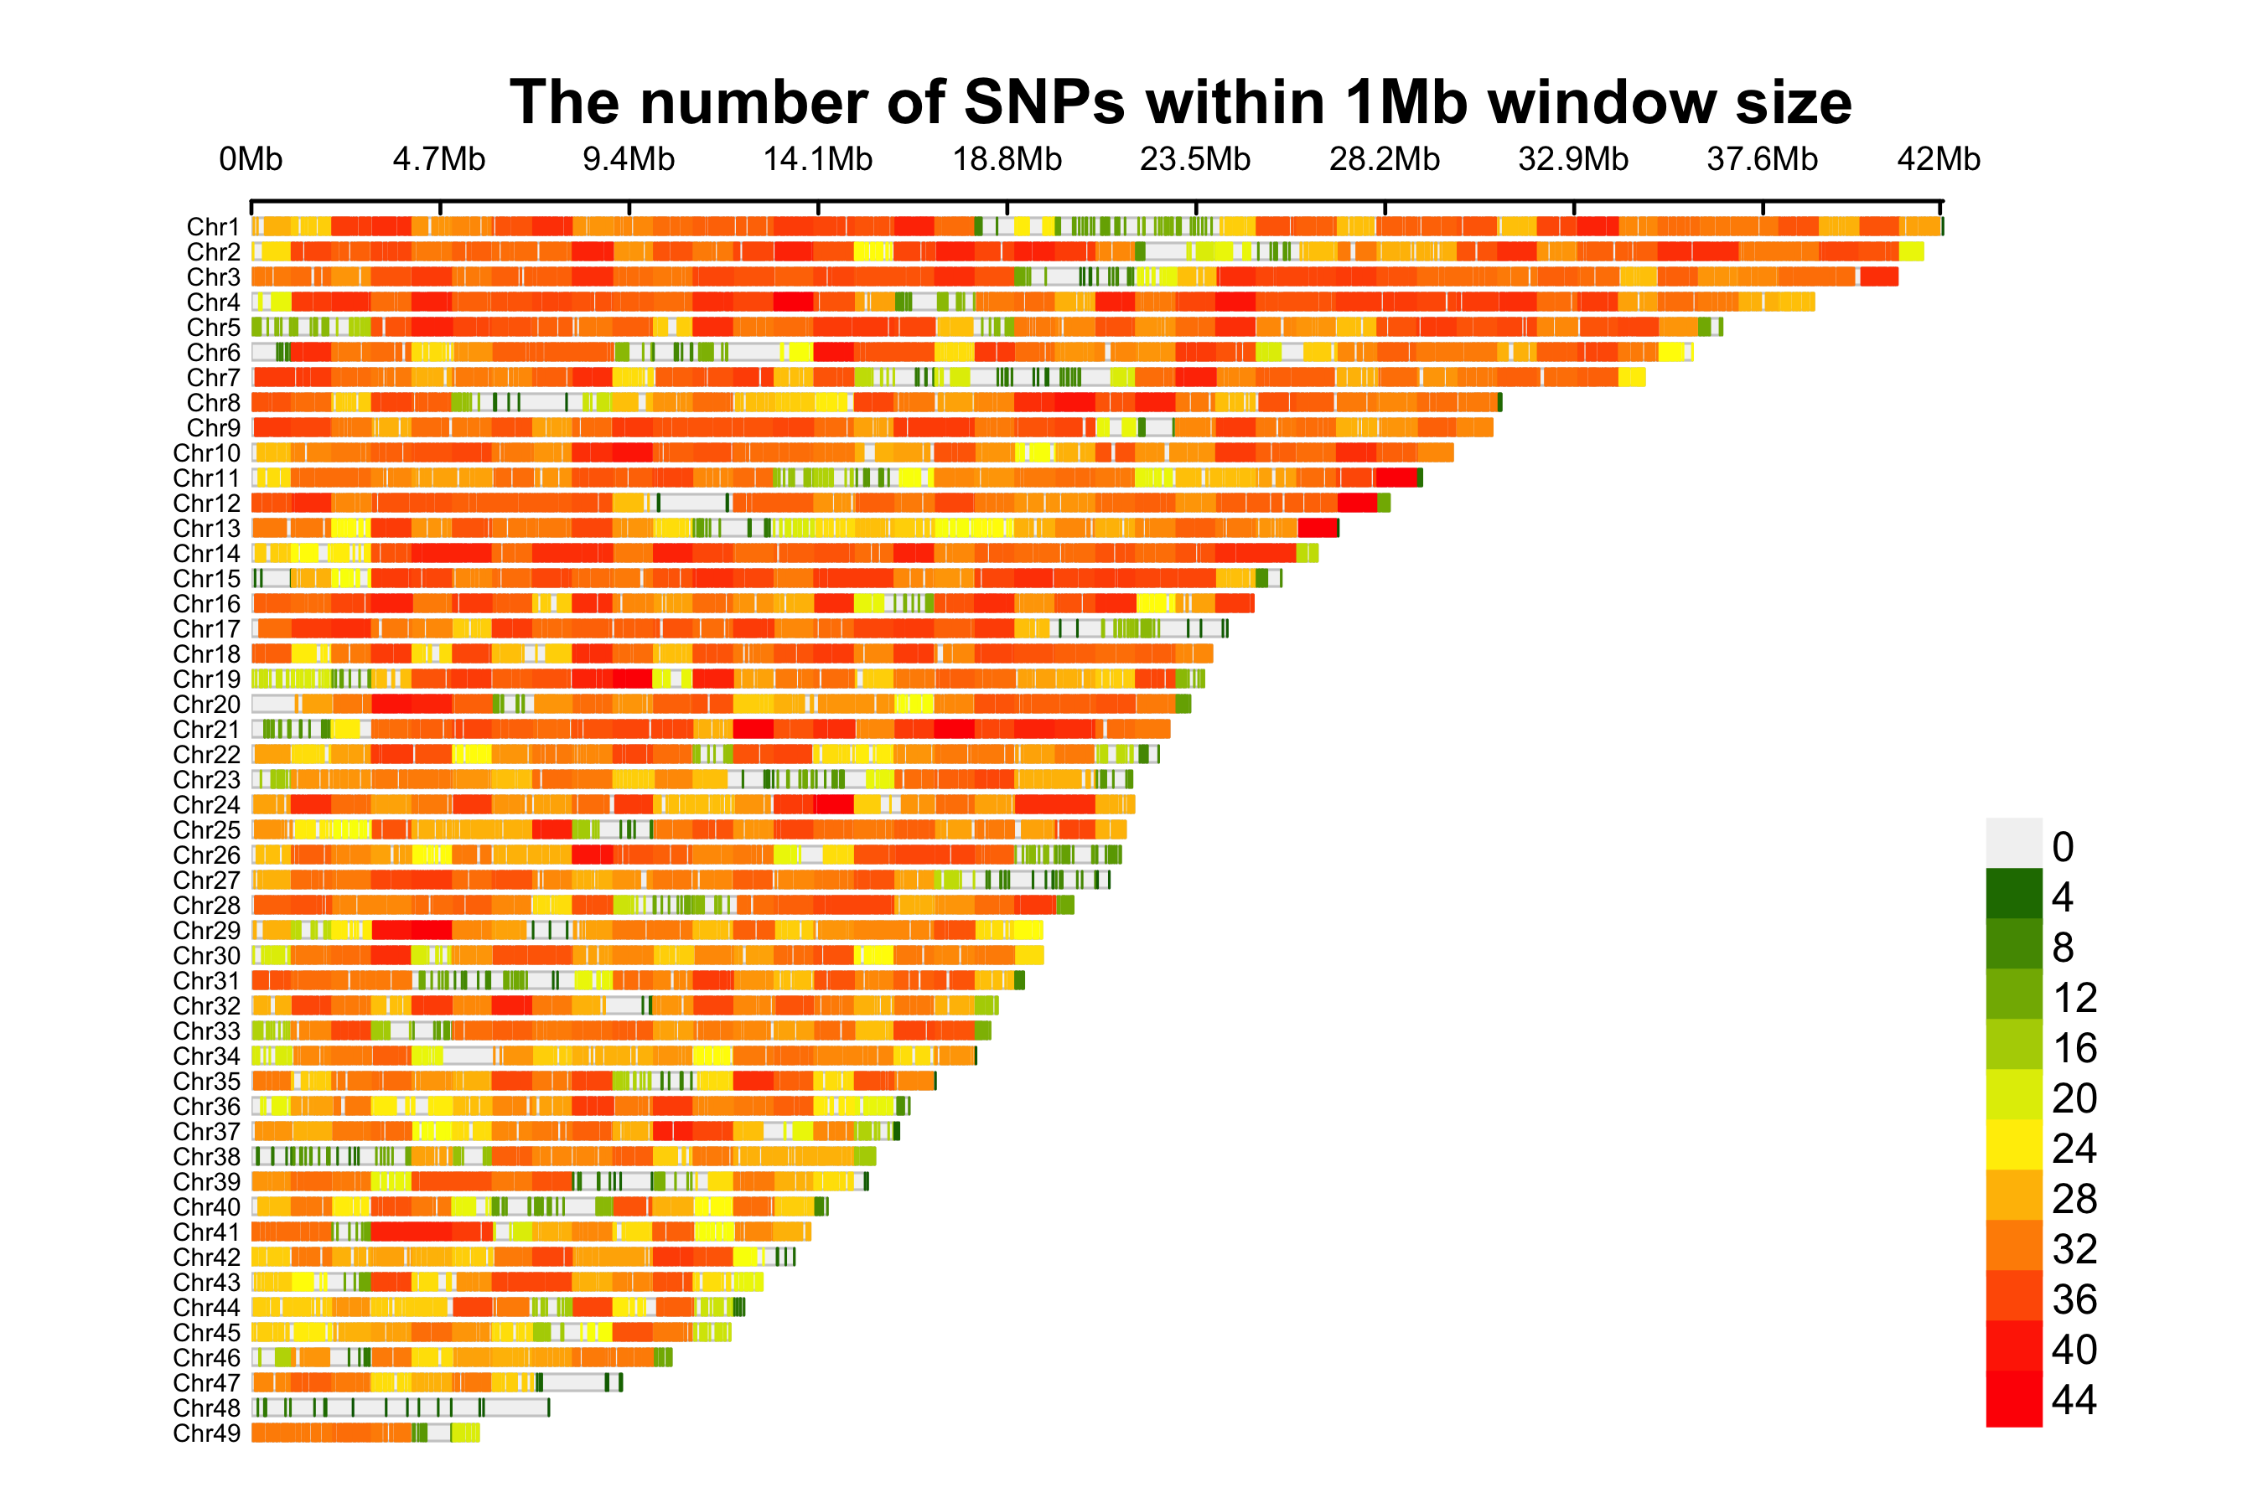
Figure S1. SNP density distribution across 49 chromosomes.

Slide 2
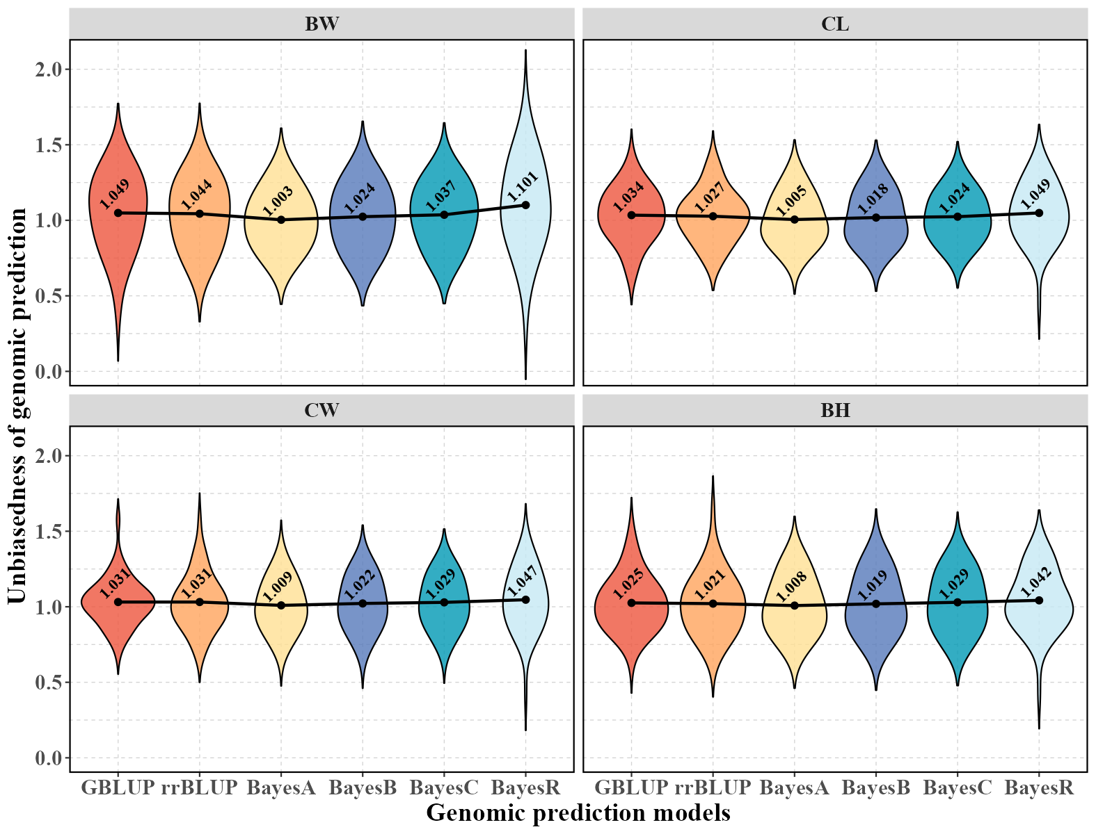
Figure S2. Prediction unbiasedness for four growth-related traits of mud crab based on different statistical models.

Slide 3
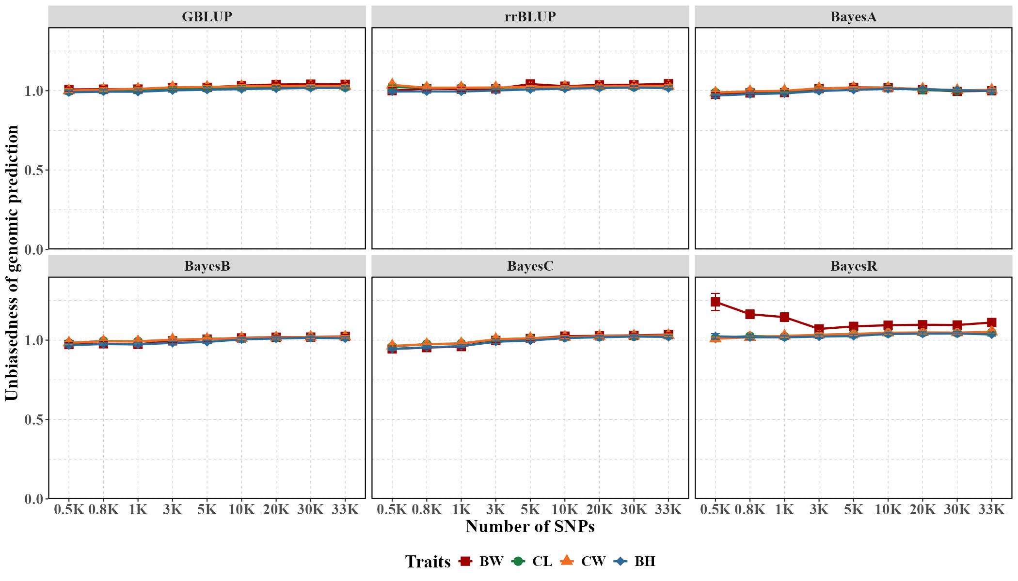
Figure S3. Prediction unbiasedness for four growth-related traits of mud crab using different statistical models based on different SNP densities.

Slide 4
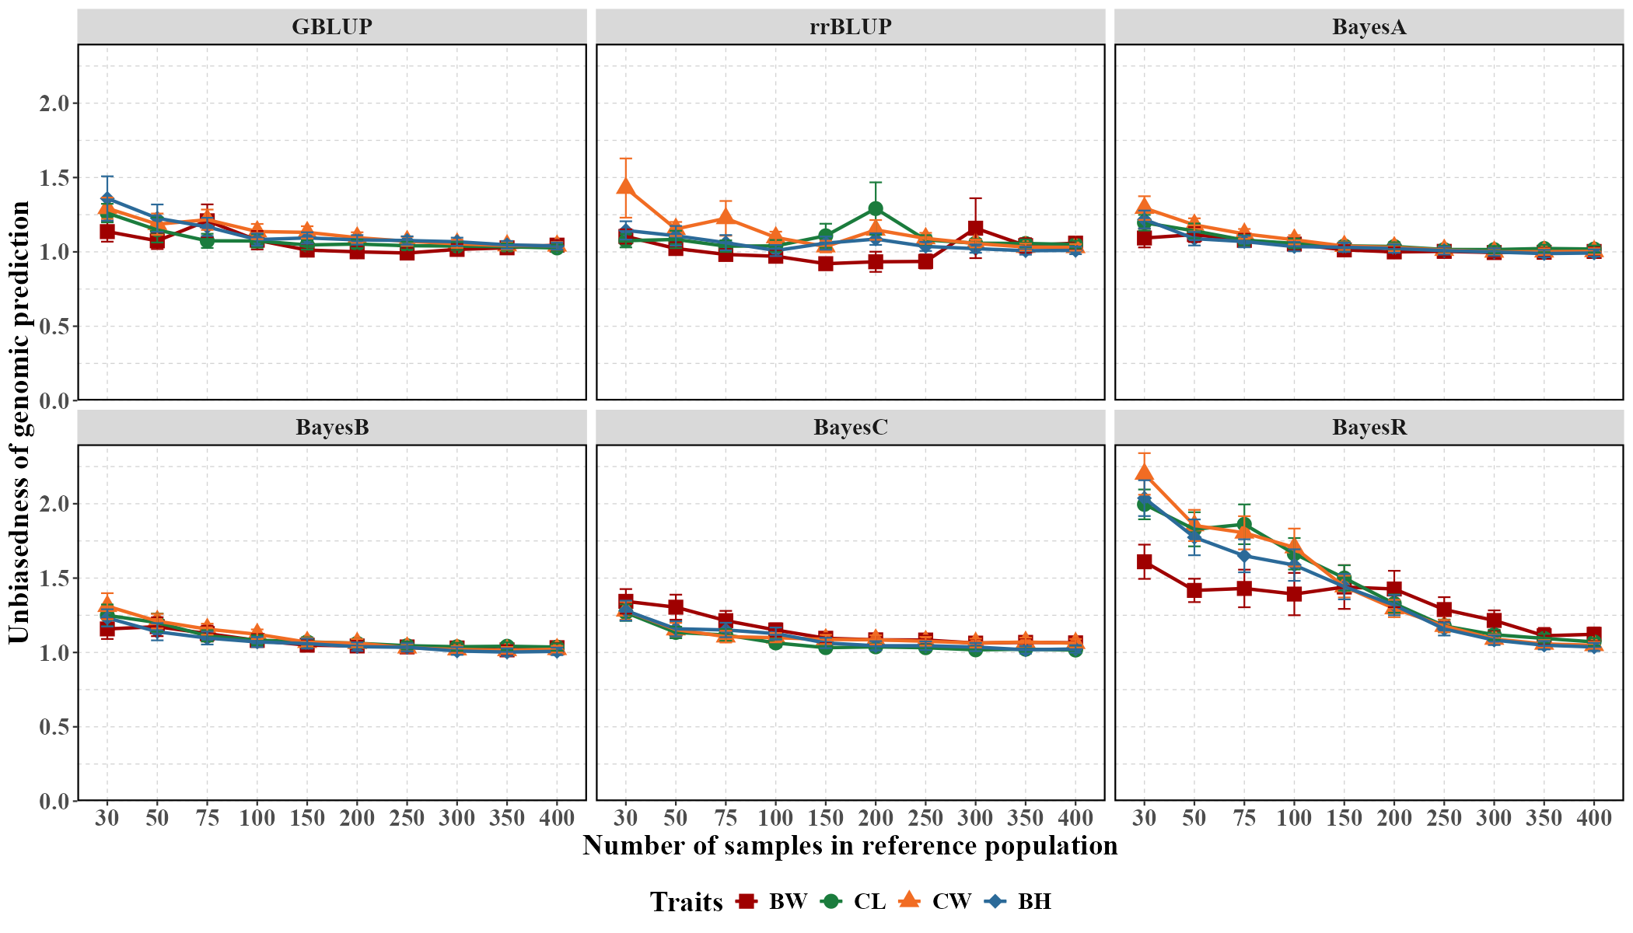
Figure S4. Prediction unbiasedness for four growth-related traits of mud crab using different statistical models based on different size reference populations.

Slide 5
Table S1. The p values of significance tests between different statistic models.
Groups | BW | CL | CW | BH
rrBLUP-GBLUP | 0.9999296326 | 0.9999965281 | 0.9999999653 | 0.9999885440
BayesA-GBLUP | 0.9999940134 | 0.9999814059 | 1.0000000000 | 0.9998523072
BayesB-GBLUP | 0.9999998101 | 0.9999445669 | 0.9999866706 | 0.9997451857
BayesC-GBLUP | 0.9998736458 | 0.9999999740 | 0.9999999963 | 0.9999983850
BayesR-GBLUP | 0.9999995855 | 0.9999994461 | 0.9999999623 | 0.9999762657
BayesA-rrBLUP | 0.9999993403 | 0.9999999638 | 0.9999999502 | 0.9999983786
BayesB-rrBLUP | 0.9999884161 | 0.9999991942 | 0.9999977984 | 0.9999942103
BayesC-rrBLUP | 0.9999999977 | 0.9999996676 | 0.9999995891 | 0.9999999579
BayesR-rrBLUP | 0.9999921065 | 0.9999525504 | 0.9999988464 | 0.9999999989
BayesB-BayesA | 0.9999998129 | 0.9999999829 | 0.9999850958 | 0.9999999966
BayesC-BayesA | 0.9999973479 | 0.9999960567 | 0.9999999980 | 0.9999885135
BayesR-BayesA | 0.9999999261 | 0.9998642588 | 0.9999999743 | 0.9999995706
BayesC-BayesB | 0.9999735223 | 0.9999833009 | 0.9999678215 | 0.9999720046
BayesR-BayesB | 1.0000000000 | 0.9997124852 | 0.9999493747 | 0.9999978603
BayesR-BayesC | 0.9999808152 | 0.9999951972 | 0.9999999997 | 0.9999996958

Slide 6
Table S1. The computational consuming of different statistic models.
Statistic models | The number of CPUs | Memory size (GB) | Computational time | Computational memory (GB)
GBLUP | 24 | 60 | 1 min 47 s | 1.12
rrBLUP | 24 | 60 | 44 min 44 s | 1.88
BayesA | 24 | 60 | 11 h 11 min 36 s | 1.51
BayesB | 24 | 60 | 11 h 13 min 8 s | 1.52
BayesC | 24 | 60 | 10 h 11 min 46 s | 1.48
BayesR | 24 | 60 | 9 h 4 min 9 s | 0.20

