Slide 1
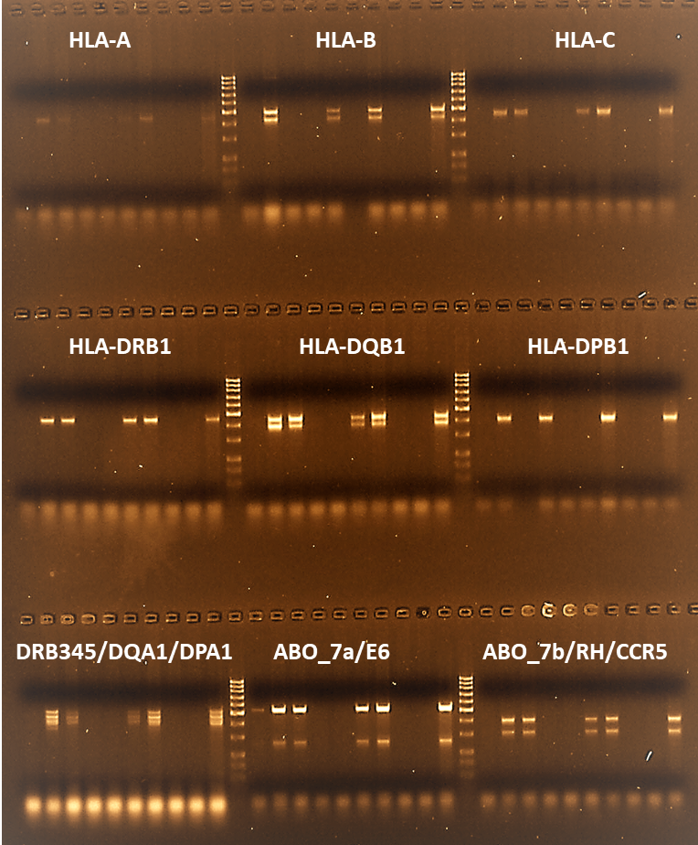
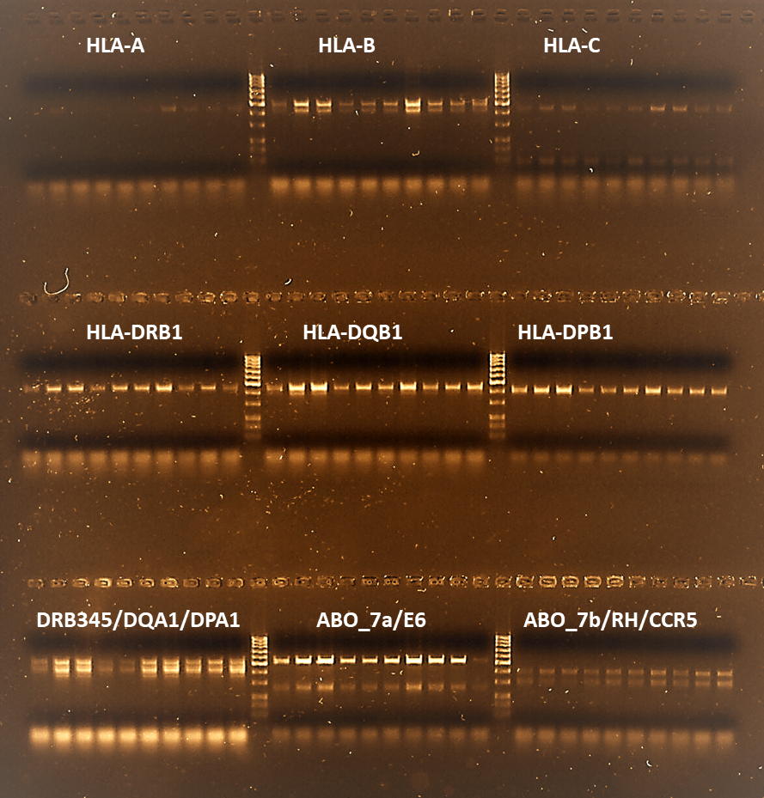
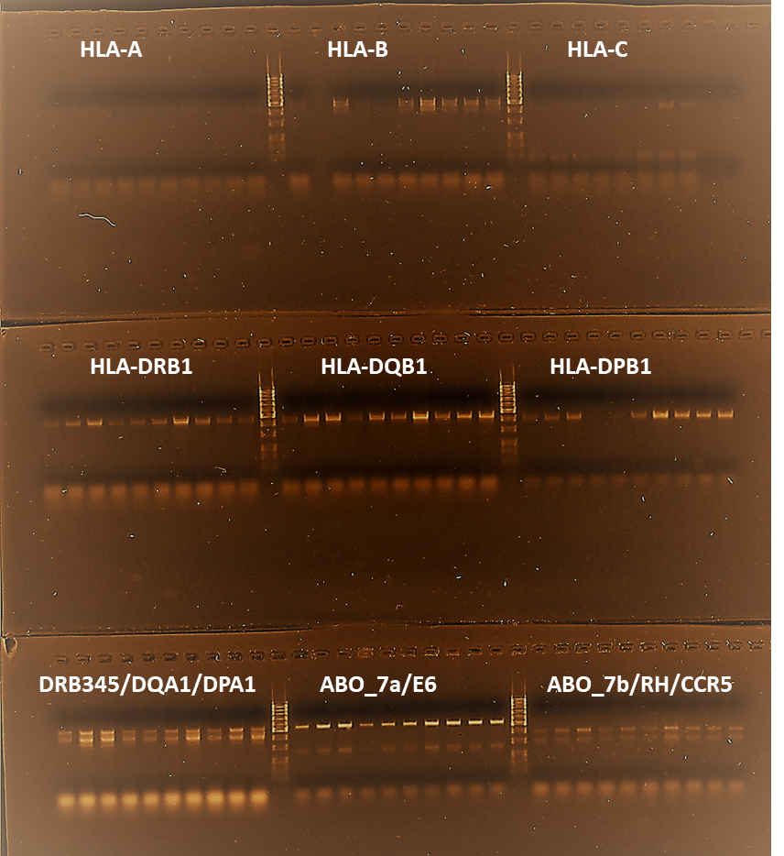
1
HLA-A
2
HLA-B
HLA-C
2
3
4
5
6
7
8
9
10
1
4
5
6
7
8
9
10
1
2
3
4
5
6
7
8
9
Sample #
-
-
3
10
-
+
+
-
+
+
+
-
+
+
-
-
+
+
-
-
+
-
-
+
+
-
-
-
+
-
+
NGS
workflow
1
2
3
4
5
6
7
8
9
10
1
2
3
4
5
6
7
8
9
Sample #
10
1
2
3
4
5
6
7
8
9
-
10
+
+
-
-
+
+
-
-
+
-
+
+
-
-
+
+
-
-
+
-
+
+
-
-
+
+
-
-
+
1:40
1:80
HLA-DRB1
HLA-DQB1
HLA-DPB1
Sample #
1
2
3
4
5
6
8
9
1
2
3
4
5
6
7
8
10
9
10
1
2
3
4
5
6
7
8
9
-
+
+
-
-
10
7
+
+
-
-
+
-
+
+
-
-
+
+
-
-
+
-
+
+
-
-
+
-
-
+
NGS
workflow
1
2
3
4
5
6
7
8
9
10
1
2
3
4
5
6
7
8
9
10
1
2
3
4
5
6
7
8
9
Sample #
10
-
+
+
-
-
+
+
-
-
+
-
+
+
-
-
+
+
-
-
+
-
+
+
-
-
+
+
-
-
+
1:40
1:80
HLA-DRB3/DRB4/DRB5/DQA1/DPA1
Sample #
1
2
3
4
5
6
7
8
9
-
10
+
+
-
-
+
+
-
-
+
NGS
workflow
1:40
1:80
Supplementary Figure 2. Overcoming PCR inhibition with DNA dilution.
Agarose gel electrophoresis of PCR products amplified with HLA-A, -B, -C, -DPA1, -DPB1, -DQA1, -DQB1, -DRB1, -DRB3, -DRB4, and -DRB5-specific primers, with -DQA1, -DPA1, -DRB3, -DRB4, and -DRB5 multiplexed in a single reaction. Samples with successful (+) or failed (-) sequencing during routine operation. Dilution of DNA with water (1:40 or 1:80) overcomes PCR inhibition.

