Slide 1
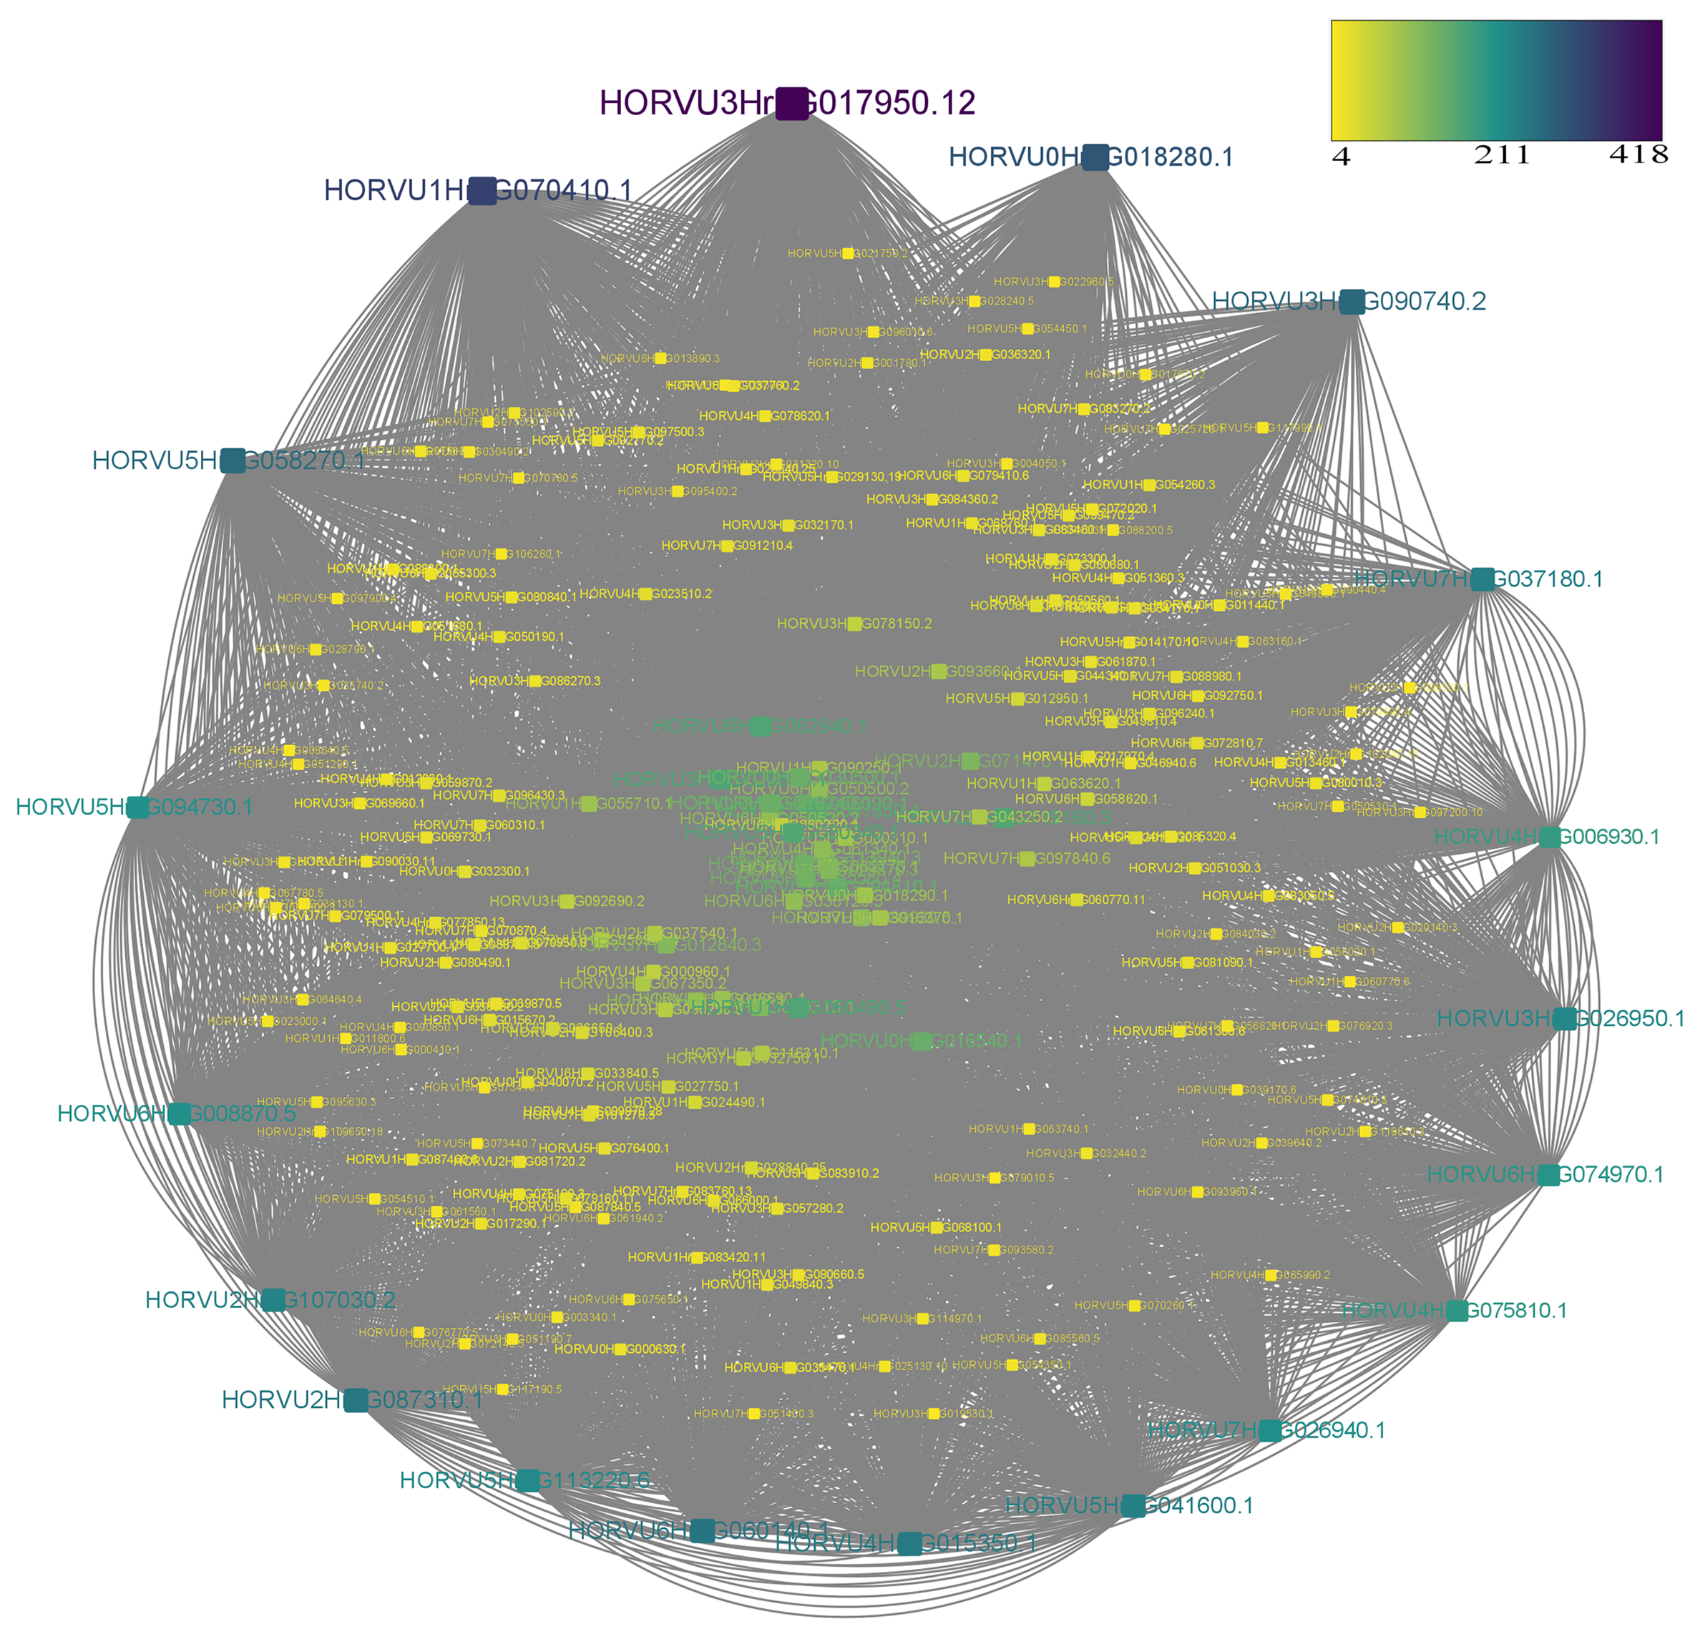
Figure S1 The results of analysis and prediction of the regulatory interactions among genes on the basis of transcription factor-binding motifs.

Slide 2
Figure S2 The results of protein-protein interaction obtained by aligning the DREB identified in barley to Arabidopsis.

Slide 3
Figure S3 Phenotypic changes of barley seedlings under different stresses.
CK
NaCL-stress
Drought-stress

