Slide 1
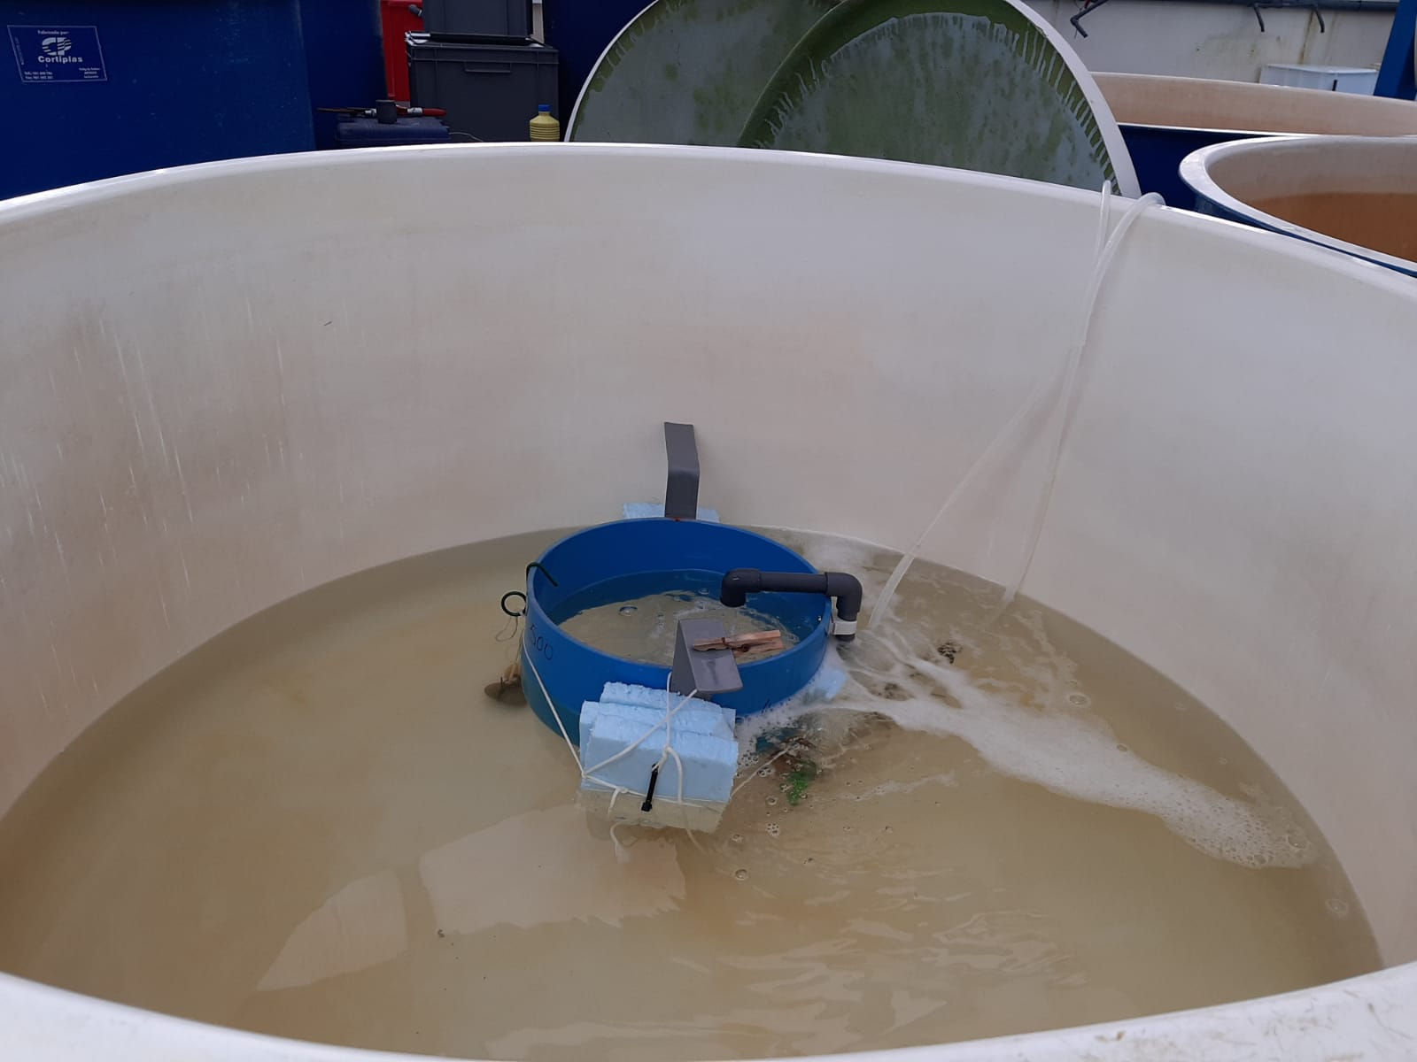
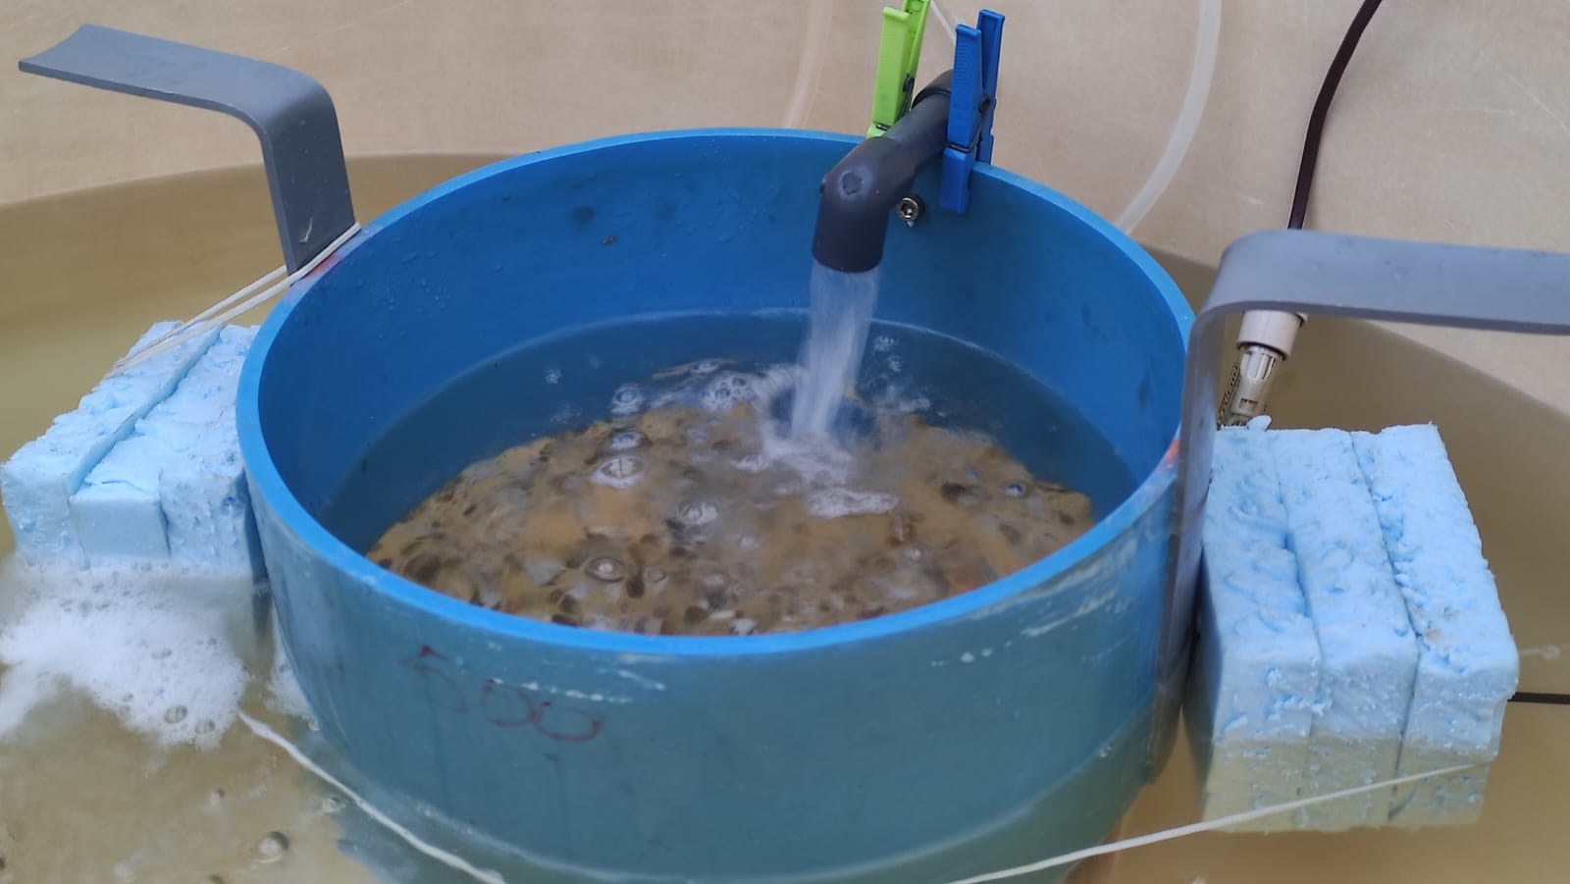
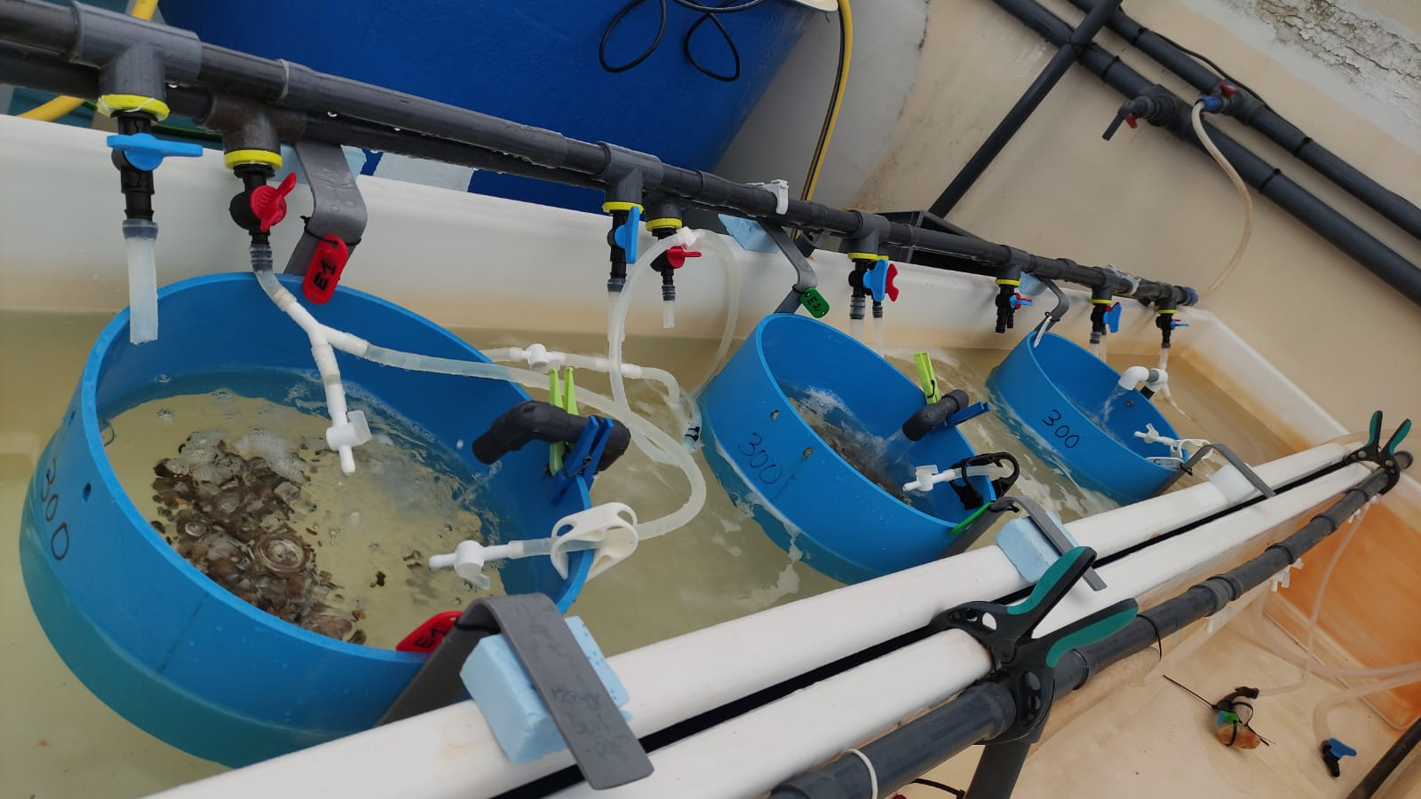
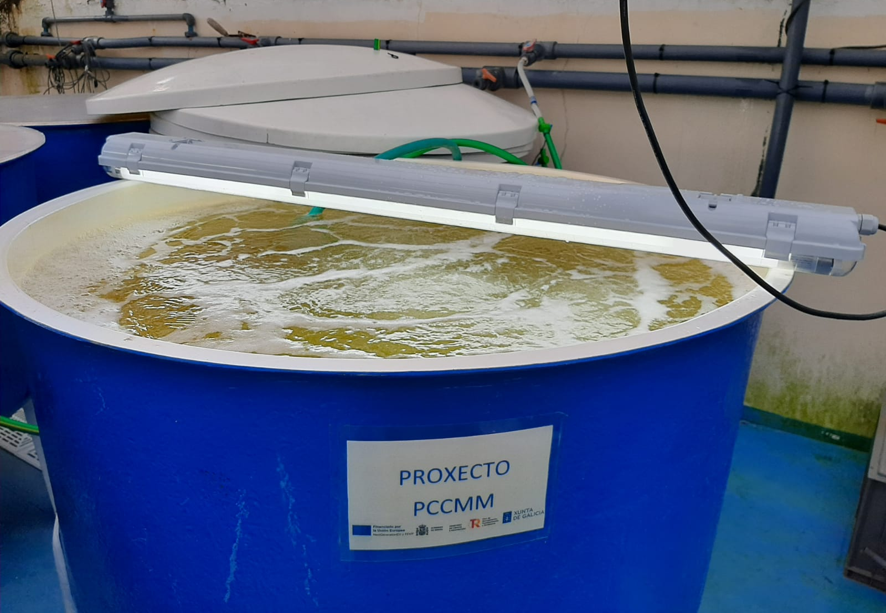
A
B
C
D
Figure S1. Photographs of the infrastructure used for the exposure of Manila clam Ruditapes philippinarum seeds to Perkinsus olseni zoospores. A: One of the 750 L tank used for the challenge showing inside a floating cylinder where clam seeds were hold; the level of seawater in the tank appears low and it raised as food supply was added through the seven-days challenge period. B: Closer view of the cylinder, with a mesh (500 µm) screen at the bottom on which the clams were laid; expanded polystyrene floats were attached in the outside and an air-lift system provided continuous circulation of the seawater from the tank top-down through the cylinder. C: Open-flow raceway used to hold the cylinders with clam seeds for three weeks after their exposure to P. olseni zoospores. D: One of the 550 L tanks used to generate phytoplankton blooms used as food for clam seeds through the seven-days challenge period as well as the post-challenge three-weeks period

Slide 2
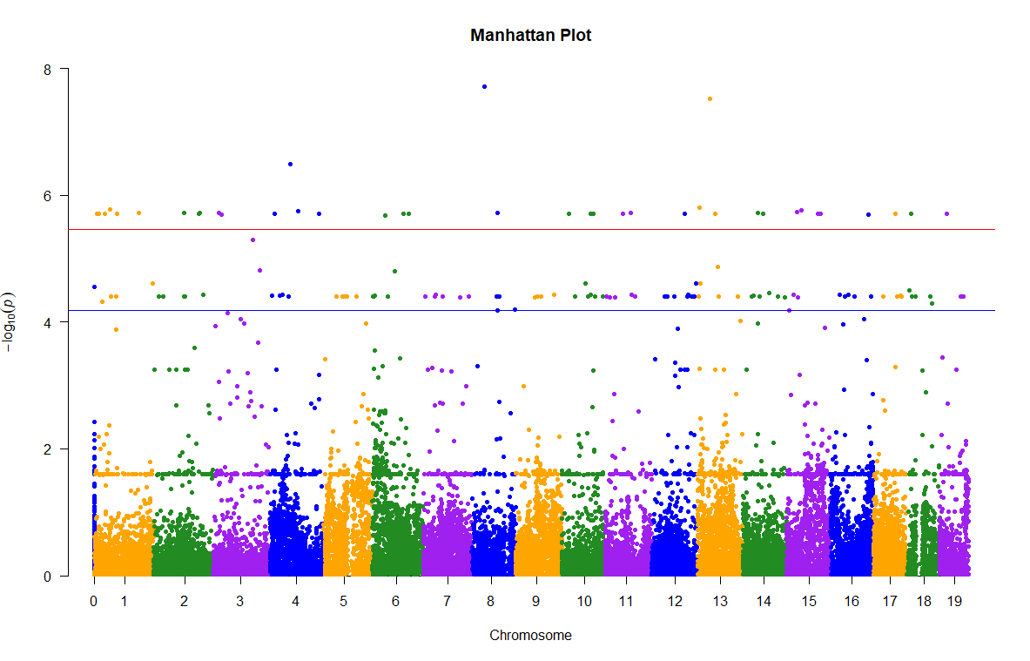
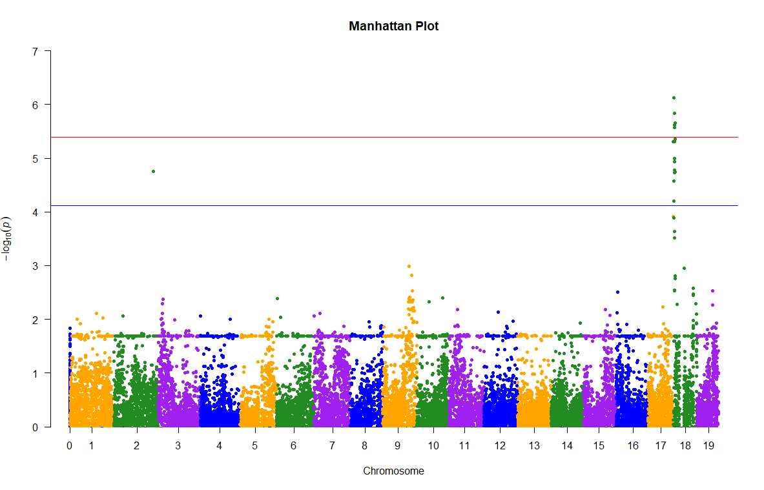
A)
B)
Figure S2. Manhattan plot in the two large families for genome-wide analysis with parasite load. SNPs across the 19 chromosomes on the x-axis in bp, and significance as -log10(p-value) on the y-axis Manhattan plot. The red and blue horizontal lines indicate the genome-wide and chromosome-wide significance thresholds, respectively. A) GWAS F6M8 B) GWAS F1M3

Slide 3
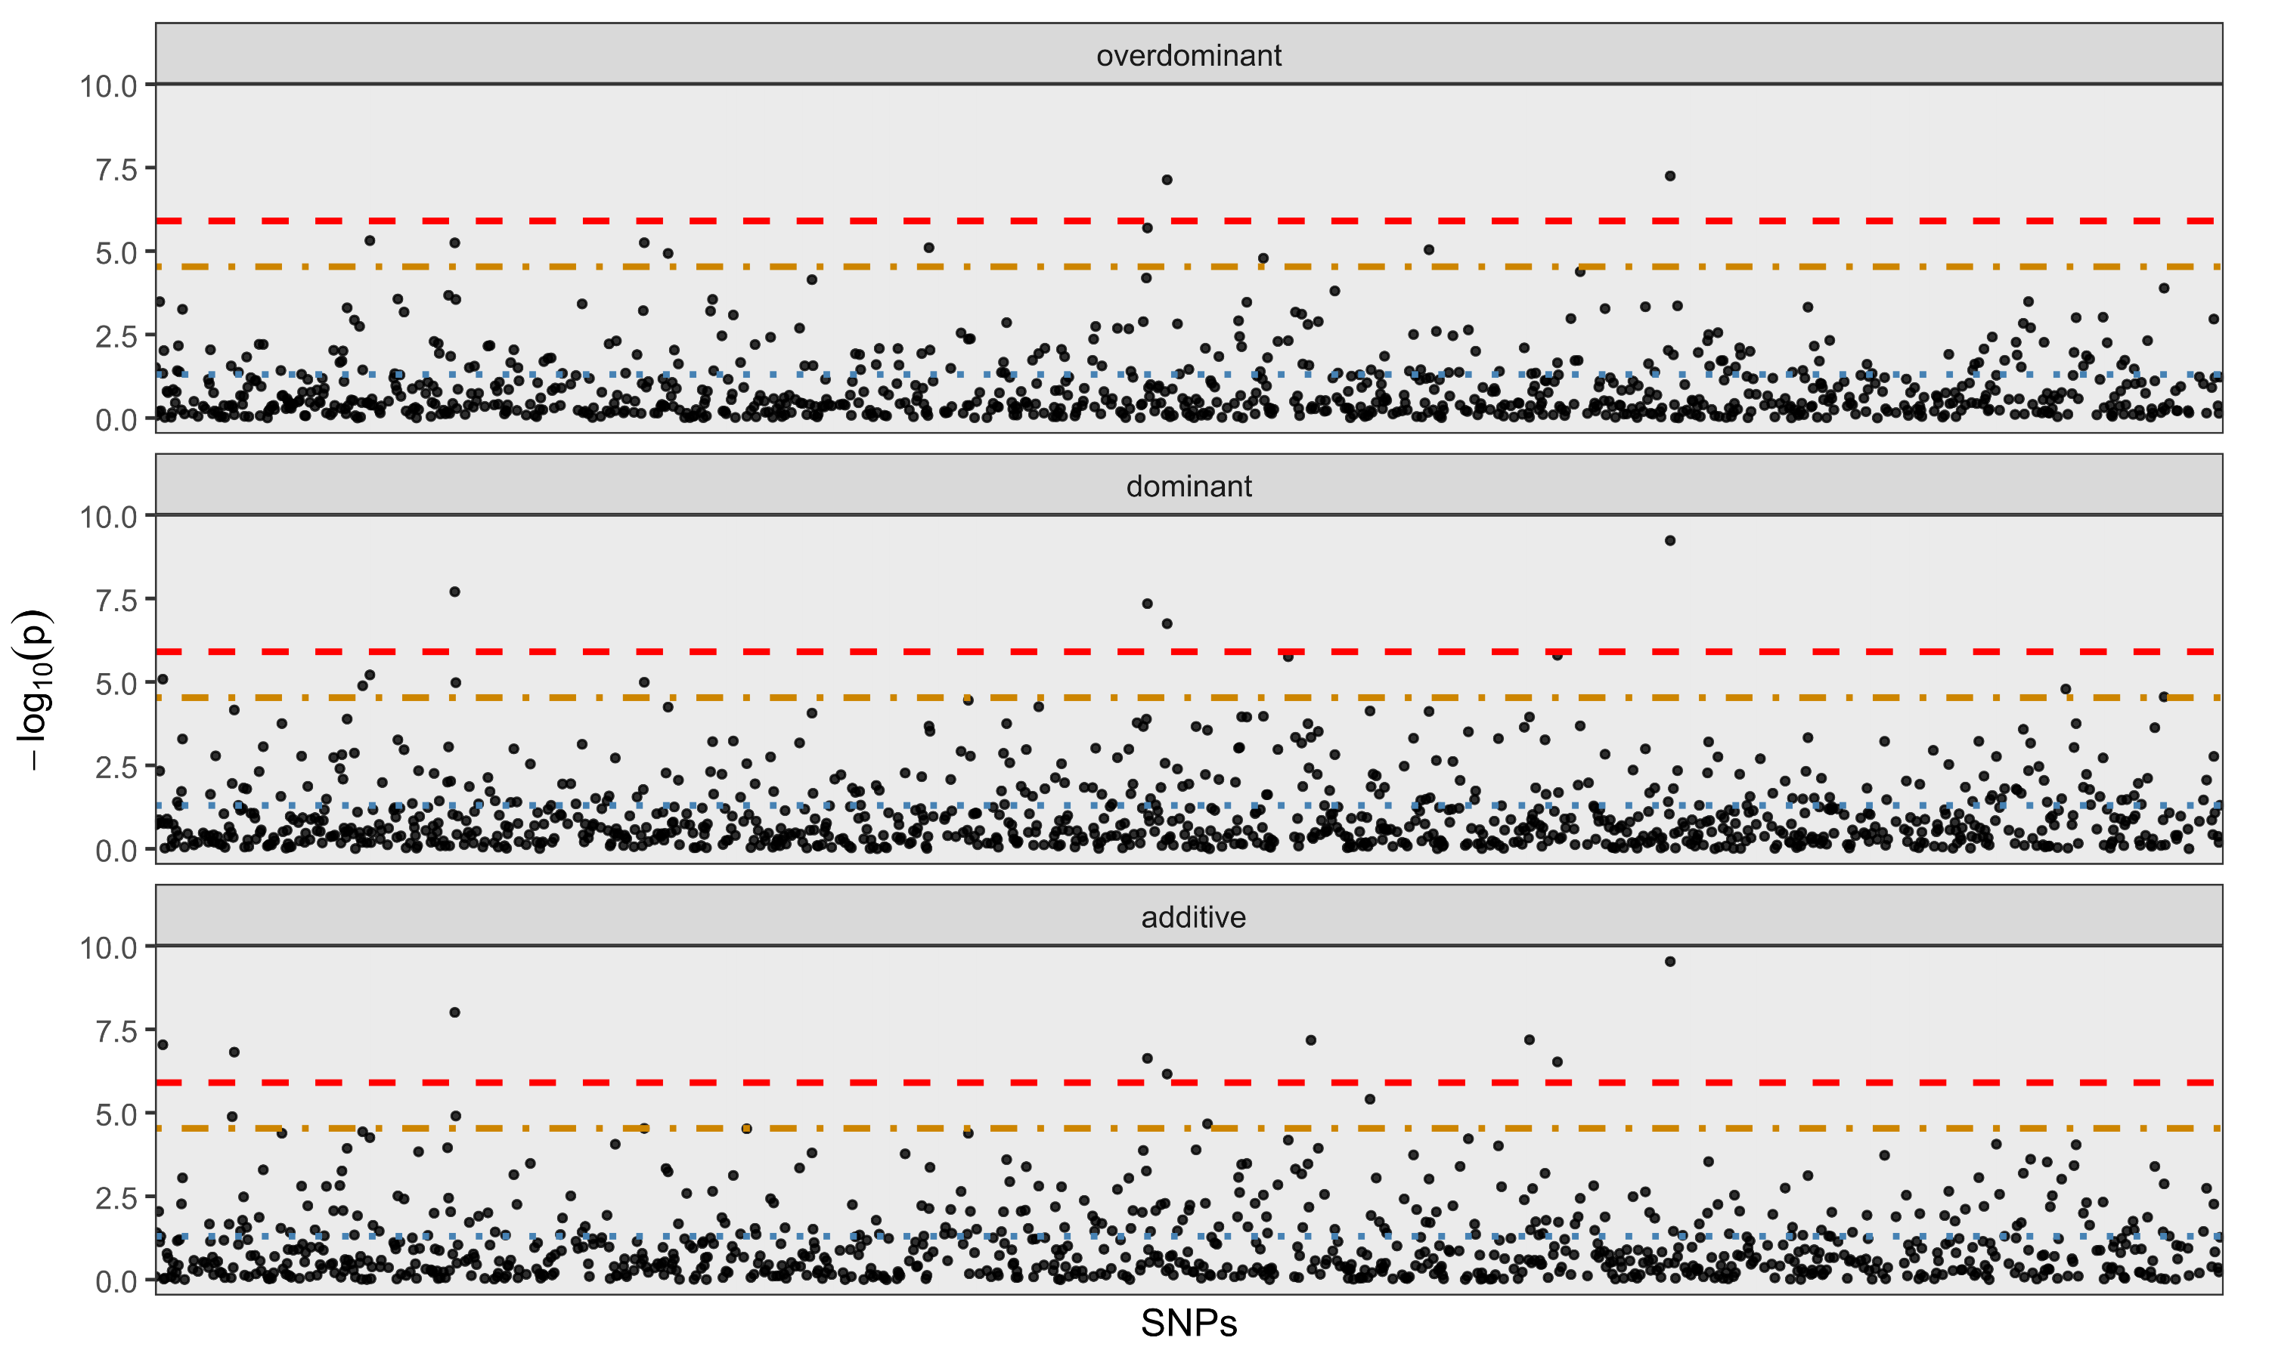
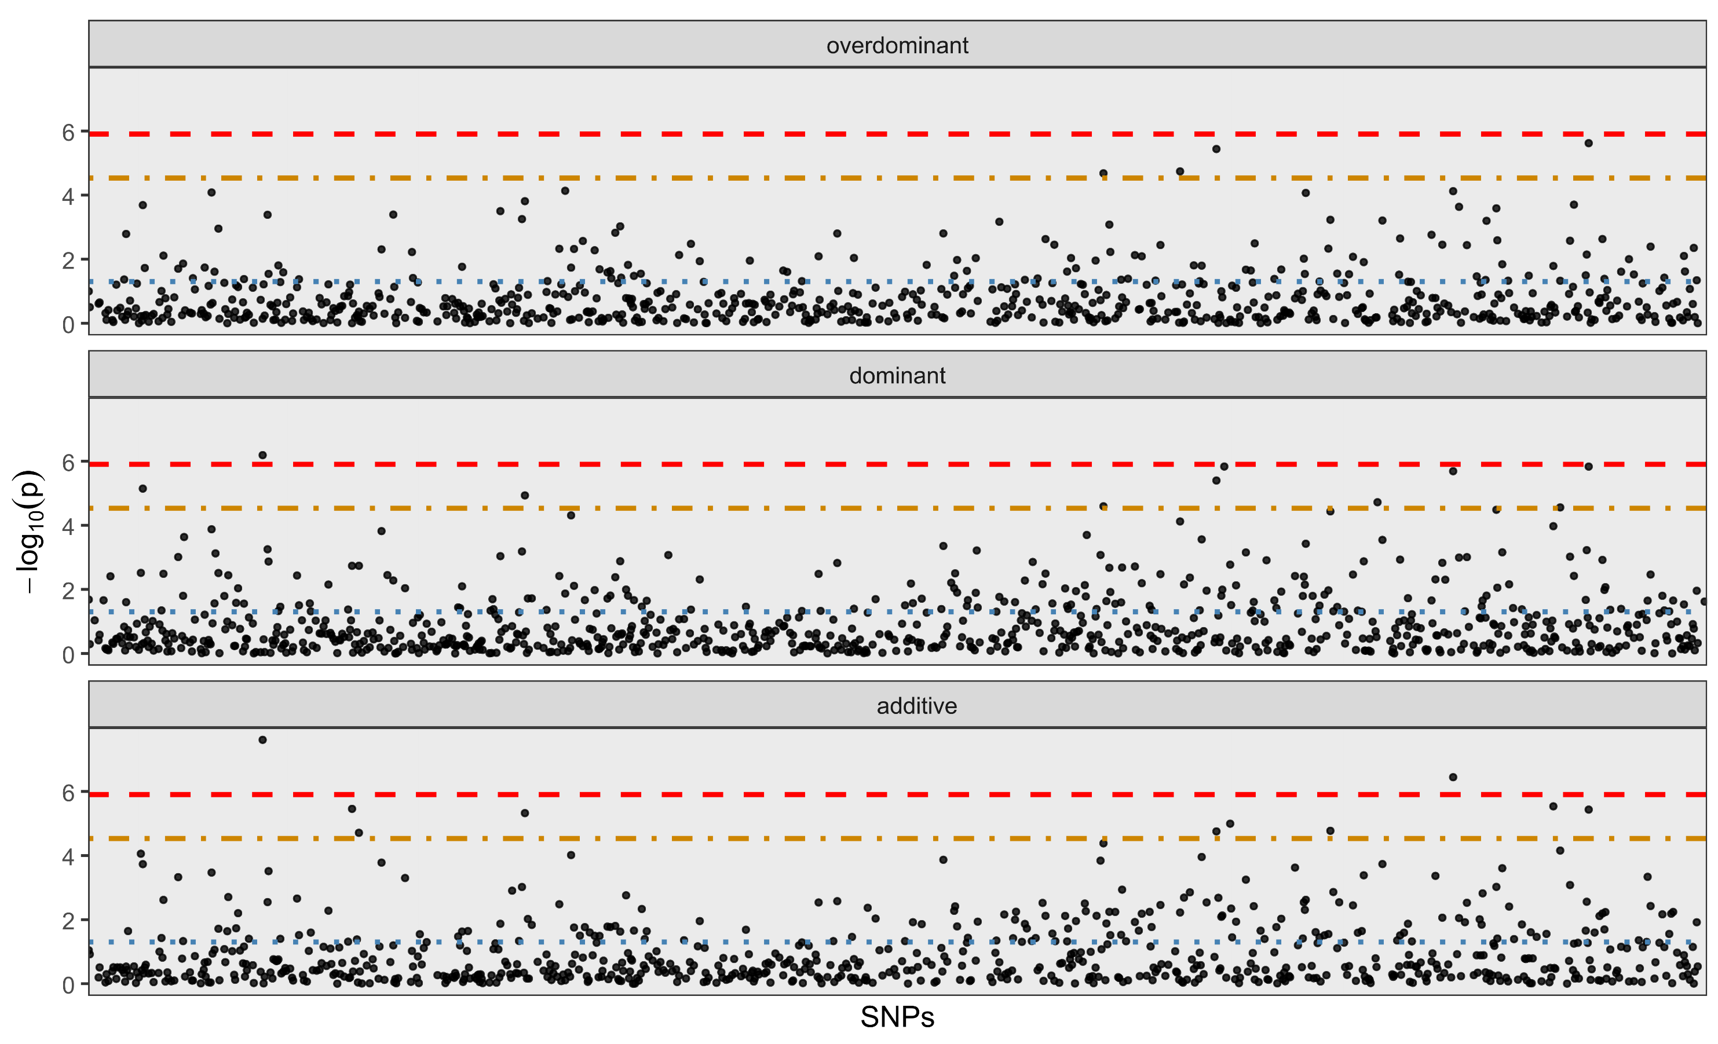
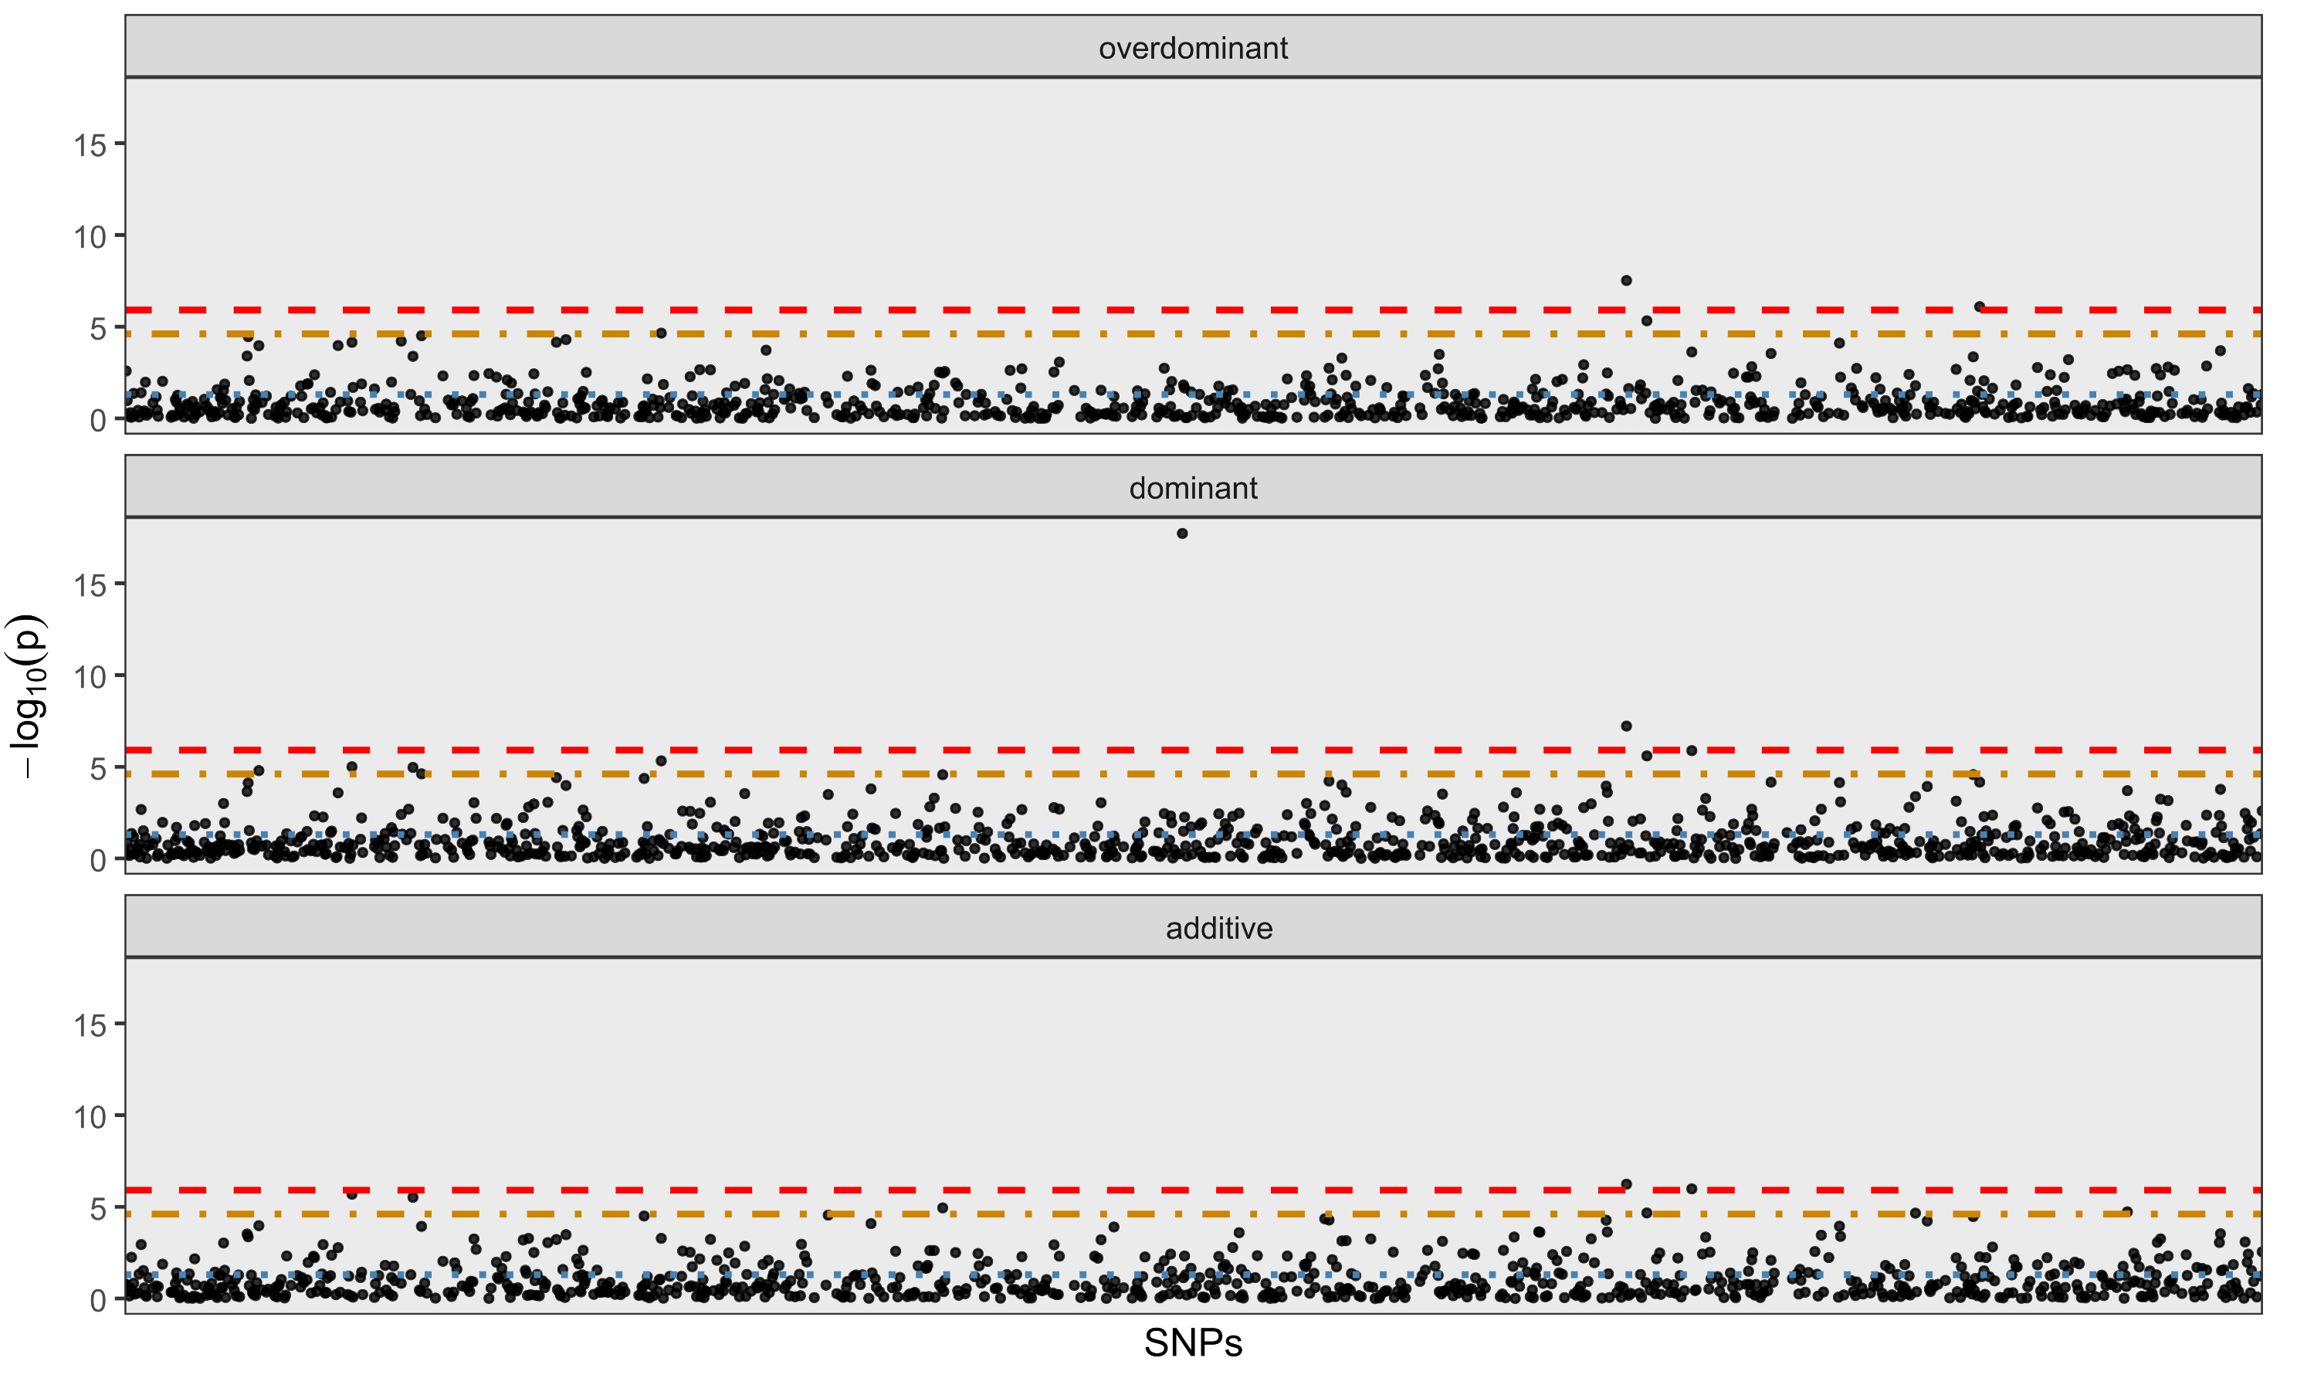
Chromosome 6
Chromosome 8
Chromosome 10
Figure S3. SNPassoc for chromosomes where significant genoma-wide association was detected in GWAS. Red line Genome-wide Bonferroni; Yellow line chromosome-wide Bonferroni; Blue line p<0.05

Slide 4
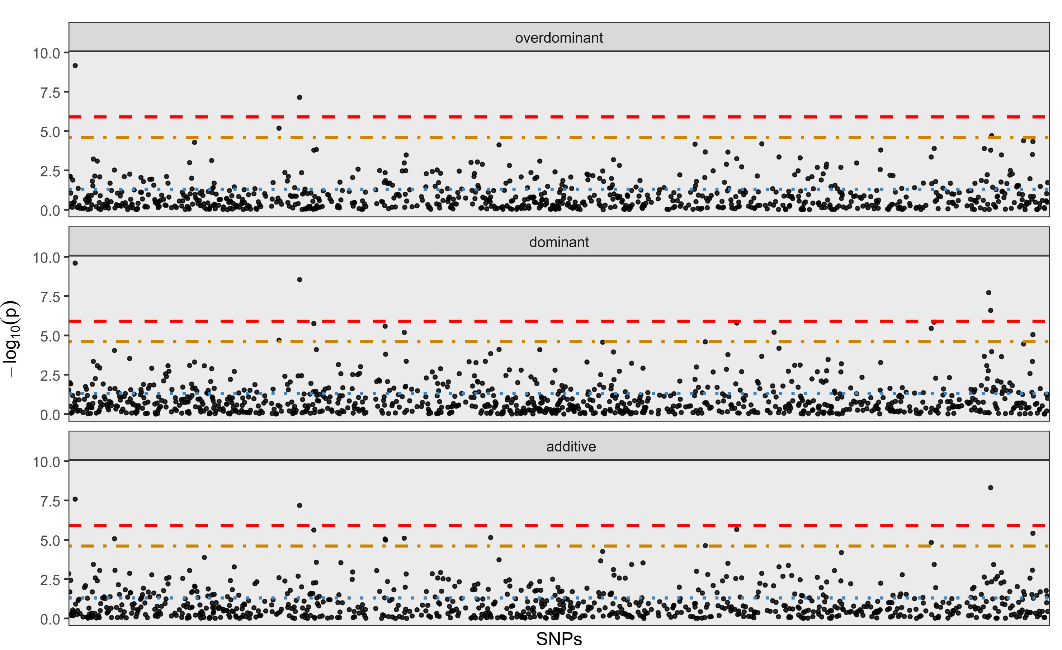
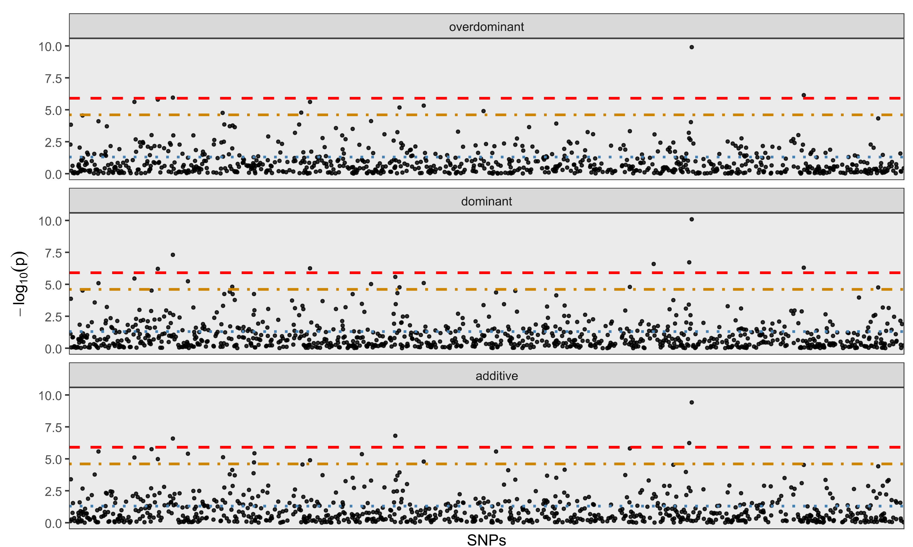
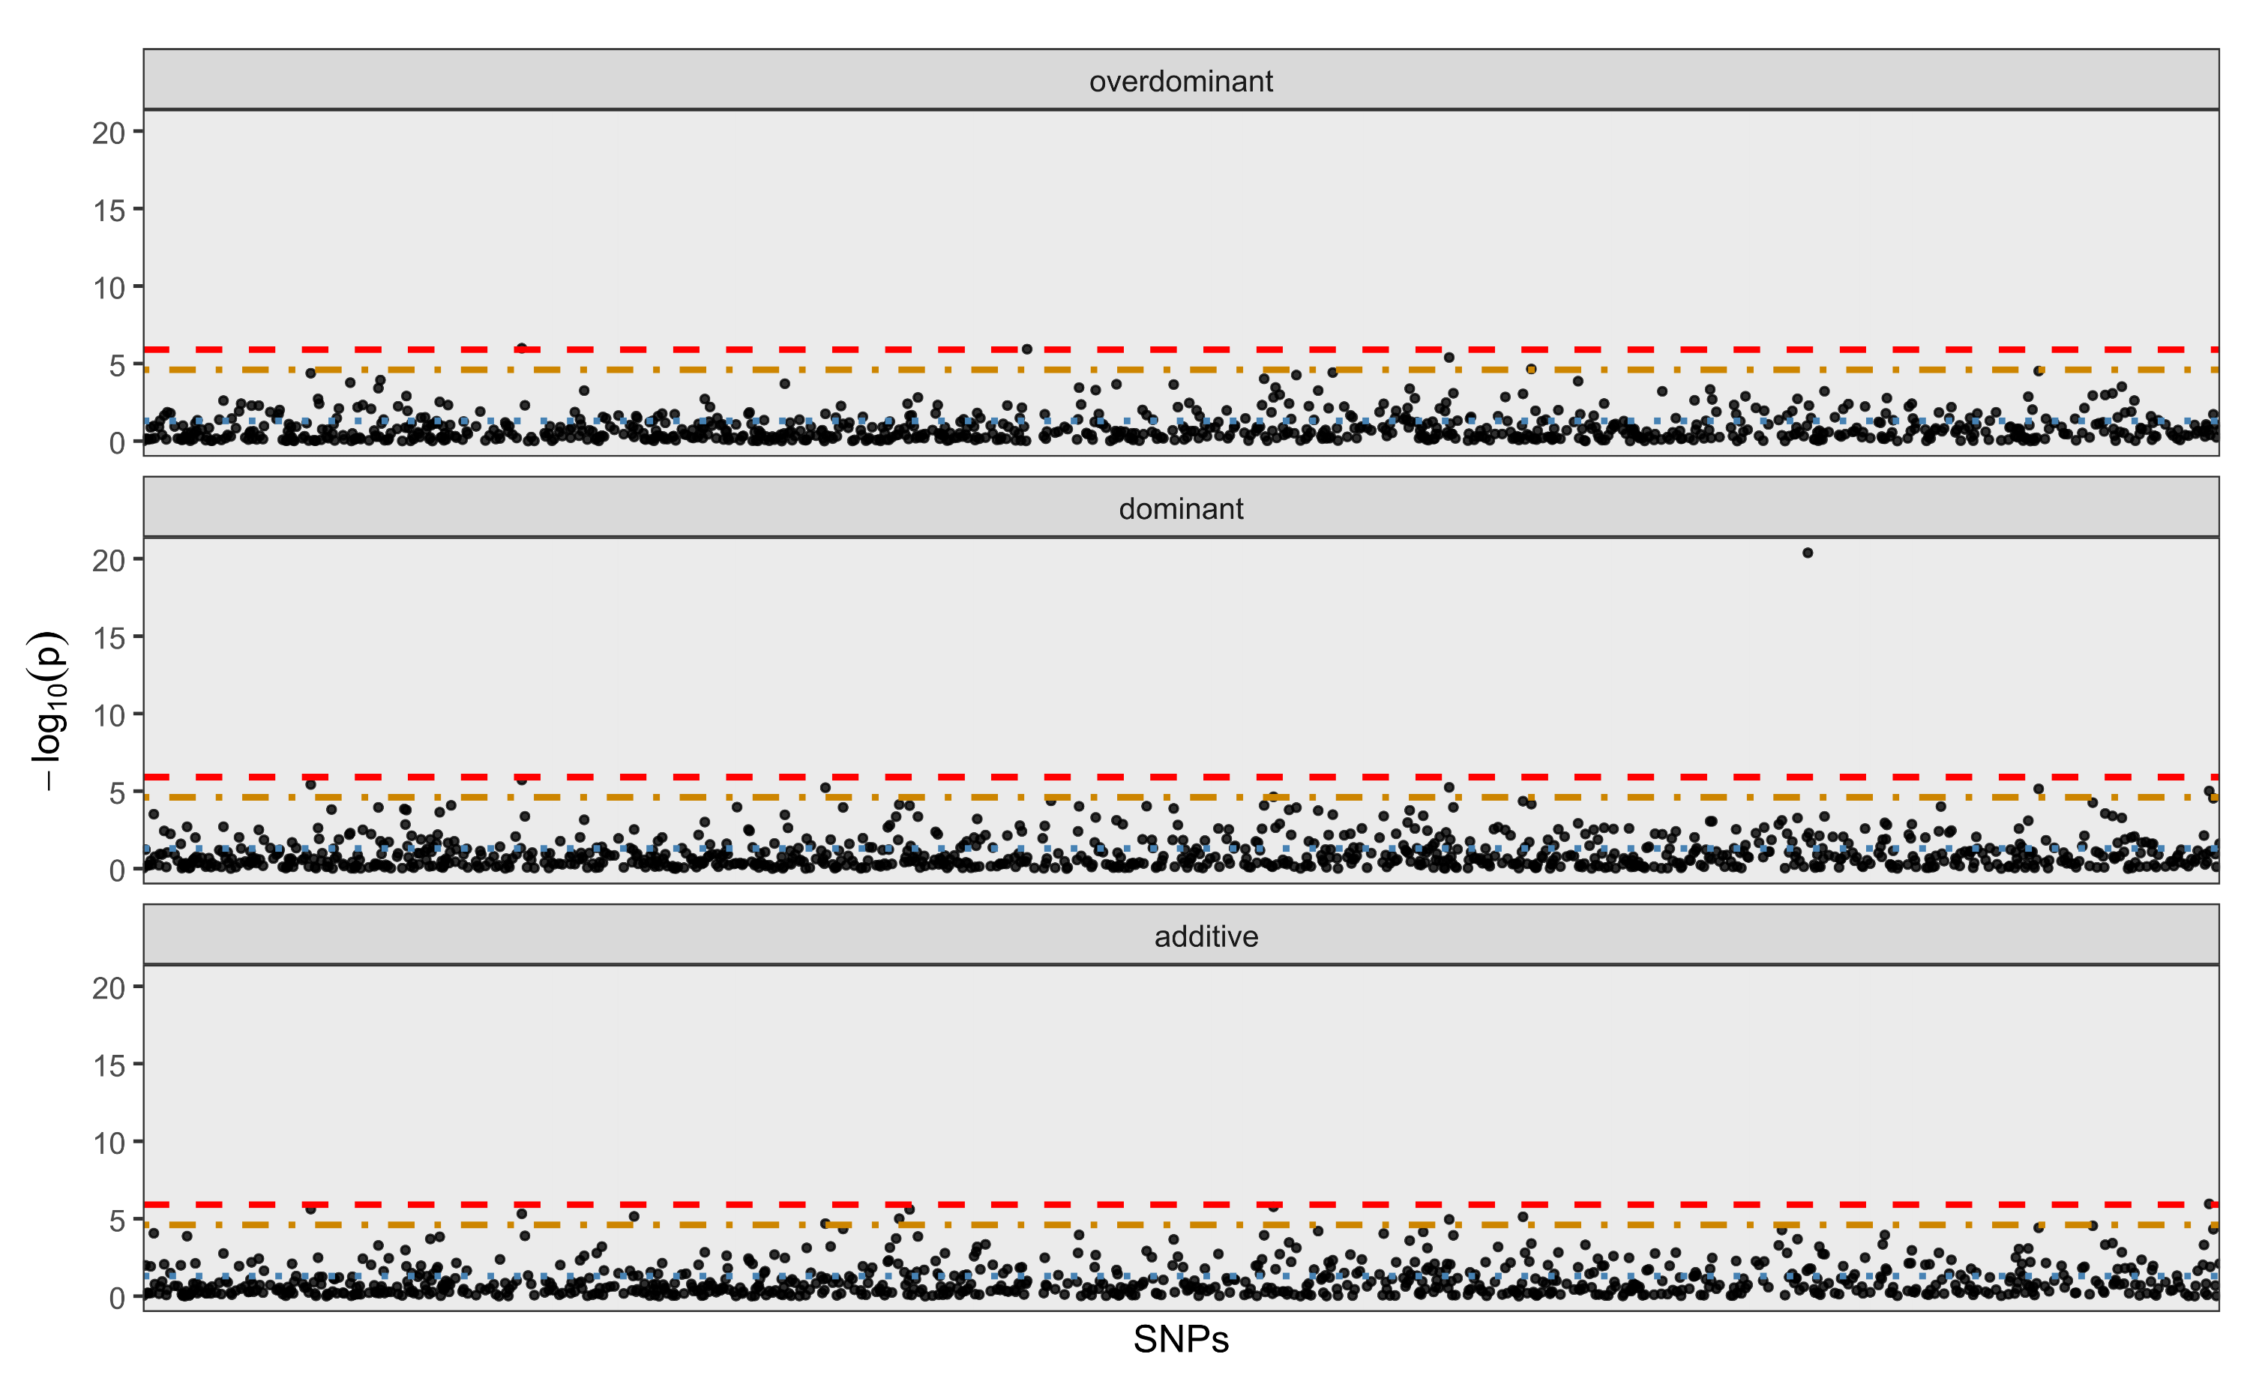
Chromosome 13
Chromosome 15
Chromosome 16
Figure S3. SNPassoc for chromosomes where significant genoma-wide association was detected in GWAS. Red line Genome-wide Bonferroni; Yellow line chromosome-wide Bonferroni; Blue line p<0.05 (cont.)

Slide 5
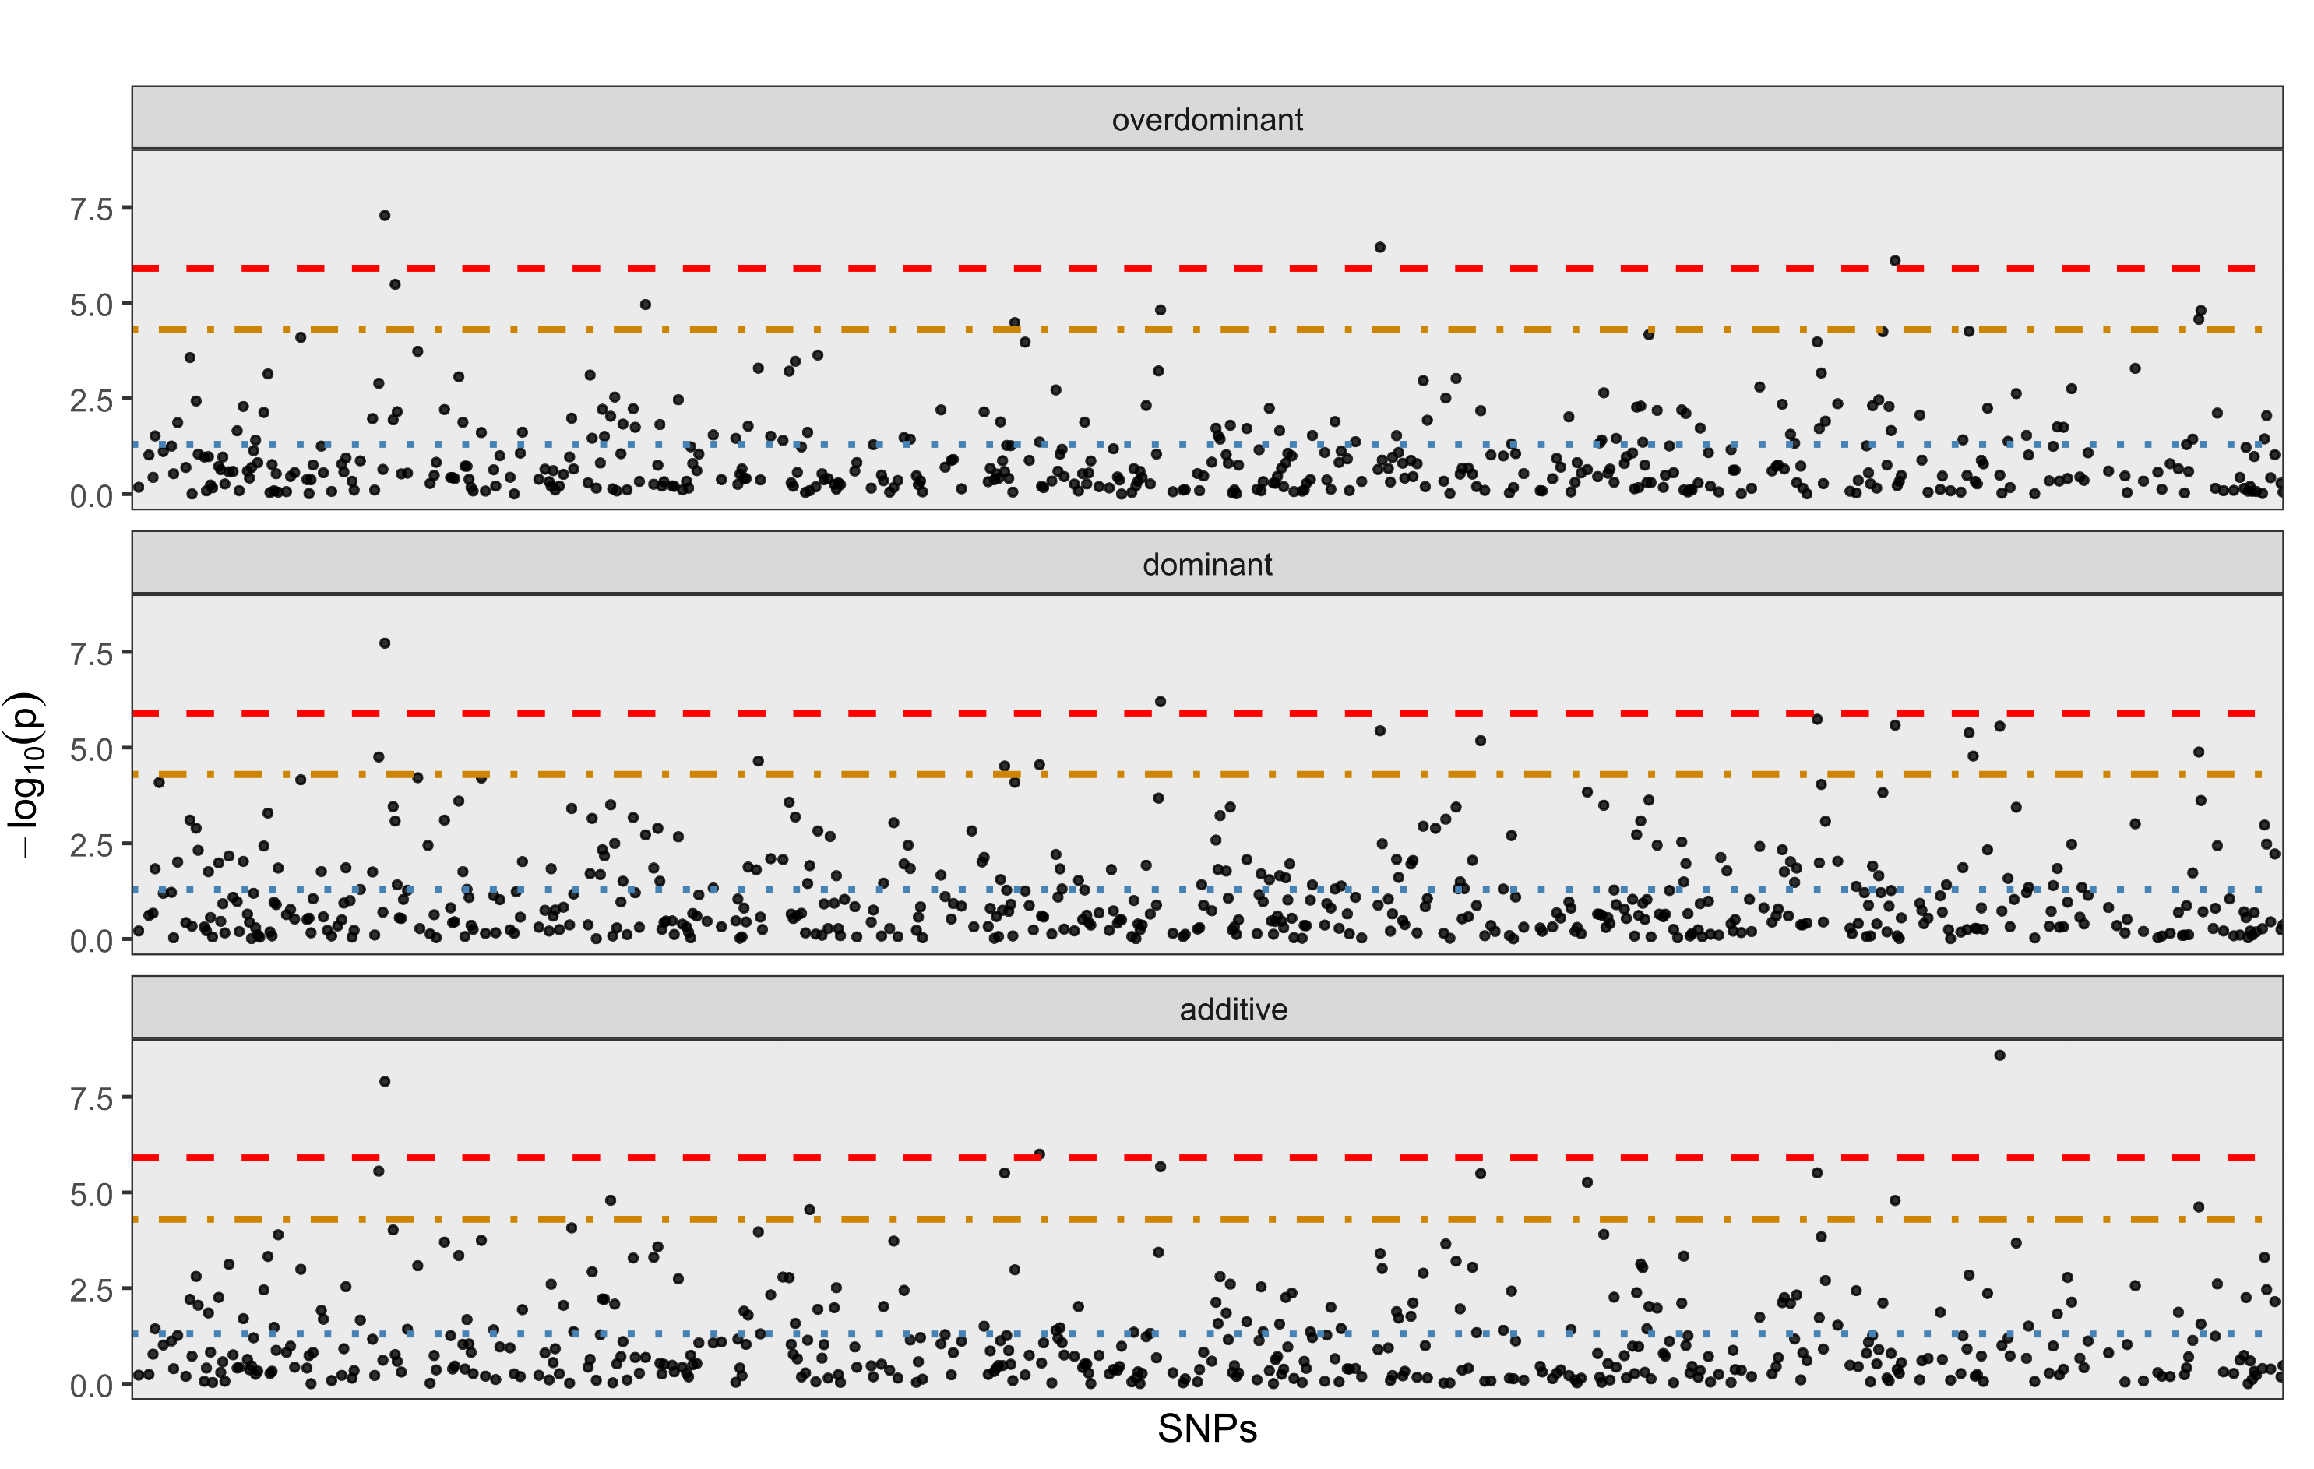
Chromosome 18
Figure S3. SNPassoc for chromosomes where significant genome-wide association was detected in GWAS. Red line Genome-wide Bonferroni; Yellow line chromosome-wide Bonferroni; Blue line p<0.05 (cont.).

Slide 6
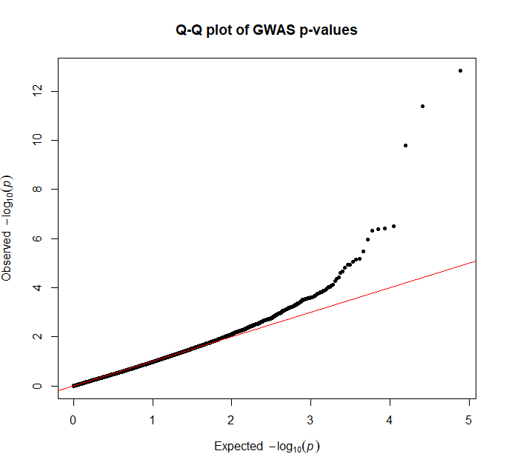
Figure S4. Q–Q plot of GWAS p-values showing good agreement with the null distribution and deviation only at the extreme tail.

Slide 7
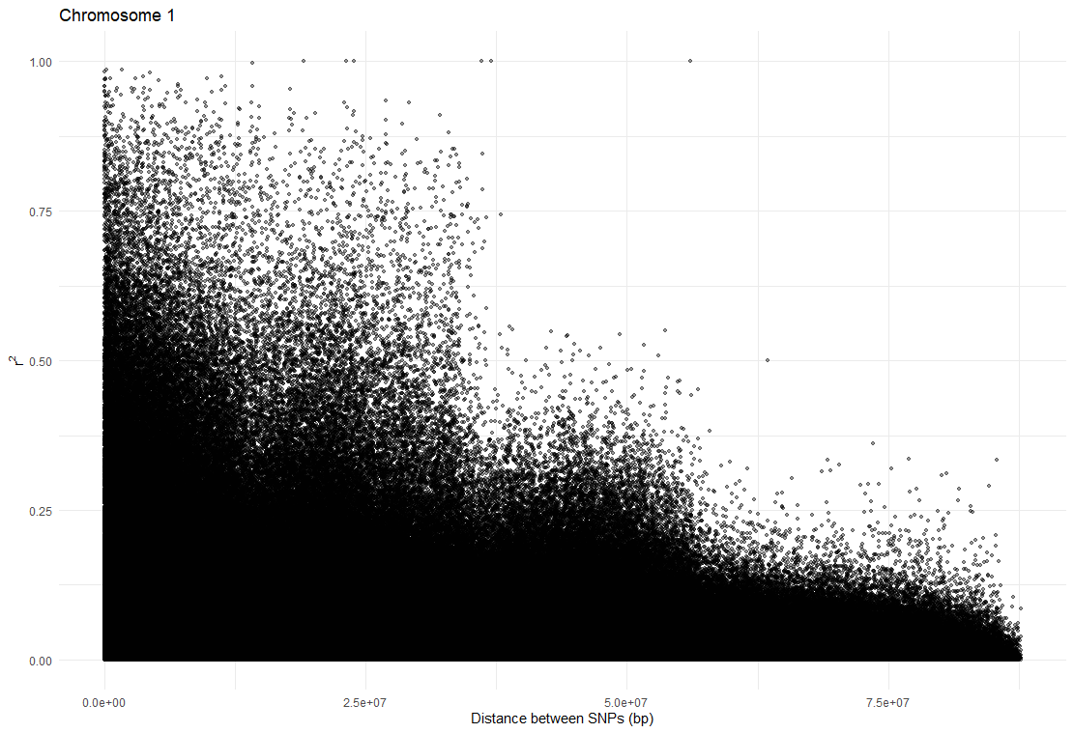
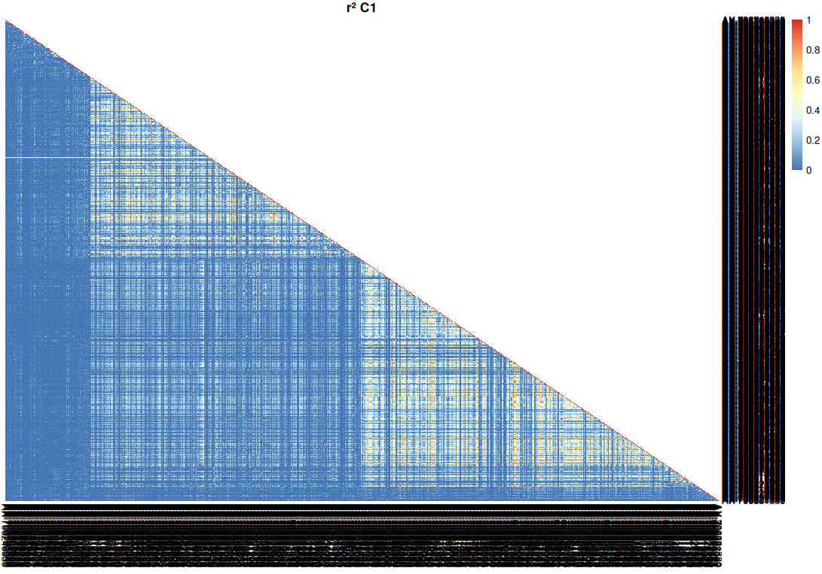
Chromosome 1
Figure S5. Atypical LD (r2) decay with physical distance and LD heatmaps in chromosomes 1, 8 and 16, suggestive of structural variation

Slide 8
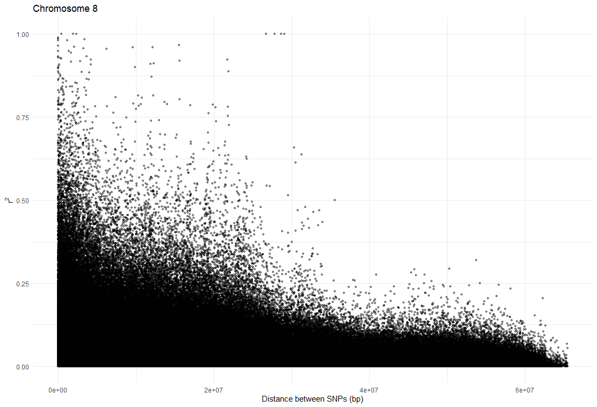
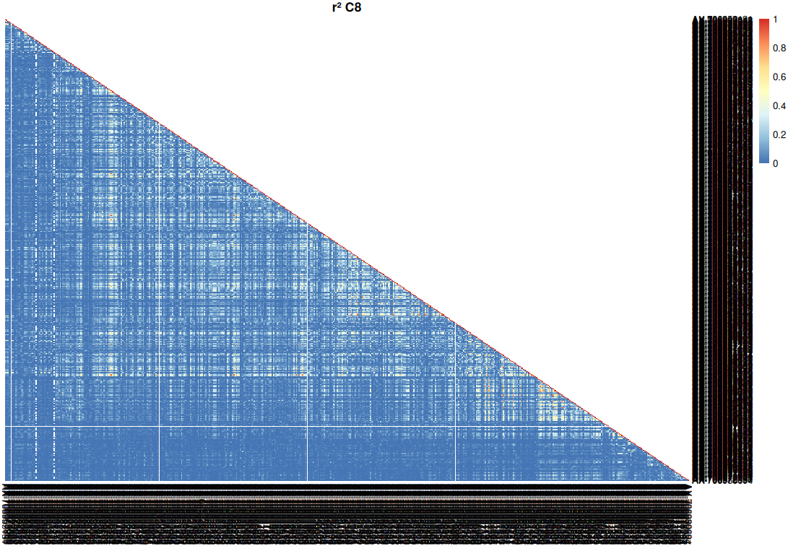
Chromosome 8
Figure S5. Atypical LD (r2) decay with physical distance and LD heatmaps in chromosomes 1, 8 and 16, suggestive of structural variation (cont.)

Slide 9
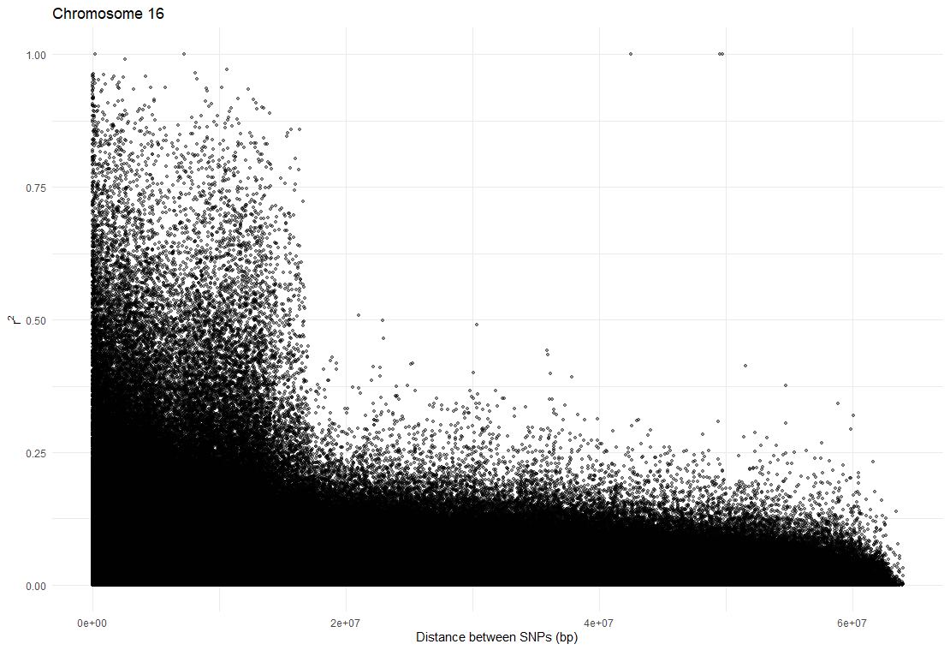
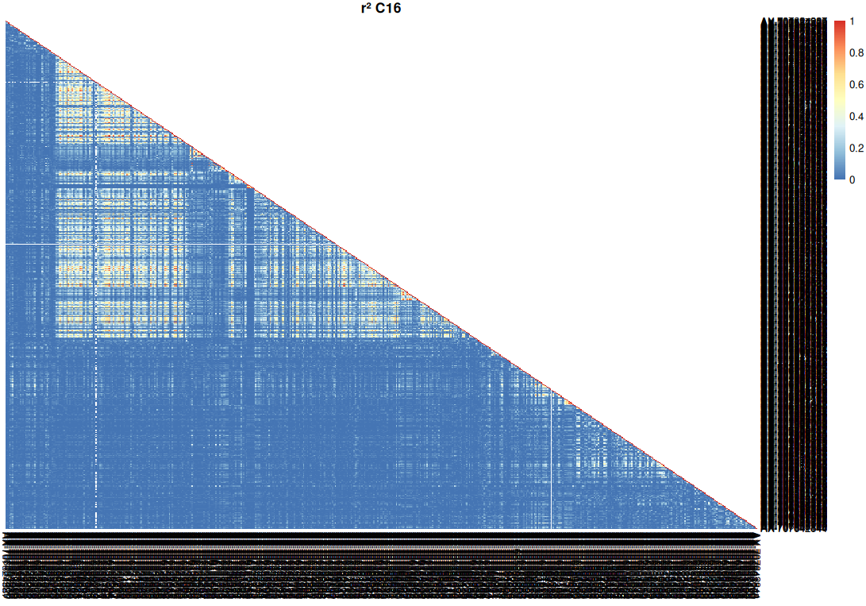
Chromosome 16
Figure S5. Atypical LD (r2) decay with physical distance and LD heatmaps in chromosomes 1, 8 and 16, suggestive of structural variation (cont.)

