Slide 1
The Augment of Regulatory T Cells Undermines the Efficacy of Anti-PD-L1 treatment in Cervical Cancer
Fengying Xu^{1, †}, Fengying Zhang^{1, †}, Qian Wang², Ying Xu³, Shuifang Xu¹, Caihong Zhang¹, Lihua Wang^{4*}
Department of Gynaecology and Obstetrics, Jinshan District Tinglin Hospital, Shanghai, 100191, China.
Department of Pathology, Jinshan District Tinglin Hospital, Shanghai, 100191, China.
Department of Gastroenterology, Jinshan District Tinglin Hospital, Shanghai. Shanghai, 100191, China.
International Peace Maternity & Child Health Hospital, Shanghai JiaoTong University School of Medicine Department of Gynecologic Oncology, Shanghai, 200025, China.
*Correspondence author: Li-hua Wang, International Peace Maternity & Child Health Hospital, Shanghai JiaoTong University School of Medicine Department of Gynecologic Oncology. Address: 910 Hengshan Road, Xuhui District, Shanghai, 200030 China. Phone: 86-21-64070434; E-mail: drwanglh0420@163.com.
† These authors contributed equally to this work.

Slide 2
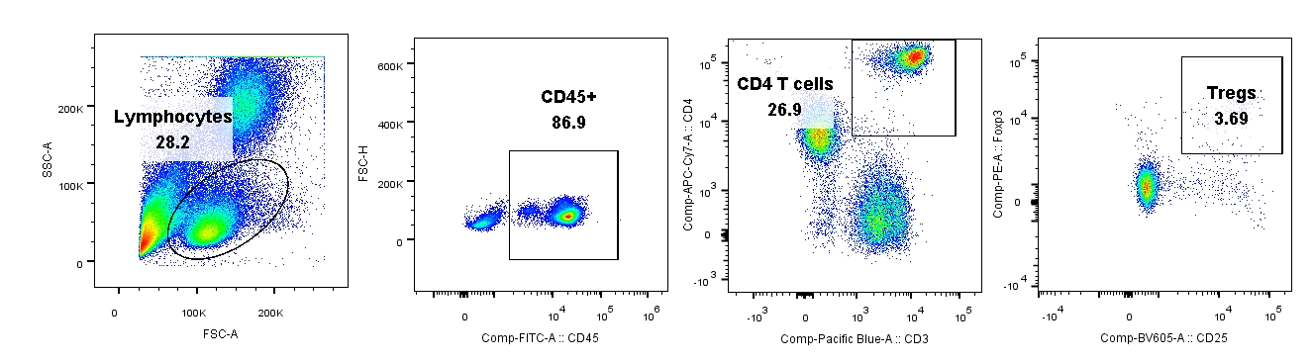
Supplementary data.
A
Tumor challenge (U14 cell 3 x 10⁶/mice)
0
5
12
14
16
18
20
B
PBS or Anti-PD-1 or Anti-CD25 or Combination
Figure S1. The treatment schedule and Tregs analyses and isolation.
The anti-PD-L1 treatment schedule in syngeneic tumor mouse model. 3x10⁶ U14 cervical cells was
subcutaneously injected on the flank of 7-weeks C57BL/6 mouse. PBS or Anti-PD-L1 or CD25 or combination was intraperitoneally injected in mouse seven days post tumor challenge.
B. The schematic diagram of flow cytometry for Tregs analysis and sorting.
A

