Slide 1
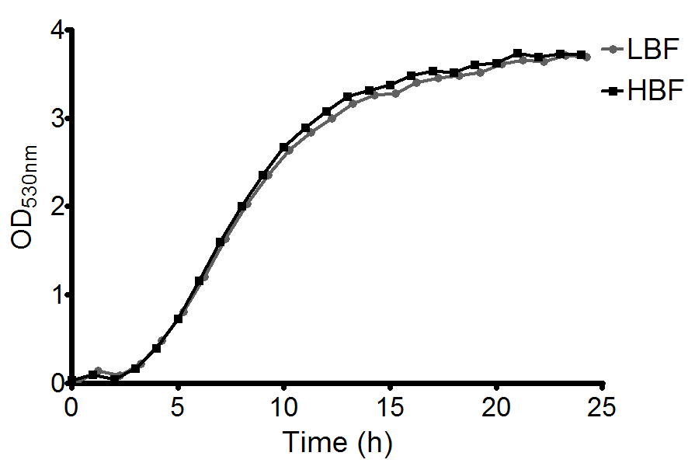
Additional data - Supplementary Figure 1

