Slide 1
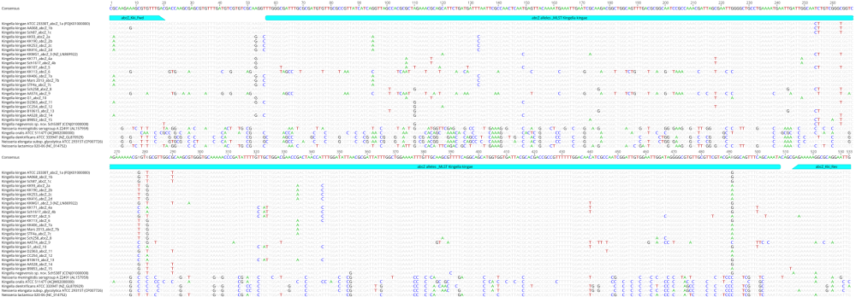
Figure S1. MAFFT alignment of MLST genomic regions of abcZ from distinct Kingella kingae sequence types tested in our study and closely related Kingella and Neisseria species. Primers and MLST regions are colored in blue. Only each distinct variant of abcZ are represented. MAFFT alignment was performed by using Geneious 10.2.3 (Biomatters).

Slide 2
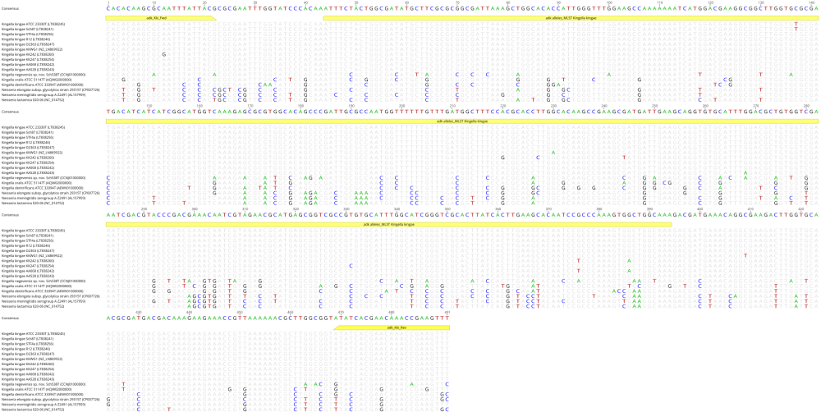
Figure S1. MAFFT alignment of MLST genomic regions of the adk gene from distinct Kingella kingae sequence types tested in our study and closely related Kingella and Neisseria species. Primers and MLST regions are colored in yellow. Only each distinct variant of adk are represented. MAFFT alignment was performed by using Geneious 10.2.3 (Biomatters).

Slide 3
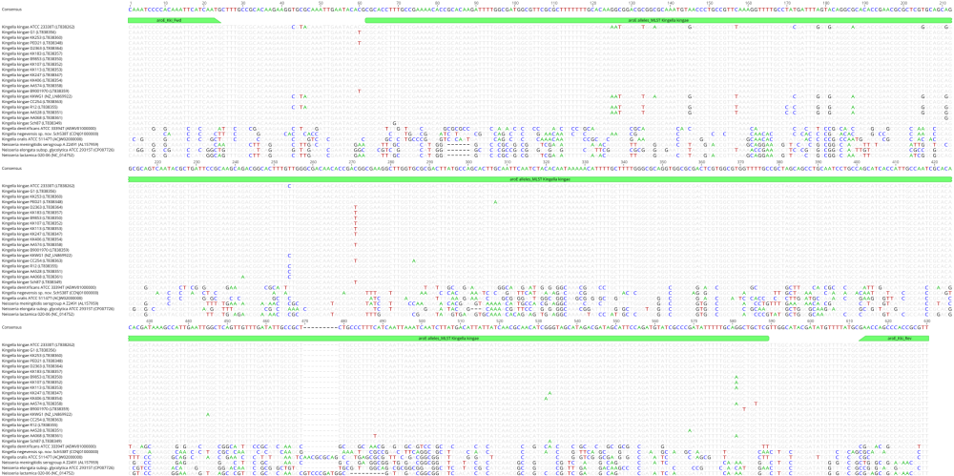
Figure S1. MAFFT alignment of MLST genomic regions of the aroE gene from distinct Kingella kingae sequence types tested in our study and closely related Kingella and Neisseria species. Primers and MLST regions are colored in green. Only each distinct variant of aroE are represented. MAFFT alignment was performed by using Geneious 10.2.3 (Biomatters).

Slide 4
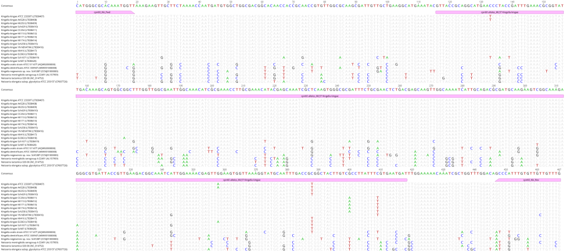
Figure S1. MAFFT alignment of MLST genomic regions of the cpn60 gene from distinct Kingella kingae sequence types tested in our study and closely related Kingella and Neisseria species. Primers and MLST regions are colored in pink. Only each distinct variant of cpn60 are represented. MAFFT alignment was performed by using Geneious 10.2.3 (Biomatters).

Slide 5
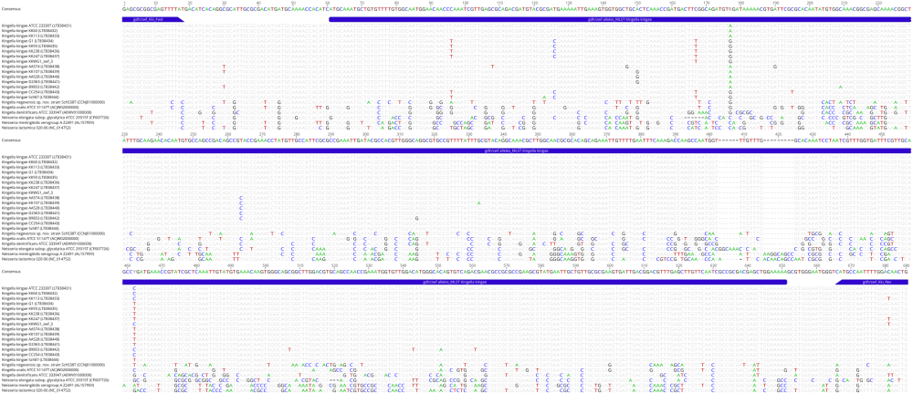
Figure S1. MAFFT alignment of MLST genomic regions of the gdh/zwf gene from distinct Kingella kingae sequence types tested in our study and closely related Kingella and Neisseria species. Primers and MLST regions are colored in dark blue. Only each distinct variant of gdh/zwf are represented. MAFFT alignment was performed by using Geneious 10.2.3 (Biomatters).

Slide 6
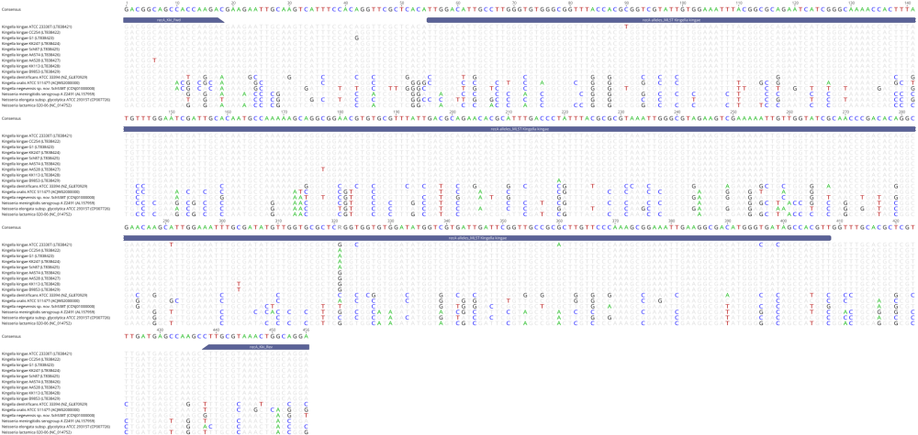
Figure S1. MAFFT alignment of MLST genomic regions of the recA gene from distinct Kingella kingae sequence types tested in our study and closely related Kingella and Neisseria species. Primers and MLST regions are colored in dark grey. Only each distinct variant of recA are represented. MAFFT alignment was performed by using Geneious 10.2.3 (Biomatters).

