Slide 1
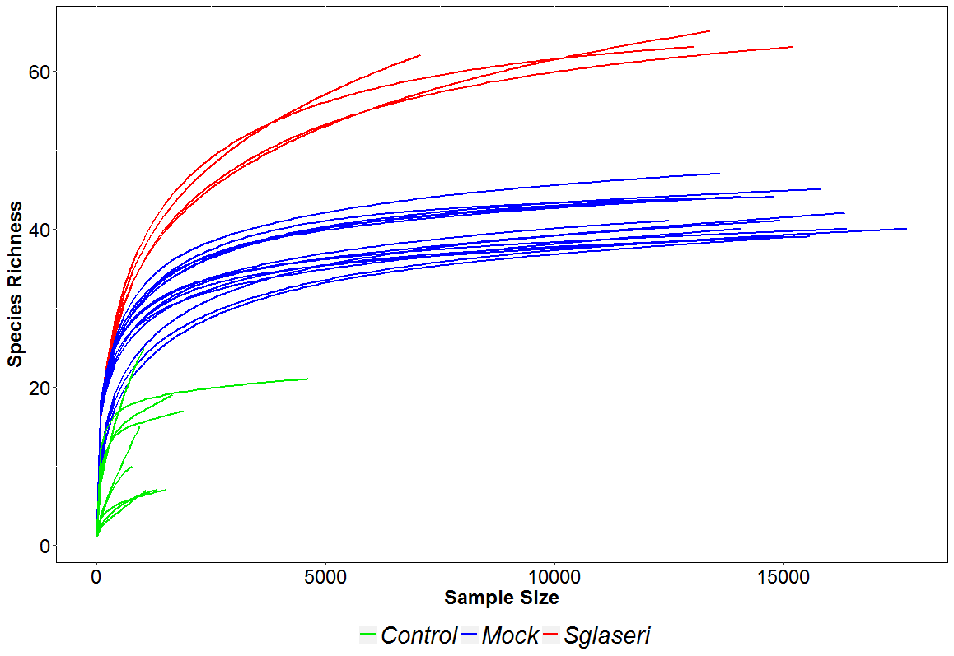
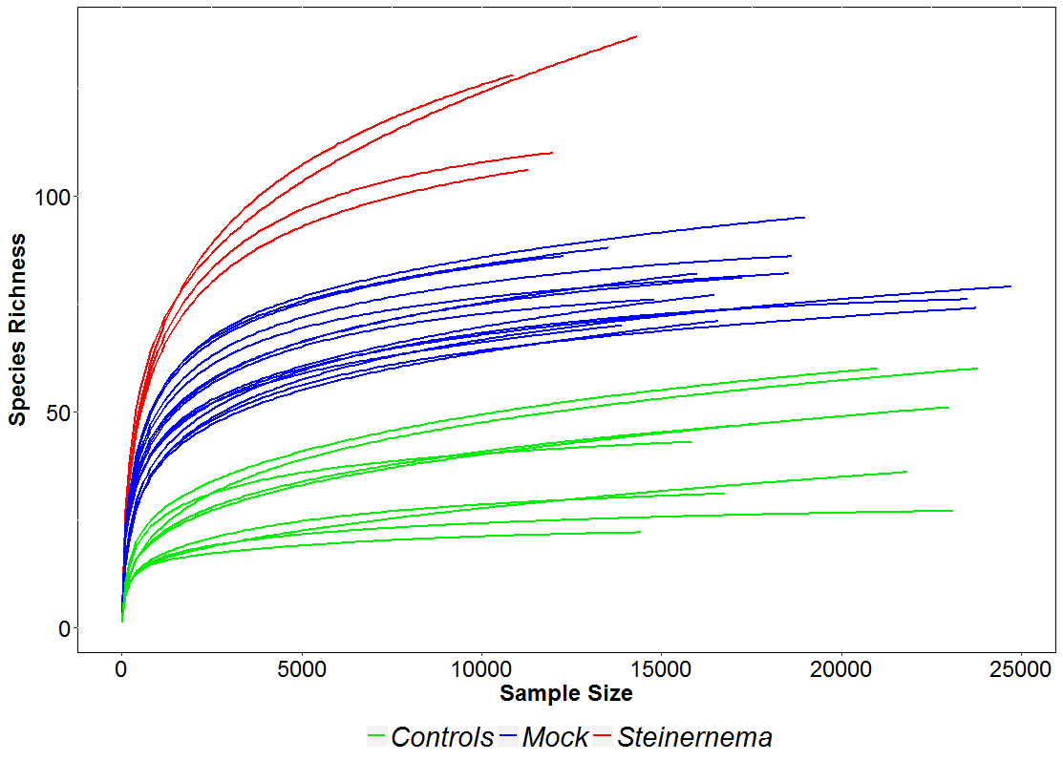
Additional file 2
A. rpoB marker
Methods:
Rarefaction curves were assembled, with an estimation of species richness (x-axis), defined with a sequence identity cutoff of 97%, relative to the total number of bacterial sequences identified (y-axis). Samples are presented separately, with blue lines corresponding to the mock community samples and red lines corresponding to the nematode samples.
B. V3V4 marker

