Slide 1
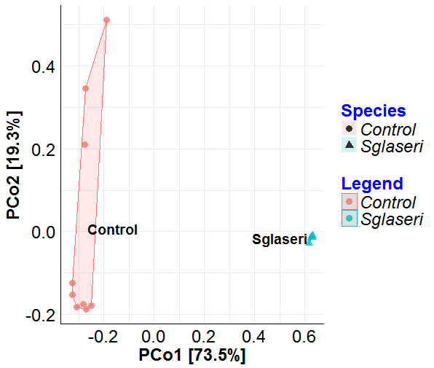
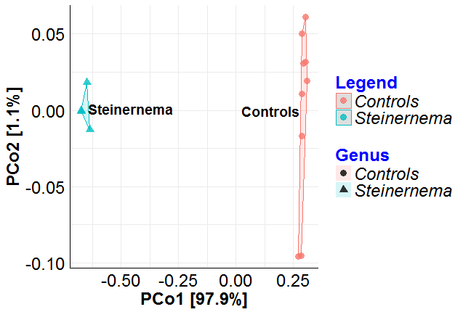
Additional file 7
A. rpoB marker
Methods:
Principal coordinate analysis (PCoA) was performed based on Bray-Curtis distances between nematode and control samples after Illumina-amplicon sequencing of the (A) rpoB marker; (B) the 16S marker. Nematode samples are shown as blue triangles, extraction control samples are shown as pink circles. Each point represents an individual replicate. The proportion of the variance explained by each axis is indicated as a percentage. The difference between the nematode and extraction control samples sets is statistically significant for both the rpoB marker (Permanova, df = 1, R² = 0.81, p-value = 0.0015) and the 16S marker (Permanova, df = 1, R² = 0.93, p-value = 0.0015)
s
A. 16S marker

