Slide 1
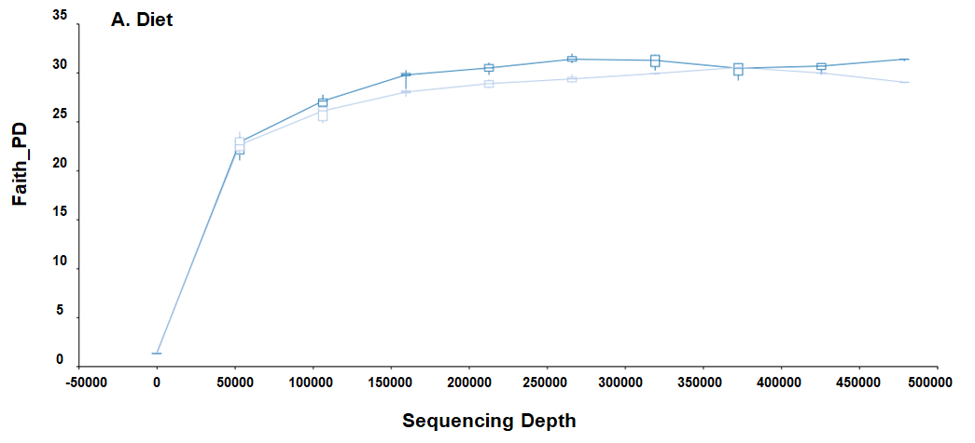
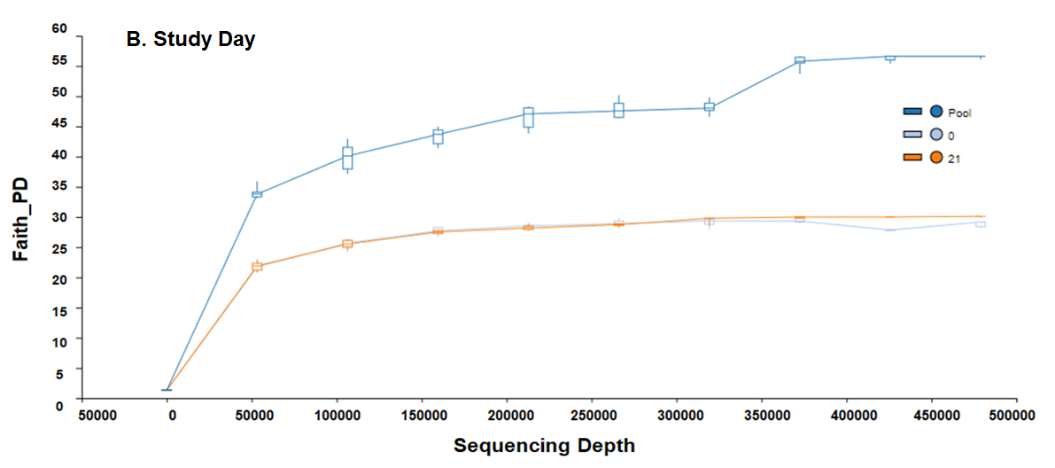

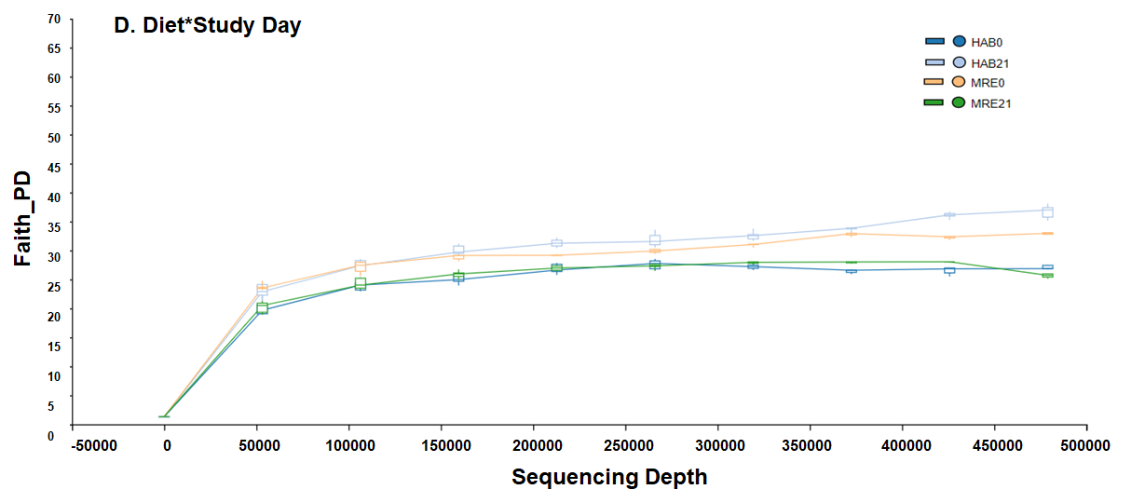
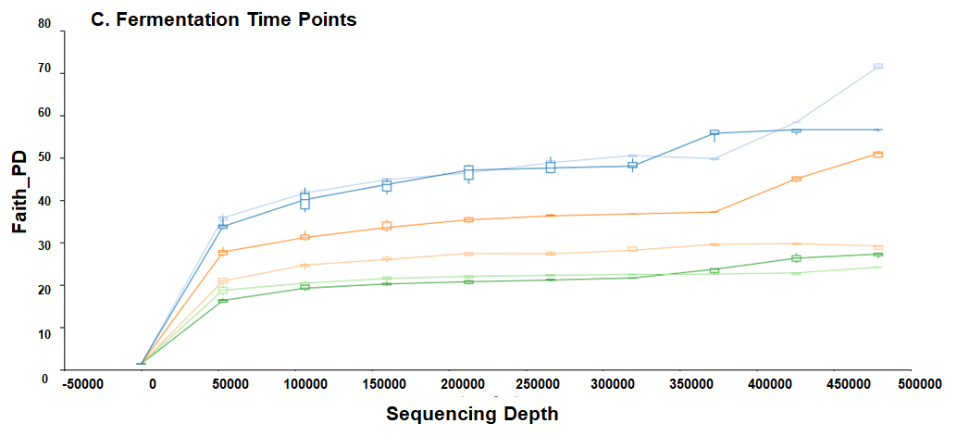
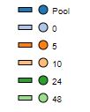
FIGURE S1: Alpha Diversity Plots: Faith_PD

Slide 2
FIGURE S1: Alpha Diversity Plots: Faith_PD
Rarefaction curves for Alpha Diversity Analysis. As the Faith Phylogenetic Diversity (Faith_PD) shows, there are no observed differences in alpha diversity by Diet (A) and Study Day (B). Alpha diversity decreases with fermentation time (C). There are no differences in the interaction Diet*Study Day (D).

Slide 3
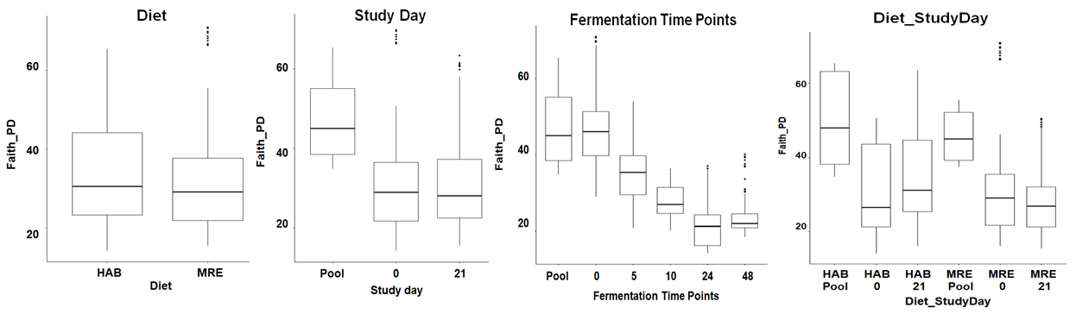
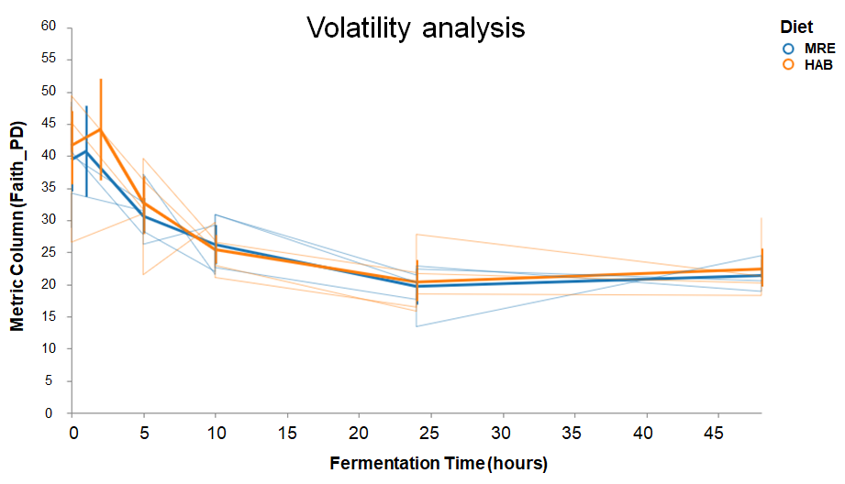
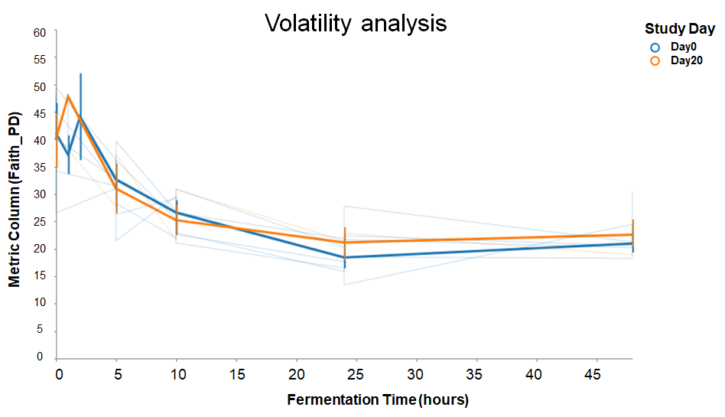
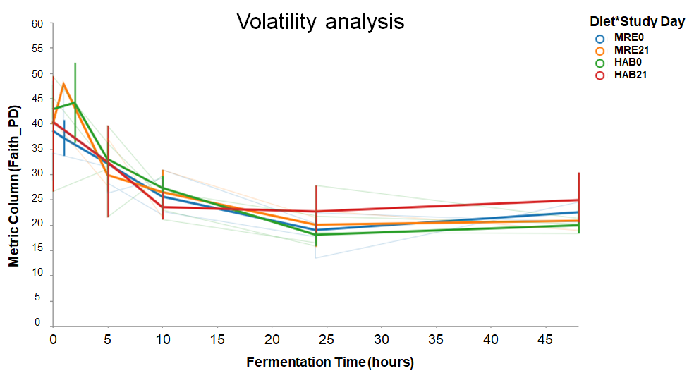
FIGURE S2: Faith_PD Alpha Diversity Metric Boxplots (A) and Alpha Diversity Volatility Analysis (B)
A.
a
b
c
d
B.
a
b
c

Slide 4
FIGURE S2: Faith_PD Alpha Diversity Metric Boxplots (A) and Alpha Diversity Volatility Analysis (B)
Panel A presents the Alpha Diversity Faith_PD metric boxplots that were generated using a determined sequencing depth of 212,889 for the four variables (a) Diet, (b) Study Day, (c) Fermentation Time Points and (d) Diet_Study Day. Panel B shows the Volatility Analysis for the Alpha Diversity Faith_PD metric for (a) Diet, (b) Study Day and (c) Diet_Study Day.

Slide 5
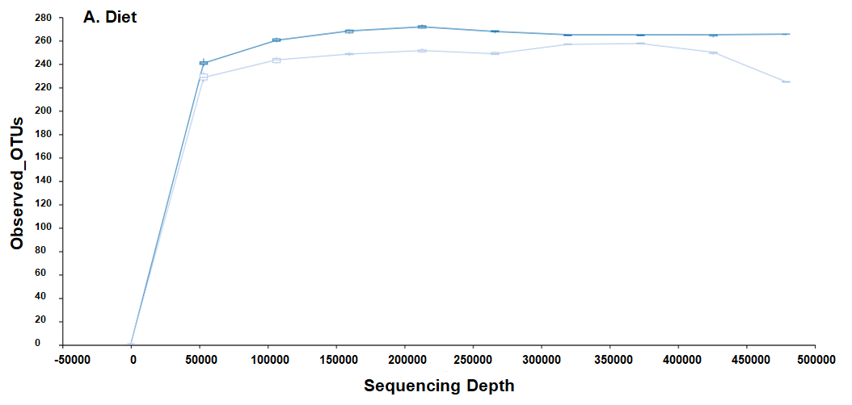
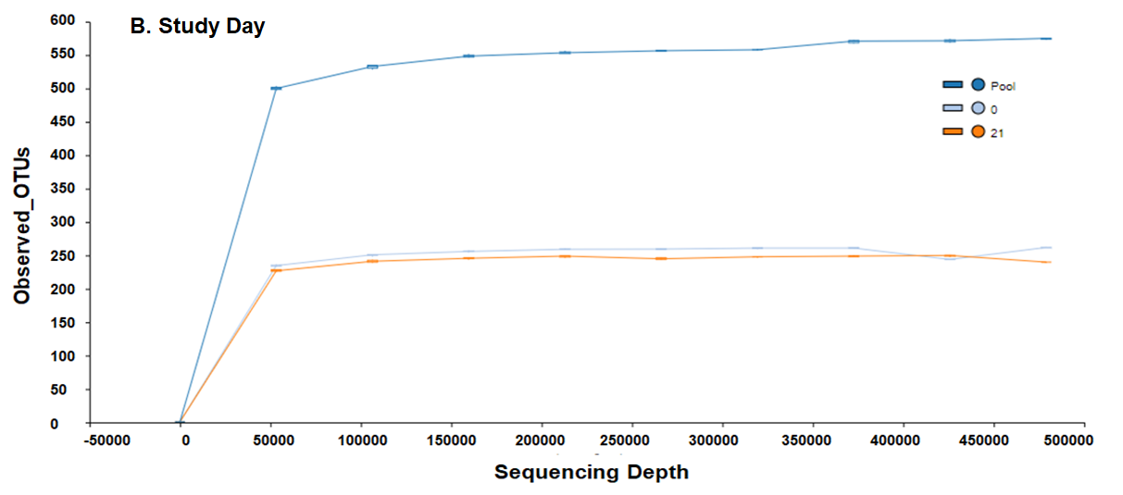
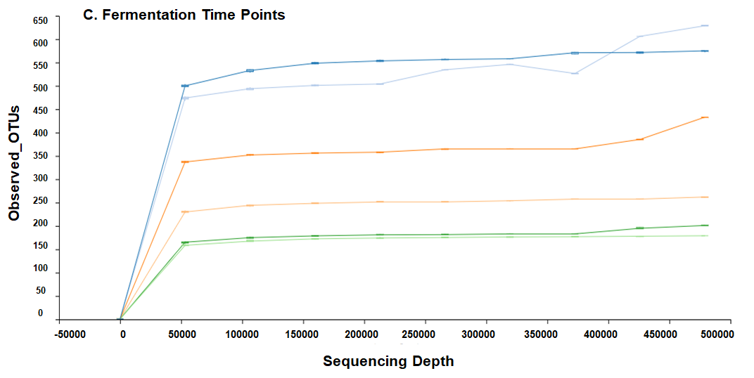
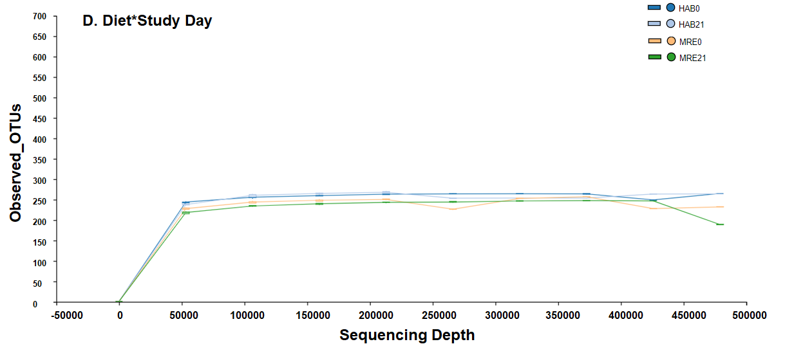
FIGURE S3: Alpha Diversity Plots: Observed OTUs

Slide 6
FIGURE S3: Alpha Diversity Plots: Observed OTUs
Rarefaction curves for Alpha Diversity Analysis. As the Observed OTUs shows, there are no differences in alpha diversity by Diet (A) and Study Day (B). Alpha diversity decreases with fermentation time(C). There are no observed differences in the interaction Diet*Study Day (D).

Slide 7
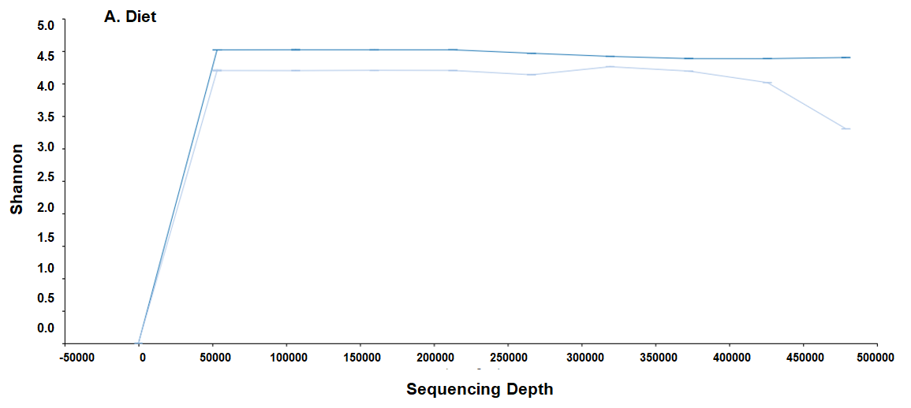
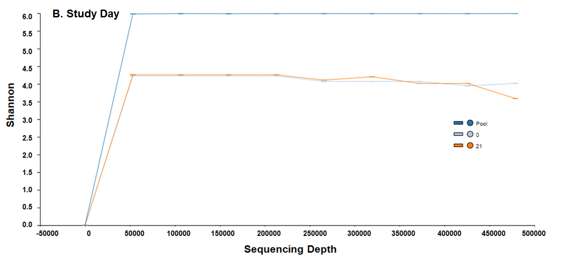
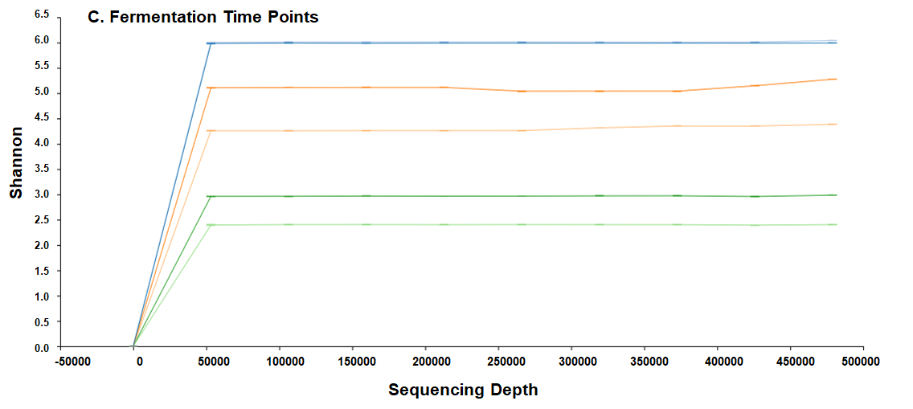
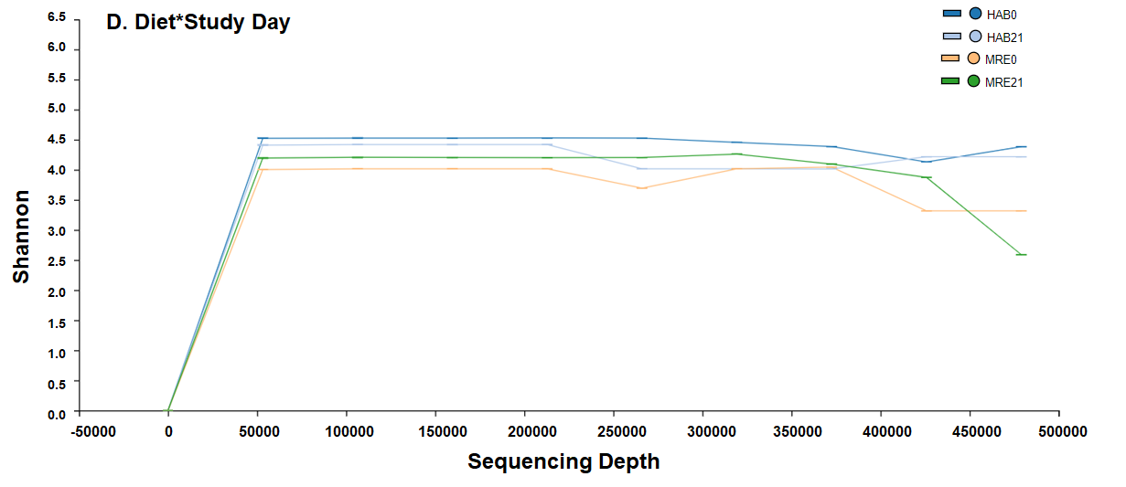
Figure S4: Alpha Diversity Plots: Shannon

Slide 8
Figure S4: Alpha Diversity Plots: Shannon
Rarefaction curves for Alpha Diversity Analysis. As the Shannon Diversity shows, there are no differences in alpha diversity by Diet (A) and Study Day (B). Alpha diversity decreases with fermentation time(C). There are no observed differences in the interaction Diet*Study Day (D).

Slide 9
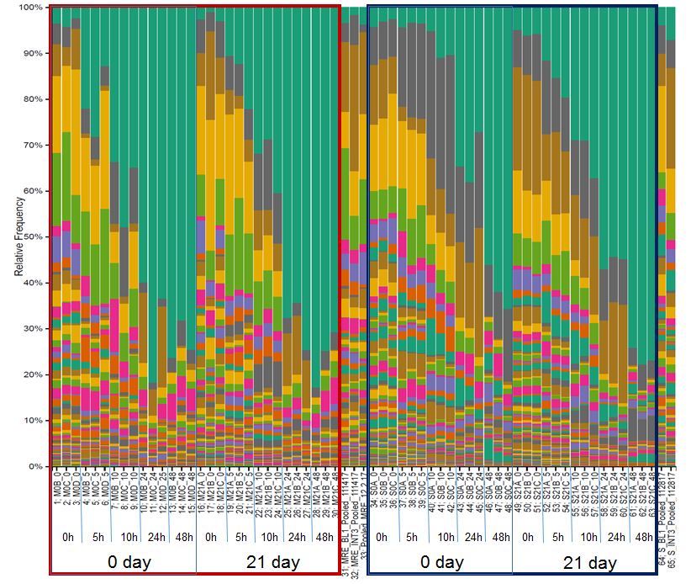
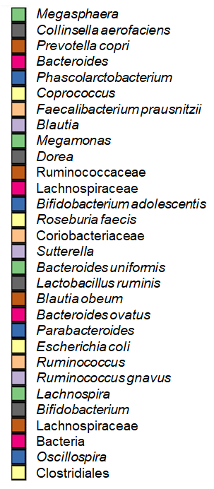
FIGURE S5: Taxonomy Bar Blot Whole Community
MRE-diet group
HAB-diet group
100%
90%
80%
70%
60%
50%
40%
30%
20%
10%
0%
High Frequency
Relative Frequency
Low frequency

Slide 10
FIGURE S5: Taxonomy Bar Blot Whole Community
Bar plot showing the taxonomy for the whole community. 201 taxa identified from all group of samples with their relative frequencies. Legend is showing the 30 most abundant taxa from the top of the bar graph. Among the most abundant taxa and pertinent to mention due to its relation to following results are one species of Prevotella, Dorea, Bifidobacterium adolescentis and Lachnospira.

Slide 11
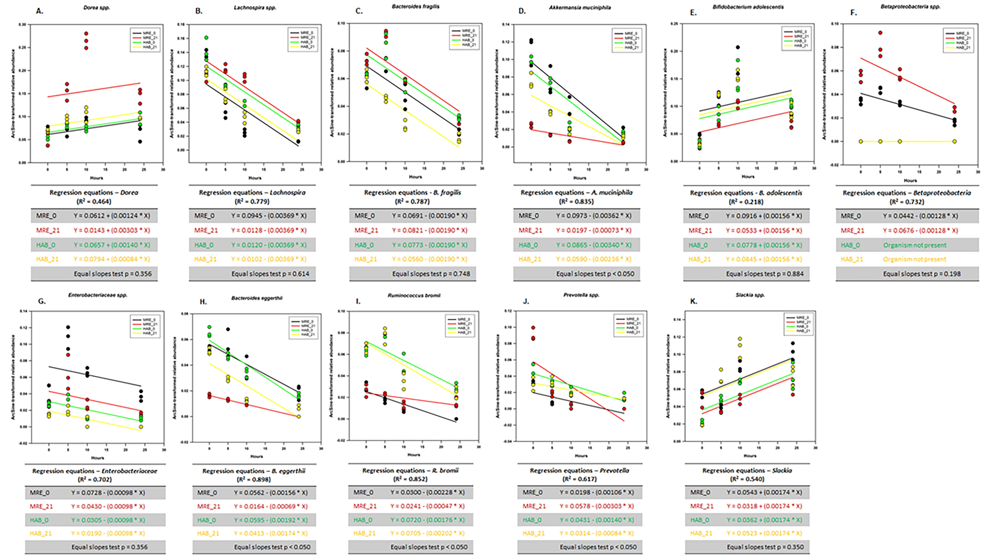
Figure S6: 16S rRNA Regression Lines for Groups

Slide 12
Figure S6: 16S rRNA Regression Lines for Groups
To assess whether significant differences were due to relative abundance at 0h, features were subjected to analysis of covariance with fermentation time as the covariate and tested for equality of slopes between groups (p<0.05) (one-way ANCOVA). Regression lines corresponds to (A) Dorea, (B), Lachnospira (C) Bacteroides fragilis, (D) A. muciniphila, (E) Bifidobacterium adolescentis, (F) Betaproteobacteria, (G) Enterobacteriaceae, (H) Bacteroides eggerthii, (I) Ruminococcus bromii, (J) Prevotella, and (K) Slackia.

Slide 13
Table S1. Taxa Linear Mixed Model Analysis

Slide 14
Taxa | 3-way interaction Diet:StudyDay:Time p values | Adjusted p values (BH) | Day0 Diet:Time p values | Adjusted p values (BH) | Day21 Diet:Time p values | Adjusted p values (BH)
Prevotella | 4.80E-11 | 6.10E-09 | 6.18E-02 | 7.83E-02 | 2.00E-16 | 5.72E-16
Clostridium_hathewayi | 6.66E-10 | 4.23E-08 | 2.20E-16 | 8.17E-16 | 4.18E-01 | 4.63E-01
Succiniclasticum | 4.71E-09 | 1.99E-07 | 2.20E-16 | 8.17E-16 | 2.20E-16 | 5.72E-16
Lachnospira | 9.36E-09 | 2.97E-07 | 1.02E-03 | 1.66E-03 | 8.62E-16 | 1.95E-15
Prevotella_stercorea | 8.59E-08 | 2.18E-06 | 2.20E-16 | 8.17E-16 | 2.20E-16 | 5.72E-16
Lactobacillus_ruminis | 1.65E-07 | 3.49E-06 | 2.20E-16 | 8.17E-16 | 2.20E-16 | 5.72E-16
Erysipelotrichaceae | 4.69E-07 | 8.51E-06 | 2.20E-16 | 8.17E-16 | 4.58E-03 | 5.96E-03
Bacteroides_fragilis | 7.62E-07 | 1.21E-05 | 2.69E-01 | 2.97E-01 | 2.20E-16 | 5.72E-16
Acidaminococcus | 1.12E-06 | 1.58E-05 | 2.20E-16 | 8.17E-16 | 2.20E-16 | 5.72E-16
Dialister | 1.27E-06 | 1.61E-05 | 2.20E-16 | 8.17E-16 | 2.20E-16 | 5.72E-16
Dorea | 2.32E-06 | 2.68E-05 | 1.67E-03 | 2.34E-03 | 2.20E-16 | 5.72E-16
Desulfovibrionaceae | 2.59E-06 | 2.74E-05 | 2.20E-16 | 8.17E-16 | 1.14E-06 | 1.85E-06
Lachnobacterium | 5.03E-06 | 4.91E-05 | 3.04E-13 | 9.87E-13 | 1.60E-06 | 2.45E-06
Desulfovibrio | 1.29E-05 | 1.10E-04 | 8.67E-01 | 8.84E-01 | 2.20E-16 | 5.72E-16
Haemophilus_parainfluenzae | 1.30E-05 | 1.10E-04 | 1.90E-01 | 2.15E-01 | 2.07E-14 | 4.48E-14
Butyricimonas | 2.69E-05 | 2.14E-04 | 1.67E-01 | 1.92E-01 | 3.27E-16 | 7.73E-16
Slackia | 3.12E-05 | 2.33E-04 | 8.66E-06 | 1.67E-05 | 2.20E-16 | 5.72E-16
Catenibacterium | 7.15E-05 | 5.04E-04 | 2.20E-16 | 8.17E-16 | 1.57E-12 | 3.26E-12
Roseburia_faecis | 8.35E-05 | 5.58E-04 | 7.98E-07 | 1.73E-06 | 2.20E-16 | 5.72E-16
Bilophila | 1.29E-04 | 8.16E-04 | 2.34E-06 | 4.86E-06 | 8.19E-02 | 9.47E-02
Akkermansia_muciniphila | 1.52E-04 | 9.21E-04 | 6.60E-02 | 8.17E-02 | 2.20E-16 | 5.72E-16
g__Oscillospira | 2.15E-04 | 1.19E-03 | 4.77E-02 | 6.36E-02 | 2.27E-04 | 3.28E-04
Ruminococcus_albus | 2.13E-04 | 1.19E-03 | 5.43E-02 | 7.06E-02 | 1.33E-06 | 2.09E-06
Oscillospira_guilliermondii | 2.61E-04 | 1.38E-03 | 2.85E-01 | 3.09E-01 | 2.20E-16 | 5.72E-16
Megamonas | 3.49E-04 | 1.71E-03 | 2.21E-05 | 3.96E-05 | 2.56E-08 | 4.59E-08
Betaproteobacteria | 3.46E-04 | 1.71E-03 | 2.20E-16 | 8.17E-16 | 2.20E-16 | 5.72E-16
Faecalibacterium_prausnitzii | 4.22E-04 | 1.99E-03 | 3.89E-11 | 1.12E-10 | 4.56E-01 | 4.94E-01
Streptococcus | 4.43E-04 | 2.01E-03 | 1.19E-03 | 1.88E-03 | 5.84E-11 | 1.17E-10
Veillonella_parvula | 5.37E-04 | 2.35E-03 | 4.90E-06 | 9.80E-06 | 2.20E-16 | 5.72E-16
SMB53 | 6.53E-04 | 2.67E-03 | 1.55E-10 | 4.04E-10 | 9.34E-03 | 1.16E-02
Dehalobacteriaceae | 6.45E-04 | 2.67E-03 | 2.20E-16 | 8.17E-16 | 3.17E-16 | 7.73E-16
Bacteroides_eggerthii | 6.86E-04 | 2.72E-03 | 2.78E-05 | 4.82E-05 | 2.20E-16 | 5.72E-16
SHA_98 | 9.11E-04 | 3.51E-03 | 1.66E-03 | 2.34E-03 | 1.27E-07 | 2.20E-07
Ruminococcus_bromii | 9.44E-04 | 3.53E-03 | 9.14E-13 | 2.80E-12 | 2.20E-16 | 5.72E-16
Ruminococcaceae | 1.06E-03 | 3.85E-03 | 1.30E-01 | 1.57E-01 | 2.62E-04 | 3.68E-04
ML615J_28 | 1.30E-03 | 4.59E-03 | 1.51E-03 | 2.24E-03 | 7.10E-02 | 8.40E-02
Christensenellaceae | 1.41E-03 | 4.84E-03 | 2.48E-10 | 6.14E-10 | 6.04E-01 | 6.28E-01
Rothia_mucilaginosa | 2.49E-03 | 8.32E-03 | 2.20E-16 | 8.17E-16 | 9.41E-01 | 9.41E-01
RF32 | 2.60E-03 | 8.47E-03 | 9.25E-14 | 3.21E-13 | 2.20E-16 | 5.72E-16
g__Roseburia | 2.89E-03 | 9.18E-03 | 9.97E-01 | 9.97E-01 | 2.57E-07 | 4.30E-07
Clostridium | 4.10E-03 | 1.22E-02 | 9.09E-05 | 1.53E-04 | 2.20E-16 | 5.72E-16
g__Ruminococcus | 4.14E-03 | 1.22E-02 | 4.19E-03 | 5.73E-03 | 1.31E-01 | 1.48E-01
Phascolarctobacterium | 4.11E-03 | 1.22E-02 | 1.62E-05 | 3.01E-05 | 5.01E-02 | 6.06E-02
Bifidobacterium_adolescentis | 5.26E-03 | 1.52E-02 | 4.01E-01 | 4.26E-01 | 6.73E-11 | 1.30E-10
f__Ruminococcaceae | 5.63E-03 | 1.59E-02 | 7.80E-08 | 1.76E-07 | 1.10E-04 | 1.63E-04
Clostridiales | 6.38E-03 | 1.76E-02 | 7.94E-10 | 1.88E-09 | 7.29E-01 | 7.43E-01
Veillonella_dispar | 7.73E-03 | 2.09E-02 | 2.20E-16 | 8.17E-16 | 2.20E-16 | 5.72E-16
Megasphaera | 1.03E-02 | 2.72E-02 | 1.02E-10 | 2.79E-10 | 8.89E-09 | 1.65E-08
Alistipes_indistinctus | 1.14E-02 | 2.89E-02 | 1.44E-03 | 2.20E-03 | 4.84E-01 | 5.13E-01
Enterobacteriaceae | 1.12E-02 | 2.89E-02 | 2.20E-16 | 8.17E-16 | 3.87E-04 | 5.30E-04
Oribacterium | 1.26E-02 | 3.13E-02 | 6.09E-01 | 6.33E-01 | 3.05E-03 | 4.07E-03
Parabacteroides | 1.93E-02 | 4.72E-02 | 1.39E-01 | 1.64E-01 | 8.22E-03 | 1.04E-02

Slide 15
Table S2: Taxa Tukeys HSD p-values (pairwise multiple comparison)
Lachnospira | 0h | Adjusted p values (BH) | 5h | Adjusted p values (BH) | 10h | Adjusted p values (BH) | 24h | Adjusted p values (BH)
HAB21-HAB0 | 3.27E-02 | 7.73E-02 | 1.56E-01 | 1.56E-01 | 8.88E-03 | 8.88E-03** | 3.48E-01 | 4.17E-01
MRE0-HAB0 | 8.28E-01 | 8.81E-01 | 2.48E-03 | 4.97E-03^^ | 7.96E-05 | 1.59E-04^^^ | 1.26E-02 | 3.79E-02^
MRE21-HAB21 | 8.81E-01 | 8.81E-01 | 1.26E-03 | 3.79E-03^^ | 9.40E-06 | 2.82E-05^^^ | 6.96E-02 | 1.39E-01
MRE21-MRE0 | 3.86E-02 | 7.73E-02 | 6.98E-05 | 4.19E-04*** | 8.00E-07 | 4.80E-06*** | 2.89E-03 | 1.73E-02*
Bacteroides_fragilis | 0h | Adjusted p values (BH) | 5h | Adjusted p values (BH) | 10h | Adjusted p values (BH) | 24h | Adjusted p values (BH)
HAB21-HAB0 | 9.90E-01 | 9.99E-01 | 1.18E-04 | 3.55E-04*** | 7.65E-04 | 2.30E-03** | 1.21E-03 | 7.25E-03**
MRE0-HAB0 | 9.73E-01 | 9.99E-01 | 8.52E-02 | 1.02E-01 | 2.11E-01 | 2.54E-01 | 3.70E-02 | 7.40E-02
MRE21-HAB21 | 1.57E-01 | 4.70E-01 | 2.79E-05 | 1.67E-04^^^ | 4.67E-04 | 2.30E-03^^ | 2.72E-03 | 8.15E-03^^
MRE21-MRE0 | 1.33E-01 | 4.70E-01 | 6.77E-03 | 1.02E-02** | 1.07E-01 | 1.61E-01 | 1.02E-01 | 1.23E-01
Dorea | 0h | Adjusted p values (BH) | 5h | Adjusted p values (BH) | 10h | Adjusted p values (BH) | 24h | Adjusted p values (BH)
HAB21-HAB0 | 8.27E-01 | 9.93E-01 | 6.15E-01 | 6.90E-01 | 4.50E-02 | 6.75E-02 | 1.00E+00 | 1.00E+00
MRE0-HAB0 | 9.92E-01 | 9.93E-01 | 6.90E-01 | 6.90E-01 | 2.79E-01 | 3.35E-01 | 1.19E-01 | 1.47E-01
MRE21-HAB21 | 6.85E-01 | 9.93E-01 | 1.48E-03 | 2.96E-03^^ | 1.00E-06 | 2.00E-06^^^ | 1.01E-02 | 2.07E-02^
MRE21-MRE0 | 9.44E-01 | 9.93E-01 | 1.48E-04 | 8.87E-04*** | 5.00E-07 | 1.50E-06*** | 5.42E-04 | 3.25E-03**
Slackia | 0h | Adjusted p values (BH) | 5h | Adjusted p values (BH) | 10h | Adjusted p values (BH) | 24h | Adjusted p values (BH)
HAB21-HAB0 | 9.21E-01 | 9.21E-01 | 7.13E-04 | 1.43E-03*** | 5.67E-04 | 1.70E-03** | 9.88E-01 | 9.88E-01
MRE0-HAB0 | 3.72E-04 | 1.12E-03^^^ | 2.17E-01 | 2.60E-01 | 6.80E-02 | 6.80E-02 | 5.71E-02 | 1.71E-01
MRE21-HAB21 | 5.95E-04 | 1.19E-03^^^ | 2.17E-05 | 1.30E-04^^^ | 3.03E-05 | 1.82E-04^^^ | 4.90E-01 | 7.36E-01
MRE21-MRE0 | 6.96E-01 | 8.35E-01 | 2.60E-01 | 2.60E-01 | 9.00E-04 | 1.80E-03** | 1.17E-02 | 7.00E-02
Akkermansia_muciniphila | 0h | Adjusted p values (BH) | 5h | Adjusted p values (BH) | 10h | Adjusted p values (BH) | 24h | Adjusted p values (BH)
HAB21-HAB0 | 5.44E-02 | 6.53E-02 | 3.66E-03 | 7.15E-03** | 8.09E-01 | 8.09E-01 | 6.30E-02 | 7.56E-02
MRE0-HAB0 | 4.10E-01 | 4.10E-01 | 9.96E-01 | 9.96E-01 | 1.44E-02 | 2.88E-02^ | 3.53E-01 | 3.53E-01
MRE21-HAB21 | 8.48E-04 | 1.70E-03^^ | 2.35E-02 | 2.82E-02^ | 1.64E-01 | 1.97E-01 | 2.51E-02 | 3.76E-02^
MRE21-MRE0 | 1.60E-05 | 9.60E-05*** | 1.08E-04 | 3.25E-04*** | 3.64E-04 | 2.18E-03** | 1.30E-04 | 7.79E-04***
Betaproteobacteria | 0h | Adjusted p values (BH) | 5h | Adjusted p values (BH) | 10h | Adjusted p values (BH) | 24h | Adjusted p values (BH)
HAB21-HAB0 | 1.00E+00 | 1.00E+00 | 1.00E+00 | 1.00E+00 | 1.00E+00 | 1.00E+00 | 1.00E+00 | 1.00E+00
MRE0-HAB0 | 1.70E-06 | 2.55E-06^^^ | 3.32E-05 | 4.98E-05^^^ | 1.20E-06 | 1.80E-06^^^ | 9.00E-06 | 1.35E-05^^^
MRE21-HAB21 | 0.00E+00 | 0.00E+00 | 3.00E-07 | 9.00E-07^^^ | 0.00E+00 | 0.00E+00 | 1.00E-07 | 3.00E-07^^^
MRE21-MRE0 | 6.29E-05 | 7.55E-05*** | 1.23E-04 | 1.47E-04*** | 1.02E-05 | 1.22E-05*** | 1.37E-04 | 1.64E-04***
Bacteroides_eggerthii | 0h | Adjusted p values (BH) | 5h | Adjusted p values (BH) | 10h | Adjusted p values (BH) | 24h | Adjusted p values (BH)
HAB21-HAB0 | 4.91E-04 | 7.36E-04*** | 2.21E-02 | 3.32E-02* | 4.03E-03 | 6.05E-03** | 2.42E-02 | 3.64E-02*
MRE0-HAB0 | 1.78E-03 | 2.13E-03^^ | 2.85E-01 | 2.85E-01 | 9.87E-01 | 9.87E-01 | 7.96E-01 | 7.96E-01
MRE21-HAB21 | 9.00E-07 | 1.80E-06^^^ | 3.70E-02 | 4.44E-02^ | 8.32E-01 | 9.87E-01 | 4.29E-01 | 5.15E-01
MRE21-MRE0 | 5.00E-07 | 1.50E-06*** | 7.63E-05 | 4.58E-04*** | 1.07E-03 | 4.57E-03** | 1.12E-03 | 6.70E-03**
Ruminococcus_bromii | 0h | Adjusted p values (BH) | 5h | Adjusted p values (BH) | 10h | Adjusted p values (BH) | 24h | Adjusted p values (BH)
HAB21-HAB0 | 8.86E-01 | 8.86E-01 | 9.98E-01 | 9.98E-01 | 9.49E-02 | 1.14E-01 | 6.67E-01 | 6.67E-01
MRE0-HAB0 | 1.36E-04 | 2.04E-04^^^ | 4.00E-07 | 1.20E-06^^^ | 2.19E-04 | 1.32E-03^^^ | 1.33E-04 | 7.95E-04^^^
MRE21-HAB21 | 3.21E-05 | 1.50E-04^^^ | 9.00E-07 | 1.35E-06^^^ | 1.47E-02 | 2.21E-02^ | 7.84E-02 | 9.40E-02
MRE21-MRE0 | 6.90E-01 | 8.28E-01 | 3.58E-01 | 4.30E-01 | 7.20E-01 | 7.20E-01 | 9.37E-03 | 1.87E-02*
Bifidobacterium_adolescentis | 0h | Adjusted p values (BH) | 5h | Adjusted p values (BH) | 10h | Adjusted p values (BH) | 24h | Adjusted p values (BH)
HAB21-HAB0 | 9.98E-01 | 9.98E-01 | 7.88E-03 | 1.58E-02* | 9.88E-01 | 9.88E-01 | 5.04E-01 | 7.55E-01
MRE0-HAB0 | 3.37E-01 | 8.97E-01 | 2.42E-02 | 3.64E-02^ | 6.39E-01 | 9.59E-01 | 8.67E-01 | 8.99E-01
MRE21-HAB21 | 9.76E-01 | 9.98E-01 | 5.93E-04 | 3.56E-03^^ | 1.03E-01 | 3.10E-01 | 7.19E-02 | 1.44E-01
MRE21-MRE0 | 4.49E-01 | 8.97E-01 | 1.44E-03 | 4.33E-03** | 2.96E-02 | 1.77E-01 | 2.74E-02 | 8.23E-02
Enterobacteriaceae | 0h | Adjusted p values (BH) | 5h | Adjusted p values (BH) | 10h | Adjusted p values (BH) | 24h | Adjusted p values (BH)
HAB21-HAB0 | 1.92E-01 | 2.30E-01 | 4.87E-01 | 4.87E-01 | 4.95E-01 | 4.95E-01 | 2.03E-02 | 2.44E-02*
MRE0-HAB0 | 1.82E-01 | 2.30E-01 | 5.18E-04 | 1.55E-03^^ | 6.40E-06 | 1.92E-05^^^ | 3.87E-05 | 1.16E-04^^^
MRE21-HAB21 | 1.83E-01 | 2.30E-01 | 1.16E-02 | 1.89E-02^ | 4.59E-03 | 6.88E-03^^ | 1.76E-03 | 2.64E-03^^
MRE21-MRE0 | 1.90E-01 | 2.30E-01 | 1.26E-02 | 1.89E-02* | 7.30E-05 | 1.46E-04*** | 1.92E-04 | 3.83E-04***

Slide 16
Tukey multiple comparisons of means 95% family-wise confidence level;BH: benjamini-hochberg; (*) symbol indicates a difference between study days 0 and 21 for the same diet, and a (^) symbol indicates a difference between MRE and habitual (HAB) diets for the same study day. One symbol indicates p ≤ 0.05, two symbols indicates p ≤ 0.01, and three symbols indicates p ≤ 0.001; a BH adjusted P-value <0.05 was considered statistically significant and it is presented in bold.

Slide 17
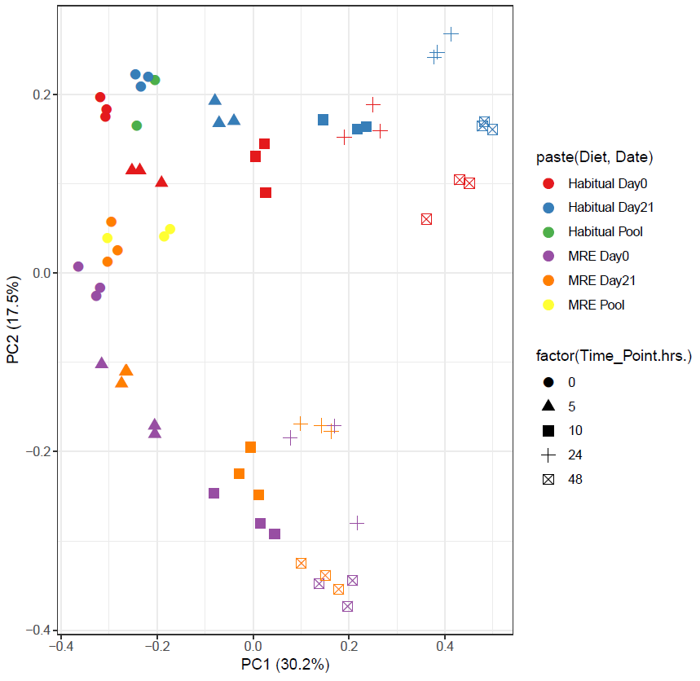
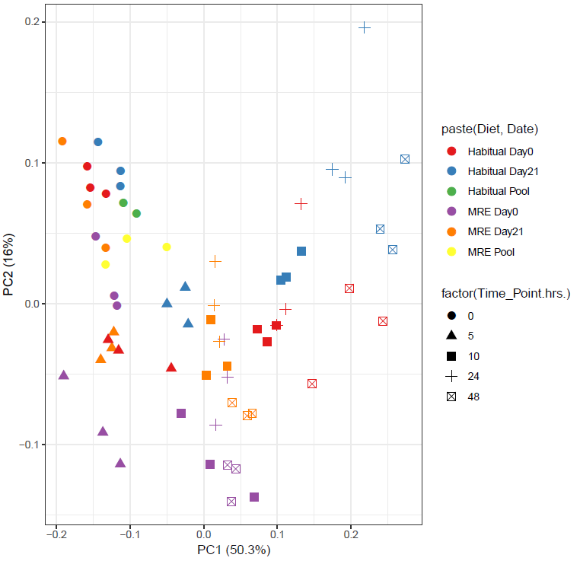
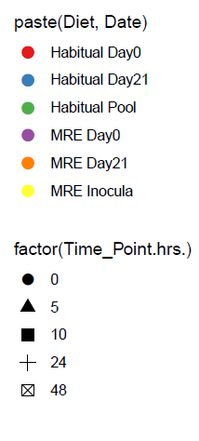
Figure S7: WGS: Bray-Curtis PCoA by (A) Gene Families and
(B) Pathways
A.
B.

Slide 18
Figure S7: WGS: Bray-Curtis PCoA by (A) Gene Families and
(B) Pathways
Gene Families PCoA (A) and Pathways PCoA (B). PCoA of Bray-Curtis distances in gene family abundances (A) resulted in the first principal coordinate associating with fermentation time. The second principal coordinate was associated with diet. PCoA of Bray-Curtis distances in pathway abundances (B) primarily clustered by fermentation time with effects of Diet.

Slide 19
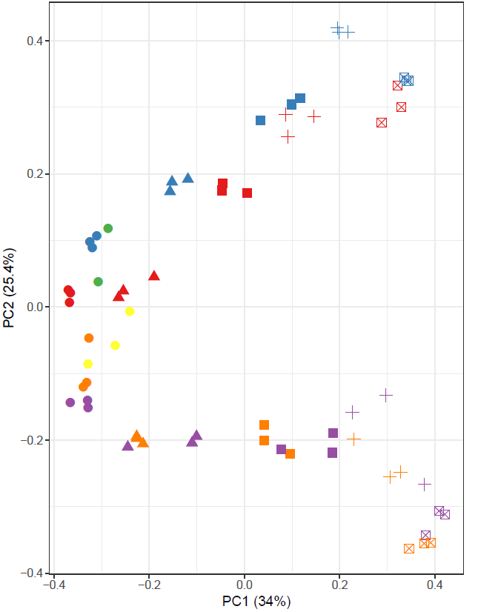
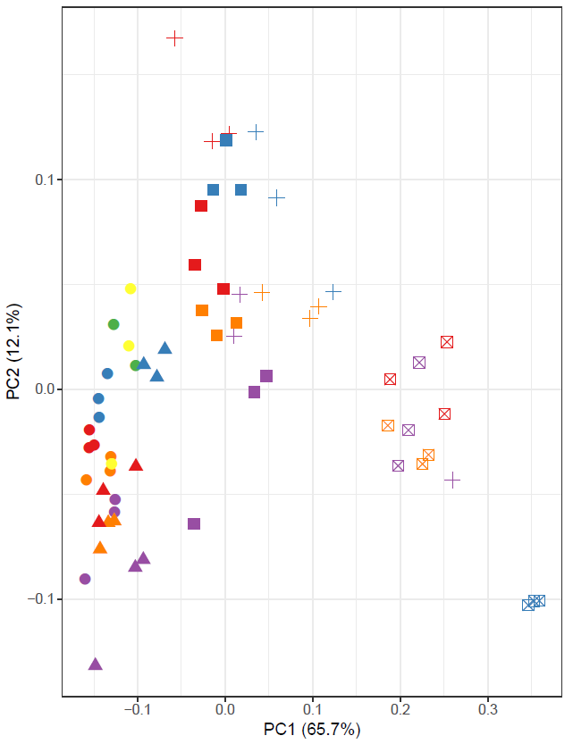
FIGURE S8: WGS: Bray-Curtis PCoA by (A) metagenomic bin
and B) CAZymes
A.
B.
Habitual Inocula

Slide 20
FIGURE S8: WGS: Bray-Curtis PCoA by (A) metagenomic bin
and B) CAZymes
Metagenomic bin PCoA (A) and CAZymes PCoA (B). The bin PCoA shows the same pattern as the 16S PCoA in which Diet and fermentation time points have the highest effect (A). The CAZyme PCoA (B) shows a much smaller effect of Diet and larger effect of fermentation time points.

Slide 21
Table S3. CAZymes LMM Analysis p values
CAZYmes | 3-way interaction Diet:StudyDay:Time p values | Adjusted p values (BH) | Day0 Diet:Time p values | Adjusted p values (BH) | Day21 Diet:Time p values | Adjusted p values (BH)
GT2_Glyco_tranf_2_2.hmm | 8.87E-09 | 2.66E-06 | 2.20E-16 | 8.80E-16 | 7.73E-01 | 7.73E-01
CBM23.hmm | 6.45E-07 | 8.11E-05 | 1.99E-10 | 6.62E-10 | 7.55E-04 | 1.08E-03
GH13_14.hmm | 8.11E-07 | 8.11E-05 | 1.10E-01 | 1.16E-01 | 2.20E-16 | 7.33E-16
GH79.hmm | 5.69E-06 | 4.27E-04 | 4.52E-03 | 7.54E-03 | 2.20E-16 | 7.33E-16
GH101.hmm | 5.06E-05 | 3.04E-03 | 5.23E-02 | 6.53E-02 | 2.00E-16 | 7.33E-16
CBM40.hmm | 1.07E-04 | 5.37E-03 | 4.83E-05 | 1.38E-04 | 1.59E-03 | 2.12E-03
PL22.hmm | 2.32E-04 | 9.95E-03 | 2.20E-16 | 8.80E-16 | 4.33E-04 | 7.21E-04
GH125.hmm | 2.95E-04 | 1.07E-02 | 2.20E-16 | 8.80E-16 | 2.20E-16 | 7.33E-16
GH13_4.hmm | 3.56E-04 | 1.07E-02 | 5.35E-03 | 8.23E-03 | 1.29E-09 | 3.69E-09
GH5_22.hmm | 3.45E-04 | 1.07E-02 | 2.20E-16 | 8.80E-16 | 2.20E-16 | 7.33E-16
CBM26.hmm | 4.78E-04 | 1.30E-02 | 3.55E-04 | 7.10E-04 | 2.27E-06 | 5.68E-06
PL1.hmm | 5.80E-04 | 1.45E-02 | 3.12E-02 | 4.16E-02 | 5.31E-04 | 8.18E-04
PL11.hmm | 6.56E-04 | 1.51E-02 | 3.32E-04 | 7.10E-04 | 1.75E-05 | 3.49E-05
GH5_35.hmm | 8.15E-04 | 1.75E-02 | 5.33E-01 | 5.33E-01 | 2.20E-16 | 7.33E-16
GT76.hmm | 1.41E-03 | 2.82E-02 | 8.60E-02 | 1.01E-01 | 1.99E-03 | 2.48E-03
GH36.hmm | 1.71E-03 | 3.21E-02 | 9.26E-02 | 1.03E-01 | 3.70E-05 | 6.72E-05
GH73.hmm | 2.26E-03 | 3.98E-02 | 9.10E-05 | 2.28E-04 | 2.55E-02 | 3.00E-02
GH27.hmm | 2.50E-03 | 4.16E-02 | 8.92E-04 | 1.62E-03 | 5.84E-02 | 6.15E-02
GH13_2.hmm | 2.69E-03 | 4.26E-02 | 6.60E-03 | 9.42E-03 | 5.68E-02 | 6.15E-02
GH13_18.hmm | 3.10E-03 | 4.65E-02 | 2.20E-16 | 8.80E-16 | 9.81E-06 | 2.18E-05

Slide 22
Table S4: CAZymes Tukeys HSD p-values (pairwise multiple comparison)
GH13_14.hmm | 0h | Adjusted p values (BH) | 5h | Adjusted p values (BH) | 10h | Adjusted p values (BH) | 24h | Adjusted p values (BH)
HAB21-HAB0 | 2.91E-01 | 3.49E-01 | 9.70E-01 | 9.70E-01 | 9.50E-01 | 9.50E-01 | 7.03E-01 | 9.91E-01
MRE0-HAB0 | 5.91E-01 | 5.91E-01 | 3.62E-02 | 1.09E-01 | 9.45E-01 | 9.50E-01 | 8.51E-01 | 9.91E-01
MRE21-HAB21 | 6.89E-04 | 4.14E-03^^ | 5.97E-01 | 8.96E-01 | 2.96E-04 | 1.47E-03^^^ | 8.01E-03 | 3.50E-02^
MRE21-MRE0 | 3.35E-02 | 6.70E-02 | 1.15E-02 | 6.92E-02 | 8.50E-04 | 1.70E-03** | 1.17E-02 | 3.50E-02*
GH79.hmm | 0h | Adjusted p values (BH) | 5h | Adjusted p values (BH) | 10h | Adjusted p values (BH) | 24h | Adjusted p values (BH)
HAB21-HAB0 | 1.88E-04 | 2.25E-04*** | 9.78E-03 | 1.17E-02** | 1.90E-01 | 2.28E-01 | 9.89E-01 | 9.89E-01
MRE0-HAB0 | 4.07E-02 | 4.07E-02^ | 6.72E-05 | 1.01E-04^^^ | 1.00E-01 | 1.50E-01 | 3.74E-01 | 6.48E-01
MRE21-HAB21 | 1.00E-07 | 6.00E-07^^^ | 1.10E-06 | 6.60E-06^^^ | 9.36E-04 | 5.61E-03^^ | 8.89E-02 | 2.67E-01
MRE21-MRE0 | 4.89E-05 | 7.34E-05*** | 1.84E-01 | 1.84E-01 | 5.04E-01 | 5.04E-01 | 5.40E-01 | 6.48E-01
CBM40.hmm | 0h | Adjusted p values (BH) | 5h | Adjusted p values (BH) | 10h | Adjusted p values (BH) | 24h | Adjusted p values (BH)
HAB21-HAB0 | 9.59E-02 | 1.44E-01 | 5.74E-01 | 6.89E-01 | 4.60E-01 | 7.76E-01 | 1.00E+00 | 1.00E+00
MRE0-HAB0 | 2.73E-02 | 8.20E-02 | 3.64E-01 | 5.47E-01 | 1.35E-01 | 4.05E-01 | 2.79E-01 | 9.49E-01
MRE21-HAB21 | 4.47E-02 | 8.95E-02 | 4.86E-02 | 1.46E-01 | 5.17E-01 | 7.76E-01 | 8.54E-01 | 1.00E+00
MRE21-MRE0 | 1.32E-02 | 7.90E-02 | 8.75E-02 | 1.75E-01 | 9.63E-01 | 9.63E-01 | 7.21E-01 | 1.00E+00
PL22.hmm | 0h | Adjusted p values (BH) | 5h | Adjusted p values (BH) | 10h | Adjusted p values (BH) | 24h | Adjusted p values (BH)
HAB21-HAB0 | 1.20E-01 | 2.41E-01 | 8.79E-01 | 8.79E-01 | 9.12E-01 | 9.12E-01 | 2.22E-01 | 2.66E-01
MRE0-HAB0 | 2.29E-01 | 3.18E-01 | 5.19E-05 | 2.79E-04^^^ | 5.38E-04 | 1.61E-03^^ | 3.19E-02 | 9.58E-02
MRE21-HAB21 | 2.65E-01 | 3.18E-01 | 1.24E-02 | 1.49E-02^^ | 1.80E-01 | 2.70E-01 | 1.04E-01 | 1.55E-01
MRE21-MRE0 | 1.03E-01 | 2.41E-01 | 6.87E-03 | 1.03E-02** | 3.15E-03 | 6.31E-03** | 6.93E-02 | 1.39E-01
GH13_4.hmm | 0h | Adjusted p values (BH) | 5h | Adjusted p values (BH) | 10h | Adjusted p values (BH) | 24h | Adjusted p values (BH)
HAB21-HAB0 | 1.00E+00 | 1.00E+00 | 4.68E-01 | 9.27E-01 | 1.09E-02 | 1.63E-02* | 7.87E-01 | 7.87E-01
MRE0-HAB0 | 4.72E-01 | 1.00E+00 | 3.46E-01 | 9.27E-01 | 4.93E-01 | 4.93E-01 | 6.60E-01 | 7.87E-01
MRE21-HAB21 | 8.70E-01 | 1.00E+00 | 6.18E-01 | 9.27E-01 | 9.53E-05 | 5.72E-04^^^ | 1.51E-02 | 9.04E-02
MRE21-MRE0 | 8.25E-01 | 1.00E+00 | 4.76E-01 | 9.27E-01 | 1.41E-03 | 4.24E-03** | 2.75E-01 | 4.12E-01
PL1.hmm | 0h | Adjusted p values (BH) | 5h | Adjusted p values (BH) | 10h | Adjusted p values (BH) | 24h | Adjusted p values (BH)
HAB21-HAB0 | 6.65E-01 | 9.98E-01 | 2.71E-01 | 4.07E-01 | 1.00E+00 | 1.00E+00 | 8.00E-01 | 8.00E-01
MRE0-HAB0 | 9.72E-01 | 9.98E-01 | 9.42E-01 | 9.42E-01 | 9.93E-02 | 1.34E-01 | 3.45E-01 | 5.17E-01
MRE21-HAB21 | 7.60E-01 | 9.98E-01 | 4.99E-01 | 5.99E-01 | 3.12E-03 | 6.86E-03^^ | 7.49E-01 | 8.00E-01
MRE21-MRE0 | 9.94E-01 | 9.98E-01 | 1.66E-02 | 9.99E-02 | 2.08E-04 | 1.25E-03*** | 2.47E-02 | 1.48E-01
GT76.hmm | 0h | Adjusted p values (BH) | 5h | Adjusted p values (BH) | 10h | Adjusted p values (BH) | 24h | Adjusted p values (BH)
HAB21-HAB0 | 4.69E-01 | 7.03E-01 | 7.33E-01 | 8.80E-01 | 7.85E-01 | 7.85E-01 | 9.75E-01 | 9.80E-01
MRE0-HAB0 | 9.73E-01 | 9.73E-01 | 1.31E-01 | 3.94E-01 | 1.07E-02 | 1.61E-02^ | 9.50E-01 | 9.80E-01
MRE21-HAB21 | 7.90E-02 | 1.58E-01 | 6.76E-01 | 8.80E-01 | 3.67E-04 | 1.10E-03^^^ | 9.80E-01 | 9.80E-01
MRE21-MRE0 | 1.71E-02 | 5.14E-02* | 1.14E-01 | 3.94E-01 | 2.32E-05 | 1.39E-04*** | 5.79E-01 | 9.80E-01
GH36.hmm | 0h | Adjusted p values (BH) | 5h | Adjusted p values (BH) | 10h | Adjusted p values (BH) | 24h | Adjusted p values (BH)
HAB21-HAB0 | 7.68E-03 | 3.41E-02* | 6.70E-05 | 4.02E-04*** | 7.85E-01 | 7.85E-01 | 9.69E-01 | 1.00E+00
MRE0-HAB0 | 9.26E-01 | 9.95E-01 | 2.32E-02 | 2.79E-02^ | 1.07E-02 | 1.61E-02^ | 1.00E+00 | 1.00E+00
MRE21-HAB21 | 1.25E-02 | 3.41E-02^ | 1.84E-02 | 2.75E-02^ | 3.67E-04 | 1.10E-03^^^ | 4.51E-01 | 1.00E+00
MRE21-MRE0 | 9.95E-01 | 9.95E-01 | 4.16E-01 | 4.16E-01 | 2.32E-05 | 1.39E-04*** | 6.70E-01 | 1.00E+00
GH13_18.hmm | 0h | Adjusted p values (BH) | 5h | Adjusted p values (BH) | 10h | Adjusted p values (BH) | 24h | Adjusted p values (BH)
HAB21-HAB0 | 9.90E-01 | 9.96E-01 | 1.45E-01 | 2.17E-01 | 2.76E-03 | 3.32E-03** | 6.54E-01 | 6.54E-01
MRE0-HAB0 | 9.96E-01 | 9.96E-01 | 2.36E-03 | 1.41E-02^^ | 5.60E-06 | 3.36E-05^^^ | 1.64E-03 | 9.84E-03^^
MRE21-HAB21 | 8.95E-01 | 9.96E-01 | 7.36E-01 | 7.36E-01 | 1.37E-03 | 2.05E-03^^ | 6.28E-02 | 9.42E-02
MRE21-MRE0 | 6.38E-01 | 9.96E-01 | 2.35E-01 | 2.82E-01 | 4.86E-01 | 4.86E-01 | 3.98E-01 | 4.77E-01
Tukey multiple comparisons of means 95% family-wise confidence level;BH: benjamini-hochberg; (*) symbol indicates a difference between study days 0 and 21 for the same diet, and a (^) symbol indicates a difference between MRE and habitual (HAB) diets for the same study day. One symbol indicates p ≤ 0.05, two symbols indicates p ≤ 0.01, and three symbols indicates p ≤ 0.001; a BH adjusted P-value <0.05 was considered statistically significant and it is presented in bold.

Slide 23
Table S5. Pathways LMM Analysis p values
Pathways | 3-way interaction Diet:StudyDay:Time p values | Adjusted p values (BH) | Day0 Diet:Time p values | Adjusted p values (BH) | Day21 Diet:Time p values | Adjusted p values (BH)
GLUCUROCAT-PWY: superpathway of &beta;-D-glucuronide and D-glucuronate degradation | 1.24E-05 | 3.58E-03 | 8.21E-10 | 2.46E-09 | 2.41E-02 | 2.71E-02
GALACT-GLUCUROCAT-PWY: superpathway of hexuronide and hexuronate degradation | 6.75E-05 | 3.90E-03 | 9.16E-07 | 2.06E-06 | 3.36E-03 | 6.05E-03
PWY-5695: urate biosynthesis/inosine 5'-phosphate degradation | 2.80E-05 | 3.90E-03 | 3.39E-02 | 3.39E-02 | 2.20E-16 | 6.60E-16
PWY-6703: preQ0 biosynthesis | 5.65E-05 | 3.90E-03 | 2.52E-05 | 4.53E-05 | 2.20E-16 | 6.60E-16
PWY0-1296: purine ribonucleosides degradation | 6.45E-05 | 3.90E-03 | 5.07E-10 | 2.28E-09 | 1.58E-09 | 3.56E-09
PWY-4981: L-proline biosynthesis II (from arginine) | 4.06E-04 | 1.96E-02 | 2.20E-16 | 1.98E-15 | 2.36E-02 | 2.71E-02
PWY-5177: glutaryl-CoA degradation | 8.99E-04 | 3.25E-02 | 2.46E-03 | 2.77E-03 | 1.65E-02 | 2.47E-02
PWY-6507: 4-deoxy-L-threo-hex-4-enopyranuronate degradation | 7.90E-04 | 3.25E-02 | 8.27E-05 | 1.24E-04 | 4.50E-02 | 4.50E-02
PWY-5188: tetrapyrrole biosynthesis I (from glutamate) | 1.27E-03 | 4.09E-02 | 1.27E-04 | 1.64E-04 | 2.20E-16 | 6.60E-16

