Slide 1
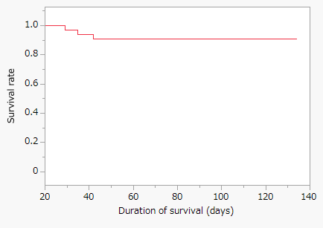
a
b
Fig S8. Data of the changes of body weight and survival rate following infection with 1×10⁶ CFUs of M. intracellulare strains. (a) Time-course of the changes in body weight in mice infected with M. intracellulare strains. (b) Survival curve of mice infected with M.i.198. Mortality sporadically occurred during 4–6 weeks of infection.

