Slide 1
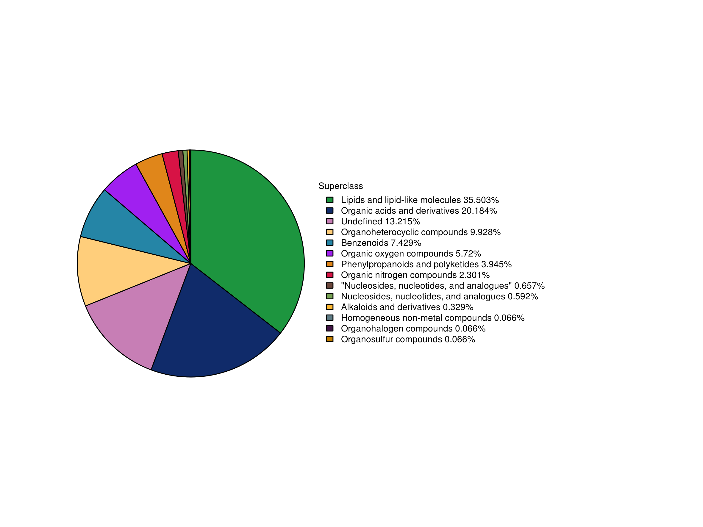
Supplemental Fig. 3 The proportion of identified metabolites in each classification

