Slide 1
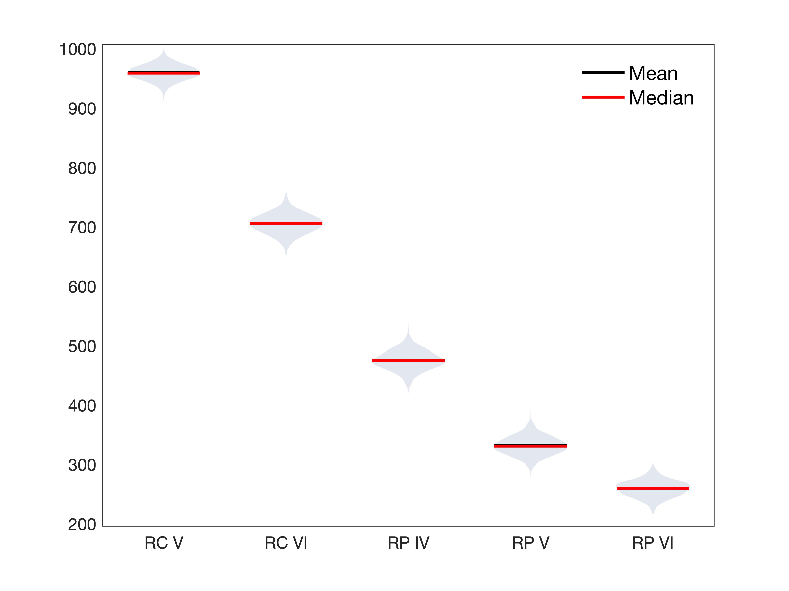
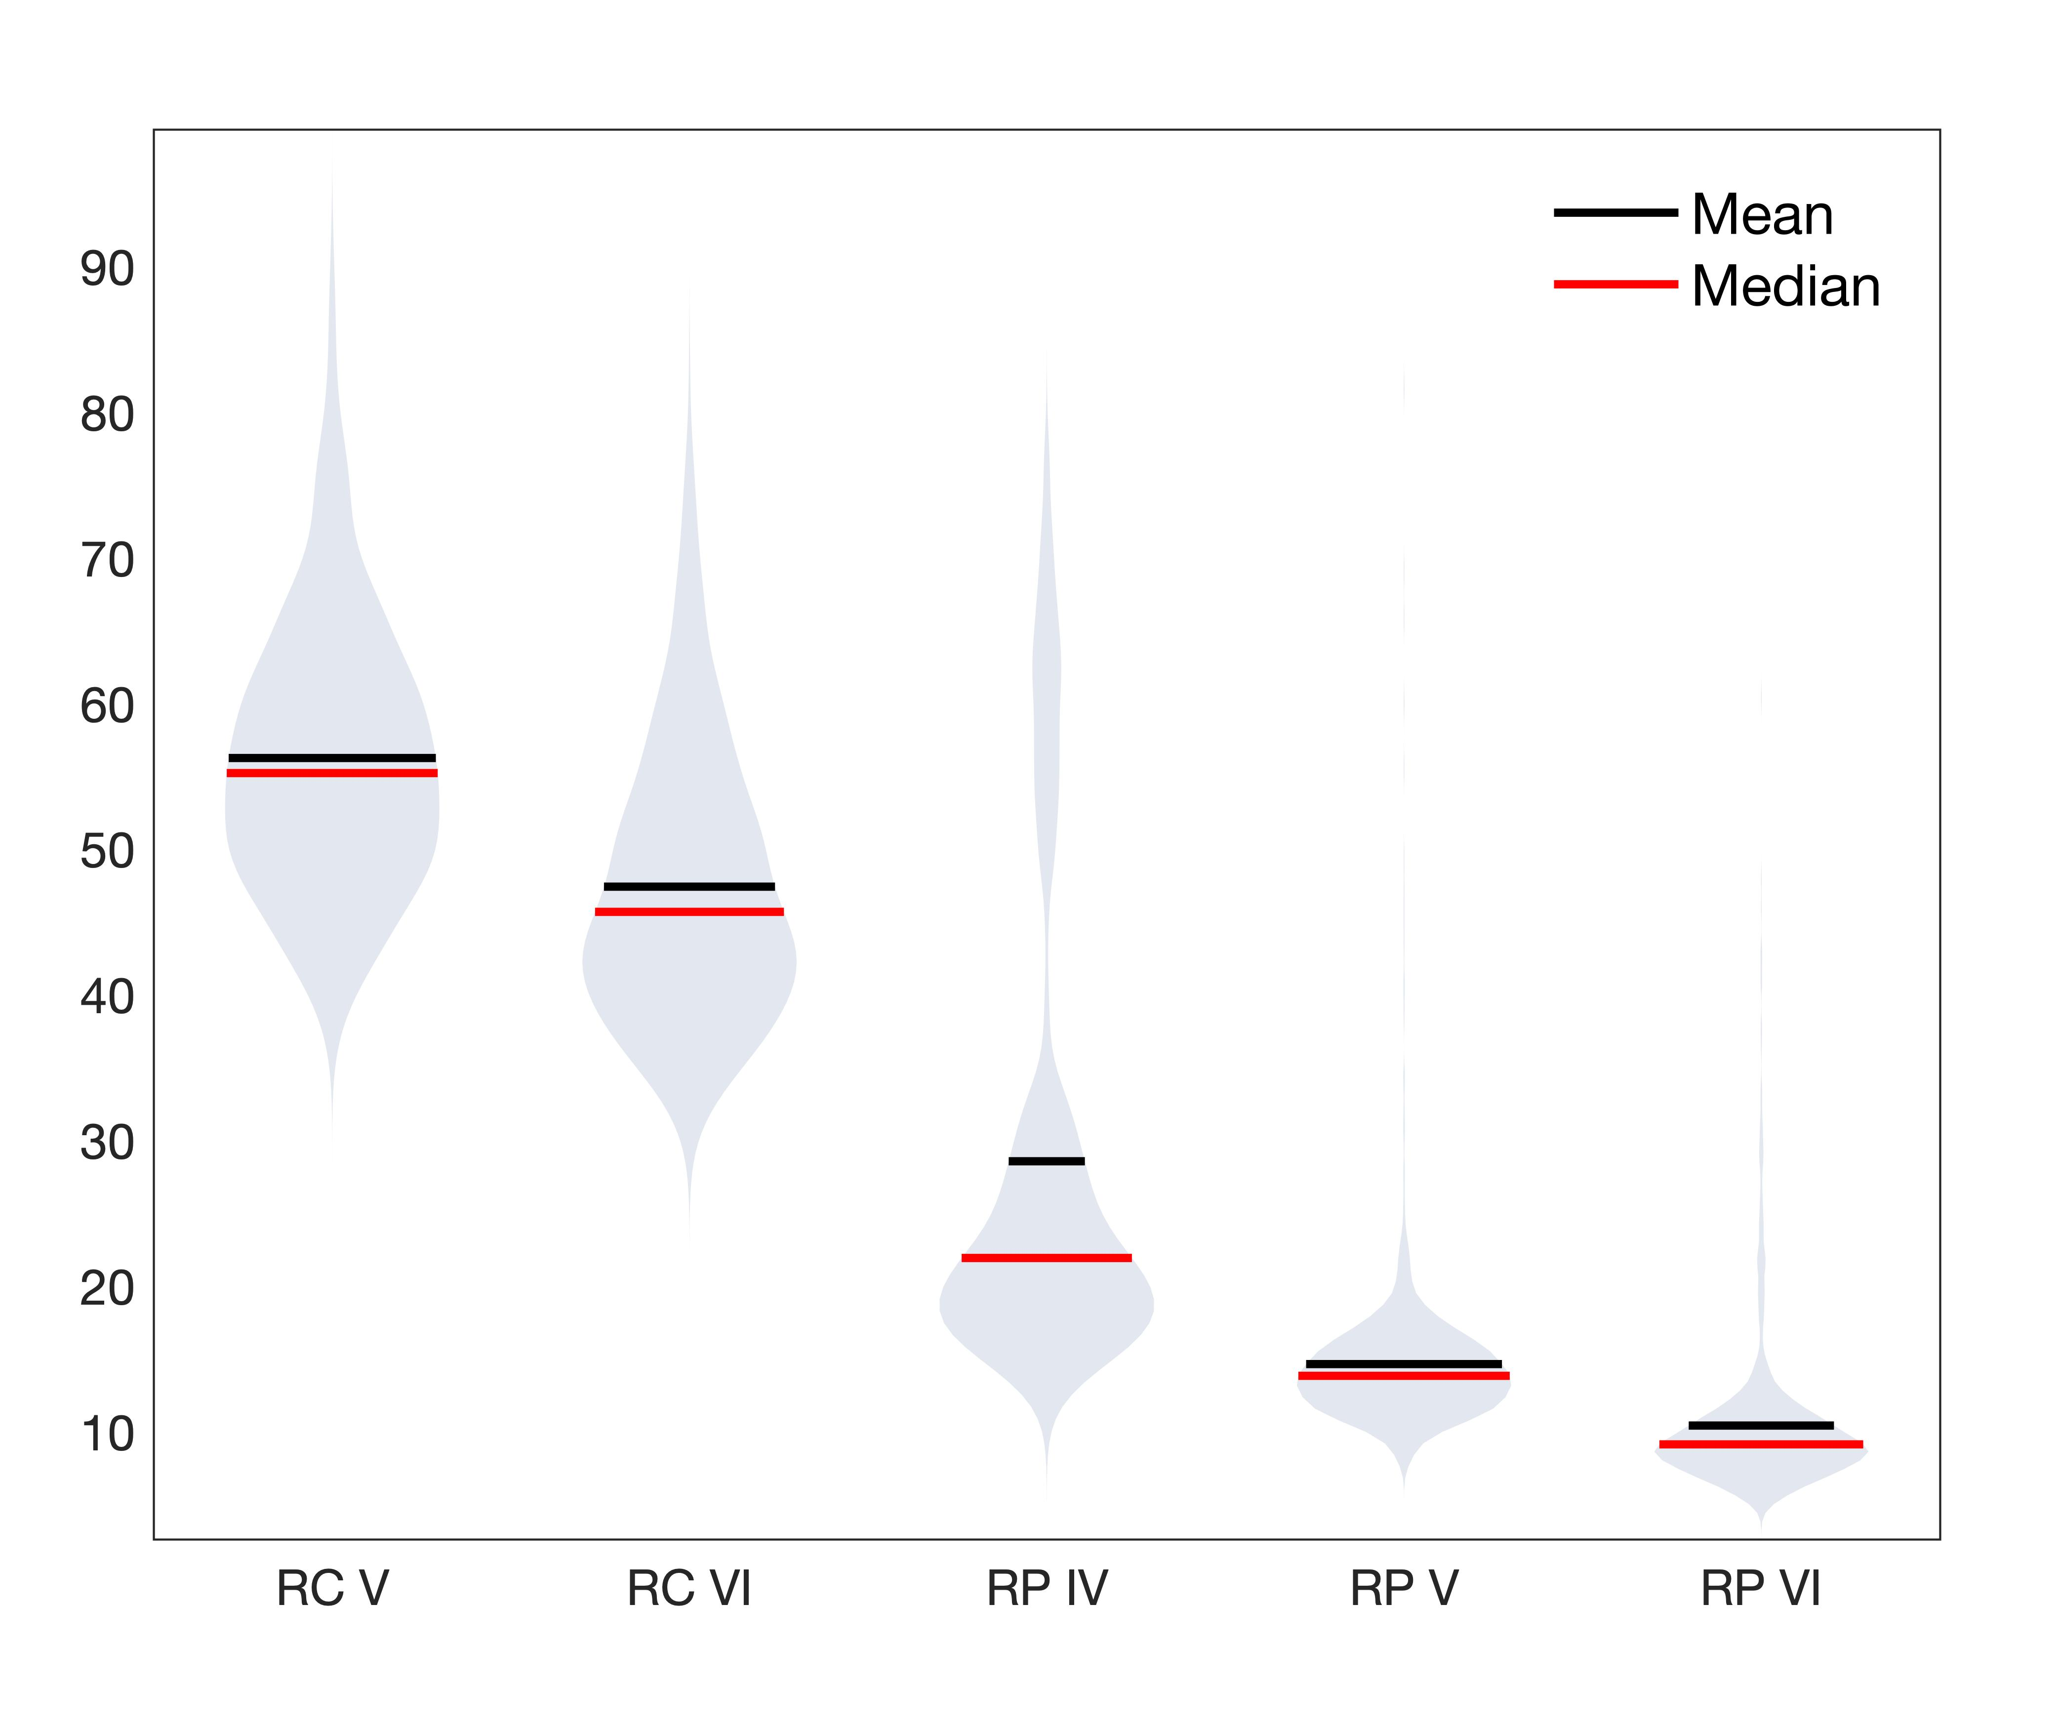
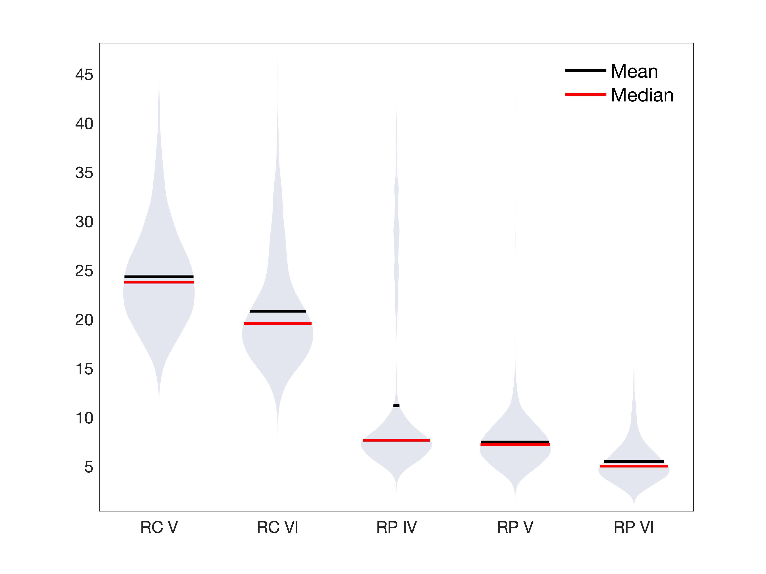
q = 0
q = 1
q = 2
Mean = Median
Diversity
CON-b CON-e HM-1 HM-2 HM-5
CON-b CON-e HM-1 HM-2 HM-5
0b 0e 1X 2X 5X
0b 0e 1X 2X 5X
0b 0e 1X 2X 5X
CON-b CON-e HM-1 HM-2 HM-5

