Slide 1
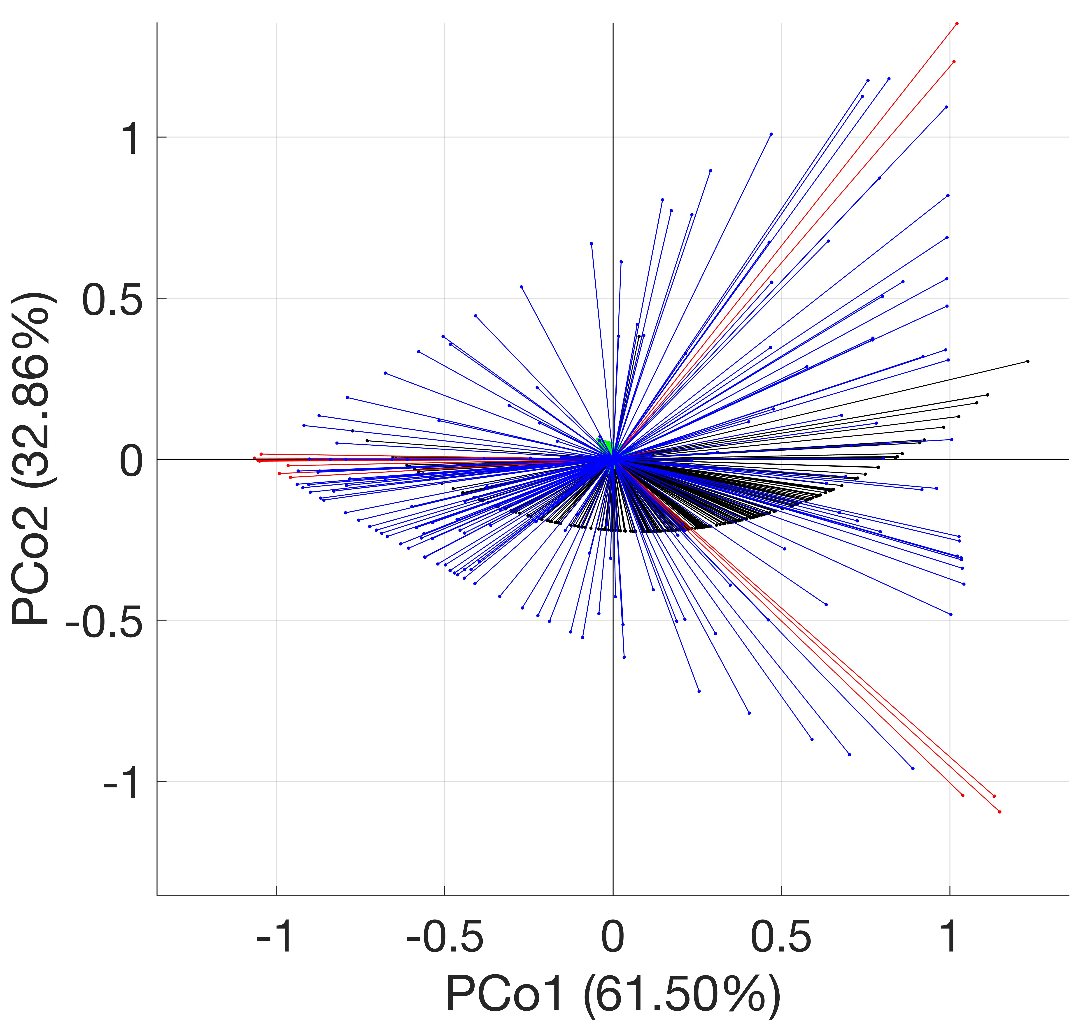
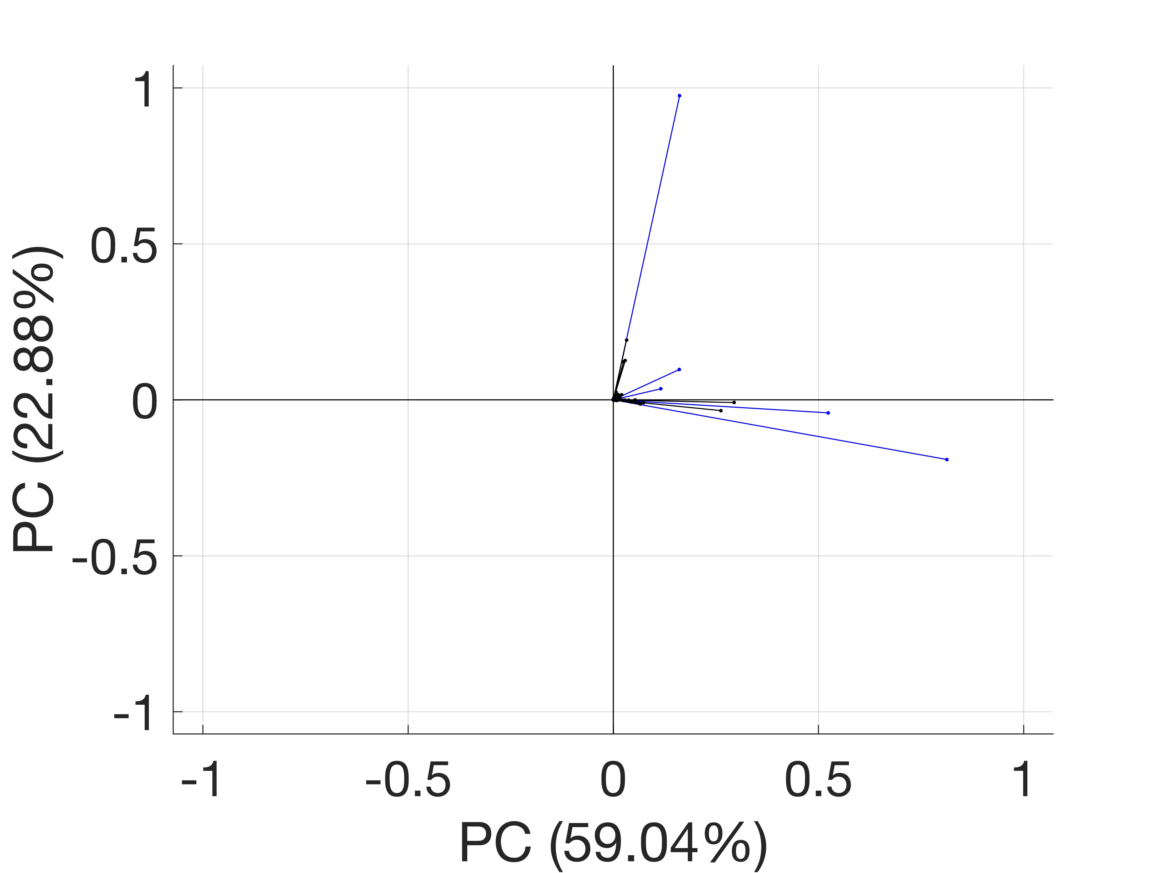
A)
B)
Control bioreactor (C)
Heavy metal amended bioreactor (M)
C->M
M->C
HM-1
CON-e
CON-b
HM-2
HM-5

