Slide 1
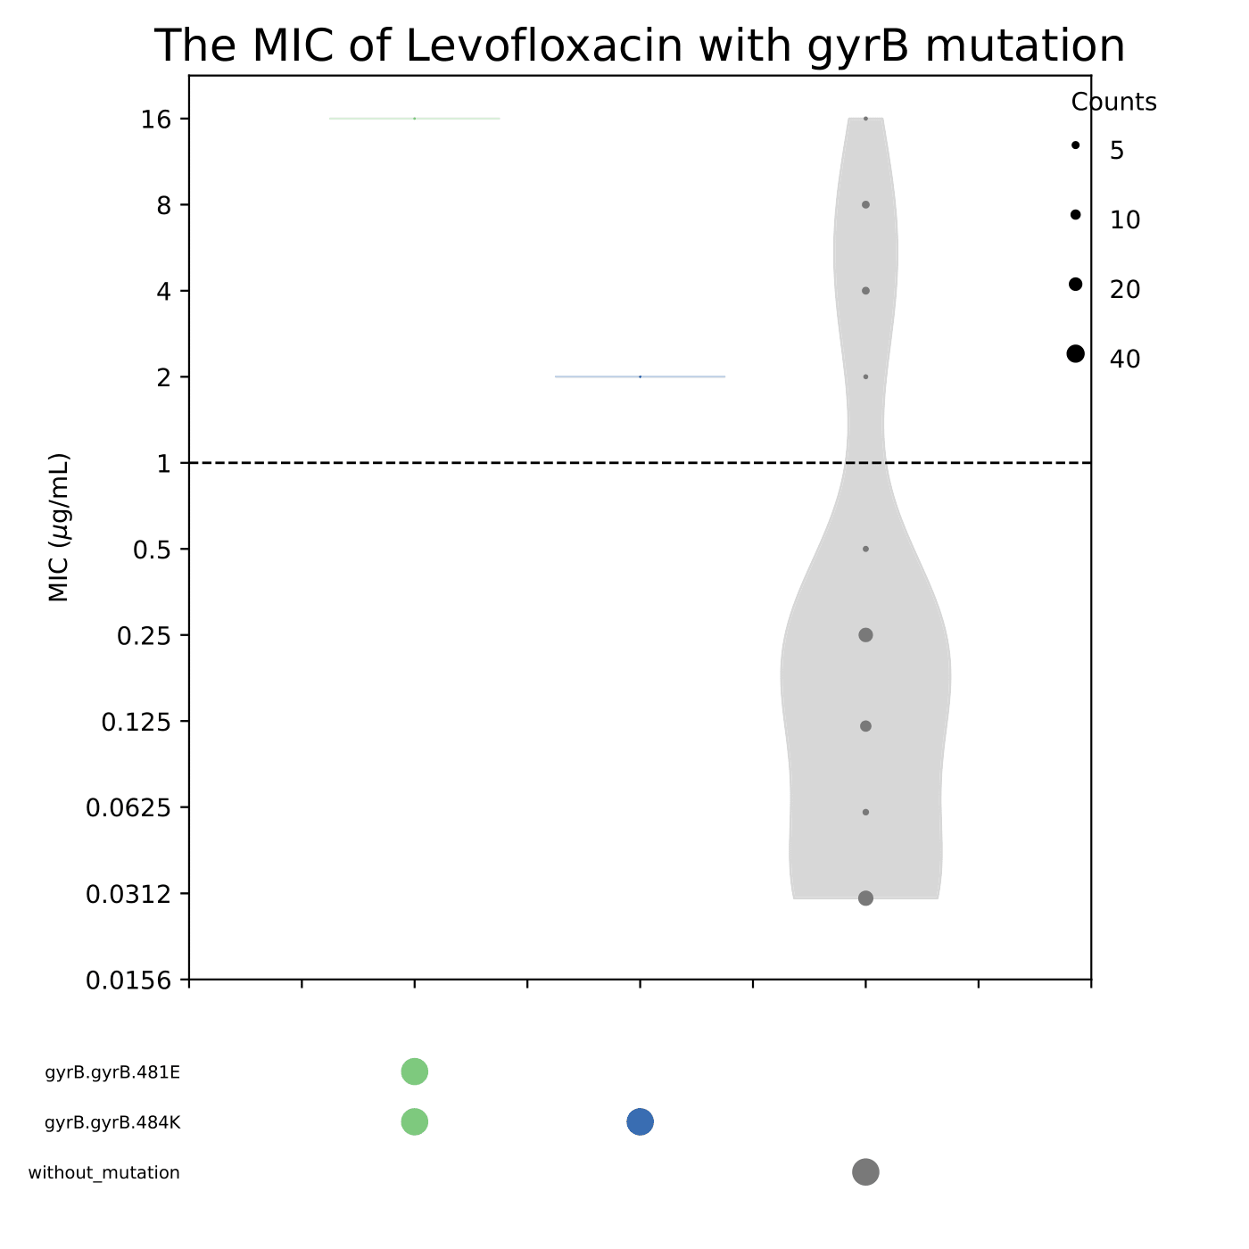
Figure S1
Levofloxacin minimum inhibitory concentrations and the corresponding mutations in gyrB for all observed combinations of the relevant antibiotic resistance determinants. *** indicates p < 0.001 compared with isolates without mutations, ** indicates p < 0.01, * indicates p < 0.05.

