Slide 1
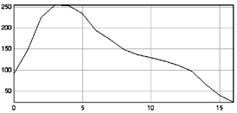
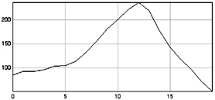
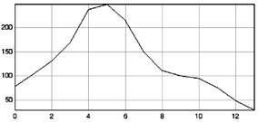
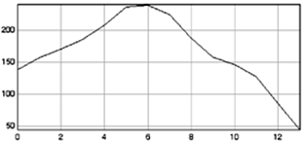
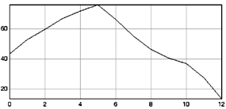
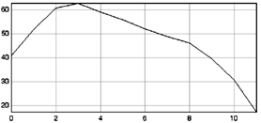
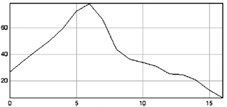
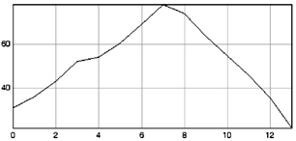
25 °C
37 °C
Gray value
Gray value
WT
Nucleolus
Distance
Nucleolus
Distance
Gray value
Gray value
Δnop17
Nucleolus
Distance
Nucleolus
Distance
Δrsa1
Gray value
Gray value
Nucleolus
Distance
Nucleolus
Distance
Gray value
Gray value
Δtah1
Nucleolus
Distance
Nucleolus
Distance
Figure S3
Prieto et al.

