Slide 1
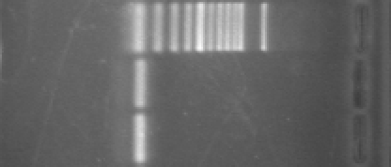
Marker
ACTIN1
500bp
100bp
122bp
Figure S1 PCR amplification of FaACTIN1 on 2% agarose gel.

