Slide 1
93
Potri.019G000400
98
Potri.019G023100
66
Potri.T001100
95
Potri.019G016500
100
Potri.T072200
93
Potri.019G016900
Potri.T072300
100
61
Potri.019G045400
TPS-a
STS
81
Potri.019G045300
31
62
Potri.019G045100
Potri.007G074400
Potri.005G095500
98
60
76
Potri.001G415100
Potri.011G142800
61
Potri.015G085500
37
100
Potri.015G032100
NtEAS
Potri.007G119700
26
AmMYS
TPS-g
MTS
100
Potri.011G032300
99
74
Potri.004G030200
100
Potri.004G030400
81
100
Potri.007G118600
Potri.017G041700
Potri.011G031800
80
MsLS
55
Potri.001G308200
100
Potri.T073000
56
Potri.001G308300
96
Potri.T072900
TPS-b
MTS
84
72
Potri.019G023000
99
Potri.019G022900
Potri.T001300
100
Potri.T000800
99
Potri.T000300
61
Potri.T001000
TPS-f, DTS
100
Potri.004G037900
AtTPS4
91
AtKS
TPS-e, KS
100
Potri.008G082700
100
Potri.008G082400
AtCPS
TPS-c, CPS
100
Potri.002G052100
0.1
100
Potri.005G210300
Figure S1. Phylogenetic tree of putative PtTPS genes and representative TPS genes from 6 different TPS gene subfamilies. The tree was inferred with the neighbor-joining method (nucleotides were treated as triplets) and n = 1000 replicates for bootstrapping. Bootstrap values are shown next to each node. NtEAS (L04680), Nicotiana tabacum 5-epi-aristolochene synthase; AtCPS, (NM_116512) copalyl diphosphate synthase; AtKS, (NM_106594) kaurene synthase and AtTPS4, (AY059757) geranyllinalool synthase of Arabidopsis thaliana; MsLS, Mentha spicata (L13459) (4S)-limonene synthase; AmMYS, Antirrhinum majus (AY195609) myrcene synthase; STS, sesquiterpene synthase ; MT, monoterpene synthase ; CPS, copalyl diphosphate synthase ; DTS, diterpene synthase ; KS, kaurene synthase

Slide 2
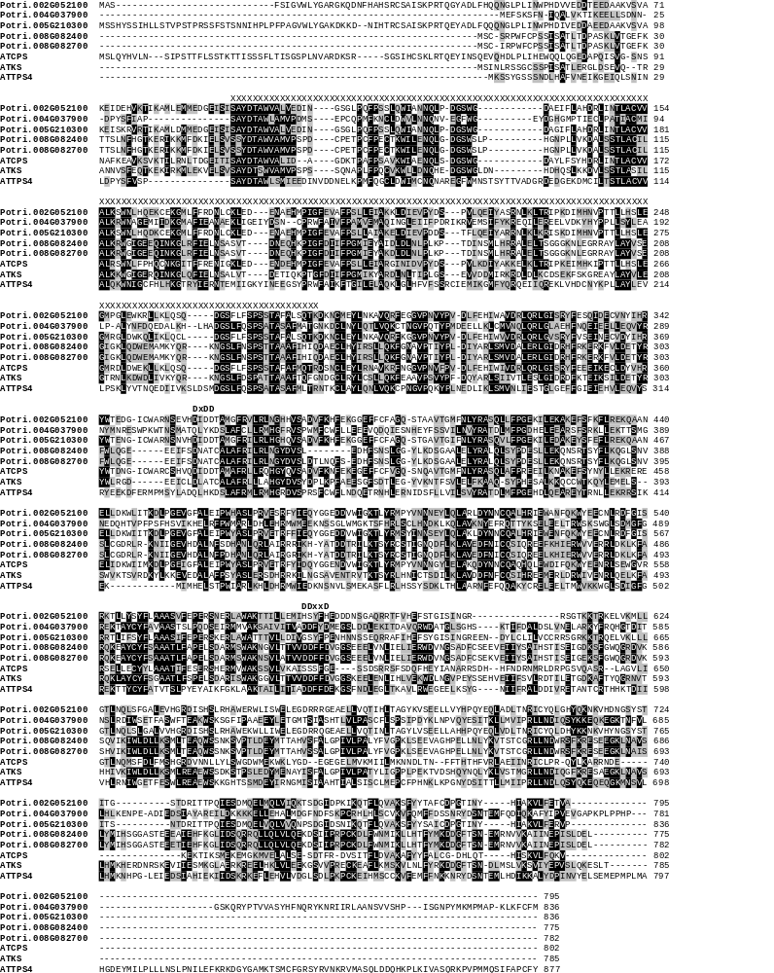
Figure S2. Amino acid sequence comparison of putative diterpene synthases of P. trichocarpa with characterized diterpene synthases from A. thaliana. Identical amino acids are marked by black boxes and amino acids with similar side chains are marked by gray boxes. The highly conserved DDxxD and DxxDD motifs are labeled. Amino acids belonging to a conserved N-terminal stretch are labeled by X. AtCPS, (Q38802) copalyl diphposphate synthase; AtKS, (Q9SAK2) kaurene synthase and AtTPS4, (Q93YV0) geranyllinalool synthase of Arabidopsis thaliana.

Slide 3
Chromosome 19
20k
50k
80k
110k
019G000400
019G000600
1890k
1920k
1950k
2610k
2640k
2670k
019G016500
019G016700
019G016900
019G022900
019G023000
019G023100
5370k
5430k
5310k
5340k
5400k
5590k
5620k
019G045100
019G045300
019G045400
Figure S3. PtTPS genes located on P. trichocarpa chromosome 19. The analysis was performed with the version 3 assembly of the P. trichocarpa genome (www.phytozome.net). Big arrows indicate putative functional monoterpene synthase genes (gray) and sesquiterpene synthase genes (black). Small arrows show TPS gene fragments. Arrow direction is in accordance to gene direction. Black boxes show other non TPS genes.

Slide 4
TPS-a
TPS-b
PtTPS14
PtTPS2
PtTPS11
PtTPS4
MsLS
PtTPS8
100
PtTPS6
PtTPS5
PtTPS12
100
NtEAS
69
100
PtTPS13
69
100
63
84
54
PtTPS7
93
58
93
94
100
AmMYS
PtTPS9
90
100
PtTPS3
PtTPS1
92
PtTPS15
TPS-g
100
100
100
100
100
Potri.008G082700
Potri.005G210300
Potri.008G082400
AtKS
Potri.002G052100
TPS-e
AtCPS
AtTPS4
PtTPS10
TPS-c
TPS-f
0.1
Figure S4. Phylogenetic tree of characterized PtTPS enzymes and representive TPS from 6 different TPS subfamilies. The tree was inferred with the neighbor-joining method and n = 1000 replicates for bootstrapping. Bootstrap values are shown next to each node. NtEAS (Q40577), Nicotiana tabacum 5-epi-aristolochene synthase; AtCPS, (Q38802) copalyl diphposphate synthase; AtKS, (Q9SAK2) kaurene synthase and AtTPS4, (Q93YV0) geranyllinalool synthase of Arabidopsis thaliana; MsLS, Mentha spicata (AAC37366) (4S)-limonene synthase; AmMYS, Antirrhinum majus (AAO41727) myrcene synthase

Slide 5
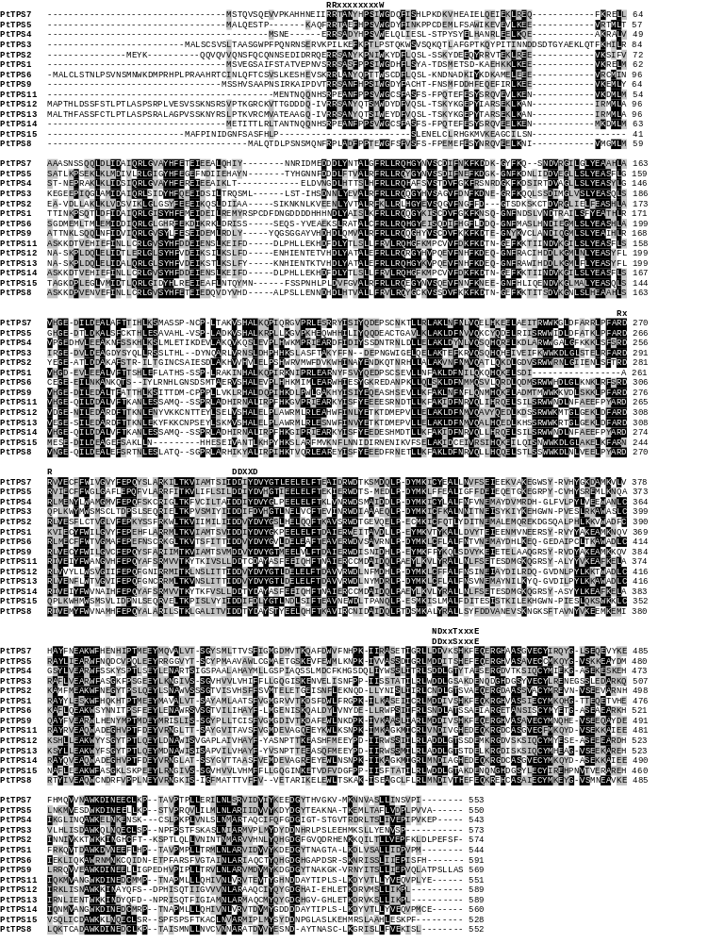
Figure S5. Amino acid sequence comparison of the characterized poplar mono- and sesquiterpene synthases. Identical amino acids are marked by black boxes and amino acids with similar side chains are marked by gray boxes. Conserved motifs are labeled.

Slide 6
PtTPS11
PtTPS7
160
1
40
8
injector
temperature
230°C
120
2
30
Relative abundance
(TIC x 10,000 ions)
Relative abundance
(TIC x 10,000 ions)
cont.
80
4
20
1
7
cont.
40
3
10
6
16
17
18
0
15
16
17
18
19
20
Retention time (min)
Retention time (min)
injector
temperature
150°C
30
2
5
16
cont.
Relative abundance
(TIC x 10,000 ions)
Relative abundance
(TIC x 10,000 ions)
20
4
12
7
8
9
1
3
8
6
cont.
10
4
1
5
16
17
18
0
15
16
17
18
19
20
Retention time (min)
Retention time (min)
Figure S6. GC-MS analysis of PtTPS7 and PtTPS11 products. The enzymes were expressed in E. coli, extracted, partially purified, and incubated with the substrate FPP. Products were collected with a solid-phase microextraction (SPME) fiber and analyzed by GC-MS with different injection temperatures to visualize heat induced rearrangements. 1, β-elemene; 2, eremophilene; 3, α-selinene; 4, unidentified sesquiterpene; 5, germacrene A; 6, (E)-β-caryopyhyllene; 7, α-humulene; 8, elemol; 9, hedycaryol.

Slide 7
(±)-caryophyllene
(-)
9
(+)
6
3
PtTPS15
sesqui-terpene products
(+)-(3S)
PtTPS15
mono-terpene products
(+)-(3S)
18
20
22
24
26
120
60
18
(-)-caryophyllene
80
40
12
40
20
6
46
47
48
49
22
23
24
Relative abundance (TIC x 10.000)
18
20
22
24
26
120
(±)-nerolidol
(±)-linalool
Relative abundance (TIC x10.000)
(+)-(3S)
(+)-(3S)
60
Relative abundance (TIC x10.000)
40
PtTPS9
product
80
60
(-)-(3R)
40
(-)-(3R)
40
20
20
18
20
22
24
26
46
47
48
49
22
23
24
120
(+)-nerolidol
(-)-linalool
30
P. trichocarpa
volatiles
80
(+)-(3S)
60
(-)-(3R)
20
40
40
10
20
18
20
22
24
26
46
47
48
49
22
23
24
Retention time (min)
Retention time (min)
Retention time (min)
60
PtTPS12
mono-
terpene
product
(-)-(3R)-linalool
45
(+)-(3S)-
linalool
30
15
20
22
24
26
40
(±)-linalool
(+)-(3S)
30
(-)-(3R)
Relative abundance (TIC x 10.000)
20
10
20
22
24
26
10
(-)-linalool
(-)-(3R)
8
6
4
2
20
22
24
26
Retention time (min)

Slide 8
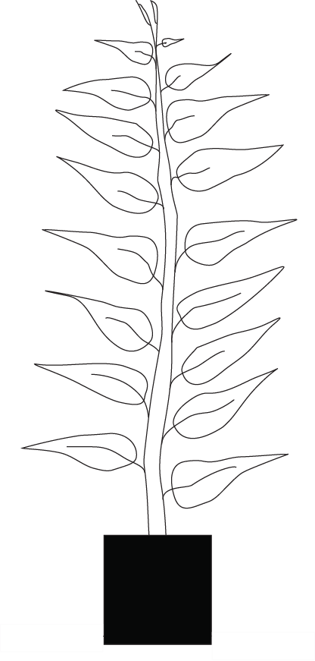
3
1
2
4
3
1
2
4
3
1
2
4
5
6
5
6
5
6
7
8
7
8
7
8
9
10
9
10
9
10
basal herbivory
apical herbivory
control
Figure S8. Experimental set up. Herbivory was applied to a single leaf of intact trees either apically (LPI3), basally (LPI10), or not at all (control). Volatiles of eight single leaves (LPI3 to LPI10) were individually measured from all trees.

Slide 9
1000
empty vector control + GPP
geraniol
geranial
Relative abundance
(TIC x 1,000 ions)
500
neral
nerol
0
5.00
7.00
9.00
11.00
13.00
300
empty vector control + FPP
200
Relative abundance
(TIC x 10,000 ions)
(E,E)-farnesal
(Z,Z)-farnesal
(E)-farnesol
100
(Z)-farnesol
0
15.00
17.00
19.00
21.00
30
empty vector control + GGPP
20
Relative abundance
(TIC x 1,000 ions)
10
0
19.00
21.00
23.00
25.00
27.00
Retention time (min)
Figure S9. GC-MS analysis of protein extracts from E. coli expressing an empty vector. The empty vector was expressed in E. coli and the raw protein extract was incubated with GPP, FPP and GGPP, respectively. Products were collected with a solid-phase microextraction (SPME) fiber and analyzed by GC-MS. Substrate hydrolysis products are labeled, peaks not labeled are non-terpenoide contaminations.

