Slide 1
Figure S1．Distribution of traits of the F1 population derived from the cross ‘Beihong’ (BH) × ‘E.S.7-11-49’ (ES) in 2011 and 2012. There were 241 genotypes in 2011 and 225 genotypes in 2012, using the averages of three replicates per genotype. The values for the maternal parent, BH, and the paternal parent, ES, are indicated by arrows. SSC and β ratio represent soluble solids content and the tartaric acid-to-malic acid ratio, respectively。

Slide 2
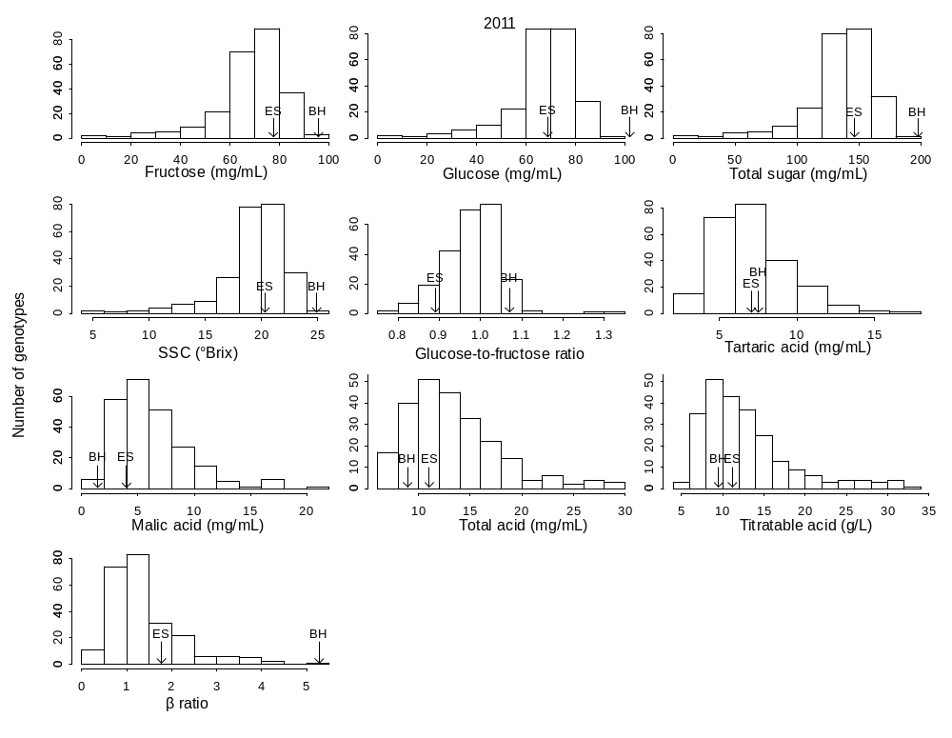

Slide 3
