Slide 1
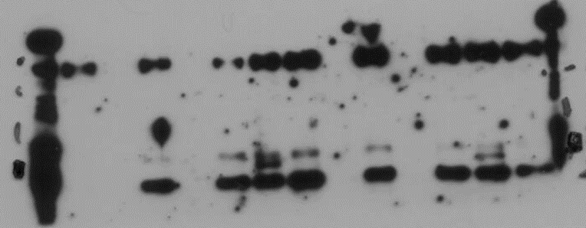
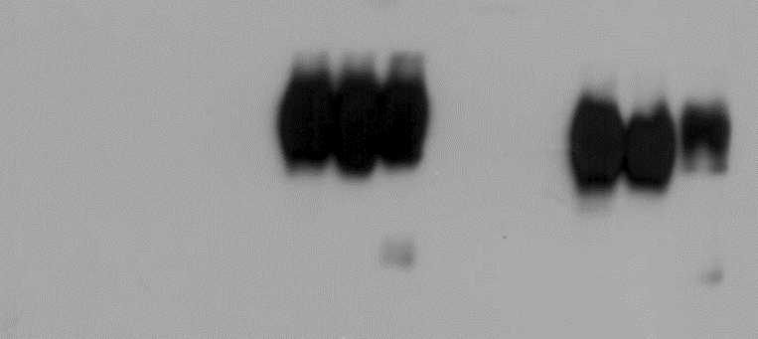
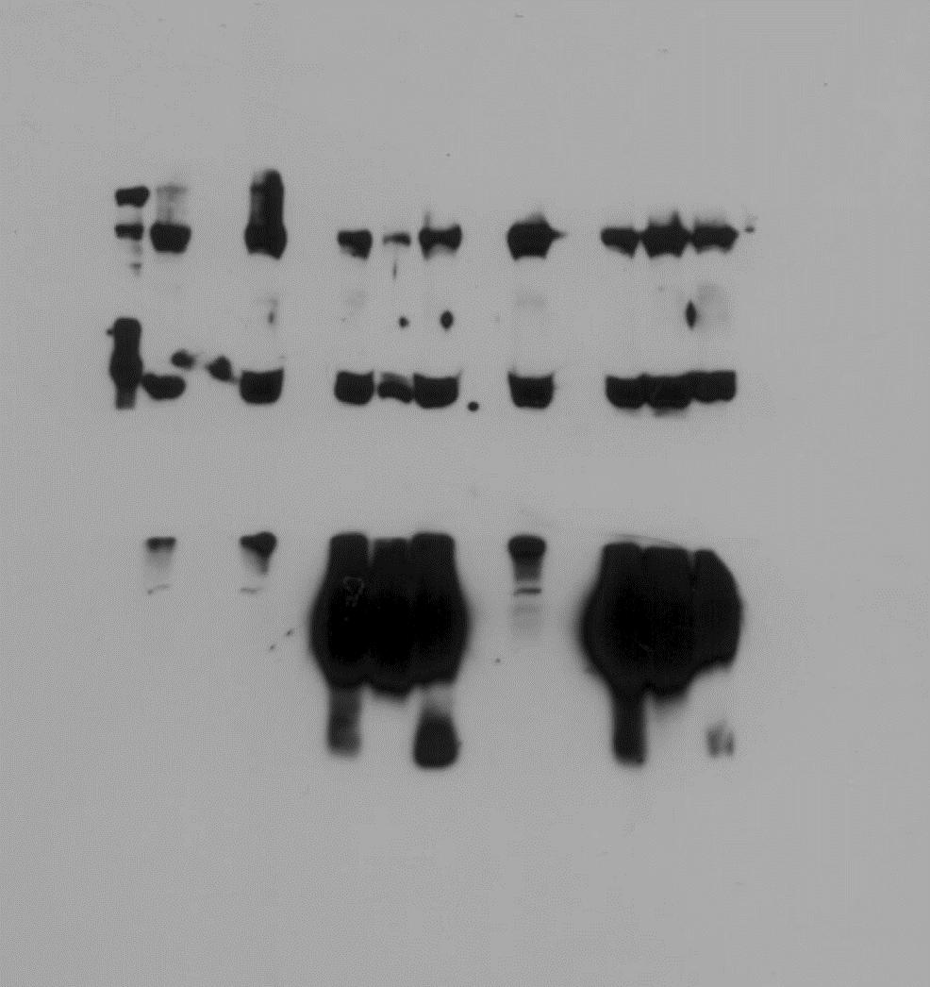
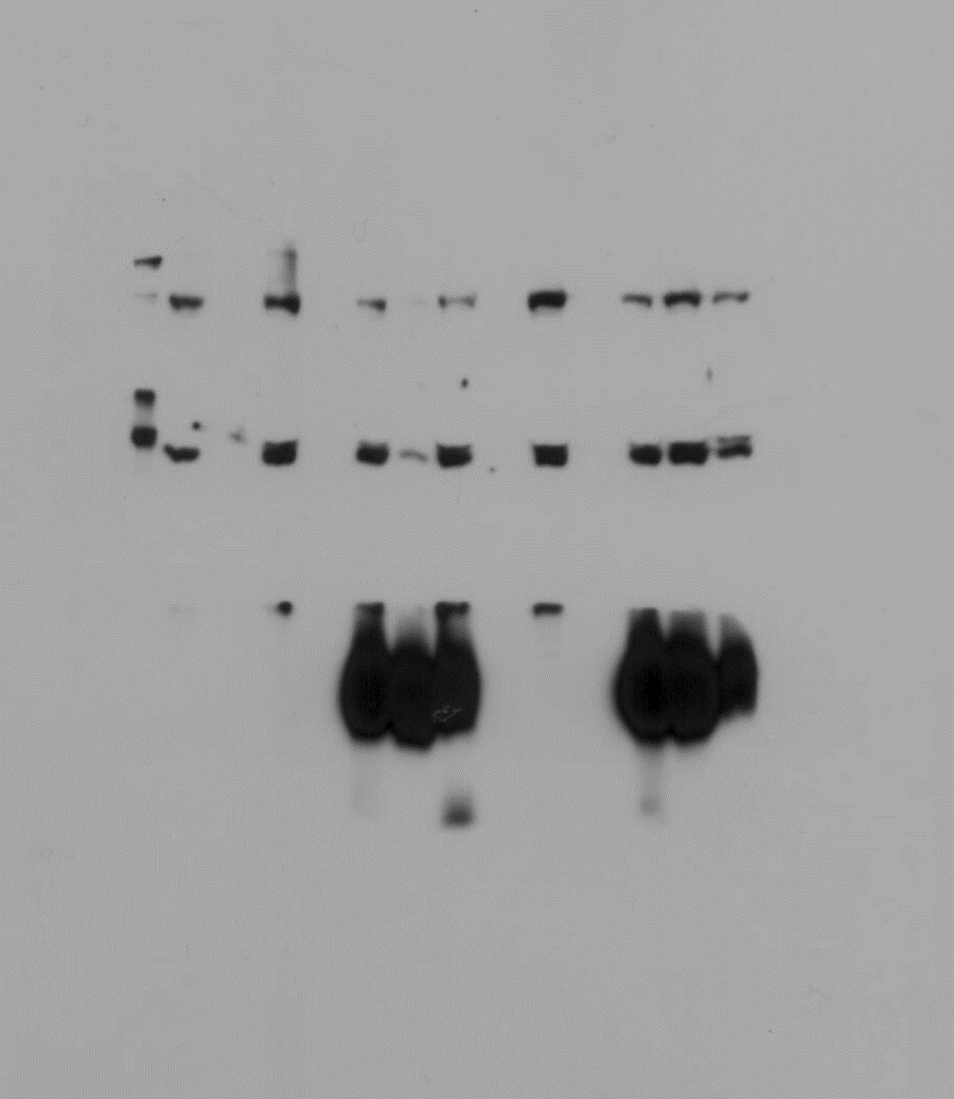
(a)
HSA^{PIE1}-Flag | - |  | - |  | + | - | - |  | - |  | + | - | -
HSA^{AtEAF1B}-Flag | - |  | - |  | - | + | - |  | - |  | - | + | -
HSA^{AtINO80}-Flag | - |  | - |  | - | - | + |  | - |  | - | - | +
AtYAF9A-nEYFP | - |  | + |  | + | + | + |  | - |  | - | - | -
AtYAF9B-nEYFP | - |  | - |  | - | - | - |  | + |  | + | + | +
No Plasmid | + |  | - |  | - | - | - |  | - |  | - | - | -
IP: αFlag
WB: αGFP
IP: αFlag
WB: αFlag
(b)
HSA^{PIE1}-Flag | - |  | - |  | + | - | - |  | - |  | + | - | -
HSA^{AtEAF1B}-Flag | - |  | - |  | - | + | - |  | - |  | - | + | -
HSA^{AtINO80}-Flag | - |  | - |  | - | - | + |  | - |  | - | - | +
AtYAF9A-nEYFP | - |  | + |  | + | + | + |  | - |  | - | - | -
AtYAF9B-nEYFP | - |  | - |  | - | - | - |  | + |  | + | + | +
No Plasmid | + |  | - |  | - | - | - |  | - |  | - | - | -
- |  | - |  | + | - | - |  | - |  | + | - | -
- |  | - |  | - | + | - |  | - |  | - | + | -
- |  | - |  | - | - | + |  | - |  | - | - | +
- |  | + |  | + | + | + |  | - |  | - | - | -
- |  | - |  | - | - | - |  | + |  | + | + | +
+ |  | - |  | - | - | - |  | - |  | - | - | -
WB: αGFP
WB: αFlag
Additional file 5. Uncropped scans of the Western blot films. (a) Coimmunoprecipitation. Green arrowhead points at AtYAF9A-nEYFP (left) and AtYAF9B-nEYFP (right). Red arrowhead points at HSA-Flag fusion proteins. SB – sample buffer (no sample control). (b) Inputs. Long (left) and short exposures (right).

