Slide 1
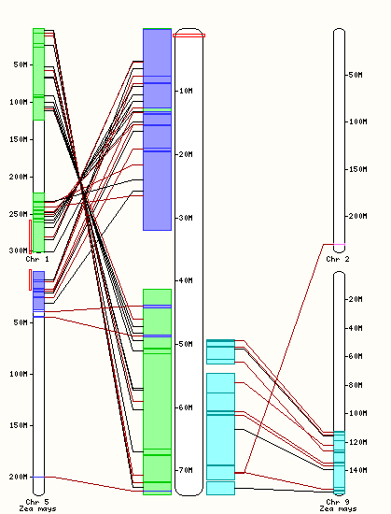
CYP79A1
(GRMZM2G138248)
(1.131.660-1.134.016)
no orthologues
Chromosome 1
Sorghum bicolor
Supplemental figure 1: Comparative genomic analysis of Sorghum bicolor chromosome 1 with maize chromosomes 1, 2, 5, and 9. The analysis was done using the web server http://www.plants.ensembl.org.

Slide 2
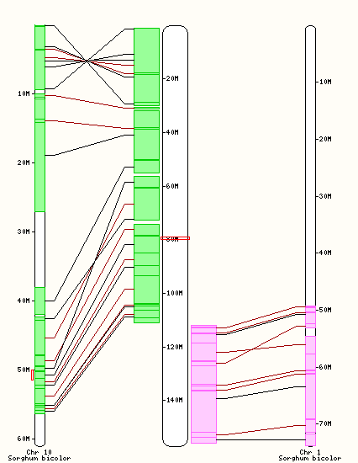
CYP79A61
(GRMZM2G138248)
(79.214.248-79.216.270)
Sb10g022470
(50.340.814-50.342.632)
Chromosome 9
Zea mays
Supplemental figure 2: Comparative genomic analysis of Zea mays chromosome 9 with Sorghum bicolor chromosomes 1 and 10. The analysis was done using the web server http://www.plants.ensembl.org.

Slide 3
87
Sb05g022010
88
Sb06g015920
72
Sb05g022070
85
Sb01g016460
67
99
Sb01g016470
Sb01g016480
66
GRMZM2G011156
GRMZM2G105185
85
GRMZM2G178351
Sb01g001200 (CYP79A1)
99
GRMZM2G138248 (CYP79A61)
located on
syntenic regions
100
Sb10g022470
CYP71A13
0.2
Supplemental Figure 3. Phylogenetic tree of CYP79 sequences from maize and Sorghum bicolor. The rooted tree was inferred with the neighbor-joining method and n = 1000 replicates for bootstrapping. Bootstrap values are shown next to each node. As an outgroup, CYP71A13 from Arabidopsis thaliana was chosen.

Slide 4
35S::CYP79A61
3
4
100
IS
80
Relative abundance
(TIC x 1,000 ions)
60
1
2
40
5
20
12
16
20
24
28
32
36
40
Retention time (min)
35S::eGFP
100
IS
80
Relative abundance
(TIC x 1,000 ions)
60
40
1
20
12
16
20
24
28
32
36
40
Retention time (min)
1, 5-epi-aristolochene; 2, 2-phenylethanol; 3, benzyl cyanide; 4, 2-phenylnitroethane; 5, phenylacetaldoxime; IS, internal standard
Supplemental figure 4: Volatiles released from transgenic Nicotiana benthamiana plants transiently overexpressing either a 35S::eGFP construct or a 35S::CYP79A61 construct. Volatiles were collected three days after Agrobacterium tumefaciens infiltration and analyzed using GC-MS. 1, 5-epi-aristolochene; 2, 2-phenylethanol; 3, benzyl cyanide; 4, 2-phenylnitroethane; 5, phenylacetaldoxime; IS, internal standard.

Slide 5
herbivory
12
6
11
4
4
8
2
5
IS
9
10
0
1
2
3
6
7
13
14
2
control
IS
0
6
8
10
12
14
16
18
20
22
24
26
Supplemental figure 5: Volatiles released from undamaged 10 day-old Zea mays (cultivar Delprim) seedlings (control) and seedlings treated with caterpillar oral secretion (herbivory). Volatiles were collected and analyzed using GC-MS. 1, β-myrcene; 2, 3-hexen-1-ol acetate; 3, limonene; 4, linalool; 5, (E)-4,8-dimethyl-1,3,7-nonatriene; 6, phenylmethyl acetate; 7, 2-phenylethyl acetate; 8, indole; 9, geranyl acetate; 10, (E)-β-caryophyllene; 11, (E)-α-bergamotene; 12, (E)-β-farnesene; 13, β-sesquiphellandrene; 14, 4,8,12-trimethyltrideca-1,3,7,11-tetraene; IS, internal standard.

Slide 6
A
Dhurrin
B
Prunasin
3.7e5
1.0e5
authentic
standard
3.7e5
1.0e5
Sorghum bicolor
coleoptiles
3.7e5
1.0e5
Zea mays var. Delprim
coleoptiles
Intensity, cps
Intensity, cps
3.7e5
1.0e5
Zea mays var. Delprim
undamaged leaves
3.7e5
1.0e5
Zea mays var. Delprim
damaged leaves
0
1
2
3
4
5
6
7
0
1
2
3
4
5
6
7
Retention time (min)
Retention time (min)
Supplemental figure 6: Accumulation of cyanogenic glycosides in maize and sorghum. Maize and sorghum coleoptiles were harvested three days after germination. Undamaged maize leaves and caterpillar oral secretion-treated maize leaves were obtained as described in the Methods section. Glycosylated compounds were extracted with methanol and cyanogenic glycosides were analyzed using LC-MS/MS with multiple reaction monitoring (MRM). MRMs for dhurrin, prunasin, and amygdalin were established using authentic standards obtained from SIGMA-Aldrich (http://www.sigmaaldrich.com) (dhurrin) or prepared from bitter almonds (prunasin, amygdalin) and MRMs for lotaustralin and linamarin were calculated from those of dhurrin and prunasin. Amygdalin, lotaustralin and linamarin could not be detected in maize and sorghum (data not shown).

Slide 7
Supplemental table 1: Oligonucleotides used in this study.
 | primer | purpose
138248_fwd | ATGGTTTCCTCTCCGCAAGCA | GRMZM2G138248 cloning
138248_rev | CTACTTACAAAGCAAGATCCCG | GRMZM2G138248 cloning
Del-CYP79-USER-fwd | GGCTTAAUATGGTTTCCTCTCCGCAAGCAA | pCAMBiA
Del-CYP79-USER-rev | GGTTTAAUCTACTTACAAAGCAAGATCCCGG | pCAMBiA
CYP79-NotI fwd | AAGCGGCCGCAATGGTTTCCTCTCCGCAAGCAAAT | pESC-Leu2d
CYP79-BglII rev | TTAGATCTCTACTTACAAAGCAAGATCCCGG | pESC-Leu2d
HG-LUG fwd | TCCAGTGCTACAGGGAAGGT | qRT-PCR
HG-LUG rev | GTTAGTTCTTGAGCCCACGC | qRT-PCR
CYP79-QRT1 | TACTGCGGGAATGTCGTC | qRT-PCR
CYP79-QRT2 | GGAGACACAGAAGGAGTAGAG | qRT-PCR
SPI1-fwd5 | GGTCAGCCTGGATTTGTGCC | qRT-PCR
SPI1-rev5 | AACGTCGAGAGACCCAGCAT | qRT-PCR

