Slide 1
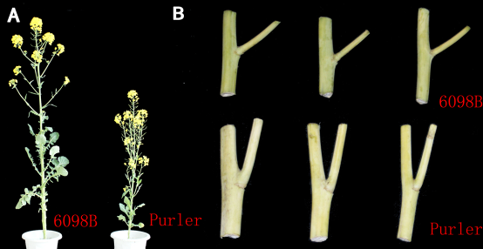
B
6098B
Purler
Purler

