Slide 1
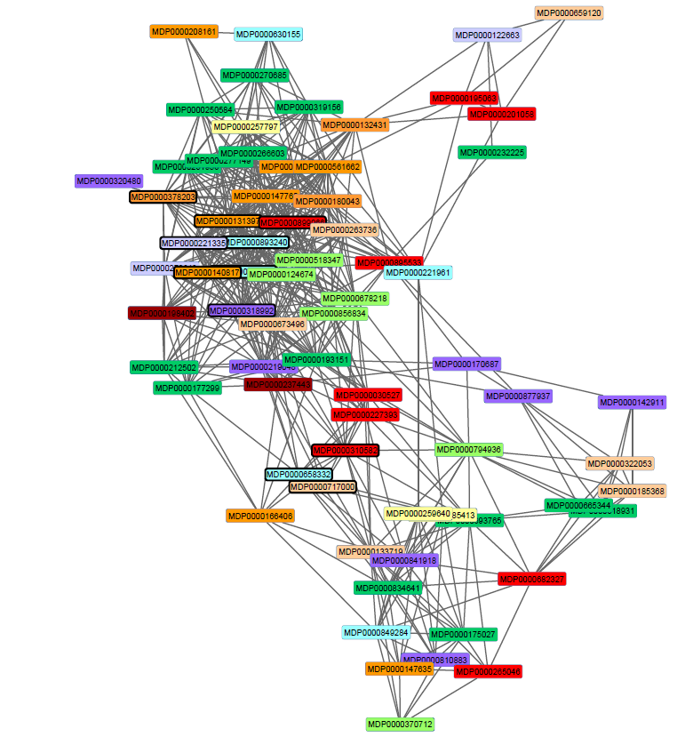
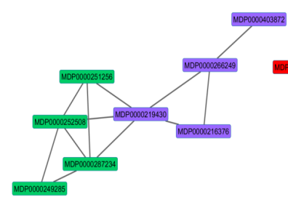
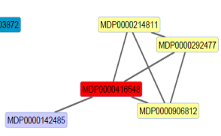
Additional file 4: Co-expression networks of clusters A and B. The distance between 2 genes corresponds to level of correlation, the more the genes expression profiles are correlated, the shorter is the distance. The color code indicates the gene functional category according to the curated annotation (Additional file 3).
A
B
Pectin biosynthesis
Pectin degradation
Cellulose/Hemicelluloses biosynthesis
Cellulose/Hemicelluloses degradation
Expansins
galactosyltransferases
β-galactosidases
Glycoproteins
Transporters
Peroxidases

