Slide 1
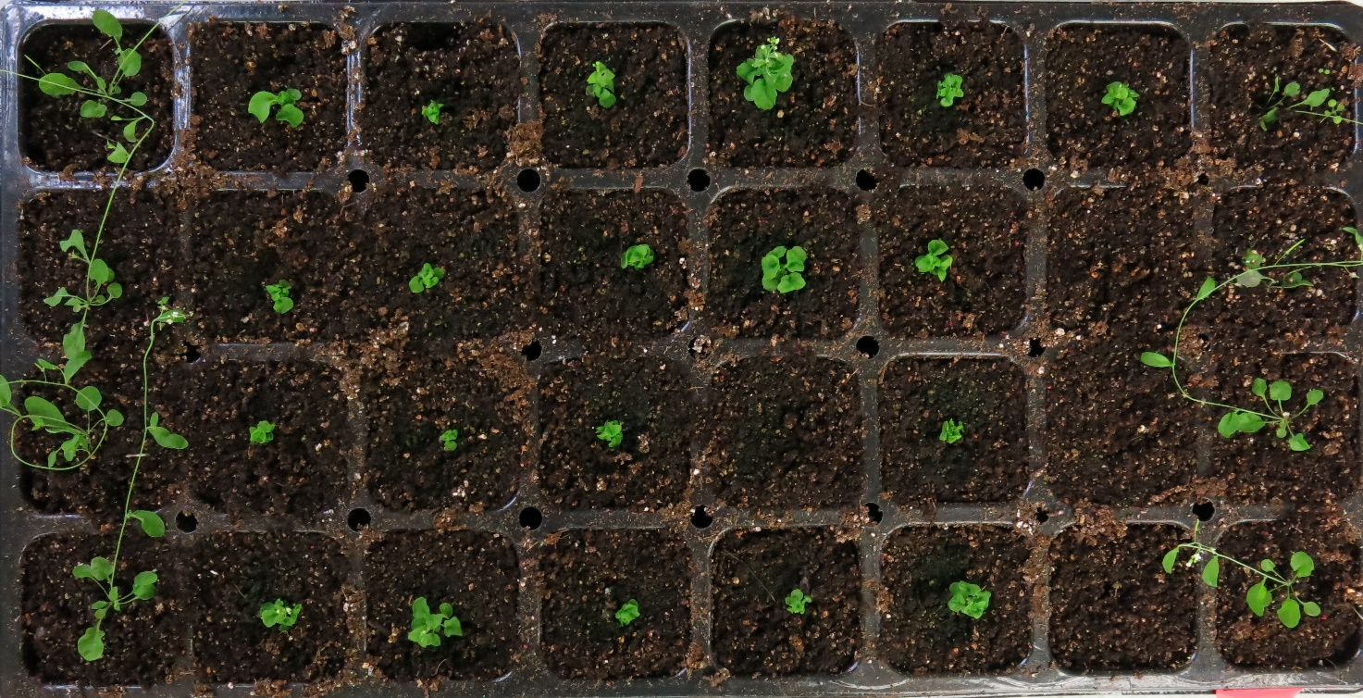
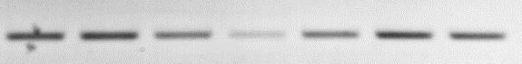
Additional file 4: Figure S3.
A
B
bri1-5/BdBRI1ox
Ws-2 bri1-5 Ws-2
#1
#2
#3
#4 #5
Ws-2 bri1-5 #1 #2 #3 #4 #5
BdBRI1
AtUBQ10

