Slide 1
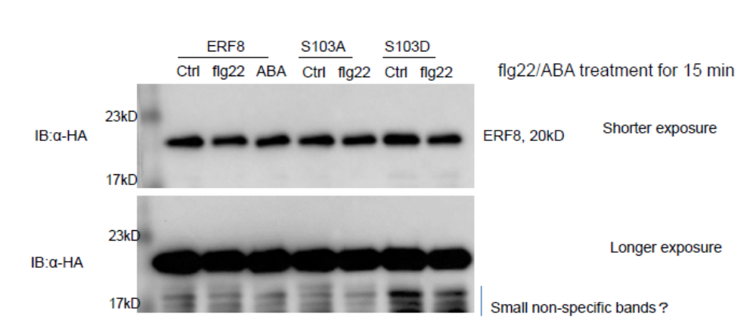
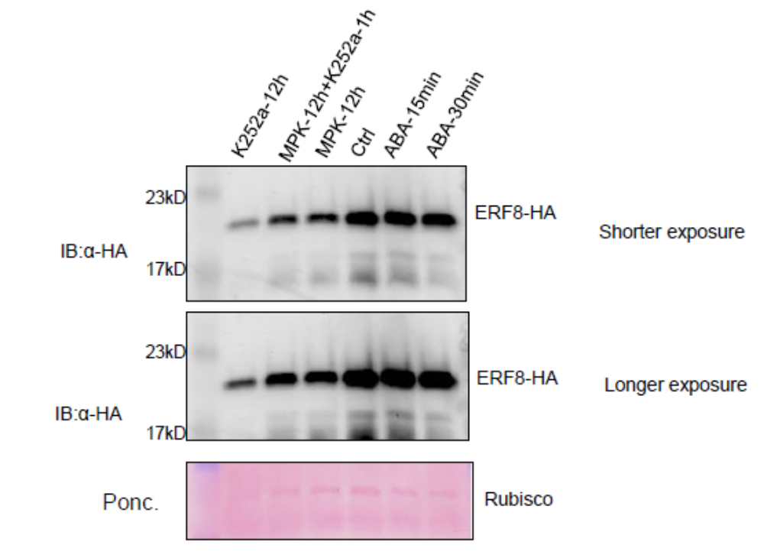
A
ERF8
ERF8
S103A
ERF8
S103D
Mock flg22 ABA Mock flg22 Mock flg22
αHA
MKP 12 h →K252a 1h
K252a 12h
ABA 30m
MKP 12h
Mock
ABA 15m
B
αHA
Additional file 6. Analysis of ERF8 and its phosphorylation status under various conditions.
(A) ERF8 wildtype and phosphorylation mutants were expressed in Arabidopsis protoplasts treated with or without flg22 (100 nM) or ABA (10 µM).
(B) Detection of ERF8 after kinase inhibitor K252a or ABA treatment or co-expression with MKP phosphatase. Arrows indicate the predicted molecular weight of ERF8-HA.

