Slide 1
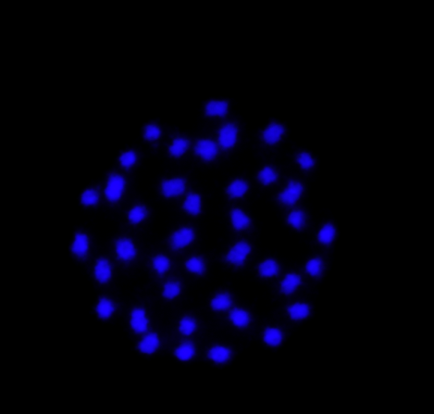
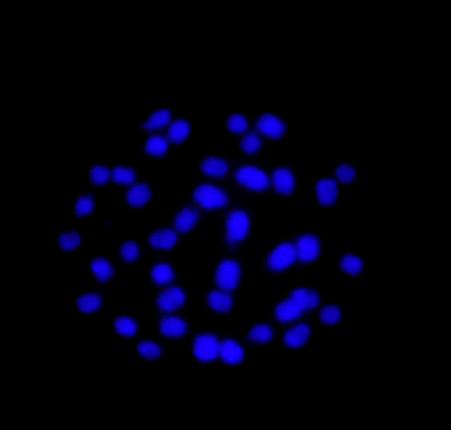
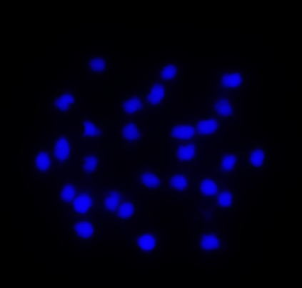
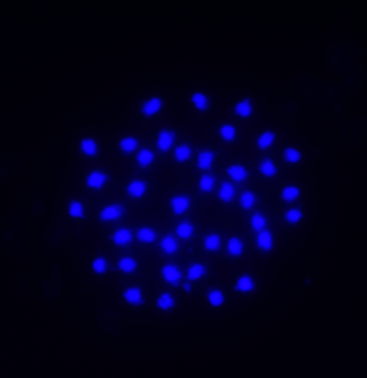
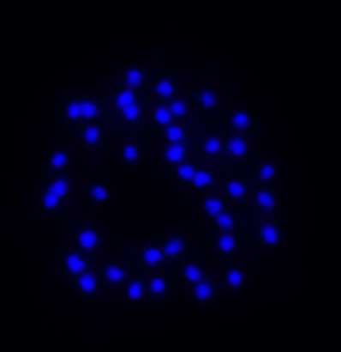
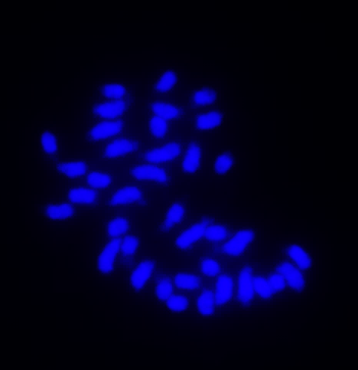
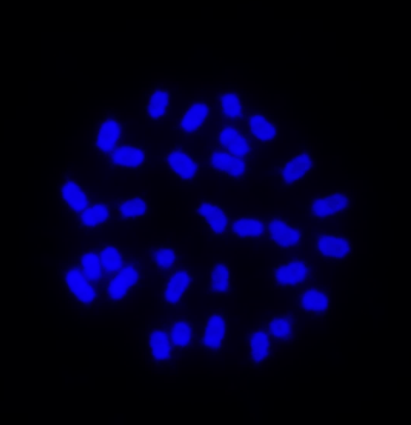
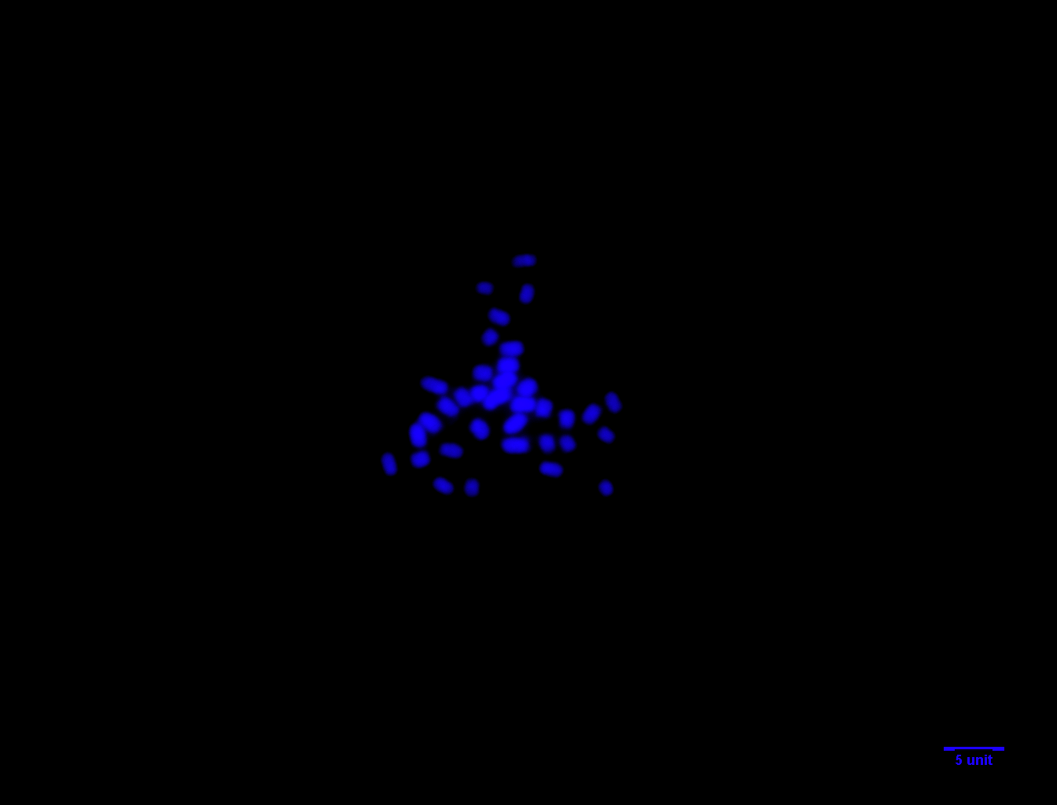
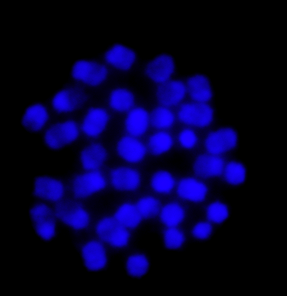
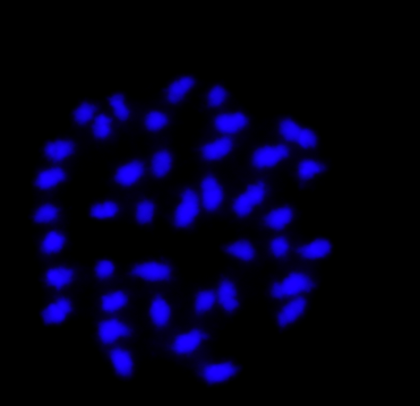
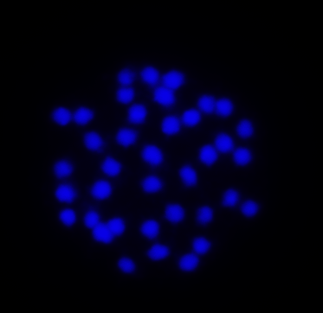
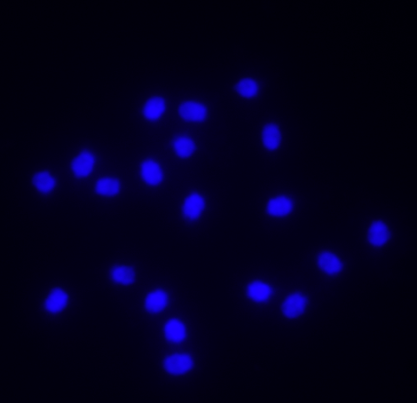
Bryaspis humularioides (2n=40)
Bryapsis lupulina (2n=40)
Cyclocarpa stellaris (2n=28)
Geissaspis cristata (2n=40)
Geissaspis tenella (2n=40)
(Gtenella)
Humularia kapiriensis (2n=38)
Kotschya africana (2n=32)
Kotschya lutea (2n=36)
Kotschya strigosa (2n=36)
Smithia abyssinica (2n=40)
Smithia sensitiva (2n=38)
Soemmeringia semperforens (2n=20)

